Slide 1
Introduction Mr Lawrence (Deputy Headteacher) The Year Ahead Mr Magee (KS4 Progress Director) Pastoral Support Miss Gentle (Year 11 Guidance Manager)
Toynbee School
YEAR 11 INFORMATION EVENING

Slide 2
Toynbee School
Mr Lawrence
Deputy Headteacher

Slide 3
Toynbee School
Mr Magee
KS4 Progress Director

Slide 4
Toynbee School Ethos: RESPECT

Slide 5
Toynbee School Ethos: RESPECT

Slide 6
THE YEAR AHEAD

Slide 7
Year 11 Academic current position
The year group begins Year 11 with an Attainment score of 50.1​
The year group averages:​
4.6 in English Literature​
4.8 in English Language​
Progress in English is below what is expected​
4.9 in Maths​
EBACC 4.5​
Currently not achieving enough 7+ grades.

Slide 8
Routines
What routines should pupils have established?
They should know how to put together a revision timetable​
They should have a quiet, well resourced work space at home​
They should have made numerous flashcards​
They should know how to conduct a effective revision session

Slide 9
Mocks and revision
One tutor session a week will focus on revision – make full use of this and make an early start on exam preparation
Mrs Stroud will be running exam stress busting sessions, please let me know if you are interested in putting your name forward for these.

Slide 10
Revision Classes
There will be a revision class in every subject starting after Christmas.​
Core subjects will be prioritised​
This should supplement revision at home, not replace it!

Slide 11
Communication
Communicating with school
Curriculum Query
Head of Department
l.gentle@toynbee.hants.sch.uk s.magee@toynbee.hants.sch.uk

Slide 12
Staff contact details
Staff | Position | Email Address
Mr Magee | Upper School Progress Director | s.magee@toynbee.hants.sch.uk
Miss Gentle | Guidance Manager for Year 11 | l.gentle@toynbee.hants.sch.uk
Mrs Hill | SENCO (Maternity Leave) | e.hill@toynbee.hants.sch.uk
Mrs Taylor | VI Resource Manager | g.taylor@toynbee.hants.sch.uk
Miss Clarke | Head of English | j.clarke@toynbee.hants.sch.uk
Mrs Lo | Head of Maths | h.lo@toynbee.hants.sch.uk
Ms Parker | Head of Science | e.parker@toynbee.hants.sch.uk
Ms Goldsmith | Head of Art | a.goldsmith@toynbee.hants.sch.uk
Mrs Hatch | Head of Drama | e.hatch@toynbee.hants.sch.uk
Mr Locke | Head of Computing & IT | w.locke@toynbee.hants.sch.uk
Mr McAllister | Head of Geography | s.mcallister@toynbee.hants.sch.uk
Mr Rice | Head of History | b.rice@toynbee.hants.sch.uk
Mrs Still | Head of MFL (French & Spanish) | r.still@toynbee.hants.sch.uk
Miss Horn/ Miss Dunning | Acting Head of PE | r.horn@toynbee.hants.sch.uk h.dunning@toynbee.hants.sch.uk
Miss Dunning | Head of Dance | h.dunning@toynbee.hants.sch.uk
Mr Law | Head of RS | r.law@toynbee.hants.sch.uk
Ms. Murchie | Head of PSHCE/Careers | r.murchie@toynbee.hants.sch.uk
Mrs Frampton | Head of Technology | s.frampton@toynbee.hants.sch.uk
Mrs Leyman | Head of Music | g.leyman@toynbee.hants.sch.uk

Slide 13
Tutor Emails
Mr Clarkson t.clarkson@toynbee.hants.sch.uk
Mrs Dalton s.dalton@toynbee.hants.sch.uk
Miss Dunning h.dunning@toynbee.hants.sch.uk
Miss Down l.down@toynbee.hants.sch.uk
Mr Sale e.sale@toynbee.hants.sch.uk
Mrs Frampton s.Frampton@toynbee.hants.sch.uk
Mr McAllister s.mcallister@toynbee.hants.sch.uk
Mr Davis s.davis@toynbee.hants.sch.uk

Slide 14
MOCK EXAMS

Slide 15
Mock Timetable
Monday 9 Oct Art (am and pm)
Thursday 12 Oct Art (am and pm)
Friday 13 Oct Food (am)
Thursday 19 Oct RS (am)
French (pm)
Thursday 2 Nov Classics (am)
Dance (pm)
Friday 10 Nov Design (am)
Geography (pm)
Monday 13 Nov Media (am)
History (pm)
Tuesday 21 Nov Spanish (am)
iMedia (pm)
Monday 27th Nov-Wednesday 29th November MFL Speaking
Wednesday 29th Nov- MFL Speaking exams (All day)
Friday 1st Dec PE (am)
Psychology (pm

Slide 16
HOW TO REVISE

Slide 17
Study Environment
Workbox of pens etc. Keep topping up
Have a set file for revising each subject
Buy ONE good revision aid-be selective
Past papers
Flashcards/Revision cards
Water
Food

Slide 18
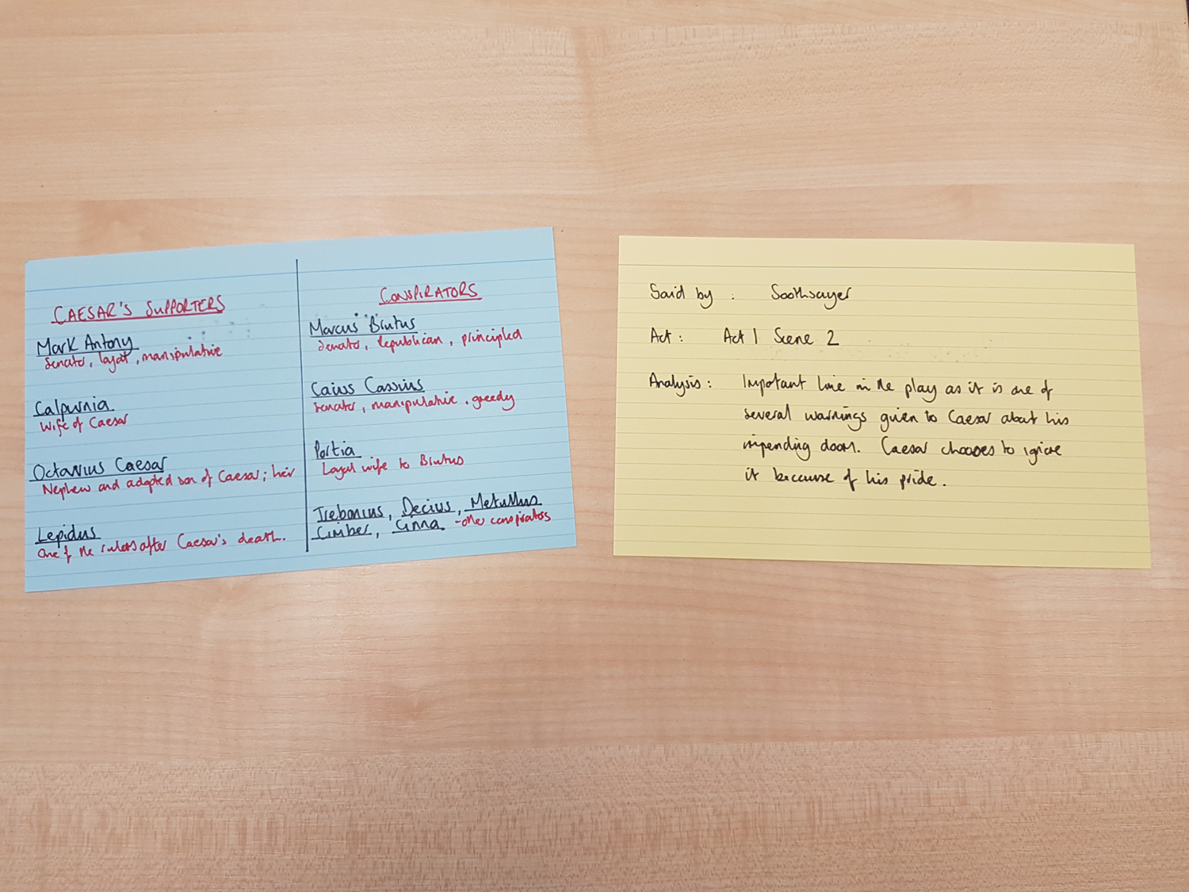

Slide 19
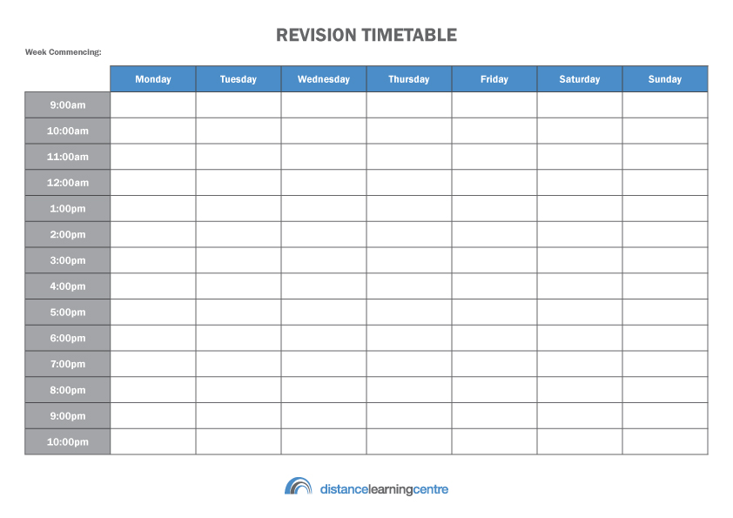
Revision at home

Slide 20
Final Timetable
Time | Mon | Tue | Wed | Thu | Fri | Sat | Sun
9-10 |  |  |  |  |  | Music
10-11 |  |  |  |  |  | Geog | E. Lit
11-12 |  |  |  |  |  |  | Music
12-1 |  |  |  |  |  | Training | Geog
1-2 |  |  |  |  |  | Training | Lunch
2-3 |  |  |  |  |  | Lunch
3-4 | Science | Art | Maths | Art |  | E. lang | French
4-5 | E. Lang | Geog | Music | Science | E. Lit | Maths | Science
5-6 | French | E. Lit | Tea | Geog | French
6-7 | Tea | Training | E. Lang | Training | Tea | Tea | Tea
7-8 | Piano | Training | Training | Training | Maths | French
8-9 |  | Tea | Training | Tea

Slide 21
Project Manager
Agree not impose rules - music/phone
Agree balance between work and social life and stick to it
Help them make a realistic timetable –VITAL
Balance timetable with “fun stuff”- build in REWARDS
Place timetable on family calendar
Help them prioritise
Weekly review

Slide 22
Curriculum

Slide 23
Curriculum Information
Curriculum Information:
In the next couple of weeks, more explicit and detailed information about every subject’s curriculum will be available via the website to support pupils and parents in their learning.
The aim is to provide parents and pupils with:
Explicit information about what pupils will study at Toynbee in all subjects.
Explicit information about what exactly they need to learn at Toynbee in every subject.

Slide 24
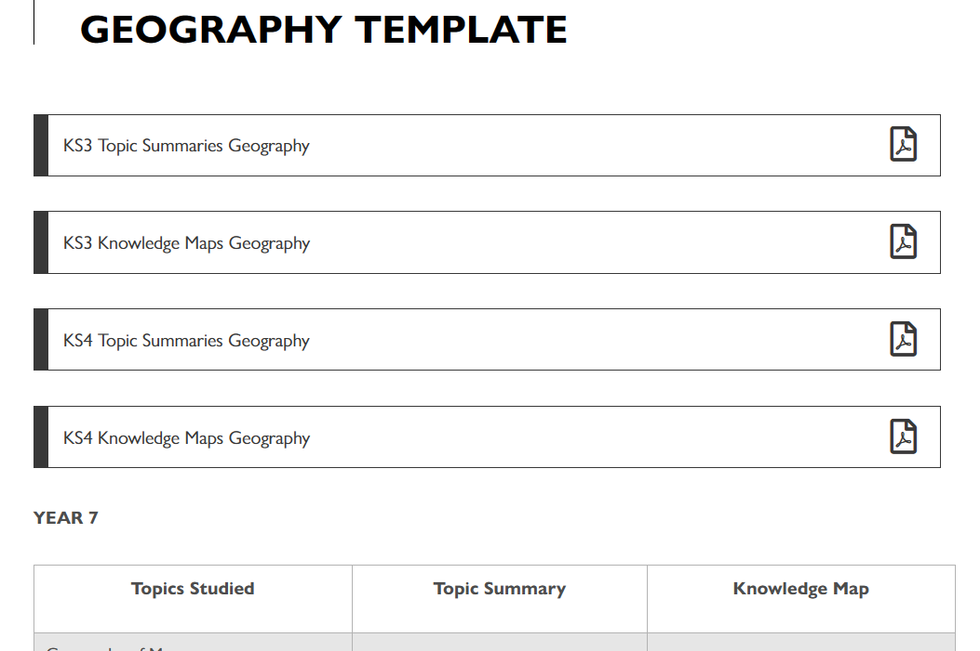

Slide 25
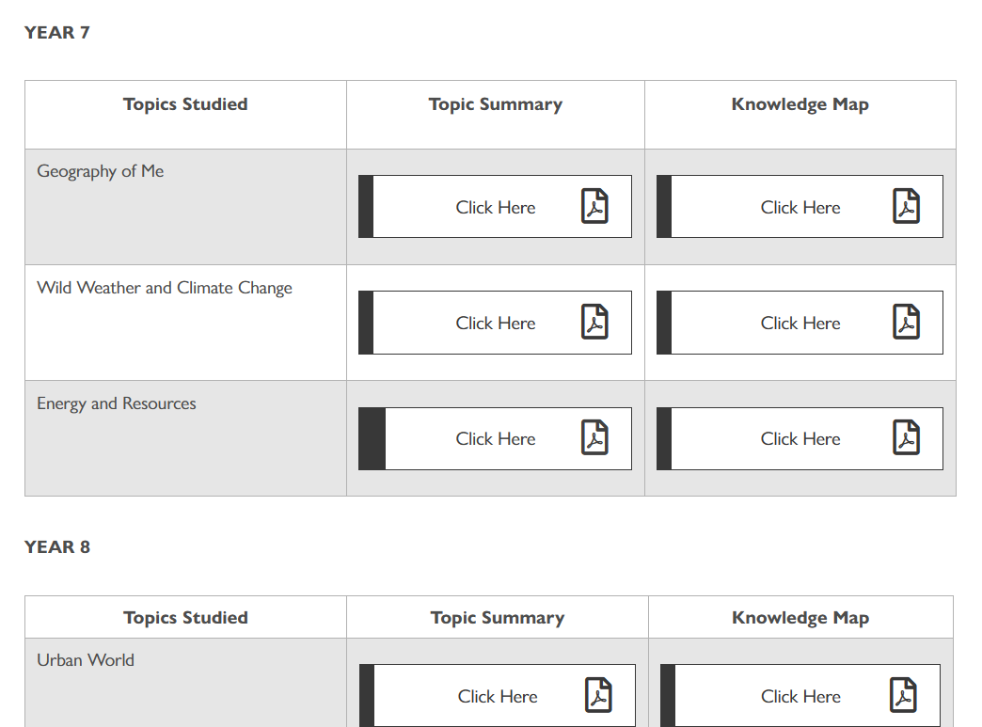

Slide 26
Via the website, two key documents for every topic studied will be available to download:
Topic Summaries:
A topic summary is an A4 one-page summary that provides an overview of that topic. It will include how it fits in with the learning that has gone before and what will follow. It will explain why the lessons have been sequenced the way they have, and outlines the resources that accompany those lessons. If a pupil misses a lesson, this will be a good resource to check what has been missed.
There will be a topic summary for every topic studied, in every subject, and every year group.
Knowledge Maps:
A knowledge map is an A4 one-page summary of all the key knowledge that needs to be learnt in that topic.
It will be an invaluable learning tool for all pupils and will be a great revision tool for Year 11.
There will be a knowledge map for every topic studied, in every subject, and every year group.

Slide 27
Toynbee School
Miss Gentle
Year 11 Guidance Manager

Slide 28
Expectations
Be punctual to every lesson – every minute counts
Remain in lesson
Have excellent attendance to both school and individual lessons
Work to the very best of ability
Show respect for one another
Support one another
Have the correct equipment
needed for each lesson
Perfect uniform

Slide 29
Expectations
Clear, consistent, high expectations in school can positively affect students' abilities, opportunities to learn, motivation, and learning outcomes.

Slide 30
My Role
One to one support ​
Exam anxiety workshops
Signposting and support with referrals
Guide through the preparation needed for the year ahead and beyond
Support with college applications
Guidance with revision and time management

Slide 31
Guidance Manager
Attendance Information
Miss Gentle L.GENTLE@TOYNBEE.HANTS.SCH.UK
From September 2015 all schools will be required to work with Hampshire County Council to take legal action if (444A & 444B Education Act 1996)​
A child has unauthorised absence for 10 or more sessions.​
A child is continually late to school and this lateness is unauthorised for 10 or more sessions.​
Session = a half day​
School starts at 9.05am​
Please check our website for further details​

Slide 32
Key Dates
5th October Open Evening
17th October Post 16 Evenings. 1730-1900
Autumn Term College Open Days and assemblies
18th January Year 11 Parents Evening
4th July Prom
22nd August Results Day

Slide 33
Careers
Toynbee School Careers Leader :
Mrs Shaw

Slide 34
Post 16 Options
If you live in England, you have to stay in education or training until the age of 18
There are lots of options available to you so its important to understand what is the best route by exploring all the possibilities

Slide 35
What are the post 16 options?
Option 1 : Stay in full-time education – A levels, BTEC, T levels, vocational and technical qualifications, exam retakes
Or
Option 2: Combine work with study – Apprenticeship, traineeship, supported internships
Or
Option 3: Spend 20 hours or more a week working or volunteering while also doing part-time education or training

Slide 36
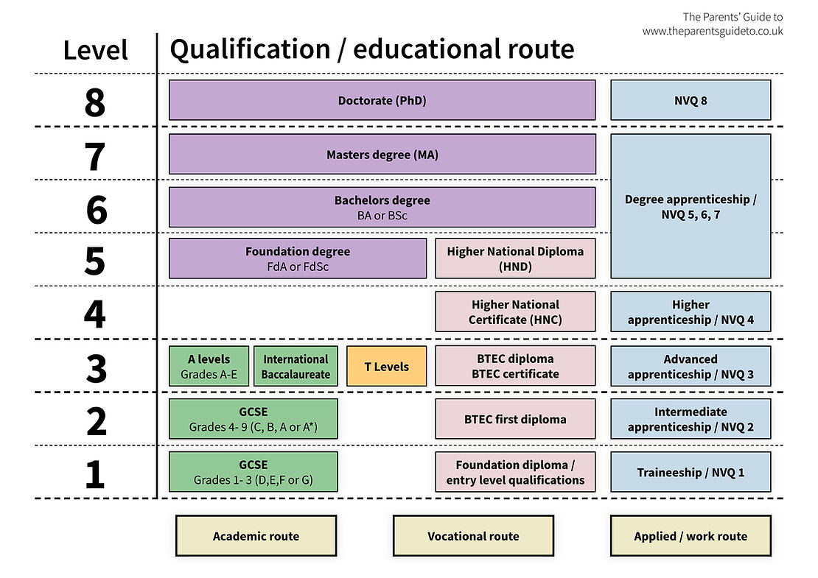
Understanding your next steps

Slide 37
What’s happening in school this term?
Post 16 options presentation given to all Year 11 pupils from our Careers Leader
College & apprenticeships assembly talks are taking place this term
Using the National Career service – pupils are completing a skills assessment & careers search
Helping with personal statements & college applications
1:1 careers advice interviews
Toynbee School Careers Fair – 17th October 2023 at 5.30 -6.30pm

Slide 38
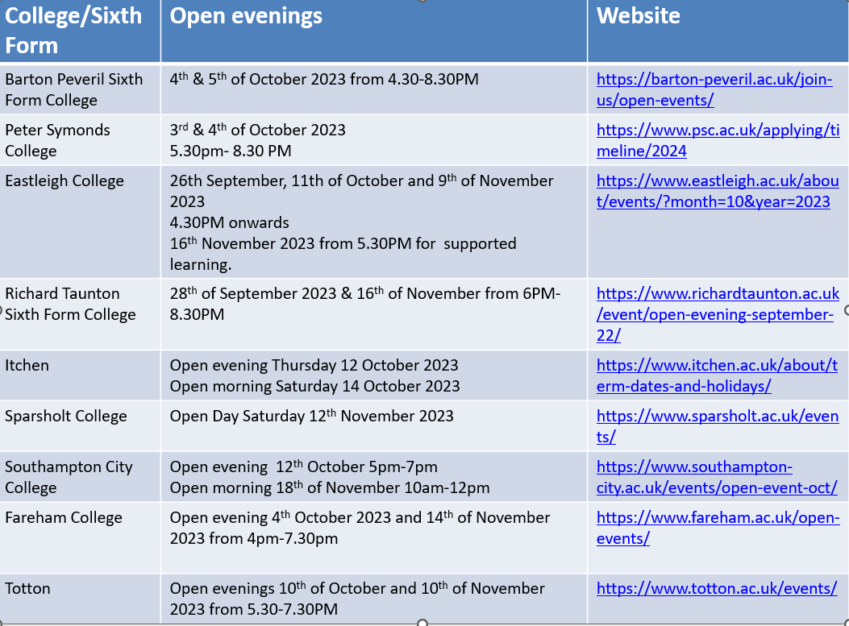
Open Events - 2023

Slide 39
Websites that can help with post 16 choices
https://nationalcareers.service.gov.uk/explore-your-education-and-training-choices
https://nationalcareers.service.gov.uk/discover-your-skills-and-careers/
https://www.careerpilot.org.uk/
https://careermap.co.uk/careerometer/
Everything you need to know about your child's choices at 16 years old | The Parents' Guide (theparentsguideto.co.uk)

Slide 40
Thank you for listening This presentation will be uploaded to the website for your reference

