Slide 1

Year 11 Information Evening
Introduction and the Year Ahead
Mr Magee (Assistant Headteacher)
Pastoral Support
Miss Vallance (Year 11 Guidance Manager)

Slide 2

Mr Magee
Assistant Headteacher KS4

Slide 3



The Toynbee Community
We want our school to be one where everyone in it is RESPECTFUL of themselves and others around them
School should be a safe, enjoyable experience for everyone
What you should expect:
Clear routines, expectations, celebrating success and consequences for poor choices

Slide 4

Toynbee School Ethos: RESPECT

Slide 5

Mobile Phones

Slide 6
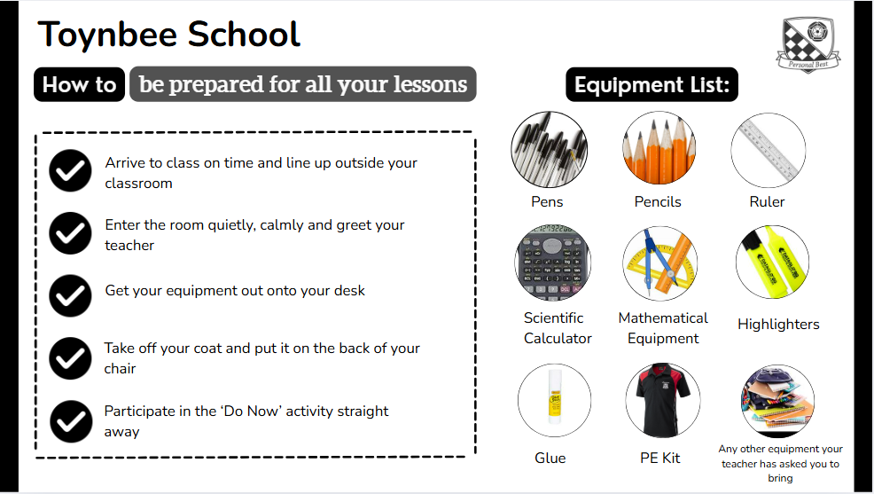

Slide 7
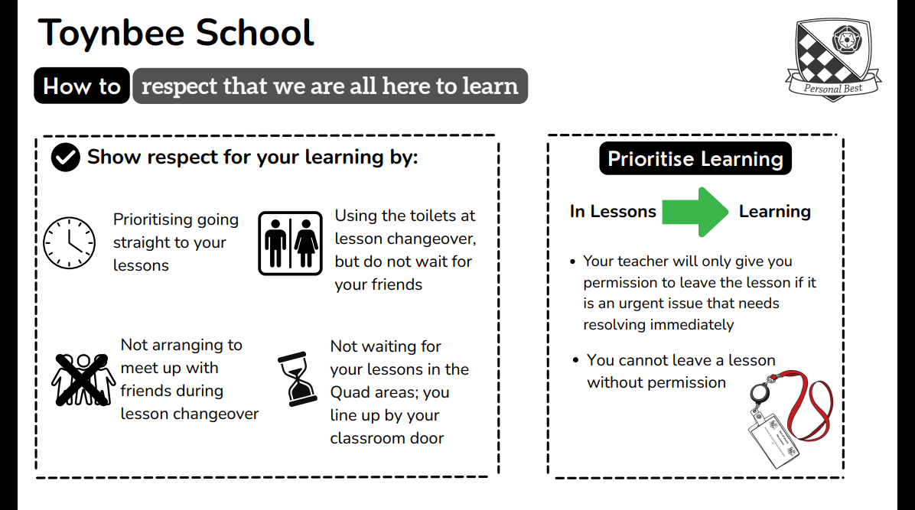

Slide 8
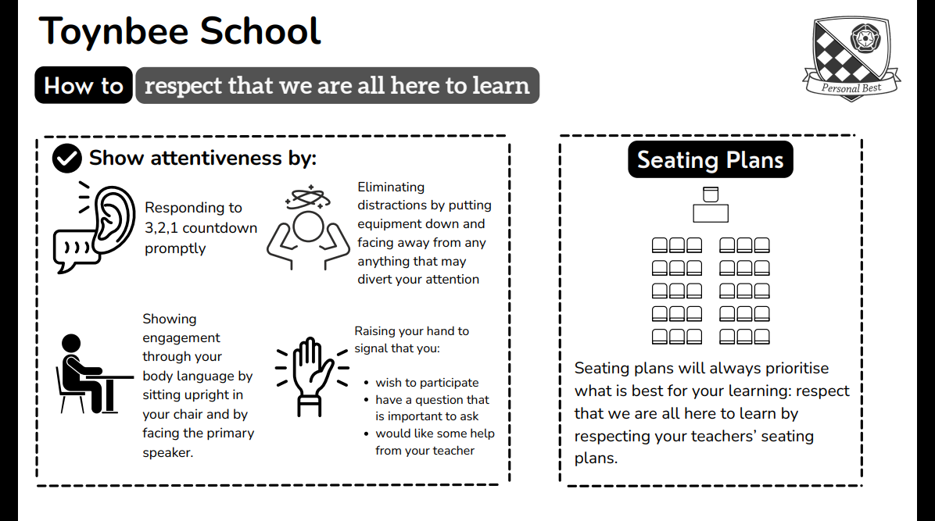

Slide 9




Breaktime and Lunchtime
Please remember that there will be lessons going on during your breaktime and lunchtime.
Respect the learning of others by remaining away from classrooms
Please use the bins provided to dispose of any litter.
Staff will ask you to pick up any litter that is on the floor near to you.
Remember that mobile phones are not allowed out during the school day; this includes breaktime and lunchtime.
They are to remain switched off in your bags.
Please use your designated year group toilets at breaktime and lunchtime; do not wait until the whistle goes!

Slide 10
SCHOOL CULTURE:
What does it mean to be a part of the Toynbee Community?
Attendance
0.7
0.35
0.29
-0.01
-0.83
-0.97

Slide 11

What will our routine be for Tutor Time?
8.30-8.40am
You will be a in a seating plan for Tutor Time
Pupils line up outside of the classroom
Tutor meets pupils at door and pupils enter
Pupils stand behind chairs in silence
Uniform check
Register
Thought for the Week
Notices
8.40-9am
Tutor Programme

Slide 12
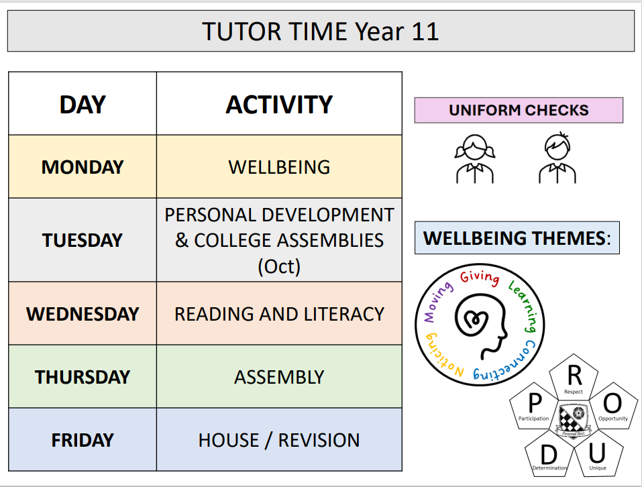

Slide 13
The Year ahead

Slide 14
Mock Exams

Slide 15
Year 11 Mocks
The written mock exams for Y11s will take place from 3rd November to 21st November 2025. MFL speaking exams will take place between 22nd October and 24th October. A Drama exam (Devising Drama) which counts towards the final Drama GCSE grade will take place all day on 21st October. The mocks will give pupils an experience of what the real exams will be like.
Morning exams will start at 9:00am and afternoon exams will start between 13:15pm and 13:30pm depending on the length of the exam. When an exam has ended, pupils will return to their normal lessons. Those with extra time allowance (Access arrangements) are expected to use this time. This may end up with a few pupils ending their school day slightly later than normal.
Access arrangements are where adjustments are made to meet specific needs of pupils. These are applied for well in advance of the summer exams (by the end of this term) and ideally before the start of the Y11 Mocks. Most pupils already know if they have access arrangements in place as they will have been using these during internal assessments. If you feel your child requires access arrangements which are not in place please contact the SENCO, Mrs. Hill or Mr. Stewart the Exam Officer.
Most exams take place in the sports hall but there will be exceptions to this. I would ask all pupils to make themselves familiar with their own exam timetable when they receive it before the end of September.

Slide 16
Week 1 | AM (9:00am start) | End | Extra time end | PM (Start time) | End | Extra time end
Monday 3/11/25 | Maths paper 1 | 10:30 | 10:53
Tuesday 4/11/25 | English Language paper 2 | 10:45 | 11:11 | Psychology paper 1 (13:15) | 15:00 | 15:26
Wednesday 5/11/25 | Classical Civilisation paper 1 | 10:30 | 10:53
Thursday 6/11/25 | Biology/Combined Science | 10:45/10:15 | 11:11/10:34 | Media Studies p2 (13:30) | 15:00 | 15:23
Friday 7/11/25 | Design Technology | 11:00 | 11:30 | Physical Education (13:30) | 15:00 | 15:23
Week 2
Monday 10/11/25 | English Literature paper 2 | 11:15 | 11:49 | Dance (13:30) | 15:00 | 15:23
Tuesday 11/11/25 | Chemistry/Combined Science | 10:45/10:15 | 11:11/10:34
Wednesday 12/11/25 | Maths paper 2 | 10:30 | 10:53
Thursday 13/11/25 | History paper 1 & 2 | 11:00 | 11:30 | Food (13:30) | 15:00 | 15:23
Friday 14/11/25 | Computer Science paper 1 & 2 | 11:00 | 11:30 | French Reading & Listening Higher & Foundation (13:15) | 15:00 (H) 14:35 (F) | 15:26 (H) 14:55 (F)
Week 3
Monday 17/11/25 | Art, Craft & Design* | 15:00 | No extra time | Art, Craft & Design* | 15:00 | No extra time
Tuesday 18/11/25 | Maths paper 3 | 10:30 | 10:53 | Spanish Reading & Listening Higher & Foundation (13:15) | 15:00 (H) 14:35 (F) | 15:26 (H) 14:55 (F)
Wednesday 19/11/25 | Geography | 10:30 | 10:53
Thursday 20/11/25 | Physics/Combined Science | 10:45/10:15 | 11:11/10:34 | Creative iMedia (13:30) | 15:00 | 15:23
Friday 21/11/25 | Religious Studies | 11:00 | 11:30 | Music (13:30) | 15:00 | 15:23

Slide 17

What routines should pupils have established?
They should know how to put together a revision timetable​
They should have a quiet, well resourced, workspace at home​
They should have made numerous flashcards​
They should know how to conduct an effective revision session

Slide 18

Mocks and revision
One tutor session a week will focus on revision – make full use of this and make an early start on exam preparation
There may be some other interventions such as group workshops/lectures during this time.

Slide 19

Revision classes
Most subjects will offer a revision class, starting after Christmas.​
This should supplement revision at home , not replace it!

Slide 20
How to revise

Slide 21
Study Environment
Workbox of pens etc. Keep topping up
Have a set file for revising each subject
Buy ONE good revision aid-be selective
Past papers
Flashcards/Revision cards
Water
Food

Slide 22
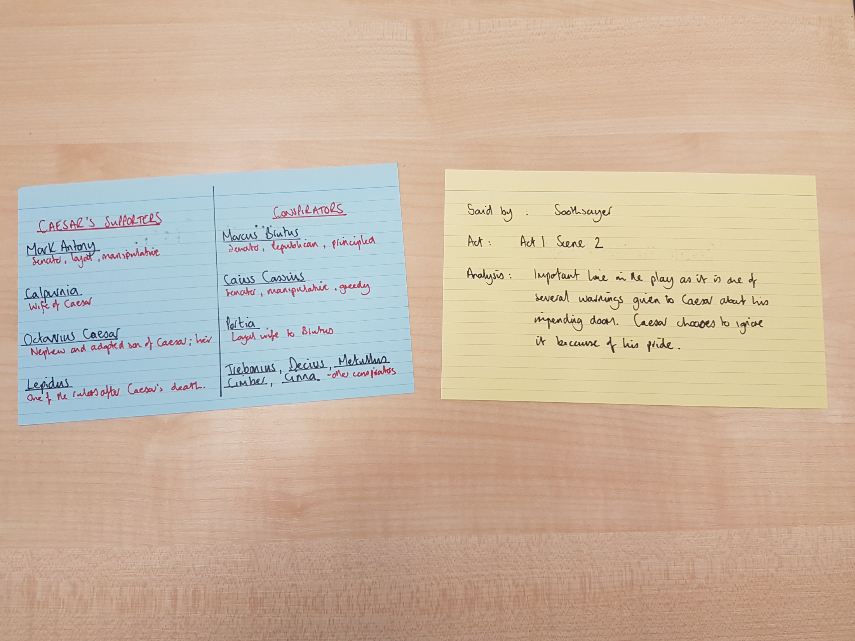

Slide 23
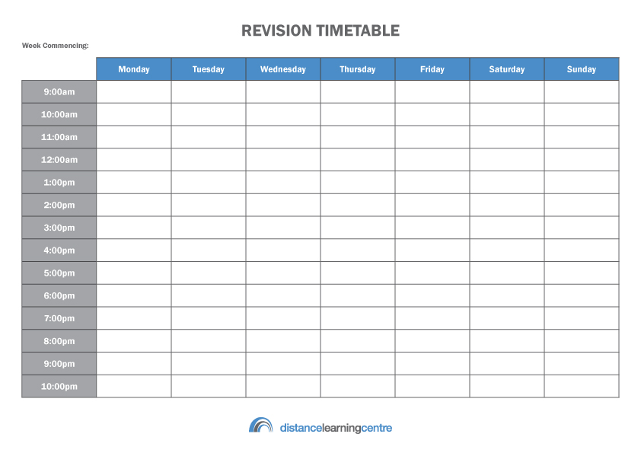
Revision at home!

Slide 24
Final Timetable
Time | Mon | Tue | Wed | Thu | Fri | Sat | Sun
9-10 |  |  |  |  |  | Music
10-11 |  |  |  |  |  | Geog | E. Lit
11-12 |  |  |  |  |  |  | Music
12-1 |  |  |  |  |  | Training | Geog
1-2 |  |  |  |  |  | Training | Lunch
2-3 |  |  |  |  |  | Lunch
3-4 | Science | Art | Maths | Art |  | E. lang | French
4-5 | E. Lang | Geog | Music | Science | E. Lit | Maths | Science
5-6 | French | E. Lit | Tea | Geog | French
6-7 | Tea | Training | E. Lang | Training | Tea | Tea | Tea
7-8 | Piano | Training | Training | Training | Maths | French
8-9 |  | Tea | Training | Tea

Slide 25
Project Manager
Agree not impose rules - music/phone
Agree balance between work and social life ad stick to it
Help them make a realistic timetable -VITAL
Balance timetable with “fun stuff”- build in REWARDS
Place timetable on family calendar
Help them prioritise
Weekly review

Slide 26


Slide 27
Curriculum Information:
Explicit and detailed information about every subject’s curriculum is available via the website to support pupils and parents in their learning.
The aim is to provide parents and pupils with:
Explicit information about what pupils will study at Toynbee in all subjects.
Explicit information about what exactly they need to learn at Toynbee in every subject.

Slide 28
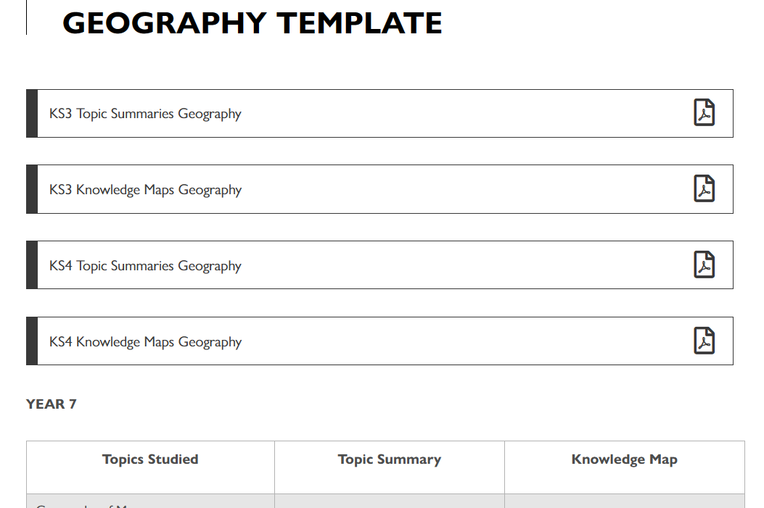

Slide 29
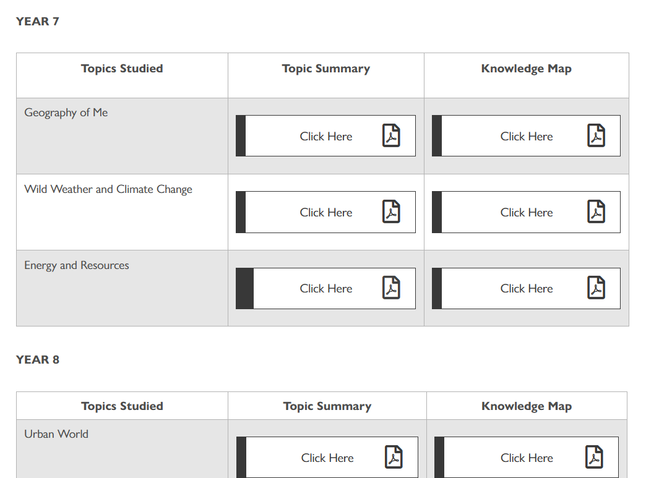

Slide 30
Via the website, two key documents for every topic studied will be available to download:
Topic Summaries:
A topic summary is an A4 one-page summary that provides an overview of that topic. It will include how it fits in with the learning that has gone before and what will follow. It will explain why the lessons have been sequenced the way they have, and outlines the resources that accompany those lessons. If a pupil misses a lesson, this will be a good resource to check what has been missed.
There will be a topic summary for every topic studied, in every subject, and every year group.
Knowledge Maps:
A knowledge map is an A4 one-page summary of all the key knowledge that needs to be learnt in that topic.
It will be an invaluable learning tool for all pupils and will be a great revision tool for Year 11.
There will be a knowledge map for every topic studied, in every subject, and every year group.

Slide 31
Post 16 Provision

Slide 32



Post 16 Options
If you live in England, you have to stay in education or training until the age of 18
There are lots of options available to you so it's important to understand what is the best route by exploring all the possibilities
Notes:
To guide our pupils to navigate the range of opportunities available to them so that they can achieve the necessary skills and experience for them to succeed.
To provide them with Equality of opportunity and to engage all the school community to help them to succeed.
To teach them that “anything is possible”

Slide 33



What are the post 16 options ?
Option 1 : Stay in full-time education
A levels, BTEC, T levels, vocational and technical qualifications, exam retakes
Or
Option 2: Combine work with study
Apprenticeship, , supported internships (for EHCP pupils only)
Or
Option 3: Spend 20 hours or more a week working or volunteering while also doing part-time education or training
Notes:
To guide our pupils to navigate the range of opportunities available to them so that they can achieve the necessary skills and experience for them to succeed.
To provide them with Equality of opportunity and to engage all the school community to help them to succeed.
To teach them that “anything is possible”

Slide 34
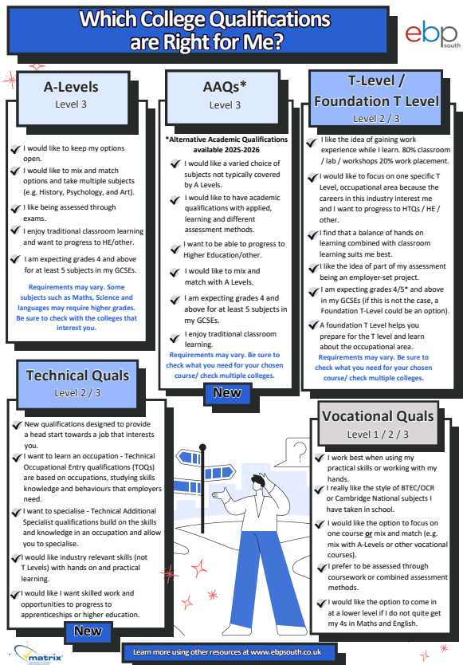

Slide 35
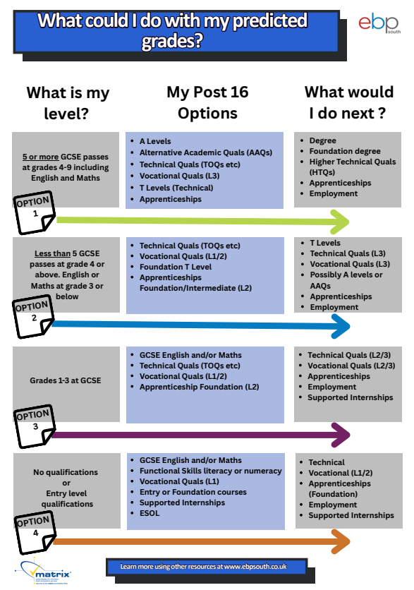

Slide 36

Helpful resources
This online careers platform is being launched at Toynbee from September 2025.
All year 11 pupils will have access to a wide range of careers information including access to local college information, apprenticeship vacancies and online CV tools.
Helpful websites
Post 16 options | National Careers Service
Year 11 Career Options - Overview | Rise 360
Careerpilot : Get information : Your choices at 16 : Help with choosing your post 16 options
Post-16 Options | UCAS
Notes:
To guide our pupils to navigate the range of opportunities available to them so that they can achieve the necessary skills and experience for them to succeed.
To provide them with Equality of opportunity and to engage all the school community to help them to succeed.
To teach them that “anything is possible”

Slide 37
Year 11 – Help with Next steps
College & Apprenticeship assemblies every Tuesday morning this half term
This term in Personal development lessons, all pupils will receive:
Next step options talk from Careers Leader – took place 5th September
Help to decide on next steps options
Help with applying to college
Help with Personal statements
Future jobs and the impact of AI
Preparing for college interviews
Career leader to run - After school club- after half term to help with college applications and personal statements
By February 2025 Intended destinations are recorded to ensure all pupils have a post 16 pathway.
Careers Fair – 15th October 1730-1900
Colleges, Universities, Apprenticeship providers & Employers
Support from colleges – with an applications workshop day and a mock college interview day – Dates TBC
Apprenticeship workshop in School - date TBC ( planned for early 2025) this will include support with writing a CV

Slide 38

Open Events – 2025
College/Sixth Form | Open evenings | Website
Barton Peveril Sixth Form College | Wednesday 24 & 25 September 2025 | www.barton-peveril.ac.uk/
Peter Symonds College | Wednesday 1 & Thursday 2 October 2025 | www.psc.ac.uk
Eastleigh College | Wednesday 22 October 2025 | www.shcg.ac.uk
Richard Taunton Sixth Form College | Wednesday 8 October 2025 & Wednesday 19 November 2025 | www.richardtaunton.ac.uk
Itchen | Thursday 9 October 2025 Saturday 11 October 2025 | www.itchen.ac.uk
Sparsholt College | Saturday 4 October 2025 | www.sparsholt.ac.uk
Southampton City College | Tuesday 21 October | www.shcg.ac.uk
Fareham College | Tuesday 14 October | www.shcg.ac.uk
Totton | Tuesday 14 October 2025 & Thursday 6 November 2025 | www.totton.ac.uk
Notes:
To guide our pupils to navigate the range of opportunities available to them so that they can achieve the necessary skills and experience for them to succeed.
To provide them with Equality of opportunity and to engage all the school community to help them to succeed.
To teach them that “anything is possible”

Slide 39
College applications deadlines
All College applications are online via the college website and generally open around the 15th September 2025 (*check college websites)
Peter Symonds - Deadline to apply is the 8th of December 2025
Barton Peveril - Deadline to apply TBC
All other colleges have no deadline for applications, but we strongly recommend all applications are completed by the 13th of February 2026 or earlier to avoid missing out on the course you want to do!
Pupils can visit and apply to multiple colleges and accept offers. They then make their final choice after their GCSE results.

Slide 40

Careers Advice
Need help with your post 16 options?
An independent careers adviser will be in school to offer 1:1 advice on your next steps- appointments available (every Wednesday plus some additional dates in the Autumn term)
To book in for Careers Advice please email Mrs Shaw
j.shaw@toynbee.hants.sch.uk

Slide 41
Communicating with school
Communication
Pastoral Query
Curriculum Query
Tutor
Class Teacher
Guidance Manager
Head of Department
Assistant Headteacher
Assistant Headteacher
Senior Leadership Team
Senior Leadership Team
m.vallance@toynbee.hants.sch.uk s.magee@toynbee.hants.sch.uk

Slide 42
Staff | Position | Email Address
Mr Magee | Assistant Headteacher KS4 | s.magee@toynbee.hants.sch.uk
Miss Vallance | Guidance Manager for Year 11 | m.vallance@toynbee.hants.sch.uk
Mrs Hill | SENCO | e.hill@toynbee.hants.sch.uk
Mrs Taylor | VI Resource Manager | g.taylor@toynbee.hants.sch.uk
Mrs Cox | Head of English | h.cox@toynbee.hants.sch.uk
Mrs Lo | Head of Maths | h.lo@toynbee.hants.sch.uk
Ms Parker | Head of Science | e.parker@toynbee.hants.sch.uk
Ms Goldsmith | Head of Art | a.goldsmith@toynbee.hants.sch.uk
Mrs Hatch | Head of Drama | e.hatch@toynbee.hants.sch.uk
Mr Locke | Head of Computing & IT | w.locke@toynbee.hants.sch.uk
Ms Robinson | Head of Geography | m.robinson@toynbee.hants.sch.uk
Miss Butler | Head of History | e.butler@toynbee.hants.sch.uk
Mrs Still | Head of MFL (French & Spanish) | r.still@toynbee.hants.sch.uk
Mr French | Head of PE | c.french@toynbee.hants.sch.uk
Miss Jones | Teacher of Dance | s.jones@toynbee.hants.sch.uk
Mr Law | Head of RS | r.law@toynbee.hants.sch.uk
Ms. Murchie | Head of PSHCE/Careers | r.murchie@toynbee.hants.sch.uk
Mrs Frampton | Head of Technology | s.frampton@toynbee.hants.sch.uk
Mrs Leyman | Head of Music | g.leyman@toynbee.hants.sch.uk

Slide 43
Tutor emails
Parents Bulletin will be sent out by Mr Magee every Friday.
Ms Robinson: m.robinson@toynbee.hants.sch.uk
Mr Roberts: n.roberts@toynbee.hants.sch.uk
Ms Parker: e.parker@toynbee.hants.sch.uk
Mr Law: r.law@toynbee.hants.sch.uk
Mrs Harris: e.harris@toynbee.hants.sch.uk
Mr May: j.may@toynbee.hants.sch.uk
Miss Savage: l.savage@toynbee.hants.sch.uk
Ms Down: l.down@toynbee.hants.sch.uk

Slide 44
Thank you for listening
This presentation will be uploaded to the website for your reference

