Slide 1
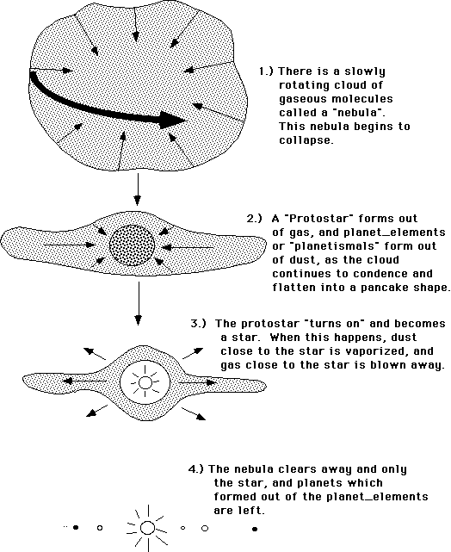
SPACE
3 Life cycle of a STAR
1 Stars and the Solar system
The lifecycle of a star depends on the size of the star. They begin the same way as the Sun did- clouds of dust and gas are drawn together by gravity to form a protostar and eventually a main sequence star. This is when fusion begins where hydrogen atoms fuse together to create helium. In this stage the star is stable for a long time because the force of gravity is balanced by the outward radiation pressure cause by nuclear fusion.
As the star ages, more and more mass is converted into energy by nuclear fusion. As the mass decreases, the outward forces become larger than the force from gravity. The star expands and cools becoming a red giant or red supergiant.
The Universe is made from billions of galaxies.
Each galaxy contains hundreds of millions of stars. The Solar System is a tiny part of Milky Way.
Galaxies are made from; a star, planets, dwarf planets, asteroids and comets. Planets, dwarf planets and comets orbit a star, moons orbit planets.
The Sun was formed from a nebula which was pulled together by the force of gravity. The material not drawn into the Sun stayed in orbit around the new star and formed the planets and other objects in our Solar System.
As the star cools and the hydrogen is used up, the outward forces are reduced. The star collapses inwards due to the gravity and it causes to increase the temperature once more.
Small stars end up as black dwarf stars
Larger stars become neutron stars
The largest stars become black holes
2 Nuclear fusion
During nuclear fusion two smaller nuclei join together to form a heavier nucleus.
Some of the mass is converted into energy and some of this energy is emitted as radiation.
Nuclear fusion needs very high temperature and pressure to overcome the electrostatic repulsion of the small nuclei and to bring the positive nuclei close together enough for fusion to take place.
To work out the amount of energy release we need to apply the formula :
E = mc²
E is energy, m is mass and c is the speed of light (300,000,000 m/s).
4 Formation of elements
Before stars, the only element in the Universe was hydrogen.
All the other elements up to uranium in the periodic table were cause by the fusion process. All stars fuse hydrogen into helium.
Bigger stars fuse helium into lithium and other lightweight elements up to and including iron. During a supernova, the amount of energy released is so great that temperature and pressure is high enough to force nuclei together to create elements heavier than iron up to uranium.
The formation of new elements is called NUCLEOSYNTHESIS
6 Gravity

Slide 2
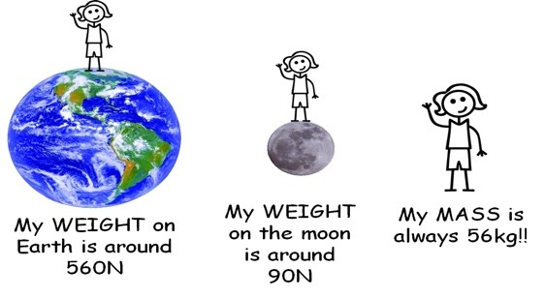
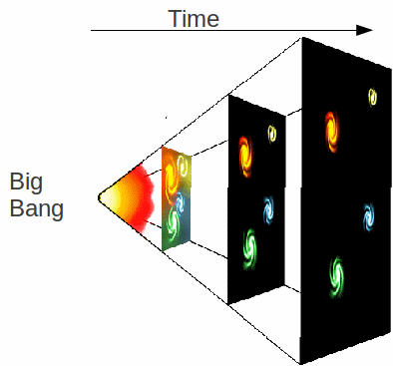
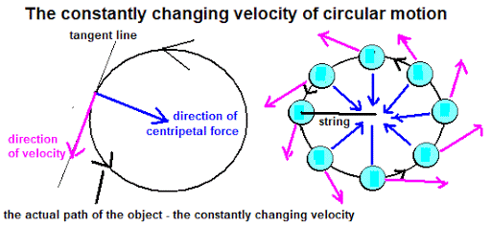
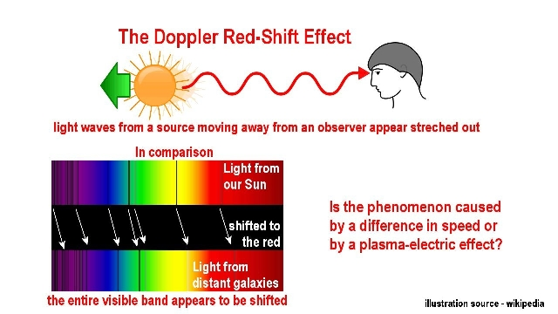
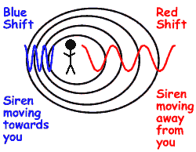
SPACE
5 Orbits of planets, moons, satellites
6 Gravity
Planets orbit the Sun in orbits. The more distant a planet is the longer it takes to orbit the Sun.
Artificial satellites are man-made satellites that orbit the Earth. They are used for: communications, GPS, weather forecasting, surveys of the Earth’s surface, map making , spying and space explorations.
If an object moves in circular motion, the speed of the object does not change, but the direction of travel changes. The instantaneous velocity is perpendicular to the centripetal force. The velocity changes. The change in velocity is acceleration. The force of gravity pulls the object in a curved path. These two quantities create a resultant force called centripetal force which acts towards the centre of the circle.
Some objects move in Elliptical orbits. For them, distance is not constant, speed changes. Therefore acceleration is not constant
The force of gravity is important to Earth.
Weight = mass x gravitational field strength
On Earth, gravitational field strength is 10 N/kg.
Gravitational field strength is different on other planets and stars.
The more distant a planet is, the weaker the force of gravity, the slower the planet moves .
Gravity is an inverse square law. If you triple the distance the force of gravity is 1/9th .
It is thought that dark energy hold the galaxies together by gravitational attraction. Also it is thought that dark matter is responsible for the increased rate of expansion of the Universe.
7 Big Bang theory, Red Shift, Doppler Effect
The same effect can be detected with sound. The Doppler Effect states when a car moves away from the observer, the pitch of the engine decreases, and the wavelength increases. When the car moves towards the observer the pitch increases so the wavelength decreases. This is called the Doppler Effect
The Big Bang theory states that the Universe began from a very small region that was extremely hot and dense. When the Big Bang happened, matter and high energy radiation was released. Since then, space started expanding and the expansion is still happening. The evidence is that the distant galaxies are moving faster and faster away from us.
There is an observed increase in the wavelength of light from distant galaxies – the further the galaxy, the greater the apparent change in wavelength, the bigger the Red Shift
6 Gravity

