Slide 1
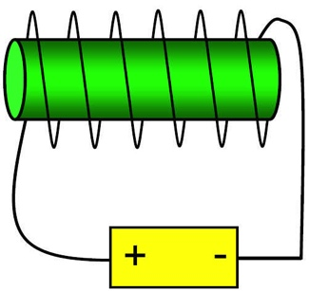
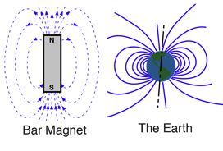
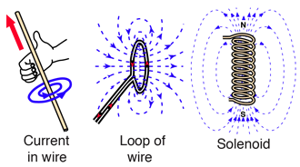
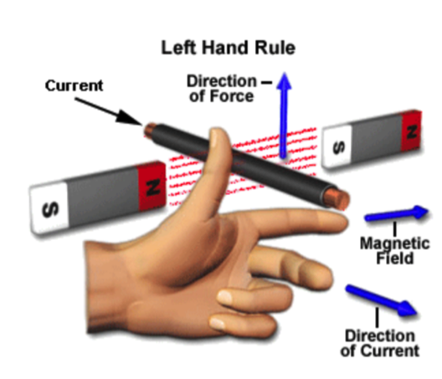
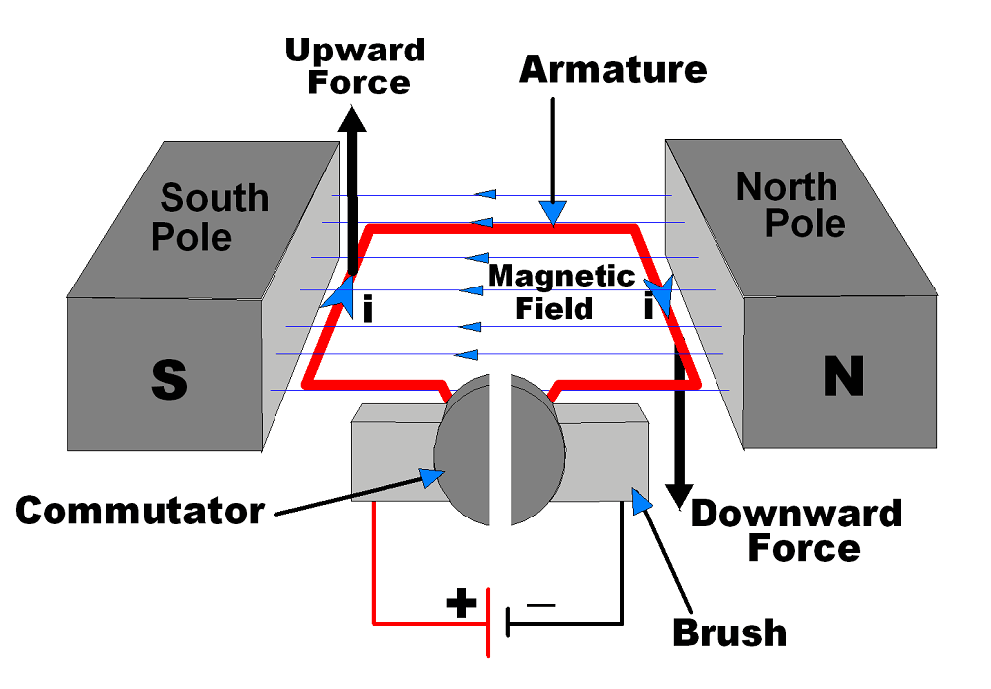
Magnets and Electromagnets
2. Electromagnets
Magnetic materials:
Iron
Cobalt
Nickel
Steel (an alloy of iron)
Permanent magnets
Have their own magnetic field. Field lines follow the same pattern running from north to south. The strongest field is at the poles.
When a current flows through a wire a magnetic field is produced around the wire. It always creates the same pattern and can be predicted using the right hand thumb rule.
The strength of the magnetic field depends on the current through the wire and the distance from the wire.
1. Magnets
The 2 poles of a bar magnet are called the north (seeking) pole and the south (seeking) pole
A solenoid is a coil of wire; coiling the wire increases the strength of the magnetic field by increasing the length of wire involved in the coil.
The magnetic field created around a solenoid is a similar shape to a bar magnet.
Like poles repel
Unlike poles attract
You can find the invisible lines using iron filings or a plotting compass
An electromagnet is a solenoid with an iron core; adding the core increases the strength of the magnetic field
Induced magnets
A magnetic material will become magnetic when placed in a strong magnetic field.
Induced magnetism always causes a force of attraction.
The liquid core of the Earth generates a magnetic field like a bar magnet. It stretches beyond the atmosphere.
3. The motor effect
The factors that affect the size of the force are:
the size of the current
the strength of the permanent magnet (the magnetic flux density)
the length of the wire
and these are linked in the formula F=BIl.
Fleming’s left-hand rule allows us to predict the force when the current is perpendicular to the magnetic field:
First finger is the magnetic Field
seCond finger is the Current
thuMb is the force (Movement)
When a current carrying wire is placed in a permanent magnetic field they exert a force on each other; this is the motor effect.

Slide 2
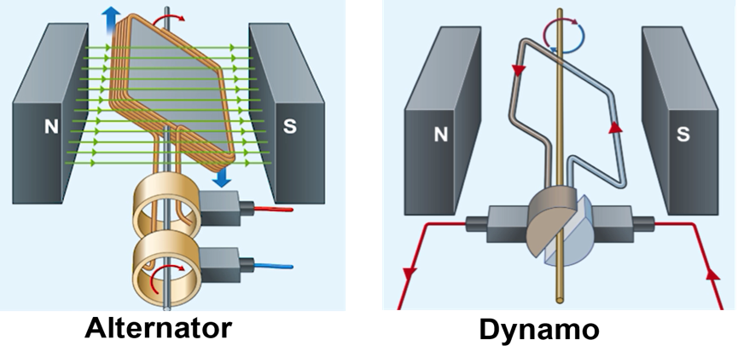
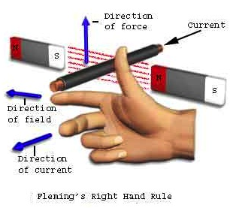
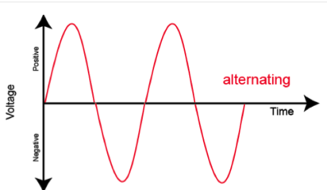
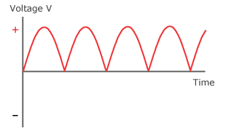
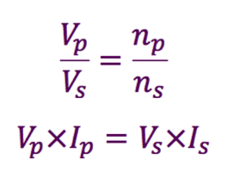
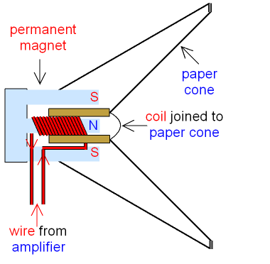
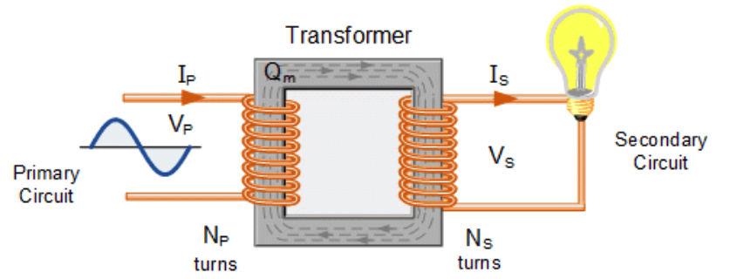
Magnets and Electromagnets (Triple)
4. The generator effect
A wire moving in a magnetic field induces a potential difference between the 2 ends of the wire. If the wire is part of a circuit a current will flow; this is called the generator effect and current direction can be predicted using Fleming’s right-hand rule.
The size of the induced potential difference is affected by
the strength of the magnetic field
length of the solenoid
force of the movement
The generator effect is used in an alternator to produce a.c. A rotating magnet spins within a coil of wire inducing an alternating potential difference.
The generator effect is used in a dynamo to produce d.c. This works in the same way as an alternator, but uses a split ring commutator to stop the current reversing.
The direction of the induced current is affected by the direction of the magnetic field and the direction of the movement.
6. Transformers
A transformer is two separate coils of wire wound around an iron core.
Two examples needed are the loudspeaker and the microphone.
An alternating current is supplied to the primary coil. This creates an alternating magnetic field in the iron core. As the alternating field is constantly moving it induces an alternating potential difference in the secondary coil; because the coil is connected to a circuit an alternating current flows in the secondary coil.
On sheet
5. Uses of electromagnetism
A microphone uses the generator effect (works the opposite way to a speaker). The sound waves move a cone in and out. This is attached to a solenoid in a permanent magnetic field; the movement of the solenoid induces a changing p.d., and therefore a.c..
Loudspeakers use the motor effect. The cone of the speaker is attached to a solenoid that is placed in a permanent magnet field. Changes in the current supplied to the
solenoid affect the force between the magnet and the solenoid causing it to move backward and forwards; this move the speaker cone in and out creating sound (pressure) waves.

