Slide 1
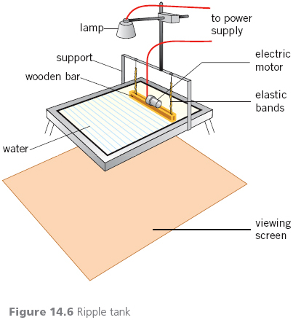
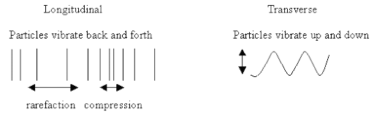
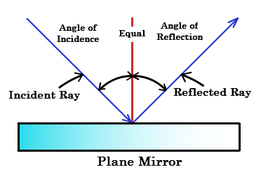
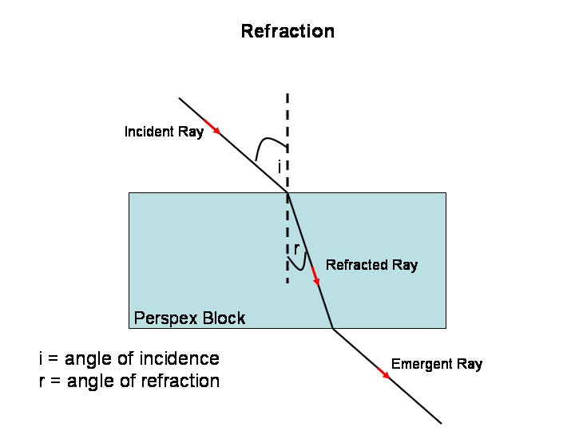
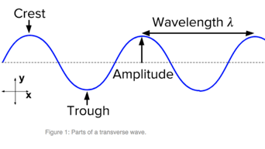
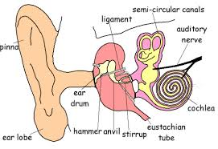
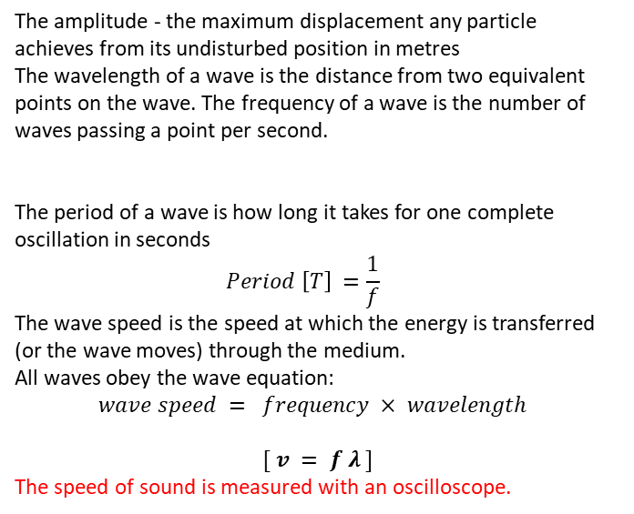
Waves
3 Measuring a wave
1 How can you describe a wave?
Required practical 1. Measuring the speed of waves in a a fluid. Using a ripple tank to measure the wavelength and frequency, so calculate the wave speed.
All waves transfer energy from one place to another. The particles that make up a wave oscillate about a fixed point, passing the energy onto the next particles. Energy moves along but the matter remains around the fixed point. In a transverse wave, e.g. water wave, the oscillations are perpendicular to the direction of energy transfer.
In a longitudinal wave, e.g. sound wave, the oscillations are parallel to the direction of energy transfer.
Required practical 2. Measuring the speed of waves in a solid. Using a vibration generator and a string to measure the wavelength and frequency, so calculate the wave speed.
4 Properties of waves
Waves travel out from a point in all directions. A ray diagram shows a number of rays travelling in a straight line between the wave source and an object or surface. When a wave meets the boundary between two materials, some of its energy is reflected, some is absorbed, and some is transmitted.
When a wave is reflected off a surface, the angle of incidence is equal to the angle of reflection
When a wave enters a glass block it is refracted. The light slows down and bends towards the normal line.
2 The wave equation
The amplitude - the maximum displacement any particle achieves from its undisturbed position in metres
The wavelength of a wave is the distance from two equivalent points on the wave. The frequency of a wave is the number of waves passing a point per second.
The period of a wave is how long it takes for one complete oscillation in seconds
$$Period \left[T\right] =\frac{1}{f}$$
The wave speed is the speed at which the energy is transferred (or the wave moves) through the medium.
All waves obey the wave equation:
$$wave speed = frequency × wavelength$$
$[ v = f λ ]$
The speed of sound is measured with an oscilloscope.
5. Sound waves
Sound waves are longitudinal waves which can travel through solids, liquids and gases. Sound in a medium is due to vibration of the particles that make up the medium.
Sounds waves have frequencies, amplitude and wavelength.
The amplitude of sound is linked to its loudness. The frequency and wavelength of a sound is linked with pitch.
period, T, in seconds, s frequency, f, in hertz, Hz
The normal range of human hearing is 20Hz to 20kHz. Within the ear sound waves cause the ear drum and other structures to vibrate.

Slide 2
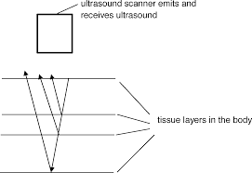
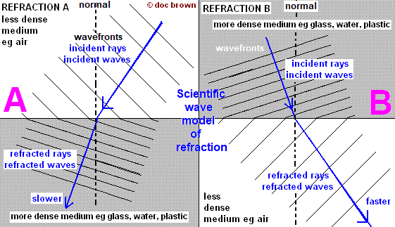
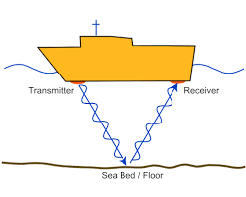
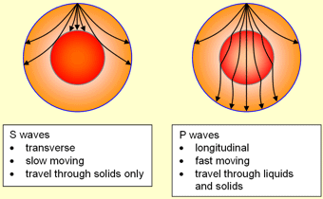
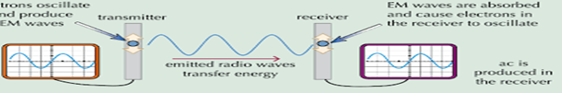
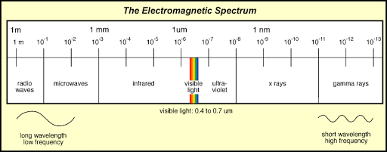
Waves
Ultrasound waves are sound waves of a very high frequency – above 20,000Hz)
8 Properties of EM spectrum
6 Uses of waves
Different wavelengths of electromagnetic waves affect how the wave is reflected, refracted, absorbed or transmitted by different substances (HT only)
Ultrasound waves are used in pre-natal scanning, detection of kidney stones, tumours and producing images of damaged ligaments and muscles.
Ultrasonic waves are partially reflected when they meet a boundary between different materials. The distance of a boundary is calculated by measuring the time taken for the wave to return to the detector and knowing the speed of sound in the medium.
Wave fronts makes it easier to visualise loads of waves moving together. If we show movement of light from air into glass, when the first wave fronts start to move into glass, they slow down; they move closer together and the wavelength decreases. So, the speed slows down because the frequency stays the same
Echo sounding, or sonar, uses ultrasonic waves to detect objects in deep water and measuring the depth of water. The time taken between a pulse being sent and the reflection being detected is used to calculate the distance travelled by the sound wave. They use high frequency sound waves.
The amount of infrared radiation absorbed or radiated by a surface depends on the nature of that surface, e.g. colour
9 EM and electrical circuits
Radio waves can be caused by oscillations in electrical circuits. A transmitter will emit radio waves if a.c. is used. (HT only.)
Seismic waves are produced by earthquakes and measured with a SEISMOMETER. P-waves are longitudinal waves and travel through solids
and liquids but travel twice as fast as S-waves.
S-waves are transverse waves and don’t travel through liquids. P-waves and S-waves provide evidence for the structure and size of the earth’s core.
When radio waves are absorbed by a conductor they create an alternating current with the same frequency as the radio wave itself, this is how the signal is received by an aerial. When the oscillation is induced in an electrical circuit it creates an electrical signal that matches the wave. (HT only.)
10 Hazards of EM waves
7. Electromagnetic spectrum
If an unstable nucleus of an atom changes, it can give out excess energy as gamma rays.
The effect on our body depends on the type of radiation and the size of the dose. Radiation dose (in Sieverts) is a measure of the damage caused by the radiation in the body.
Electromagnetic waves (EM waves) are transverse waves that transfer energy from the source of the waves to an absorber. They all travel with the speed of light in air or a vacuum. They form a continuous spectrum of wavelengths and are grouped in order of their wavelength and their frequency.
Going from long to short wavelength (or from low to high frequency) the groups are: - radio, microwave, infra-red, visible light (red to violet), ultra-violet, X-rays and gamma-rays.
UV waves can cause skin to age prematurely and increase the risk of skin cancer.
X-rays and gamma rays are ionising radiation that can cause mutation of genes and cancer.

Slide 3
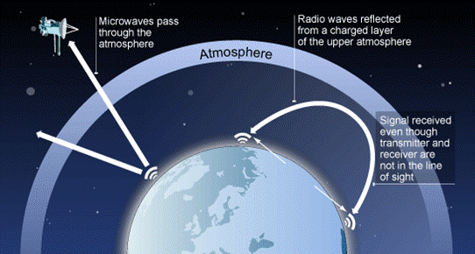
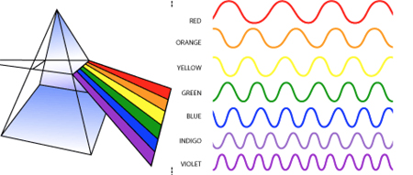
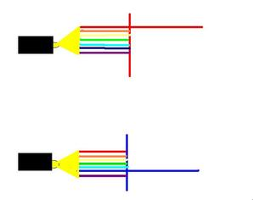
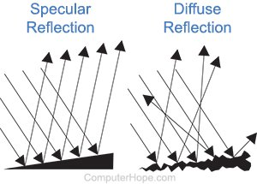
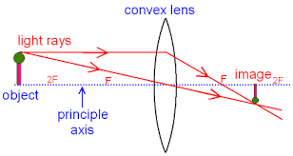
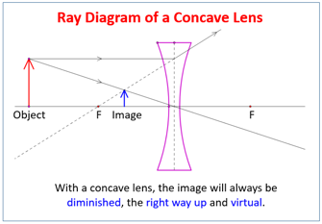
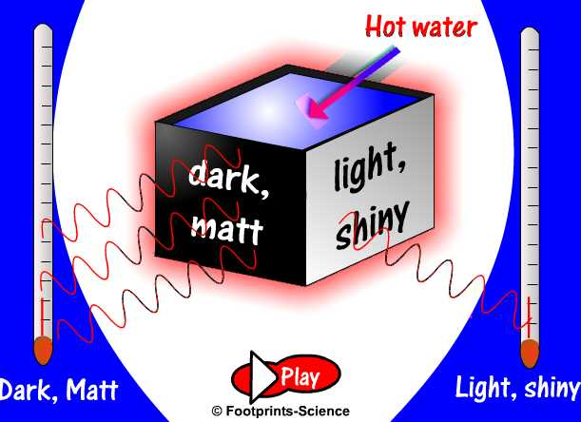
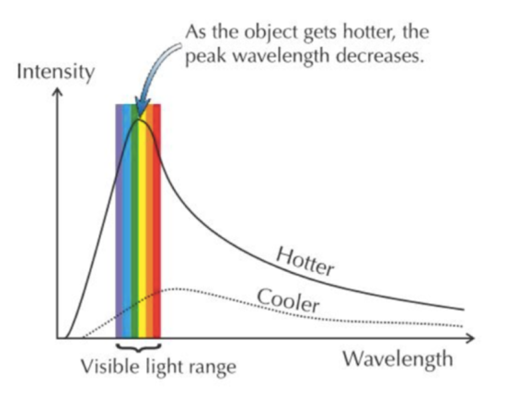
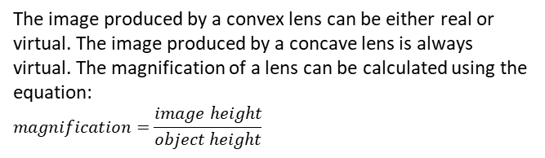
11 Uses of EM spectrum
13. Visible light and coloured light
Triple
Waves
Microwaves can be transmitted by satellites because they can penetrate the ionosphere. Radio waves have lower frequency and are reflected by the ionosphere.
Each colour within the visible light spectrum has its own narrow band of wavelength and frequency.
The colour of an object is related to the reflection, absorption and transmission of different wavelengths of light by the object.
radio waves – television and radio
microwaves – mobile phones, cooking food
infrared – electrical heaters, cooking food, IR cameras
visible light – fibre optic communications, photography
ultraviolet – energy efficient lamps, sun tanning
X-rays – medical imaging and treatments.
gamma rays – sterilisation, medical imaging.
Wavelengths not reflected are absorbed. If all wavelengths are reflected equally the object appears white
If all wavelengths are absorbed the objects appears black. Objects that transmit light are either transparent or translucent.
Reflection from a smooth surface in a single direction is called specular reflection.
12 Ray diagrams for lenses
Reflection from a rough surface causes scattering this is called diffuse reflection.
The colour of an opaque object is determined by which wavelengths of light are more strongly reflected.
A lens forms an image by refracting light. In a convex lens, parallel rays of light are brought to a focus at the principal focus.
14. Infra Red radiation
All objects, regardless of temperature, emit and absorb IR radiation. The rate at which an object emits radiation depends in the nature of the surface and on its temperature- the hotter an object is the faster it emits IR radiation.
A virtual image cannot be projected onto a screen.
The image produced by a convex lens can be either real or virtual. The image produced by a concave lens is always virtual. The magnification of a lens can be calculated using the equation:
$$magnification=\frac{image height}{object height}$$
16. Thermal equilibrium
An object at constant temperature is absorbing radiation at the same rate as it is emitting radiation. The temperature of an object increases when the object absorbs radiation faster than it emits radiation. (HT only.)
The temperature of a body determines the rate at which it emits radiation and the wavelength of radiation it emits.
As temperature increases the amount of radiation an object emits at all wavelengths increases, but the intensity of shorter wavelengths increases faster.
As an object is heated it first glows red hot. As it gets hotter, it emits even shorter wavelengths and it becomes more white as it emits all visible spectra.
15. Black bodies
A perfect black body is an object that absorbs all of the radiation incident on it and it does not reflect or transmit any radiation. Since a good absorber is also a good emitter a perfect black body would be the best possible emitter.
The temperature of the Earth depends on many factors including; how much energy it receives from the Sun, how much energy is reflected back into space and how much energy is emitted into space. The Earth’s atmosphere also affects how much of the radiation emitted from the surface escapes into space.

