Slide 1
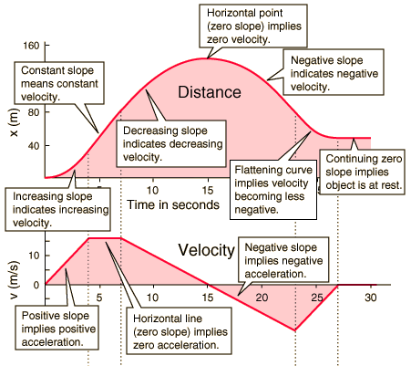
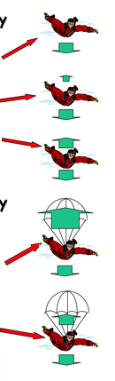
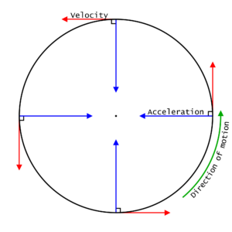

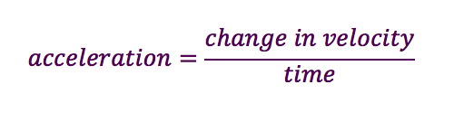
Forces (and motion 1)
11. Motion graphs
9. Scalar and vector
13. Terminal velocity
Initial acceleration due to weight
Distance is a scalar quantity (magnitude only) and measures how far something moves. Displacement is a vector quantity (magnitude and direction) and measures how far something is from its starting point.
Speed is a scalar quantity, the speed of a moving object is rarely constant and an average speed is often calculated. Velocity is a vector quantity.
Drag forces increasing, but still accelerating
Drag balances weight and terminal velocity reached
Larger surface area means the drag force increases causing deceleration
12. Velocity and acceleration
Area under the line is the distance
Lower terminal velocity reached
metres per second, m/s
10. Circular motion
metres, m
seconds, s
Circular motion involves constant speed, but changing velocity due to the change in direction.
A change in velocity over time is the definition of acceleration. This means that an object travelling in a circle will be accelerating due to a resultant force acting towards the centre of the circle.
s
Learn
Δv
v
t
metres per second, m/s
a
t
Learn
metres per second squared, m/s²
seconds, s

Slide 2
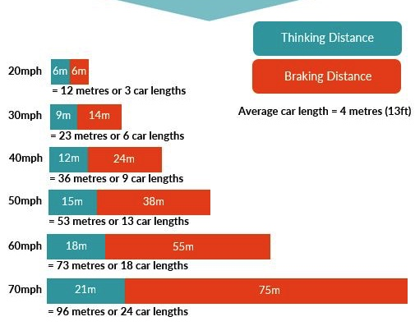
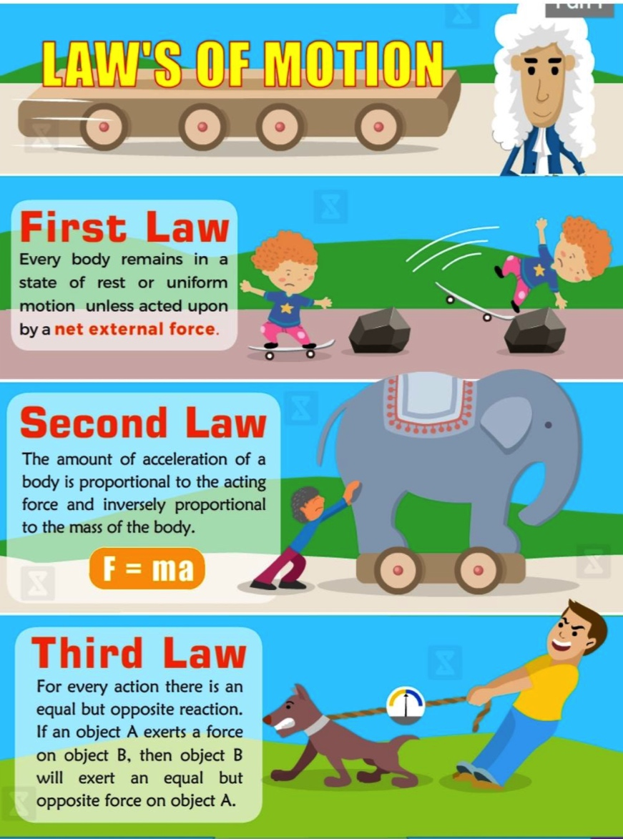

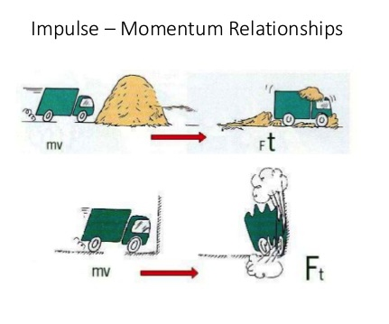


Forces (and motion 2)
15. Stopping distances
Thinking distance is the distance travelled while a driver reacts to a situation.
14. Newton’s laws of motion
Thinking distance may be affected by:
Tiredness
Dugs
Alcohol
Distractions e.g. mobile phone
The total stopping distance is the sum of thinking distance and braking distance.
Braking distance is the distance travelled while the brakes are applied.
An object will continue to be at rest or a steady speed unless acted on by a resultant force.
A vehicle’s braking distance may be affected by:
The condition of the road
The weather
The condition of the car
The mass of the vehicle
1
When a force is applied to the brakes, work is done by friction. This decreases the kinetic energy store of the car, but increases the thermal store of the brakes and surroundings, increasing the temperature.
Acceleration is proportional to the resultant force, and inversely proportional to the mass.
16. Momentum
kilograms, kg
metres per second, m/s
Learn
2
In a closed system, momentum is conserved; the total momentum before a collision is equal to the total momentum after a collision.
p
kilogram metres per second, kgm/s
m
v
When two objects interact, the forces are equal in size, but opposite in direction
For a change in momentum, force and time are inversely proportional; if you can increase the time of a collision you can decrease the force involved.
Seat belts, air bags, crash mats, cycle helmets and cushioned surfaces for playgrounds all use this idea.
3
newtons, N
seconds, s
F
kilograms, kg
Ft
m
a
m
Δv
Learn
newtons, N
metres per second squared, m/s²
On sheet
kilogram metres per second, kgm/s

