Slide 1
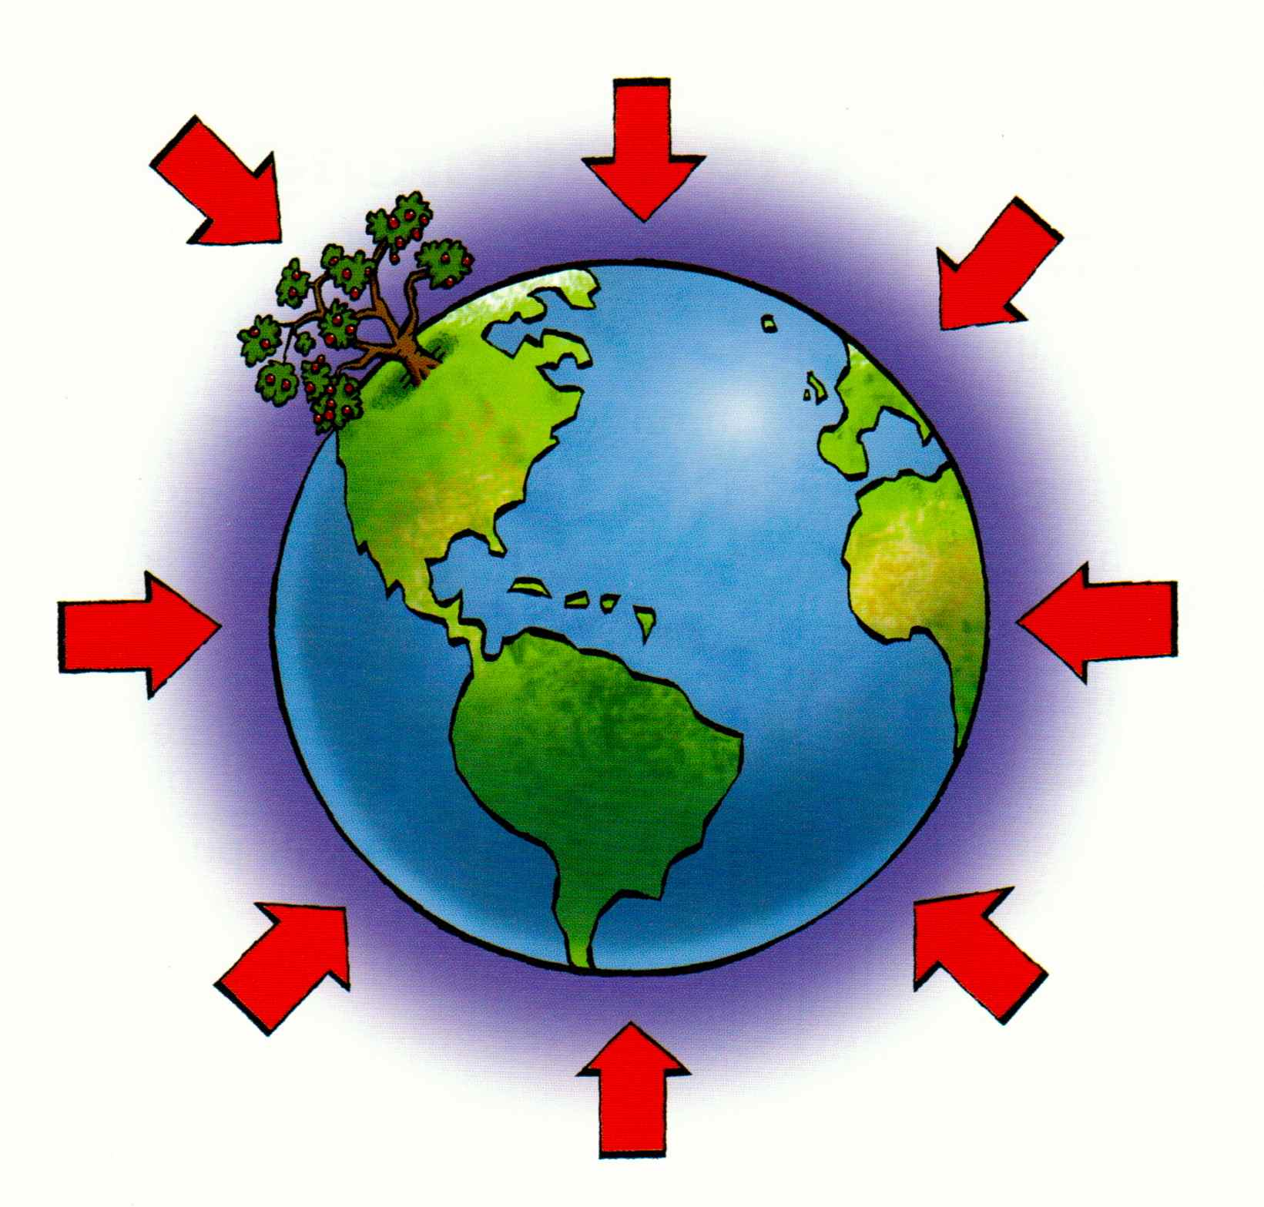
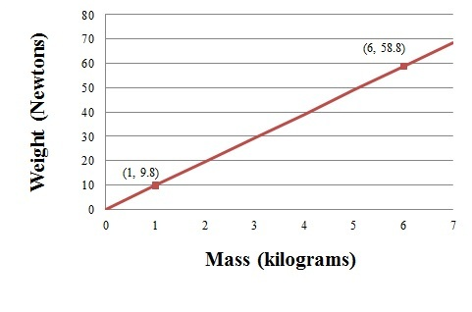


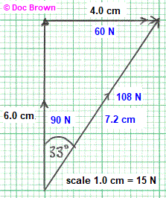
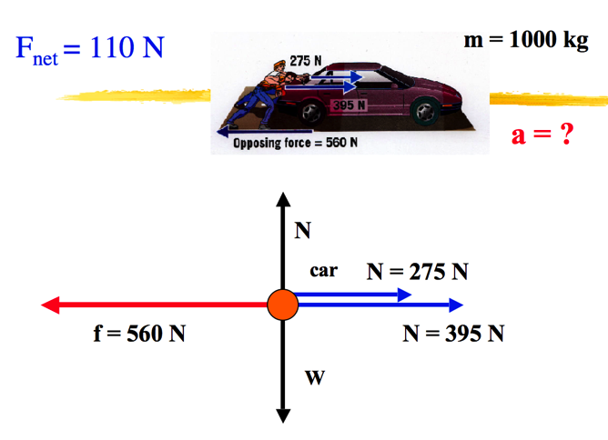
Forces (and interactions)
3. Gravity
Gravitational force is a weak force.
1. Describing forces
Weight is the force acting on an object due to gravitational field strength. Weight and mass are directly proportional (α) and will produce a straight-line graph through the origin.
Scalar quantities have size only; vector quantities have size and direction.
Scalar | Vector
time | force
distance | displacement
speed | velocity
W
m
g
Kilograms, kg
Contact forces are where the 2 objects are physically touching; non- contact forces occur where the objects are physically separated.
Gravity, magnetism and statics are the only non-contact forces.
newtons, N
Learn
Gravitational field strength on Earth is 9.8 N/kg
A resultant force is a single force that has the same effect as a system of forces on an object
2. Resultant force
Forces can be resolved into two perpendicular components or combined into a single resultant force.
In the graph paper example the vertical and horizontal forces were given. The answer needed to have both a size and a direction, e.g. 108N 33° clockwise from the vertical
As force is vector it is represented by an arrow with size and direction.
A free body diagram simplifies an object to single shape (circle or rectangle) so that the force arrows are more obvious.
Vector diagrams use scale drawings to illustrate how forces resolve and determine the resultant force. If the resultant force is zero the object will be in equilibrium , having balanced forces
The resultant force of two forces acting in a straight line will either be the sum (arrows in the same direction) or the difference (arrows in opposite directions) of the two forces. For example the forward force of the car is 275 + 395 = 670 N

Slide 2
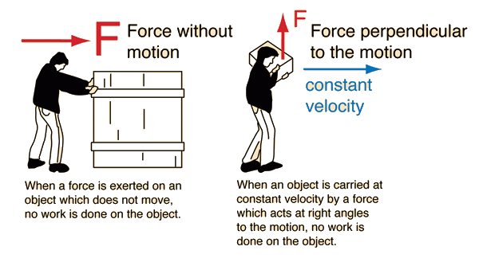
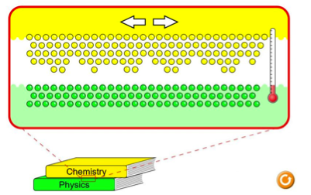

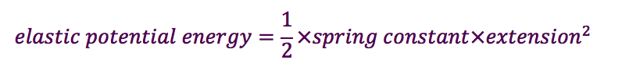
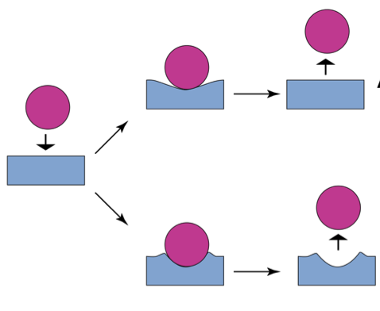
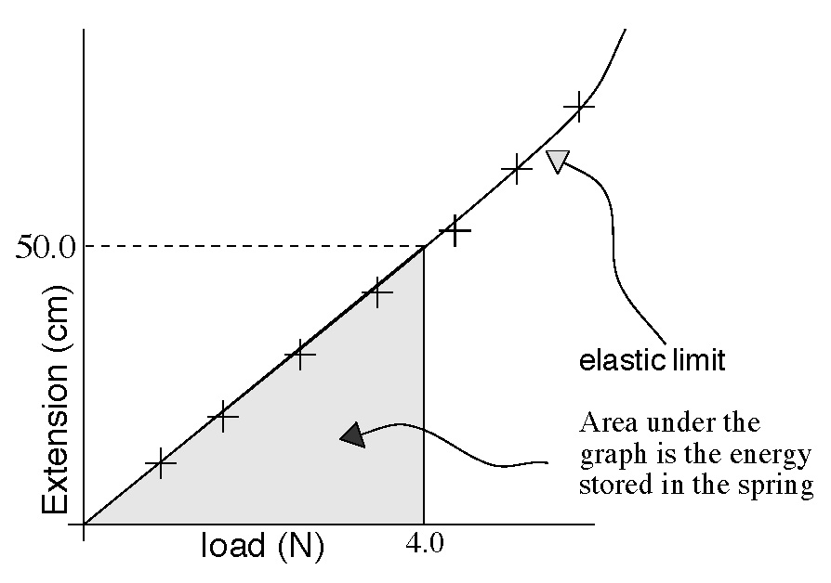

Forces (and energy)
One joule of work is done when a force of one newton moves and object a distance of one metre, therefore,
1 joule = 1 newton metre (1 J = 1 Nm)
Energy is transferred when work is done.
4. Work
Work is done when a force causes an object to move in the direction of the force.
Work done against friction causes an increase in the object’s thermal store and the thermal store of the surroundings.
This increases the kinetic energy of the particles in the object/surroundings and therefore increases the temperature.
Temperature is a measure of the average kinetic energy per particle
W
F
s
NOT WORK
newtons, N
joules, J
Learn
metres, m
5. Deformation
6. Hooke’s Law
joules, J
newtons per metre N/m
On sheet
Elastic deformation causes a temporary change of shape; the object will return to its original shape when the force is removed. An example is the stretching of a spring below its elastic limit.
Work is done when a force stretches a spring and all the energy is transferred to the elastic potential store of the spring as long as the elastic limit is not reached.
metres, m
E_{e}
Elastic
½k
e²
newtons, N
Learn
newtons per metre N/m
Extension is directly proportional to force
The object has become permanently deformed
metres, m
Inelastic
This also applies in compression, where e becomes the amount the spring has been compressed by
F
Inelastic (or plastic) deformation causes an object to permanently change shape.
k
e
To change the shape of an object more than one force needs to be applied.
Hooke’s Law is a required practical

Slide 3
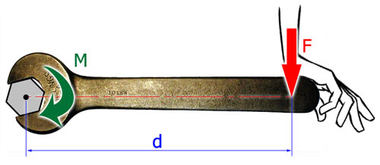
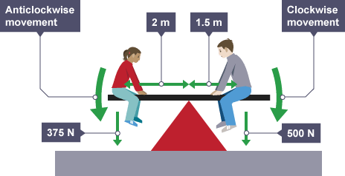

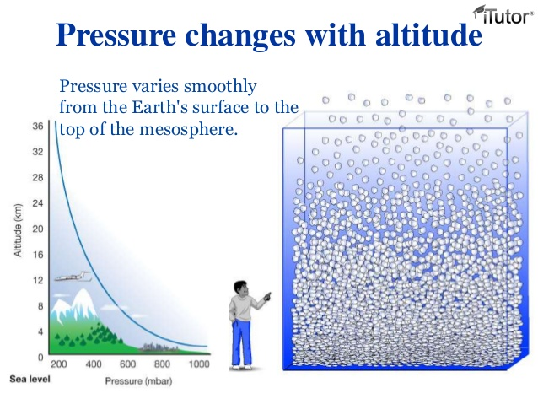
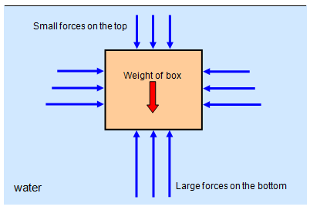
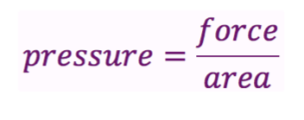
Forces (and pressure)
Separate
7. Moments
Gears and levers are examples of the use of moments to transfer rotational forces.
A moment is the turning effect of a force.
M
F
d
newtons, N
The distance is measured as the perpendicular distance between the force arrow and the pivot.
If an object is balanced, the total clockwise moments must equal the total anticlockwise moments.
Learn
metres, m
Newton metres, Nm
8. Pressure
A fluid is a liquid or a gas
Pressure is caused when the particles in the fluid collide with the surface of the container. Pressure in fluids causes a force normal (perpendicular) to a surface.
F
p
A
Learn
newtons per metre squared, N/m²
newtons, N
metres squared, m²
An object will float because the force of gravity acting on the mass (weight) is equal to the upthrust, i.e. balanced forces.
As you get further from the surface of the Earth the density of the air in the atmosphere gets less. This is due to less air in the column above you having less weight (fewer particles) to compress the particles together.
A submerged object experiences a greater pressure on the bottom surface than the top, creating a resultant force upwards. This is called upthrust.
The pressure due to a column of liquid can be calculated using:
p
h
ρg
Pascals, Pa
metres, m
kilograms per metre cubed, kg/m³
9.8 N/kg
On sheet

