Slide 1
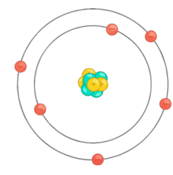
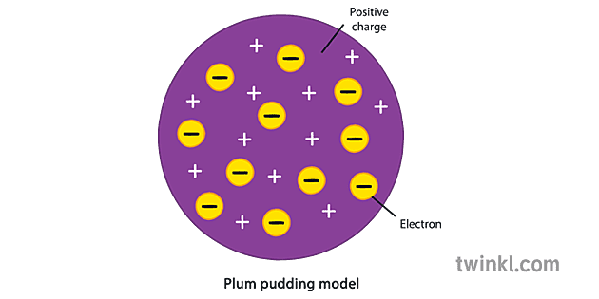
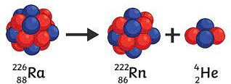
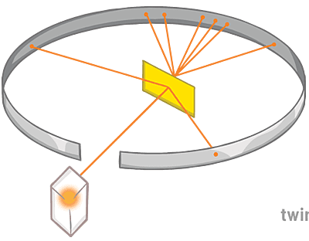
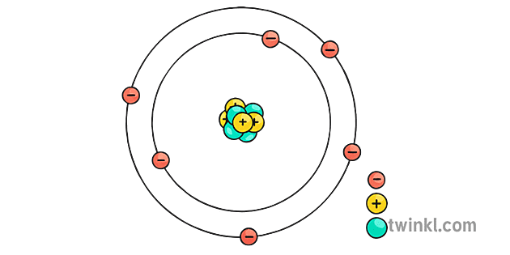
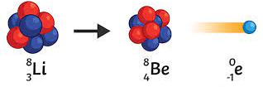
The Structure of the Atom
Atoms are very small, they have a radius of about 1x10⁻¹⁰ metres.
Atoms have a positively charged nucleus made from protons and
neutrons surrounded by negatively charged electrons.
The radius of the nucleus is less than 1/10,000 of the radius of
the atom, so most of the atom is empty space.
The electrons are arranged in energy levels. If electrons absorb
electromagnetic radiation they may move to a higher energy level,
further from the nucleus. If they emit electromagnetic radiation, they may fall to a lower energy level closer to the nucleus.
Atomic Structure: Physics
4. Atoms & Nuclear Radiation
Some atomic nuclei are unstable. This means they give out radiation as it changes to become more stable. This random process is called radioactive decay.
Activity is the rate at which a source of unstable nuclei decays it is measured in becquerel (Bq).
Count-rate is the number of decays recorded per second by a detector (e.g. a Geiger-Muller tube)
2. Mass number, atomic number and Isotopes
In an atom, the number of electrons is equal to the number of protons in the nucleus. Atoms have no overall electrical charge.
All atoms of a particular element have the same number of protons (called the atomic number).
The sum of the protons and neutrons in an atom
is its mass number
Atoms of the same element have the same number of protons but a different numbers of neutrons; these atoms are called isotopes of that element.
Atoms turn into positive ions if they lose electrons.
Radiation | Symbol | Made from | Penetrating Power | Ionising power | Range in air
Alpha | α | 2 protons & 2 neutrons (same as a He nucleus) | Stopped by paper/skin | High | <5cm
Beta | β | A high speed electron ejected from the nucleus as a neutron turns into a proton | Stopped by 3mm aluminium foil | Low | Approx. 1 m
Gamma | γ | Electromagnetic radiation from the nucleus | Stopped by lead/concrete | Very low | > 1km
Mass number, Mr →
²³
Na
Atomic number, Ar →
¹¹
^{Sodium}
3. Development of the model of the atom (common content with Physics)
Note: you only need to know the names of Bohr and Chadwick (in bold).
Scientist | Discovery
1800’s and before | Atoms were thought to be tiny spheres that could not be divided.
JJ Thomson, 1897 | The discovery of the electron led to the plum pudding model of the atom where the atom is a ball of positive charge with negative electrons embedded in it.
Ernest Rutherford, 1909 | The results from the alpha particle scattering experiment led to the conclusion that the mass of an atom was concentrated at the centre (nucleus) and that the nucleus was charged.
Niels Bohr, 1911 | Niels Bohr adapted the nuclear model by suggesting that electrons orbit the nucleus at specific distances.
Ernest Rutherford, 1920 | Later experiments led to the idea that the positive charge of any nucleus could be subdivided into protons.
James Chadwick, 1940 | Provided the evidence to show the existence of neutrons within the nucleus. This was about 20 years after the nucleus became an accepted scientific idea.
5. Nuclear Equations
Nuclear equations can be used to represent radioactive decay.
The emission of the different types of radiation may cause a change in the mass and/or charge of the nucleus, for example:
So alpha decay causes both the mass and the charge of the nucleus to decrease.
So beta decay not cause the mass of the nucleus to change, but does cause the charge of the nucleus to increase.
The emission of a gamma ray does not cause the nucleus to change.
₂₂₆
₂₂₂
₄
He
rubindium → radon +
₈₈
₈₆
₂
An alpha particle may be represented as:
₄
He
₂
₈
₈
₀
lithium → beryllium + e
₃
₄
₋₁
A beta particle may be represented as:
₀
e
₋₁

Slide 2
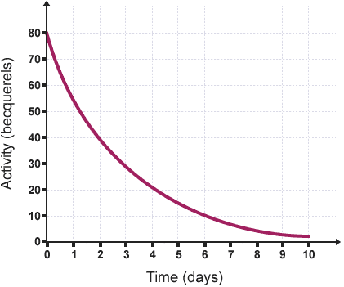
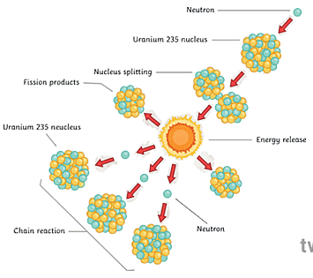
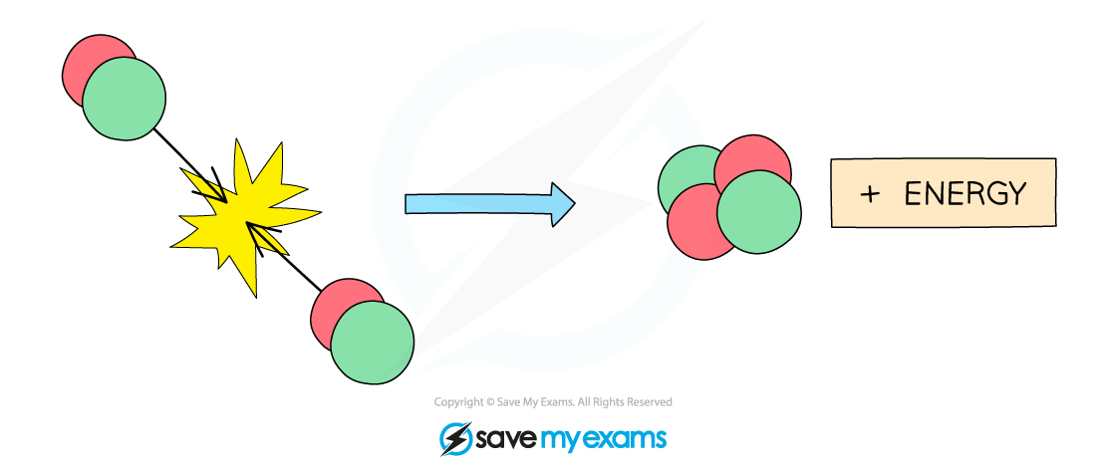
6. Half-lives
Radioactive decay is random.
The half-life of a radioactive isotope is the time it takes for the number of nuclei of the isotope in a sample to halve, or the time it takes for the count rate to fall to half of its initial level.
Atomic Structure: Physics
10. Nuclear Fission: Separate Physics Only
Nuclear fission is the splitting of a large and unstable nucleus (e.g. uranium or plutonium).
Spontaneous fission is rare.
For fission to occur the unstable nuclei must absorb a neutron.
The nuclei undergoing fission splits into two smaller, equal sized nuclei and emits neutrons, gamma rays and energy.
All the fission products have kinetic energy.
The neutrons may go on to start a chain reaction.
The chain reaction is controlled in a nuclear reactor to control the energy released. The explosion caused by a nuclear weapon is caused by an uncontrolled chain reaction.
8. Background Radiation: Separate Physics Only
Background radiation is around us all the time, it comes from:
Natural sources e.g. rocks, cosmic rays
Artificial sources e.g. nuclear weapons fallout and nuclear accidents
The level of background radiation dose may be affected by occupation and location.
Radiation dose is measured in sieverts (Sv). 1,000 millisieverts (mSv) = 1 sievert (Sv)
Radioactive isotopes have a very wide range of half-lives. The use of them depends on the half-life. E.g. a short half-life would be used for a medical tracer so it is not in the body for long.
9. Uses of Nuclear Radiation: Separate Physics Only
Medicinal uses:
Exploration of internal organs
Control and destruction of unwanted tissue (e.g. cancer). Gamma rays can be used in radiotherapy in kill cancer cells when they are targeted directly at the unwanted cells.
Nuclear Fission
You can calculate half lives from graphs such as the one here. Read off how long it takes the activity to half.
e.g. to go from 80 to 40 Bq takes 2 days.
7. Radioactive Contamination
Radioactive contamination is the unwanted presence of materials containing radioactive atoms on other materials.
The hazard from contamination is due to the decay of the contaminating atoms. The type of radiation emitted affects the level of hazard.
Irradiation is the process of exposing an object to nuclear radiation. The irradiated object does not become radioactive.
Suitable precautions must be taken to protect against any hazard that the radioactive source used in the process of irradiation may present.
Nuclear Fusion
11. Nuclear Fusion: Separate Physics Only
Nuclear fusion is the joining of two light nuclei to form a heavier nucleus. In this process some of the mass may be converted into the energy of radiation.

