Slide 1
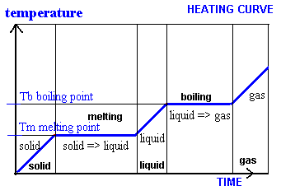
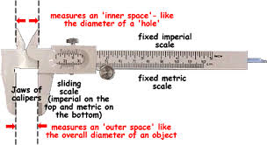
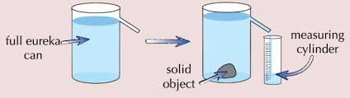
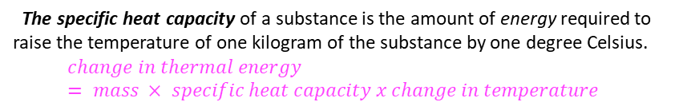
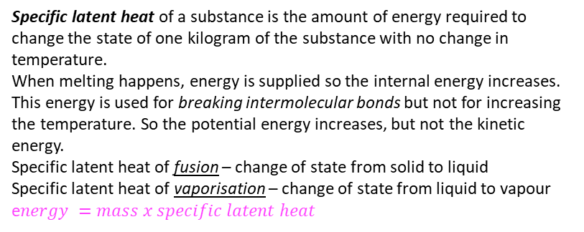

Particle theory of matter
3-4. Changes of state and Internal energy
1-2 Density
Energy is stored inside a system by the particles that make up the system. This is called internal energy. Internal energy is the sum of the kinetic energy and potential energy of all the particles that make up a system.
Kinetic energy stores are due to the movement of particles. The average kinetic energy of the particles is the temperature of the object.
Potential energy stores are due to the position of particles.
Heating changes the energy stored within the system by increasing the energy of the particles that make up the system. This either raises the temperature of the system or produces a change of state.
A change of state is a physical change , this means the substance doesn’t get changed, it is just in a different form; this change can be reversed back to its initial form. The mass is conserved because none of the substance is lost.
The density (ρ ) of a material is defined
by the equation:
m
d$ensity = mass ÷ volume$
ρ
V
In solids particles are close together (have high density), vibrate and have strong forces of attraction between them.
In liquids particles are close together but can move past each other are less dense than solids; they have irregular arrangements; the forces of attraction are weaker than those in solids.
Gases are less dense than liquids, are spread out and move randomly. There are almost no forces of attraction between particles.
Density of regular shaped objects. The sides of the object are measured with a ruler or callipers. Callipers have a higher resolution as they measure to 0.1 mm.
The volume is worked out by applying the formula for the correct shape. Mass is found out by using a top pan balance.
Density of irregular shaped objects. The volume of the object is the volume of water displaced when placed in a Eureka can.
The mass is found by using a top pan balance.
5-6. Specific heat capacity and Specific latent heat
The specific heat capacity of a substance is the amount of energy required to raise the temperature of one kilogram of the substance by one degree Celsius.
$$change in thermal energy = mass × specific heat capacity x change in temperature$$
Specific latent heat of a substance is the amount of energy required to change the state of one kilogram of the substance with no change in temperature.
When melting happens, energy is supplied so the internal energy increases. This energy is used for breaking intermolecular bonds but not for increasing the temperature. So the potential energy increases, but not the kinetic energy.
Specific latent heat of fusion – change of state from solid to liquid
Specific latent heat of vaporisation – change of state from liquid to vapour
e$nergy =mass x specific latent heat$
E
m
L

Slide 2
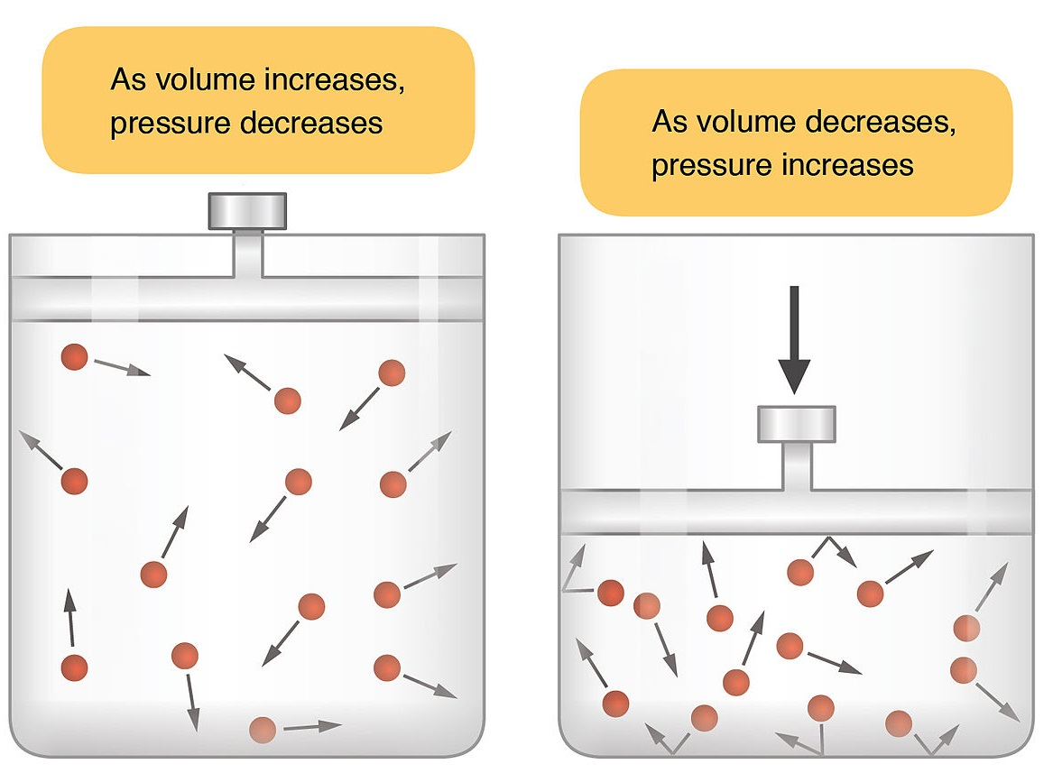
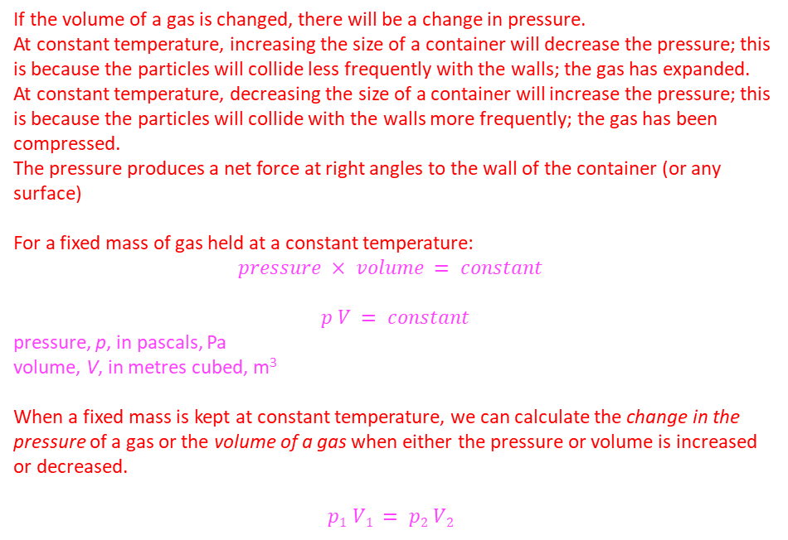
7. Particle motion in gases
The molecules of a gas move randomly. They have high kinetic energy.
The higher the temperature, the faster the particles move and the more kinetic energy they have.
If the volume is kept constant, by increasing the temperature the number of collisions with the sides of the container increase, therefore the pressure exerted by the gas increases.
Gas particles move with a high speed. When inside a container, they collide with each other and with the walls of the container.
When they collide with the wall there is a force on the wall; the sum of the forces from all particles is felt as pressure.
8. Pressure in gases
Triple
If the volume of a gas is changed, there will be a change in pressure.
At constant temperature, increasing the size of a container will decrease the pressure; this is because the particles will collide less frequently with the walls; the gas has expanded.
At constant temperature, decreasing the size of a container will increase the pressure; this is because the particles will collide with the walls more frequently; the gas has been compressed.
The pressure produces a net force at right angles to the wall of the container (or any surface)
For a fixed mass of gas held at a constant temperature:
$$pressure × volume = constant$$
$p V = constant$
pressure, p, in pascals, Pa
volume, V, in metres cubed, m³
When a fixed mass is kept at constant temperature, we can calculate the change in the pressure of a gas or the volume of a gas when either the pressure or volume is increased or decreased.
$$p1 V1 = p2 V2$$
When work is done on a gas, it increases the internal energy of the gas and can cause an increase in temperature.
Eg : when a bicycle pump is compresses, the piston hits the gas particles transferring energy to their kinetic store, so the temperature increases.
As they are moving faster, the particles collide with objects more frequently and the pressure will increase.

