Slide 1
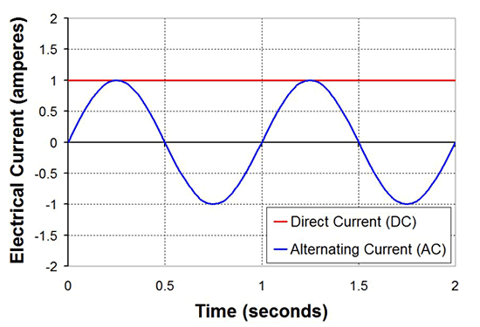
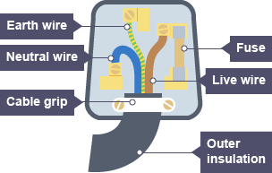

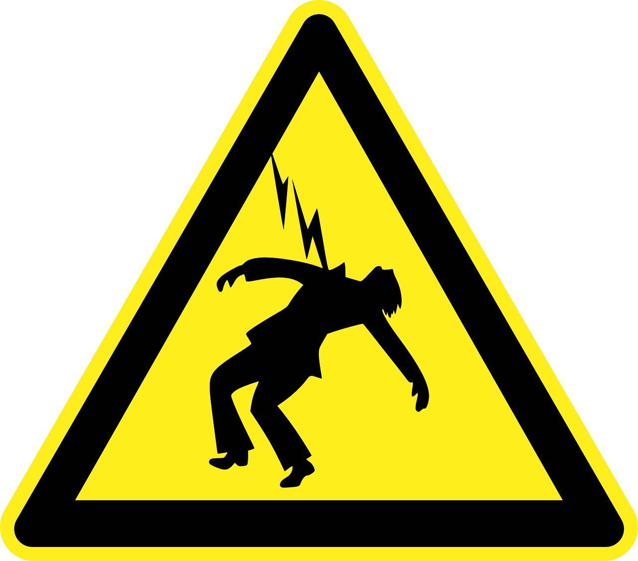
Mains electricity 1
Mains electricity in the UK is an AC supply.
It has a frequency of 50 Hz and a potential difference of 230 V.
1. AC versus DC
Oscilloscope trace showing AC and DC
We can use transformers to increase the potential difference and decrease the current.
Reducing the current reduces any heat loss through the wires, making the energy transfer more efficient.
There are two types of current:
Direct current (DC): the current travels in one direction only.
Examples: batteries, cells
Alternating current (AC): the charge moves backwards and forwards at a certain frequency (rate).
Examples: mains electricity, generators
The current is produced from two types of potential difference:
Direct potential difference: the potential difference always stays the same
Alternating potential difference: the potential of the live wire changes from a positive value to a negative value, while the neutral wire remains at 0 V. This causes a change in the direction of the potential difference.
Sometimes a fault can cause the current to get too high. There are 2 ways in which the circuit can be disconnected to stop danger:
Fuse: appliances and plugs have glass/ceramic containers that have a thin wire inside. This melts if the current is too high. The fuse is placed between the live pin and the live wire.
2. 3-pin plug
Plugs connect devices to the mains supply.
The cable contains 3 copper wires coated in plastic:
Earthing: most appliances with metal cases are earthed. This means when a fault occurs a large current flows from the live wire to the earth and melts the fuse. Some appliances are double insulated,
Live Wire
Copper wire coated with brown plastic Carries the AC current to the device
Neutral Wire
Copper wire coated with blue plastic Connects to the mains supply and completes the circuit
Earth Wire
Copper wire coated with green/yellow striped plastic Safety wire – provides a path to the ground in case of a fault
and therefore have no earth connection. ​A double insulated appliance has a casing made of an insulating material.
Electric shocks
The live has a potential of 230 V, but the ground (earth) has a potential of 0 V. This creates a potential difference and current flows.
3. Electrical safety
The live, neutral and earth pins are made of brass as this is stronger than pure copper, but has good conductivity.

Slide 2
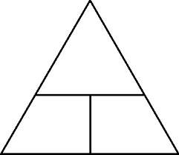
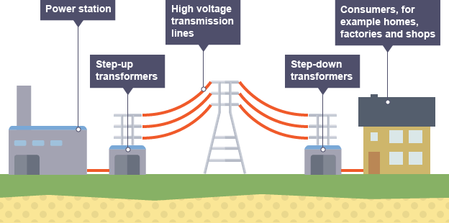

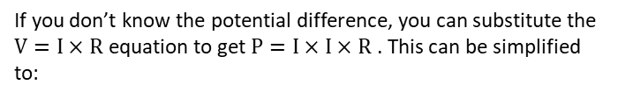

Electricity in the Home 2
5. Electrical appliances
Energy is usually measured in Joules (J), but in the home we can also measure it in kilowatt hours (kWh).
You can calculate the energy of an appliance using:
4. Power
Power is the rate at which energy is transferred in circuits.
It’s measured in watts (W).
It can be calculated using:
Learn
P, measured in watts (W)
OR kilowatts (kW)
Learn
E, measured in Joules (J)
OR kilowatt hours (kWh)
seconds (s)
OR hours (h)
P, measured in watts (W)
I, measured in amps (A)
V, measured in volts (V)
P
E
I
V
P
t
$$energy=power×time$$
$$power=current×potential difference$$
Appliances’ energy rating is usually labelled in kilowatt hours.
The higher the energy rating, the more powerful the appliance is.
Appliances that have a heating element (e.g. kettles and ovens) usually use the most energy.
If you don’t know the potential difference, you can substitute the $V=I×R$ equation to get $P=I×I×R$ . This can be simplified to:
P, measured in watts (W)
I, measured in amps (A)
R, measured in ohms (Ω)
If you are working with small amounts of energy (e.g. electrostatics), you can use the following equation:
Learn
Learn
P
E
$$power={current}^{2}×resistance$$
E, measured in Joules (J)
Q, measured in Coulombs (C)
V, measured in volts (V)
I²
R
Q
V
If you double the current, the power quadruples.
This shows how important it is to keep current low in appliances!
$$energy=charge flow×potential difference$$
This also helps define potential difference (see section 3(a)
6. The National Grid
Step-Up Transformers
These are used to increase the potential difference to 275 000 V as the electricity leaves the power station. This causes the current to decrease.
Step-Down Transformers
These are used to decrease the potential difference back down to a safer (but not safe) 230 V as the electricity leaves the National Grid and enters the home. This causes the current to increase.
The electricity generated in power stations is transported to the home through the National Grid through the use of cables and transformers.
The National Grid is very efficient, because it uses low current to transport the electricity (remember – high current causes energy to be lost as heat!).

Slide 3
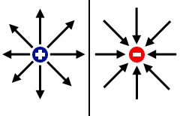
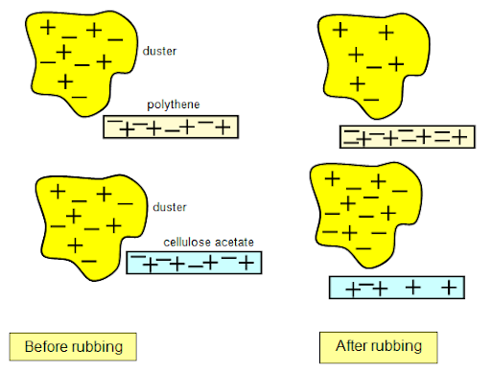
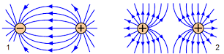
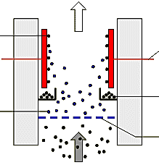
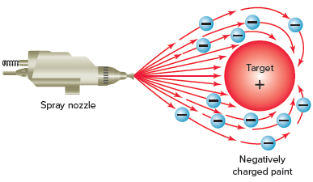
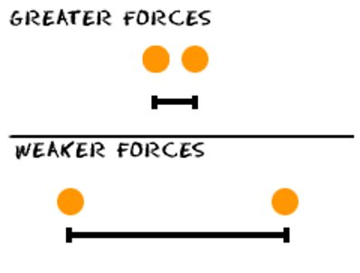
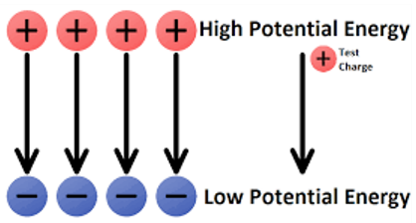
Static Electricity
8 (a). Electric fields
Separate
7. Static charge
When an object is electrically charged, it creates an electric field around itself.
The field direction goes away from a positive charge and towards a negative one.
Electric fields are strongest close to the object.
When certain materials are rubbed together, they become electrically charged.
Negatively charged electrons are rubbed off one material and onto the other.
When two electrically charged objects are brought together, they exert a force on each other. This is an example of a non-contact force.
Like charges repel, and opposite charges attract.
This is because of the electric fields around the objects (see below).
The material that gains electrons becomes negatively charged.
The material that loses electrons becomes positively charged.
This is called static electricity.
Static electricity uses
8 (b). Static shocks
Factories
Used to reduce pollution (smoke) coming out of factories. The smoke is given a charge, and sticks to electrodes with the opposite charge in the chimneys instead of leaving out the top.
When two charged objects get close to each other, sparking can occur.
Sparking is the sudden flow of electric current across the gap between the objects. This heats the air enough to cause it to glow. This can be very dangerous in industry.
The size of the spark depends on how far away the objects are, and what their potential differences are.
Spray Paint
Used to evenly cover surfaces without wasting paint or missing spots (e.g. cars). The object is given a positive charge. The spray paint is negatively charged. So, the paint is attracted to the object and sticks to it evenly.
Too close a distance or too great a potential difference leads to a static shock!

