Slide 1
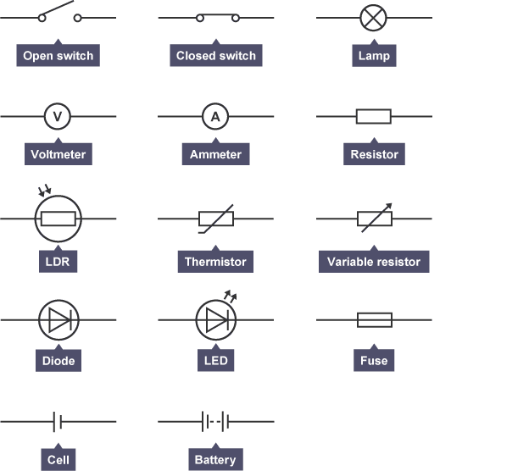

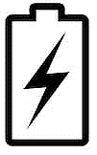

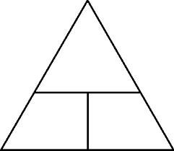

Circuit Electricity 1
2. Charge
1. Circuit symbols
Metals are conductors of electricity
Non-metals are insulators (poor conductors)
This is due to their bonding:
Metallic bonding create a ‘sea of delocalised electrons’ that can carry energy around a circuit.
The unit of charge flow is the coulomb (C). This represents a specific large number of electrons.
You must be able to remember the circuit symbols for these components, and use them when drawing a circuit:
switch (open) | voltmeter | LED
switch (closed) | ammeter | diode
cell | resistor | LDR
battery | variable resistor | fuse
lamp/bulb | thermistor
4. Potential difference
Potential difference (or voltage) is the driving force that pushes the charge around a circuit.
Potential difference is the energy per unit of charge:
It’s measured in volts (V) using a voltmeter connected in parallel over the component.
Potential difference can be supplied using a power source (e.g. a battery)
Learn
E
E, measured in Joules (J)
Q, measured in Coulombs (C)
V, measured in volts (V)
Remember: when you draw a circuit diagram, the lines (wires) must be straight and the circuit must be complete!
Q
V
$$energy=charge flow×potential difference$$
3. Current
Current is the flow of electrical charge around a circuit.
It’s measured in amps (A) using an ammeter connected in series with the component.
A circuit must include a source of potential difference (a power source) in order for current to flow.
We can calculate the charge flow using:
5. Resistance
Resistance is something that slows down the current.
It’s measured in ohms (Ω).
The bigger the resistance of a component, the less current gets through.
You can calculate the total resistance in a series circuit using:
Q, measured in Coulombs (C)
I, measured in amps (A)
t, measured in seconds (s)
total resistance
add together the individual resistances
$$charge flow = current × time$$
Q
Learn
$$R_{total}=R_{1}+R_{2}+\text{ ...}$$
You can use the equation triangle to re-arrange this:
I
t
In parallel the total resistance of two resistors is less than the resistance of the smallest individual resistor.​
Learn

Slide 2
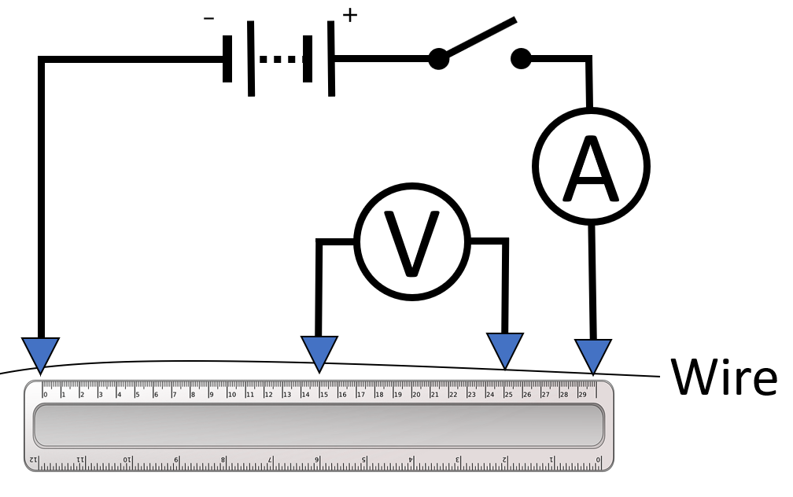
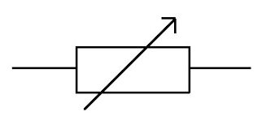
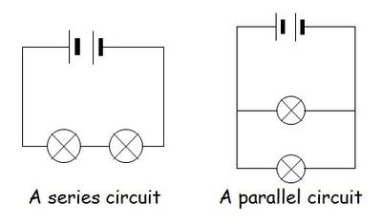
Circuit Electricity 2
6. Ohm’s Law
Learn
The following equation is used to link potential difference, current and resistance:
The current through a circuit depends on the potential difference and resistance.
If the potential difference is constant, then the current will decrease as resistance is increased.
Ohm’s Law states that current is directly proportional to potential difference for an ohmic conductor (if the temperature remains constant)
V
V, measured in volts (V)
I, measured in amps (A)
R, measured in ohms (Ω)
I
R
$$potential difference=current×resistance$$
7. Required Practical: How does the length of a wire affect its resistance?
8. Series and parallel circuits
There are two types of circuit: series and parallel.
Series Circuits | Parallel Circuits
All the components are connected in one loop | The components are connected in more than one loop
If one bulb breaks, the whole circuit stops working | If one bulb breaks, the other branches will continue to work
The current is the same everywhere | The current is shared between each branch
The potential difference is shared between components | The potential difference is the same across each component
The total resistance is the sum of all the individual resistances | The total resistance is less than the sum of the individual resistances
If you add more bulbs, they all get dimmer | If you add more bulbs, they all stay the same brightness
You can calculate the resistance of a wire if you measure the current and potential difference.
Changing the length of the wire and taking measurements will allow you to see if the resistance changes.
The ammeter measures the current through the circuit.
https://keystagewiki.com/index.php/GCSE_Physics_Required_Practical:_Investigating_Resistance
The voltmeter measures the potential difference across the wire.
As the current increases, the wire heats up which causes its resistance to increase. This reduces the accuracy of the experiment.
You can increase the accuracy by:
Stopping the current between readings to let the wire cool.
Using a low current to stop the wire heating up.
You can increase the precision by using pointed contacts to connect to the wire so the uncertainty of the measurement is reduced.
branches
http://norab.tacle.getap.licuk.mohammedshrine.org/in-a-series-circuit.html

Slide 3
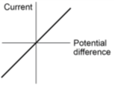
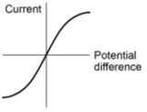
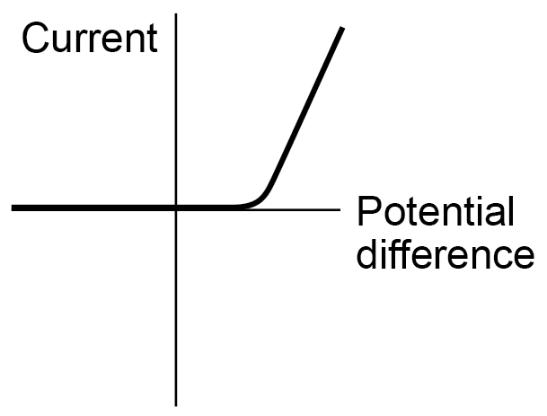
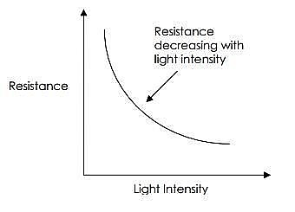
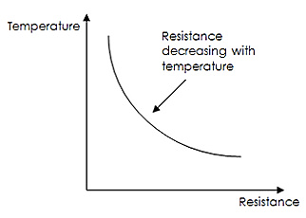
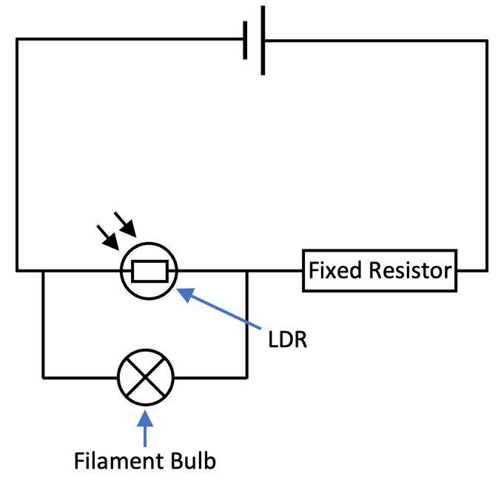
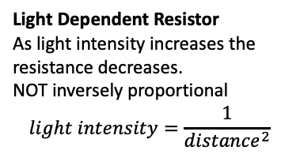
Circuit electricity 3
9. Required Practical: I-V characteristics of different components
There are two types of conductor:
Ohmic |  | Non-Ohmic
The resistance remains constant when you change the current |  | The resistance does change with current
The current is directly proportional to the potential difference
If you drew a graph of I against V, it would be a straight line through (0,0)
Example: a resistor at constant temp.
Example 1: a filament lamp
The resistance increases as it heats up
Example 2: a diode
Current can only flow in one direction, so resistance is very high the other way
10. Thermistors and LDRs
Light Dependent Resistor (LDR)
The resistance decreases as the light gets brighter. Example: street lights use these so they turn on when it gets dark
Thermistor
The resistance decreases as temperature increases. Example: used in thermostats to turn on the heating when it gets cold
Applications
As both an LDR and thermistor have low resistance at high temperature or light intensity, a parallel circuit is needed to use them to turn on lights or heaters.
Light Dependent Resistor
As light intensity increases the resistance decreases.
NOT inversely proportional
$$light intensity=\frac{1}{{distance}^{2}}$$
Thermistor
Temperature is inversely proportional to resistance.
This can be proved using the table of results.
The product of the IV x DV will be the same for every row of data.

