Slide 1








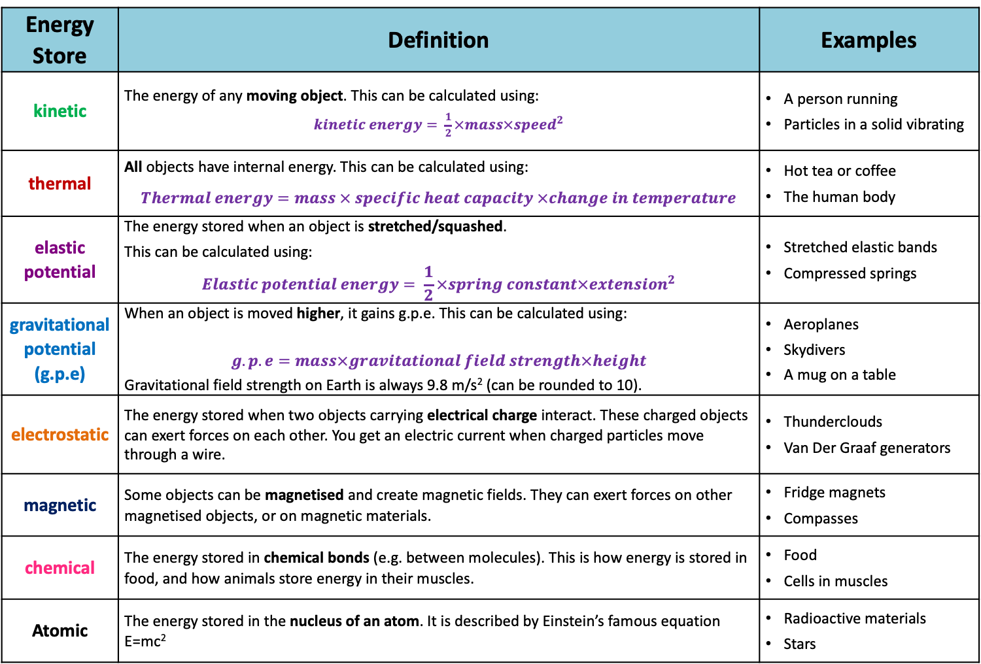
Energy Stores
Energy is a means of working out if it is possible for something to happen.
This means each store is linked to a calculation
1. Types of energy store
There are 8 stores we look at in this topic:
Energy Store | Definition | Examples
kinetic | The energy of any moving object. This can be calculated using: $kinetic energy= \frac{1}{2}×mass×{speed}^{2}$ | A person running Particles in a solid vibrating
thermal | All objects have internal energy. This can be calculated using: $$Thermal energy=mass × specific heat capacity ×change in temperature$$ | Hot tea or coffee The human body
elastic potential | The energy stored when an object is stretched/squashed. This can be calculated using: $$Elastic potential energy= \frac{1}{2}×spring constant×{extension}^{2}$$ | Stretched elastic bands Compressed springs
gravitational potential (g.p.e) | When an object is moved higher, it gains g.p.e. This can be calculated using: $$g.p.e=mass×gravitational field strength×height$$ Gravitational field strength on Earth is always 9.8 m/s² (can be rounded to 10). | Aeroplanes Skydivers A mug on a table
electrostatic | The energy stored when two objects carrying electrical charge interact. These charged objects can exert forces on each other. You get an electric current when charged particles move through a wire. | Thunderclouds Van Der Graaf generators
magnetic | Some objects can be magnetised and create magnetic fields. They can exert forces on other magnetised objects, or on magnetic materials. | Fridge magnets Compasses
chemical | The energy stored in chemical bonds (e.g. between molecules). This is how energy is stored in food, and how animals store energy in their muscles. | Food Cells in muscles
Atomic | The energy stored in the nucleus of an atom. It is described by Einstein’s famous equation E=mc² | Radioactive materials Stars
Kilograms (kg)
E_{k}
Learn
Joules (J)
Meters per second (m/s)
½m
v²
degrees Celsius (⁰C)
On Sheet
Joules (J)
Joules/kilogram degree Celsius (J/kg⁰C)
Kilograms (kg)
Newtons per meter (N/m)
meters (m)
On Sheet
Joules (J)
E_{e}
½k
e²
Learn
Joules (J)
Kilograms (kg)
Newtons per Kilogram (N/kg)
meters (m)
E_{p}
m
g
h

Slide 2
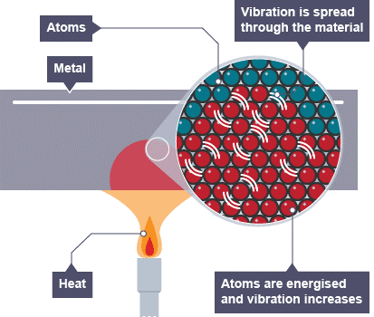


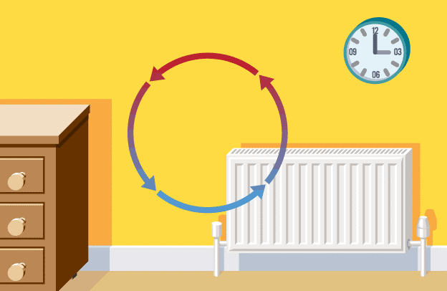


Energy Transfers
3. Energy transfer in houses
2. Types of energy transfer
Energy can be lost from your home through conduction, convection or radiation:
There are 4 ways that energy can be transferred from one type of store to another called pathways:
Conduction
Happens in solids. When the internal energy store is filled up, the particles move more vigorously. They bump into particles around them and pass internal energy through the solid. A material that lets heat pass through it easily has good thermal conductance. Therefore it is called a conductor (e.g. metal). A material that doesn’t is called an insulator (e.g. plastic). Example: if a metal pan is heated from underneath the handle will eventually become hot.
Convection
Happens in liquids/gases (fluids). These particles can move around, so the particles that have more internal energy take the place of the less energetic particles. In a liquid, the energetic particles rise to the top and the less energetic particles sink to the bottom. Examples: radiators, hot air balloons
Radiation
Energy is transferred as an electromagnetic wave. There are no particles involved! Examples: radiators giving out heat
Heating by particles
Energy is transferred from a hotter object to a cooler one. This can be done by conduction, convection or radiation.
Mechanically working
Energy is transferred when something is moved. Example: a person running
Electrically working
Energy is transferred when an electrical circuit is complete.
Heating by radiation
Energy is transferred as an electromagnetic wave. Example: the Sun warms the Earth
BBC Bitesize website
Heat energy is lost through roofs, windows, walls, floors and through gaps around windows and doors. However, there are ways that these losses can be reduced. Type of heat transfer reduced.
Fitting carpets (conduction), curtains, draught excluders (convection) and reflective foil in the walls or on them (radiation).
double glazing has a vacuum to reduce heat transfer (conduction and convection).
cavity wall insulation (conduction and convection)
loft insulation (conduction and convection).
4. Thermal equilibrium
If there is a difference in temperature between 2 objects, energy is transferred from the hotter object to the cooler one.
When they are both the same temperature, they are in thermal equilibrium.

Slide 3


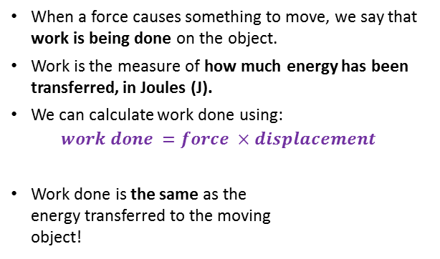

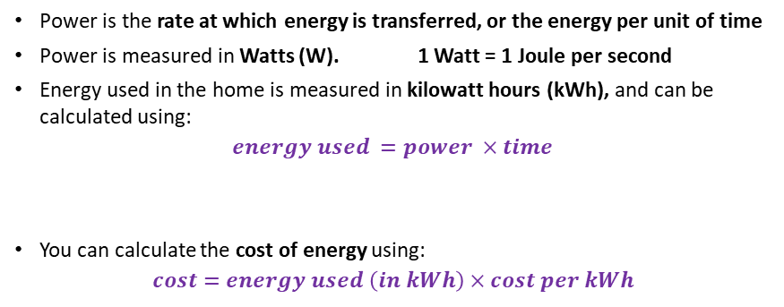
Energy Calculations
6. Conservation of energy
5. Heat and temperature
Conservation of energy rule: energy cannot be created or destroyed, only stored or transferred.
This means that the total energy of a closed system is always the same. The energy can be in a different form, but there is always the same amount.
We can draw Sankey diagrams to demonstrate the conservation of energy:
Temperature is a measure of the average kinetic energy per particle in a substance.
We use a thermometer to measure temperature in degrees Celsius (ºC).
When the kinetic energy of a substance increases, the temperature does as well.
As a material changes state the potential energy per particle increases, not the kinetic energy, so the temperature remains constant.
total energy input
useful energy output
wasted energy output
7. Work Done
BBC Bitesize website
We can use these diagrams to calculate the efficiency of something:
$$efficiency=\frac{useful energy output}{total energy input}×100$$
Learn
When a force causes something to move, we say that work is being done on the object.
Work is the measure of how much energy has been transferred, in Joules (J).
We can calculate work done using:
$$work done =force ×displacement$$
Work done is the same as the energy transferred to the moving object!
8. Power
Power is the rate at which energy is transferred, or the energy per unit of time
Power is measured in Watts (W). 1 Watt = 1 Joule per second
Energy used in the home is measured in kilowatt hours (kWh), and can be calculated using:
$$energy used =power ×time$$
You can calculate the cost of energy using:
$$cost=energy used \left(in kWh\right)×cost per kWh$$
Learn
Learn
Joules (J)
Newtons (N)
E
meters (m)
W
Kilowatts (kW)
Hours (h)
Kilowatt-hours (kWh)
P
t
F
s
The direction of the force and the displacement must be parallel, or no work is done.

Slide 4


9. Energy Resources
Humans can generate energy in lots of different ways.
All energy resources are renewable, except for fossil fuels and nuclear power.
A renewable resource is one that can be replenished as it is used.
Energy Resource | Positives | Negatives
Fossil Fuels (Coal, Oil and Gas) | Relatively cheap fuel Infrastructure already exists | Releases carbon dioxide (greenhouse gas) Releases sulphur dioxide, which causes acid rain Finite resource
Nuclear | Doesn’t produce greenhouse gases High energy density | Radioactive material could be released into the environment Expensive to store safely (nuclear waste remains dangerous for a long time)
Wind | No fuel costs Doesn’t produce any harmful chemicals Wind energy is available all over the world | Noise pollution Visual pollution Unreliable (depends on the wind)
Wave | No fuel costs Doesn’t produce any harmful chemicals Low-lying, so little visual pollution | Unreliable (depends on the waves) Difficult for wave machines to produce large amounts of electricity Limited suitable sites
Tidal | Very reliable (tides are predictable) No fuel costs Doesn’t produce any harmful chemicals | Can destroy the habitats of estuary species (e.g. wading birds) Only produces energy for about 10 hours a day Affects shipping trying to navigate estuaries
Hydroelectric | Very reliable and quick to start No fuel costs Doesn’t produce any harmful chemicals | Dams create reservoirs, which can force people/local wildlife to relocate The vegetation underwater releases methane (a greenhouse gas) Fast flowing rivers are needed, so limited sties available
Geothermal | Hot water/steam can be used to directly heat buildings No fuel costs Doesn’t produce any harmful chemicals | Most parts of the world do not have suitable areas where geothermal energy can be exploited Hazardous gases and minerals may be release (difficult to dispose of safely)
Solar | No fuel costs Doesn’t produce any harmful chemicals Solar energy is available all over the world | Very expensive Not very efficient Unreliable (depends on amount of sunlight)
Bioenergy | Carbon neutral Can be stored for when it is needed Available all over the world | Burning fuels (e.g. rubbish) causes some air pollution Growing biofuels uses land that could be used for food crops Materials for fuels are bulky, so have high transport costs

