Slide 1
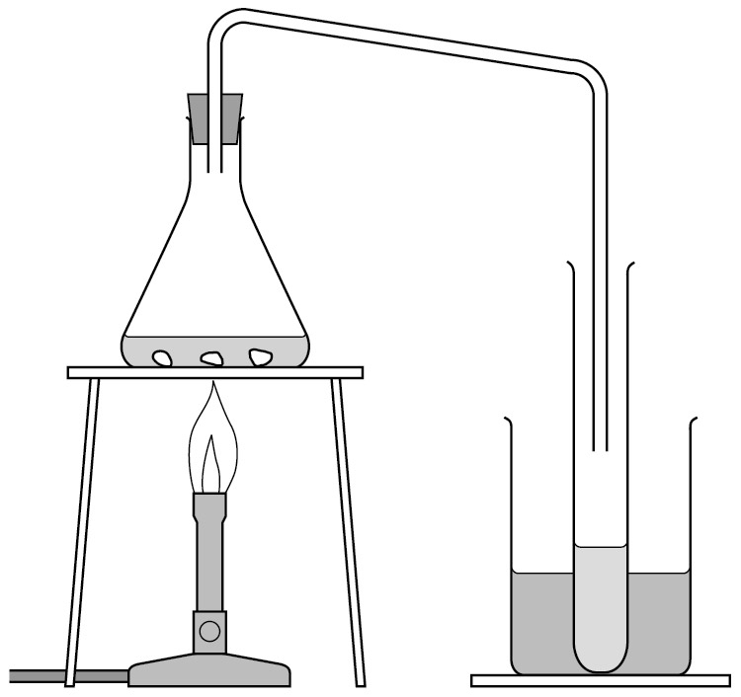
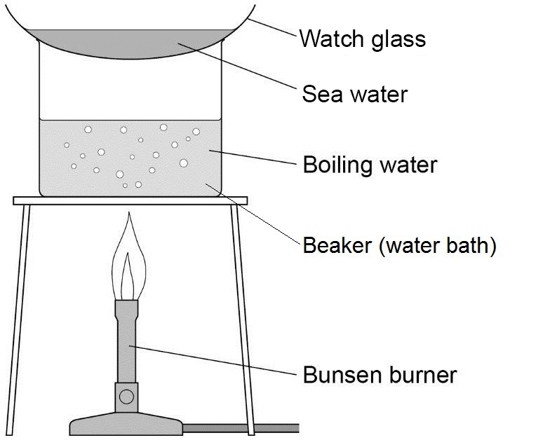
Using Earth’s Resources
Resources
The human population is increasing rapidly and our use of Earth’s resources has increased. Resources can be finite (those being used more quickly than they are made, e.g. metals and fossil fuels) or renewable (e.g. solar energy, wind power, geothermal energy). We use resources for shelter, food, clothing and construction.
Required practical Safe drinking water
In this investigation you will analyse a water sample and purify a water sample sing distillation.
Analysing the water sample:
Use the universal indicator paper to measure the pH of the water sample.
Accurately weigh an empty evaporating basin and record to two decimal places.
Pour 10 cm3 of water sample 1 into the evaporating basin.
Heat the evaporating basin on a tripod and gauze using a Bunsen burner until the solids start to form and the majority of water has evaporated.
Weigh the cooled evaporating basin again and calculate the mass of the solids that were dissolved in the water.
Record your results in a table
Purifying the Water Sample:
Place the water sample in the conical flask. Set up the apparatus for distillation as shown in the diagram above.
Heat the water using the Bunsen burner until it boils. Then reduce the heat so that the water boils gently.
The distilled water will collect in the cooled test tube. Collect about 1 cm depth of water in this way, then stop heating.
Analyse the water you have distilled by determining its boiling point
Potable Water
Potable water is water that is safe to drink. It has low levels of dissolved solutes and microbes and a pH of between 6.5 and 8.5. It is not necessarily pure.
Pure water would contain H₂O molecules only.
To make water potable, the method depends on location. In the UK water is collected as surface water (lakes, reservoirs) or groundwater (rocks) and can then be treated.
Step 1. Filtration through mesh
Step 2: Aluminium sulphate is added to clump together particles which fall to the bottom of the tanks as sludge.
Step 3. Filtration through gravel and sand bed to remove fine particles
Step 4. Sterilised to kill microbes using chlorine, UV or ozone.
Desalination
Sea water can undergo a process of desalination to remove the salt to make it potable.
Distillation: water is heated until it evaporates. The steam cools and condenses in a condensing tube. The salt is left behind. This is expensive due to the energy requirement of boiling water.
Reverse osmosis: salt water is forced through a membrane at high pressure. The membrane has holes so small only water molecules can fit through. These membranes are expensive.

Slide 2
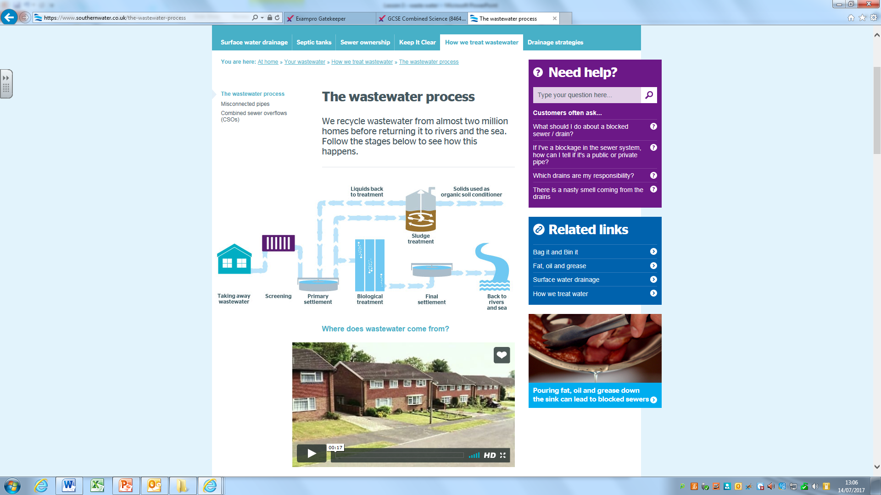
Using Earth’s Resources
Treating waste water
Water is screened to remove branches, twig, grit etc
Sedimentation: water is placed in a settlement tank, the heavier solids sink to the bottom and the lighter effluent floats on top.
The effluent is transferred to another tank where microbes are added to digest the organic matter. Oxygen is bubbled into the water for the microbes to use in respiration.
The water is now clean enough to be released into rivers.
The sludge can be used as fertilisers on crops, burnt as fuel, or used to produce biogas fuel.
Alternative ways of extracting metals (Higher Tier Only)
In order to conserve the copper ores, copper is extracted from low-grade ores by phytomining, and bioleaching. These methods avoid digging, moving and disposing of large amounts of rock.
Bioleaching uses bacteria to produce leachate solutions that contain metal compounds.
Phytomining uses plants to absorb metal compounds. The plants are harvested and then burned to produce ash that contains metal compounds. The metal can be purified either by:
a. displacement reaction extracts copper from solutions of copper compounds by displacement using scrap iron
iron + copper sulfate → iron(II) sulfate + copper
Fe(s) + CuSO₄(aq) → FeSO₄(aq) + Cu(s)
b. Electrolysis using electricity to split the positive copper ions away from the negative non-metal ions it is bonded to in the ore.
Life Cycle Assessments
A LCA is used to assess the environmental impact a product has over its whole lifetime. They provide a way of comparing several alternative products to see which one causes the least damage to the environment.
To carry out an LCA, scientists measure the impact of
Extracting the raw materials
Processing raw material
Manufacturing the product
How the product is used
How the product is transported
How the product is disposes of at the end of its life
LCAs can be subjective and hard to quantify and can therefore be misused for advertising a product.
Reduce, Reuse, Recycle
It is important to reduce the amount of finite raw materials used to produce new products. This also reduces pollution and waste products so there is less of an environmental impact.
Glass bottles can be reused by crushing and melting to make different glass products.
Metals can be recycled by melting and recasting or reforming into different products. The amount of separation required for recycling metal depends on the material and the properties required of the final product.
For example, some scrap steel can be added to iron from a blast furnace to reduce the amount of iron that needs to be extracted from iron ore.

Slide 3
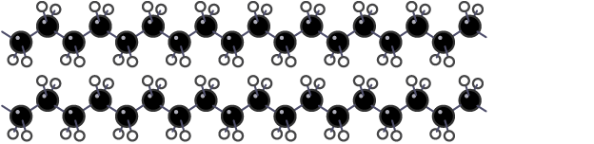
Using Earth’s Resources (SEPARATE CHEMISTRY ONLY)
Corrosion
Corrosion is the destruction of materials by chemical reactions with substances in the environment. An example of corrosion is rusting. For iron to rust it needs both water and oxygen. Iron + water + oxygen → hydrated iron ( III ) oxide
Corrosion can be prevented by applying a coating that acts as a barrier, such as greasing, painting or electroplating.
Aluminium has an oxide coating that protects the metal from further corrosion.
Sacrificial protection is the coating of a metal with a more reactive one. e.g. zinc is used to galvanise iron.
Alloys
Most metals in everyday use are alloys. They are made up of two or more chemical elements, of which at least one is a metal. An alloy has properties different from the metals it is made of. In an alloy, there are atoms of different sizes. The smaller or bigger atoms distort the layers of atoms in the pure metal. This means that a greater force is required for the layers to slide over each other. The alloy is harder and stronger than the pure metal.
Bronze is an alloy of copper and tin. Brass is an alloy of copper and zinc.
Gold used as jewellery is usually an alloy with silver, copper and zinc. The proportion of gold in the alloy is measured in carats. 24 carat being 100% (pure gold) and 18 carat being 75% gold.
Steels are alloys of iron that contain specific amounts of carbon and other metals. High carbon steel is strong but brittle. Low carbon steel is softer and more easily shaped. Steels containing chromium and nickel (stainless steels) are hard and resistant to corrosion. Aluminium alloys are low density
Ceramics, Polymers and Composite
Glass can be made by heating a mixture of sand, sodium carbonate and limestone. This is called soda-lime glass Borosilicate glass, is made from sand and boron trioxide. It melts at higher temperatures than soda-lime glass.
Clay ceramics, including pottery and bricks, are made by shaping wet clay and then heating in a furnace.
Most composites are made of two materials, a matrix or binder surrounding and binding together fibres or fragments of the other material, which is called the reinforcement.
Examples of composites are: carbon fibre composite, reinforced concrete, fibreglass
Polymers are large molecules made from small, repeating molecules called monomers.
Low density and high density poly(ethene) are both produced from ethene but at different temperatures. LD is made at moderate temperatures and high pressure and is flexible. HD is made at lower temperature and pressure with different catalysts and is more rigid.
Thermosoftening polymers melt when they are heated because the polymer chains are entwined between them with week forces between the chains.
Thermosetting polymers do not melt when they are heated because the polymer chains are cross-linked between them.

Slide 4
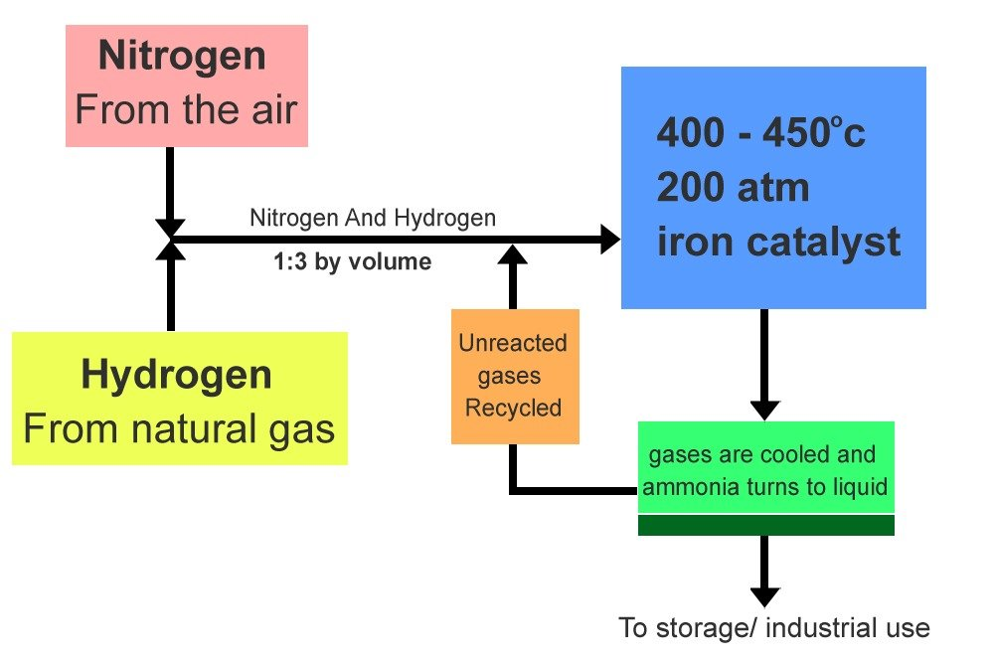
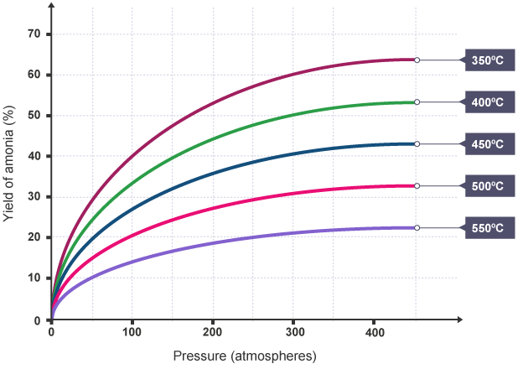
Using Earth’s Resources (SEPARATE CHEMISTRY ONLY)
The Haber process is a way of making Ammonia (NH₃)
The raw materials are:
Nitrogen – from the air
Hydrogen – from natural gas (methane)
N_{2 (g)} + 3H_{2 (g)} 2NH_{3 (g)}
This is a reversible reaction.
The conditions for making ammonia are:
200atm pressure
450ºC Temp
Iron Catalyst
The ammonia is cooled and condensed into liquid and removed so that it doesn’t break back down into hydrogen and nitrogen.
Un-reacted hydrogen and nitrogen are recycled
The forwards reaction is exothermic, so if the temperature is increased, the equilibrium position moves in the direction of the endothermic reaction. This means it moves to the left in the Haber process. The rate of reaction is low at low temperatures. So a compromise temperature of 450 °C is chosen. This is:
low enough to achieve an acceptable yield
high enough to do this in an acceptable time
If the pressure is increased, the equilibrium position moves in the direction of the fewest molecules of gas. This means it moves to the right in the Haber process. It is expensive to achieve very high pressures. Stronger equipment is needed, and more energy is needed to compress the gases. So a compromise pressure of 200 atmospheres is chosen. This is:
low enough to keep costs down
high enough to achieve an acceptable yield

Slide 5
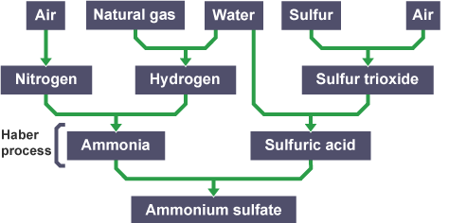
Using Earth’s Resources (SEPARATE CHEMISTRY ONLY)
Fertilisers
Fertilisers are formulations which may contain nitrogen, phosphorus and potassium compounds to promote plant growth. Fertilisers that supply all three elements are often called NPK fertilisers, after the chemical symbols for these three elements.
Fertiliser compounds must be soluble in water so they can be absorbed by the root hair cells:
Ammonium nitrate - NH₄NO₃ - and ammonium sulfate - (NH₄)₂SO₄ - are examples of fertilisers that contain the essential element nitrogen.
Ammonium phosphate - (NH₄)₃PO₄ - contains the elements nitrogen and phosphorus
Potassium nitrate - KNO₃ - contains the elements potassium and nitrogen.
Potassium salts can be mined from rock, they are already soluble so don’t need treating with acid.
phosphate rock are also obtained by mining, but phosphate rock cannot be used directly as a fertiliser. Phosphate rock is treated with nitric acid or sulfuric acid to produce soluble salts that can be used as fertilisers (see the table)
To make the salts, ammonia is reacted with different acids. Ammonia produces the ammonium ion NH⁴ when it is involved in neutralisation reactions. Ammonia is an alkali.
alkali + acid → salt
ammonia + nitric acid → ammonium nitrate
NH₃ + HNO₃ → NH₄NO₃
ammonia + sulfuric acid → ammonium sulfate
2NH₃ + H₂SO₄ → (NH₄)₂SO₄
ammonia + phosphoric acid → ammonium phosphate
3NH₃ + H₃PO₄ → (NH₄)₃PO₄
Ammonia sulphate can be made in a lab by reacting ammonia + sulphuric acid, or on an industrially large scale
.
Phosphate rock reacts with… | Compound(s) produced
Nitric acid | Calcium nitrate and phosphoric acid (which is neutralised with ammonia to make ammonium phosphate)
Sulfuric acid | Single superphosphate (a mixture of calcium sulfate and calcium phosphate)
Phosphoric acid | Triple superphosphate (calcium phosphate)
Factor | Industrial method | Laboratory method
Temperature | Between 60°C and 450°C | Room temperature then heating to evaporate the water
Equipment and process | Very expensive chemical plant machinery, used in a continuous process | Cheap and versatile laboratory equipment, used in a batch process
Starting materials | Reactants are made from raw materials, eg sulfur, air, water | Reactants are purchased from a chemical supplier
Scale/yield | Huge quantities can be made quickly. | Small quantities are made slowly
Running costs | Automatic control, labour and running costs are low | very labour-intensive, so running costs are high

