Slide 1
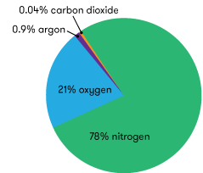
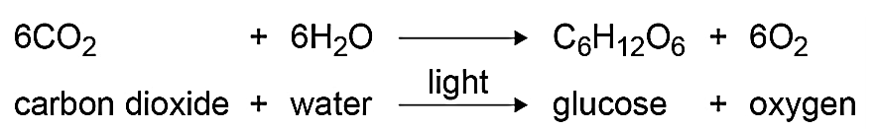
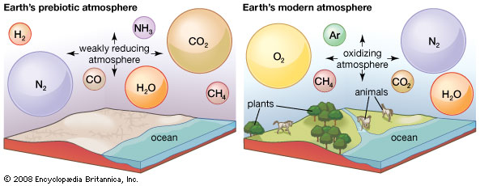



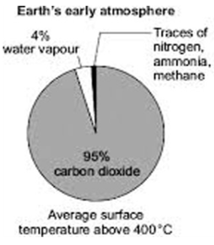
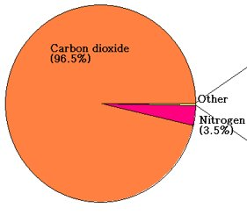
Chemistry of the Atmosphere – Composition and Evolution
1 (a). Composition of the atmosphere
2. Evolution of the atmosphere
For the last 200 million years, the composition of the atmosphere has been much the same:
As the Earth evolved, the atmosphere changed. The amount of oxygen increased and carbon dioxide decreased:
How oxygen increased
Plants make their own food through photosynthesis: Algae first produced oxygen about 2.7 billion years ago. Over the next billion years, plants evolved and the percentage of oxygen in the atmosphere increased to a level that allowed animals to evolve.
80% nitrogen
20% oxygen
Small amounts of other gases (including carbon dioxide, water vapour and noble gases)
https://www.science.org.au/curious/space-time/mars
1 (b). The early atmosphere
When the Earth first formed 4.6 billion years ago, the atmosphere was very different.
We cannot be certain what the early atmosphere was like as it happened a very long time ago, but scientists have a theory that is widely accepted:
During the first billion years, there was lots of volcanic activity, which released gases that formed the atmosphere.
These gases consisted mainly of carbon dioxide and water vapour (which condensed to become the oceans).
The volcanoes also produced nitrogen which gradually built up in the atmosphere.
How carbon dioxide decreased
There are 3 ways in which carbon dioxide was removed from the early atmosphere: When the oceans formed, carbon dioxide dissolved into the water and formed soluble carbonates. These were then precipitated as sedimentary rocks (e.g. limestone). Carbon dioxide dissolved in the oceans was also absorbed by algae for photosynthesis. Carbon dioxide was absorbed by plants, which then died. Some of these became fossil fuels (coal, oil and gas) which contain carbon. Compression and heating over millions of years formed trees into coal, and plants/small organisms into oil/natural gas.
When the oceans formed, the carbon dioxide dissolved in the water and produced sediments.
https://www.britannica.com/topic/evolution-of-the-atmosphere-1703862
The early atmosphere was very similar to that of Mars and Venus today.​
CO₂

Slide 2
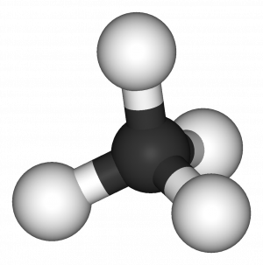

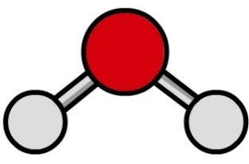
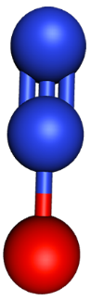
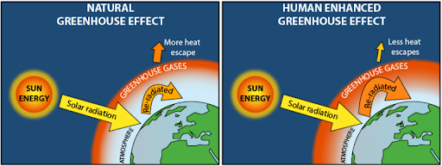
Chemistry of the Atmosphere – Greenhouse Gases
3 (a). Greenhouse gases
3 (b). The greenhouse effect
Greenhouse gases are gases in the atmosphere that increase the temperature of the Earth. They make the Earth warm enough to support life.
There are 3 greenhouse gases you need to know:
Water vapour
Carbon dioxide
Methane
The greenhouse effect is how the Earth is warmed by greenhouse gases.
How it works:
H
Electromagnetic radiation passes through the Earth’s atmosphere.
The Earth absorbs most of the radiation and heats up.
The Earth emits infrared radiation.
Some of the infrared radiation goes into space.
Greenhouse gases absorb the infrared and release energy in all directions. This warms up the Earth’s lower atmosphere.
C
H
O
O
H
H
C
H
O
O
N
N
O
The carbon footprint of something is the total amount of greenhouse gases it produces during its lifetime.
To calculate the carbon footprint of an object (e.g. a car), you have to consider the greenhouse gases released when …
… mining and transporting the parts.
… generating electricity to power it.
… using the object.
… the object is disposed of/recycled.
To calculate the carbon footprint of a person, you have to consider the greenhouse gases released when …
… they use electricity/boilers at home.
… they use transport (e.g. cars, planes).
… they eat beef or rice (releases methane).
Natural Greenhouse Effect
This is the emission of greenhouse gases through natural causes. Carbon dioxide is produced through respiration of animals and volcanic activity. Methane is produced through the formation of coal and decomposition (usually in wetlands).
Enhanced Greenhouse Effect
This is overproduction of greenhouse gases due to human activities. Carbon dioxide is released through deforestation and the burning of fossil fuels (coal, oil, and gas). Methane is released through the decomposition of landfills, burning biomass and digestive emissions from cattle. Nitrous oxides are released through car exhaust fumes and fertilisers used on farms.
It can be difficult to reduce your carbon footprint (e.g. if you are too far away from work to cycle/walk).
http://www.plankton-bloom.com/basic-concepts-2/c02-sequestration/

Slide 3
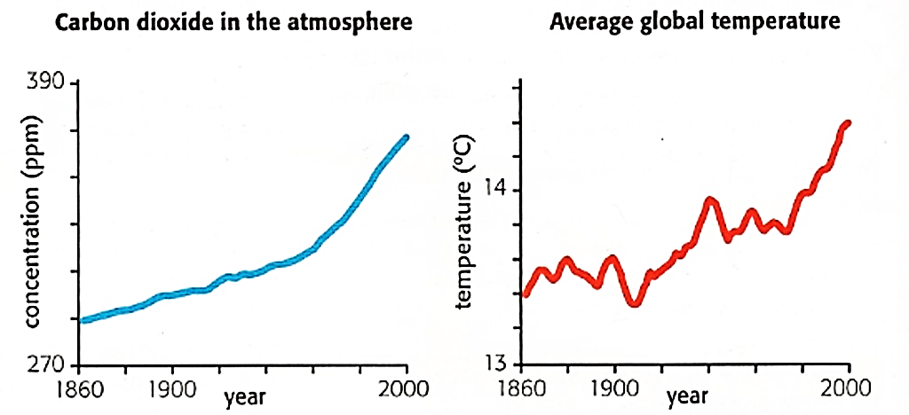
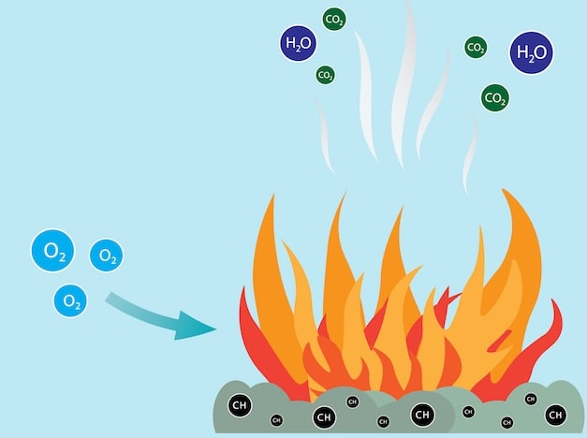
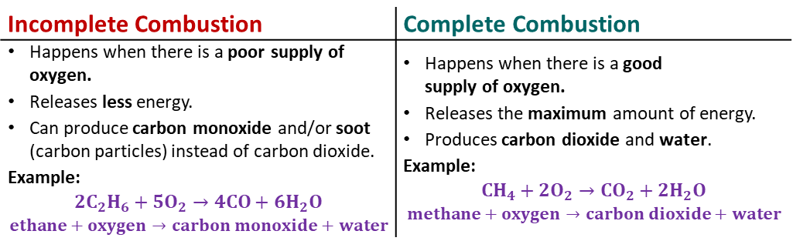
The different pollutants have different effects and sources:
Chemistry of the Atmosphere – Climate Change and Pollution
4. Climate change
5. Pollutants and their sources
Global warming describes how the Earth’s temperature has risen in the past 200 years.
Climate change is the long-term alteration of the Earth’s climate.
Based on peer-reviewed evidence, most scientists believe that human activities will result in global climate change due to Earth getting warmer.
However, this is difficult to model, which leads to lots of speculation and opinion in the media that may be biased.
The main evidence that humans are causing global warming is the strong correlation between the rise of CO₂ levels due to human activities and the rise in global temperature:
Pollutant | Source | Effect
carbon dioxide (CO₂) | Complete combustion | Greenhouse gas
carbon monoxide (CO) | Incomplete combustion | Poisonous, odourless and colourless gas
soot (C) | Incomplete combustion | Irritates lining of the lungs, can cause cancer
unburned hydrocarbons | Hydrocarbon fuel molecules which have not been oxidised | Reacts with other pollutants to create ozone (in smog)
sulphur dioxide (SO₂) | Combustion of fuel that contains sulphur | Causes acid rain, which harms the environment
nitrogen oxides (NO_{X}) | Inside vehicle engines | Causes acid rain and smog (harmful to health)
Combustion is the burning of fuels. It is a major contribution to atmospheric pollutants.
Burning fuels may release carbon dioxide, water vapour, carbon monoxide, sulphur dioxide and nitrous oxides.
There are 2 types of combustion:
When evaluating the quality of evidence on an issue like global warming, you should consider:
Who did the research.
Who funded the research.
What methods were used to collect and analyse the data.
Which organisation is reporting/publishing the evidence.
Incomplete Combustion | Complete Combustion
Happens when there is a poor supply of oxygen. Releases less energy. Can produce carbon monoxide and/or soot (carbon particles) instead of carbon dioxide. Example: $$2C_{2}H_{6}+5O_{2}→4CO+{6H}_{2}O$$ $$ethane+oxygen→carbon monoxide+water$$ | Happens when there is a good supply of oxygen. Releases the maximum amount of energy. Produces carbon dioxide and water. Example: $$CH_{4}+2O_{2}→CO_{2}+{2H}_{2}O$$ $$methane+oxygen→carbon dioxide+water$$
https://cursoparalaunam.com/reacciones-de-combustion

