Slide 1
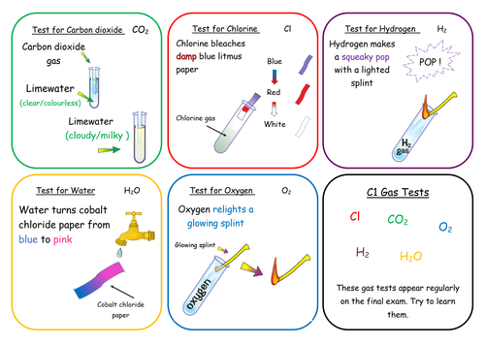
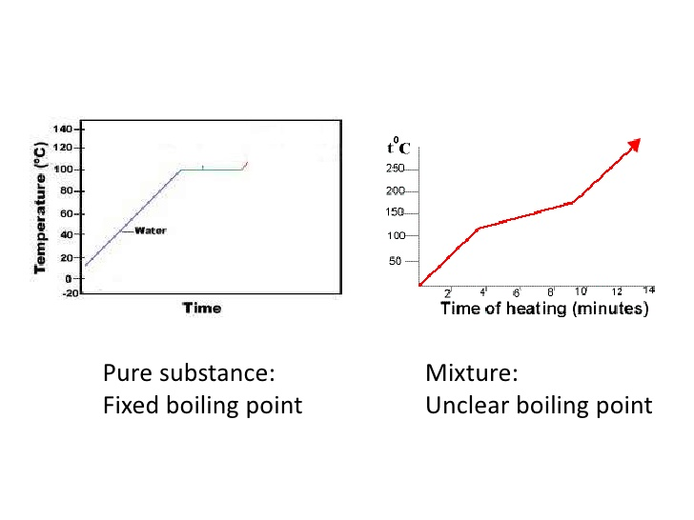
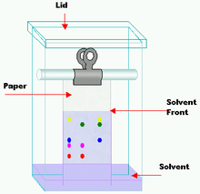
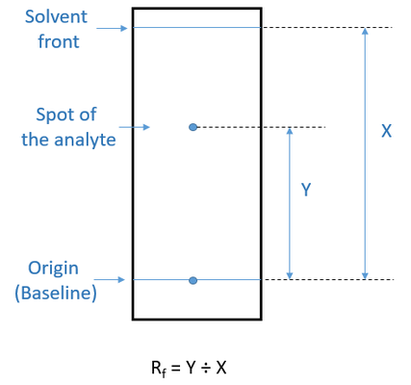
CHEMICAL ANALYSIS
Formulations
A formulation is a mixture that has been designed as a useful product.
Many products are complex mixtures in which each chemical has a particular purpose.
Formulations are made by mixing the components in carefully measured quantities to make sure the product has the required properties.
Fuels Cleaning agents Paints Medicines Alloys Fertilisers Foods
Pure Substances
In chemistry a pure substance is a single element or compound, not mixed with any other substance.
Pure elements and compounds melt and boil at specific temperatures.
Melting point and boiling point data can be used to distinguish pure substances from mixtures
In advertising a pure substance can mean a substance that has had nothing added to it (in its natural state)
Testing Gases
Chromatography
Chromatography can be used to separate mixtures and can give information to help identify substances.
Chromatography involves a stationary phase (where the molecules can’t move – the paper) and a mobile phase (where the molecules can move – the liquid called the solvent)
Separation depends on the distribution of substances between the phases. The chemicals in a mixture spend different amounts of time dissolved in the mobile phase and stuck to the stationary phase.
The Rf value of a chemical is the ratio between the distance travelled by the dissolved substance (the solute) and the distance travelled by the solvent
Rf = Distance moved by substance
Distance moved by solvent
Different compounds have different Rf values in different solvents which can be used to help identify the compounds
The compounds in a mixture may separate into different spots depending on the solvent but a pure substance will produce a single spot in all solvents
REQUIRED PRACTICAL: Investigate how paper chromatography can be used to separate and tell the difference between coloured substances. (place spot of mixture on chromatography paper and place in solvent. When the solvent moves up the paper the mixture will separate into spots. Calculate the Rf value of each spot)

Slide 2
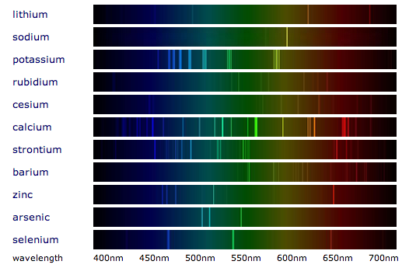
CHEMICAL ANALYSIS (CHEMISTRY)
REQUIRED PRACTICAL: Use chemical tests to identify the ions in unknown single ionic compounds (the cation and the anion)
Testing Cations
Metal Hydroxides
Sodium hydroxide can be used to identify some metal ions (cations)
They form metal hydroxide precipitates
Flame tests
Flame tests can be used to identify some metal ions (cations)
If a sample contains a mixture of ions then some flame colours can be masked
Metal Ion | Colour of Precipitate | Ionic equation for precipitate
Calcium Ca²⁺ | White | Ca²⁺ _{(aq)} + 2OH⁻ _{(aq)} → Ca(OH)_{2 (s)}
Copper (II) Cu²⁺ | Blue | Cu²⁺ _{(aq)} + 2OH⁻ _{(aq)} → Cu(OH)_{2 (s)}
Iron (II) Fe²⁺ | Green | Fe²⁺ _{(aq)} + 2OH⁻ _{(aq)} → Fe(OH)_{2 (s)}
Iron (III) Fe³⁺ | Brown | Fe³⁺ _{(aq)} + 3OH⁻ _{(aq)} → Fe(OH)_{3 (s)}
Aluminium Al³⁺ | White but then re dissolves to form a colourless solution | Al³⁺ _{(aq)} + 3OH⁻ _{(aq)} → Al(OH)_{3 (s)}
Magnesium Mg²⁺ | White | Mg²⁺ _{(aq)} + 2OH⁻ _{(aq)} → Mg(OH)_{2 (s)}
Metal Ion | Flame Colour
Lithium | Crimson
Sodium | Yellow
Potassium | Lilac
Calcium | Orange-red
Copper | Green
Testing Anions
Halides
Adding Halides to silver nitrate solution (with nitric acid) produce precipitates of silver halides
Carbonates
Carbonates react with dilute acids to form carbon dioxide gas.
Carbon dioxide can then be tested for using limewater
Na₂CO₃ _{(aq)} + 2HCl _{(aq)} → CO₂ _{(g)} + 2NaCl _{(aq)} + H₂O _{(l)}
Halide | Colour of Precipitate in acidified silver nitrate | Ionic equation for precipitate
Chloride Cl⁻ | White | Ag⁺ _{(aq)} + Cl⁻ _{(aq)} → AgCl _{(s)}
Bromide Br⁻ | Cream | Ag⁺ _{(aq)} + Br⁻ _{(aq)} → AgBr _{(s)}
Iodide I⁻ | Yellow | Ag⁺ _{(aq)} + I⁻ _{(aq)} → AgI _{(s)}
Sulphates
Sulphate ions in solution produce a white precipitate with barium chloride solution (in the presence of dilute HCl)
The precipitate is Barium Sulphate
Ba²⁺ _{(aq)} + SO₄²⁻ _{(aq)} → BaSO₄ _{(s)}
Flame emission spectroscopy
Used to analyse metal ions in solution
The sample is put into a flame and the light given out is passed through a spectroscope.
The output is a line spectrum that can be analysed to identify the metal ions in the solution and measure their concentrations
The line spectrum is unique for every ion – so you compare the pattern you get with known samples to identify the correct ion.
Instrumental Analysis
Advantages over chemical testing: They produce fast, sensitive and accurate means of analysing chemicals and are particularly useful when the amount of chemical being analysed is small.

