Slide 1
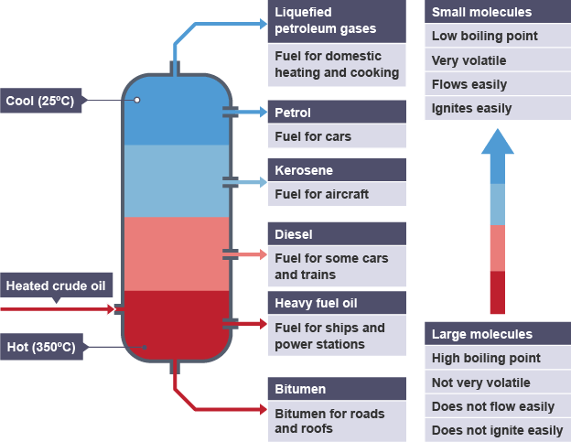
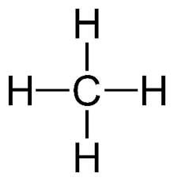
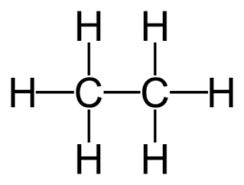
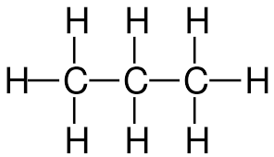
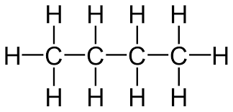
1. Hydrocarbons
Crude oil is a finite resource found in rocks. Crude oil is the remains of an ancient biomass consisting mainly of plankton that was buried in mud. Crude oil is a mixture of a very large number of compounds. Most of the compounds in crude oil are hydrocarbons, which are molecules made up of hydrogen and carbon atoms only.
Most of the hydrocarbons in crude oil are hydrocarbons called alkanes. Alkanes are hydrocarbons that contain no double bonds between the carbon atoms. We say they are saturated.
An homologous series is a family of molecules that all have the same general formula and have chemical properties that are similar.
The general formula for the homologous series of alkanes is CnH2n+2. Each alkane differs from the one before as it has an extra CH₂ added to it. The lines in the structural formula diagrams represent covalent bonds.
Organic Chemistry – Combined Science Paper 2
2. Fractional Distillation
Fractional distillation separates the fractions (parts of the mixture) of crude oil based on their chain lengths. The fractions can be processed to produce fuels and feedstock (raw materials for an industrial process) for the petrochemical industry.
During the fractional distillation of crude oil:
Crude oil is heated until it vaporises and then enters a tall fractionating column, which is hot at the bottom and gets cooler towards the top
Vapours from the oil rise through the column
Vapours condense when they become cool enough
Liquids are led out of the column at different heights
Small hydrocarbon molecules have weak intermolecular forces, so they have low boiling points. They do not condense, but leave the column as gases. Long hydrocarbon molecules have stronger intermolecular forces, so they have high boiling points. They leave the column as hot liquid bitumen.
4 Cracking of Hydrocarbons
Hydrocarbons can be broken down (cracked) to produce smaller, more useful molecules. Cracking can be done in two ways:
Catalytic cracking needs a temperature of 550°C and a catalyst of aluminium oxide.
Steam cracking uses a higher temperature of over 800°C and no catalyst
The products of cracking include alkanes and another type of hydrocarbon called alkenes. Alkenes unsaturated and are more reactive than alkanes. They react with orange bromine water to turn it colourless. This is the test for alkenes.
For example, hexane can be cracked to form butane and ethene:
hexane → butane + ethene
C₆H₁₄ → C₄H₁₀ + C₂H₄
Cracking is important for two main reasons:
It helps to match the supply of small fractions with the demand for them as fuels.
Alkenes are used to produce polymers and as starting materials for the production of many other chemicals.
3 Properties of Hydrocarbons
The boiling point, viscosity and flammability of hydrocarbons depends on their chain length, as shown in the diagram above. These properties influence how hydrocarbons are used as fuels.
The combustion of hydrocarbon fuels releases energy. During combustion, the carbon and hydrogen in the fuels are oxidised.
hydrocarbon + oxygen → carbon dioxide + water
For example, the complete combustion of propane:
C₃H₈ + 5O₂ → 3CO₂ + 4H₂O
Alkane | Molecular formula | Structural formula
Methane | CH₄
Ethane | C₂H₆
Propane | C₃H₈
Butane | C₄H₁₀

Slide 2
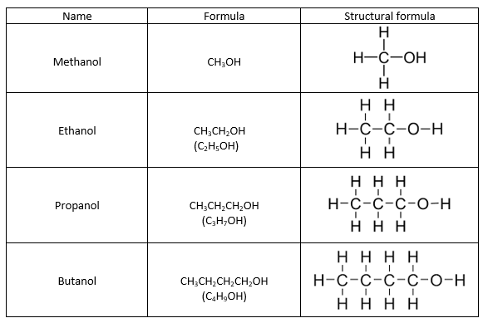
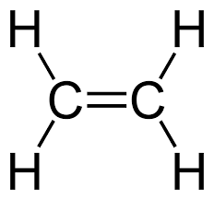
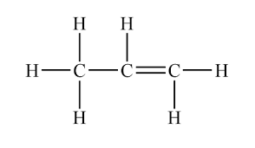
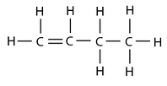
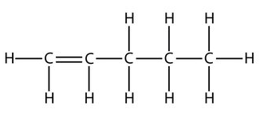



5. Alkenes
Alkenes are hydrocarbons with a double carbon-carbon bond, C=C , this is the their functional group. A functional group are the atoms that determine the reactions of organic compounds. The general formula for the homologous series of alkenes is CnH2n Alkene molecules are unsaturated because they contain two fewer hydrogen atoms than the alkane with the same number of carbon atoms.
Alkenes react with oxygen in combustion reactions in the same way as other hydrocarbons, but they tend to burn in air with smoky flames because of incomplete combustion.
The functional group, C=C, allows alkenes to undergo addition reactions with halogens, hydrogen or water.
Alkene + halogen → halogenoalkane
Chlorine, bromine or iodine can be added to an alkene. These reactions are usually spontaneous e.g.
Ethene + chlorine → dichloroethane
Alkene + hydrogen → alkane
This is called hydrogenation, and it needs a catalyst e.g.
Propene + hydrogen → propane
Alkene + water (steam) → alcohol
This is called hydration. It needs a temperature of approximately 300°C and a catalyst. e.g.
Organic Chemistry – Separate Chemistry Paper 2
6. Alcohols
Alcohols contain the functional group –OH.
Ethanol can be produced by fermentation which is an anaerobic process in yeast:
glucose → ethanol + carbon dioxide
The typical conditions needed for fermentation include:
sugars dissolved in water, and mixed with yeast
an air lock to allow carbon dioxide out, while stopping air getting in
warm temperature, 25-35°C
Uses of alcohols:
Methanol is used as a chemical feedstock. It’s toxic, so it’s added to industrial ethanol (methylated spirits) to prevent people from drinking it. Ethanol is the alcohol present in alcoholic drinks. It is also used as a fuel and a solvent. Propanol and butanol are also used as solvents and fuels.
Combustion
ethanol + oxygen → carbon dioxide + water
C₂H₅OH + 3O₂ → 2CO₂ + 3H₂O
When less oxygen is present, incomplete combustion will occur, producing H₂O and either CO₂ or CO.
Reactions with sodium
sodium + ethanol → sodium ethoxide + hydrogen
2Na + 2C₂H₅OH → 2C₂H₅ONa + H₂
Methanol, propanol and butanol undergo similar reactions
Alkene | Molecular formula | Structural formula
Ethene | C₂H₄
Propene | C₃H₆
Butene | C₄H₈
Pentene | C₅H₁₀
Alcohols continued…
Solubility in water:
When the alcohols with the shortest hydrocarbon chains are added to water, they mix easily to produce a solution. However, the solubility decreases as the length of the alcohol molecule gets longer, so butanol is less soluble than propanol. It may not mix easily, and two distinct layers might be left in the container.
Oxidation of alcohols
Alcohols can be oxidised without combustion to produce carboxylic acids. E.g. ethanol can be oxidised to ethanoic acid using an oxidising agent.
ethanol + oxidising agent → ethanoic acid + water
CH₃CH₂OH + 2[O] → CH₃COOH + H₂O
Each of the two oxygen atoms provided by the oxidising agent are shown as [O]. Notice that the left-hand side of the ethanol molecule is unchanged. The reaction involves the -OH group on the right-hand side

Slide 3
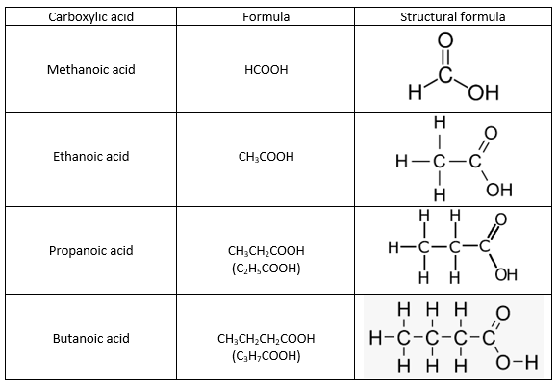
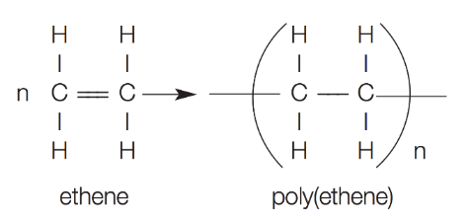
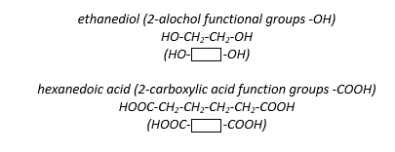

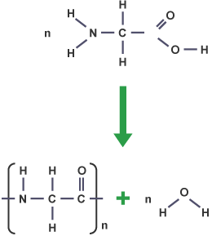
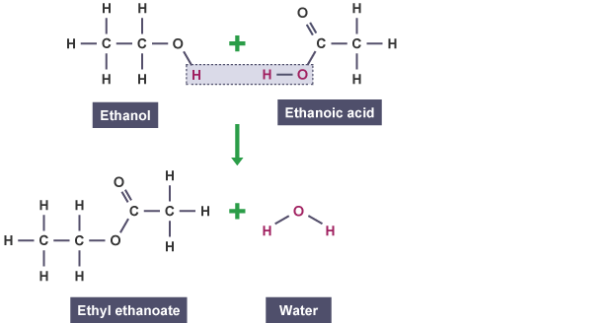
7. Carboxylic Acids
Carboxylic acids have the functional group –COOH.
The carboxylic acids have the typical properties of acids due to the –COOH functional group. For example, they:
dissolve in water to form acidic solutions with pH values less than 7
react with metals to form a salt and hydrogen
react with bases to form a salt and water
react with carbonates to form a salt, water and carbon dioxide
Carboxylic acids can react with alcohols to make esters. Esters are organic compounds which all contain the functional group -COO-. Esters have fruity smells and can be used as solvents.
The general equation for the formation of an ester is:
alcohol + carboxylic acid → ester + water
For example:
ethanol + ethanoic acid → ethyl ethanoate + water
Organic Chemistry – Separate Chemistry Paper 2
8. Addition Polymerisation
Alkenes can be used to make polymers such as poly(ethene) and poly(propene) by addition polymerisation. In addition polymerisation reactions, many small molecules (monomers) join together to form very large molecules (polymers). For example:
In addition polymers the repeating unit has the same atoms as the monomer because no other molecule is formed in the reaction.
Carboxylic Acids continued…
Carboxylic acids are weak acids. This means that their solutions do not contain many hydrogen ions compared with a solution of a strong acid with the same concentration. The pH of a weak acid will be higher than the pH of a strong acid, with the same concentrations. In a solution of a strong acid, the molecules are fully ionised, but in a weak acid, very few of the molecules are ionised.
9. Condensation Polymerisation
Condensation polymerisation involves monomers with two functional groups (OH, COOH, COO). When these types of monomers react they join together, usually losing small molecules such as water, and so the reactions are called condensation reactions. The simplest polymers are produced from two different monomers with two of the same functional groups on each monomer.
Example (notice the repeating units) –
polymerise to produce a polyester:
and
10. Amino Acids
Amino acids are molecules which have at least two functional groups. All amino
acids contain the -NH₂ group and also the carboxylic acid group -COOH. Amino
acids are polymerised in cells to make polypeptides and proteins.
Amino acids react by condensation polymerisation so for every monomer which
is added to the growing polymer chain, one molecule of water is also produced.
For example, glycine is the simplest amino acid. An equation for the formation
of a polypeptide which is made only from glycine is:
n glycine → poly(glycine) + water
n H₂NCH₂COOH → (-HNCH₂CO-)_{n} + n H₂O

Slide 4
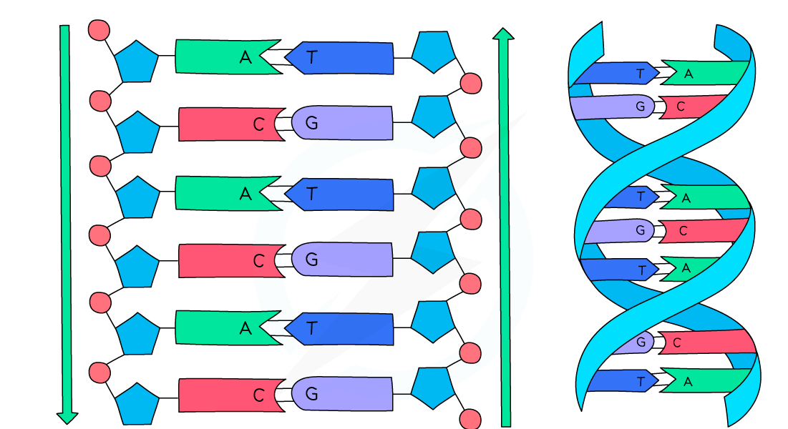
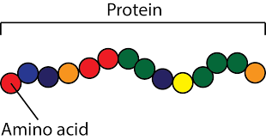
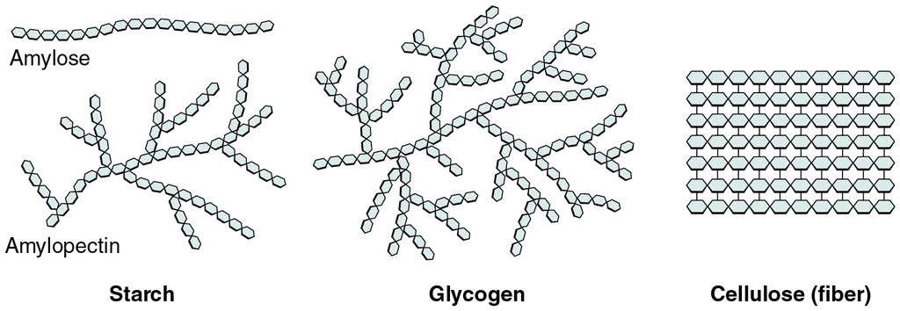
11. DNA and other Naturally Occurring Polymers
DNA (deoxyribonucleic acid) is a large molecule essential for life. DNA encodes genetic instructions for the development and functioning of living organisms and viruses. Most DNA molecules are two polymer chains, made from four different monomers called nucleotides, in the form of a double helix.
Proteins are biological polymers made inside cells. They are made from amino acid monomers and have a huge range of roles inside living things. For example, all enzymes are made from proteins.
Starch and cellulose are biological polymers which are made by plants. The monomers for both starch and cellulose are sugar molecules. Starch is used by plants as a way of storing energy as a complex carbohydrate. Cellulose is used to make the strong cell wall which gives plant cells (and therefore plants) strength.

