Slide 1
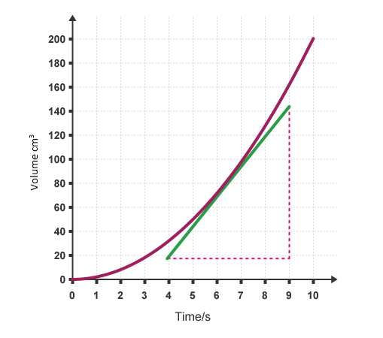
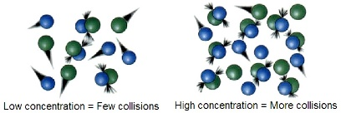
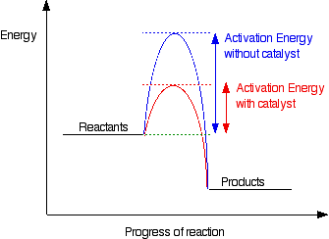
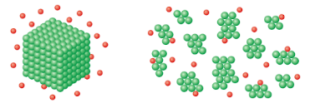
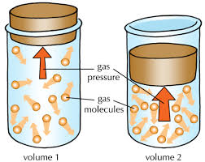
The rate and extent of chemical change
Calculating the rate of reaction from a graph
Calculating rates of reaction
Draw a tangent – this is a straight line that touches a curved surface but does not cross the curve at any point
Complete a triangle using your tangent
Use you scale to calculate the width and height of your graph (x & y)
Calculate the rate of reaction by diving the height by the width of the triangle.
Chemicals used in a reaction are called reactants
Chemicals formed in a reaction are called products
The quantity of reactant or product can be measured by mass in grams, volume in cm³ or moles (mol) HT only
How fast a chemical reaction proceeds is referred as a reactions rate
The equations for calculating rate are –
mean rate of reaction = quantity of reactant used ÷ time taken
mean rate of reaction = quantity product formed ÷ time taken
The units for mean rate of reaction can be g/s or cm³/s
To calculate the mean rate of reaction in an experiment where a colour change is timed the following equation is used –
mean rate of reaction = 1 ÷ time taken
Rate = 120 ÷ 5
Rate = 24cm³/s
y=120
X=5
Catalysts
Catalysts can be added to a reaction to change the rate of reaction
Catalysts are not used up by the reaction and do not change the products of the reaction
Different reactions need different catalysts
Enzymes act as catalyst in biological systems
Catalysts increase the rate of reaction by providing an alternative pathway that requires a lower amount of activation energy
Collision theory and activation energy
Chemical reactions occur when particles of the reactants collide with sufficient energy
The energy needed for a chemical reaction to occur is called the activation energy
Increasing the concentration of a reactant increases the number of particles present. If more particles are present, then there will be more collisions. If there are more collisions, then the rate of reaction will be greater.
Increasing the pressure of gases can be achieved in different ways. Firstly, increasing amount of a gas in a container, secondly, decreasing the size of the container and thirdly, by heating up the particles. All of these methods will increase the pressure by increasing the number of collisions with the container. The particles them selves will also collide more often. This will lead to a greater rate of reaction.
Increasing the temperature increases the particles energy. If particles have more energy they move faster. If particles are moving faster, they are more likely to collide and will also collide more energetically. This increases the rate of reaction.
Calculating surface area to volume ratio
Cutting solid reactants into smaller pieces increase the surface area to volume ratio. Increasing the surface area of solids by cutting solids into smaller pieces reveals more particles of the solid. This increases the number of particles colliding. The greater the number particles colliding the greater the rate of reaction.
Calculate the surface area of the reactant (Area of 1 side x number of sides)
Calculate the volume of the reactant (length x width x height)
Calculating a ratio using the surface area and volume
e.g.
Surface are = 10cm²
Volume= 2cm³
Ratio= 5:1

Slide 2
The rate and extent of chemical change
Energy changes and reversible reactions
Reversible reactions
If a reversible reaction is exothermic in one direction it is endothermic in the opposite direction. The same amount of energy is transferred in each case.
A + B ⇌ C + D
In this example the reaction is exothermic (releases heat energy/gets hotter) when A and B react to form C and D. The reaction is endothermic (takes in heat energy/gets colder) when C and D react to form A and B.
In some reactions the products of the reaction can react to form the original reactants
We show reversible reactions by using the ⇌ symbol
We can change the direction of a reversible reaction by changing the conditions of the reaction
A + B ⇌ C + D
This shows that the reactants A and B react to form products C and D. The example also shows that the products C and D react together to form the reactants A and B.
Exothermic
Endo
Changing temperature
If we increase the temperature the reaction will move in endothermic direction
If we decrease the temperature the reaction will move in the exothermic direction
A + B ⇌ C + D
In this example we will make more of A and B if we increase the temperature. We can say that the reaction moves in the endothermic direction
We will make more of C and D if we decrease the temperature. We can say that the reaction moves in the endothermic direction.
If we decrease the temperature too much the rate of reaction will be very slow (see collision theory & activation energy). To prevent this from happening scientists often have to compromise by reducing the temperature to a point where the rate of reaction is still suitable.
Exothermic
Equilibrium
Endo
If a reversible reaction takes place in a sealed container, that prevents the escape of reactants or products, it will reach equilibrium when the rate of the forward and reverse reaction is equal.
The effect of changing conditions on equilibrium
Changing the conditions of a reaction that has reached equilibrium will cause the reaction to respond and counteract the change
The conditions that can be changed are temperature, pressure, and concentration.
Changing concentration
Changing pressure
If the concentrations of one of the reactants or products is changed then the reaction will no longer be at equilibrium
If a reaction is no longer at equilibrium the concentrations of all the substances involved in the reaction will change until a new equilibrium is found
If the concentration of a reactant is increased more products will be formed until a new equilibrium is reached
If the concentration of a product is increased more reactants will be formed until a new equilibrium is reached
N₂ + 3H₂ ➔ 2NH₃
If we increase the pressure in a reaction involving gases the reaction will move to the side with the fewest molecules of gas. In this example there are only 2 Molecules of NH₃ so the reaction will move to the right.
If we decrease the pressure in a reaction involving gases the reaction will move to the side with the most molecules of gas. In this example there is 1 molecule of N₂ and 3 molecules of H₂ (4 in total) so the reaction would move to the left.

