Slide 1
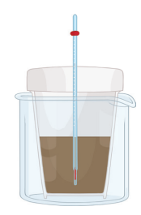
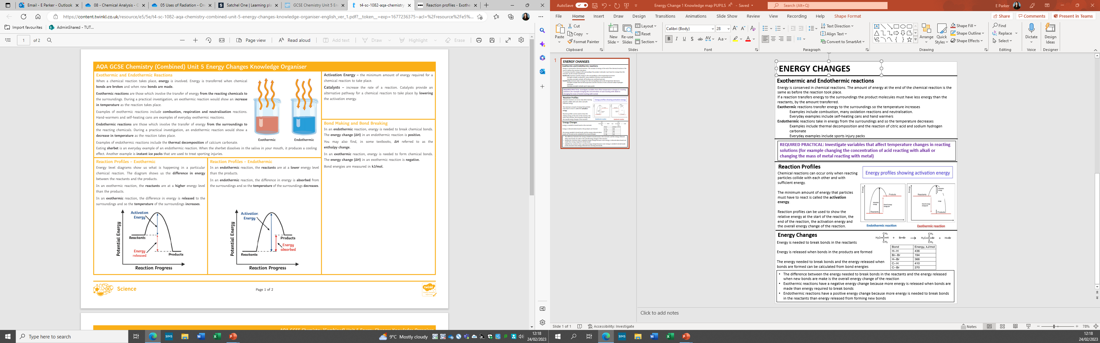
Exothermic & Endothermic Reactions
Exothermic reactions transfer energy to the surroundings and the temperature of the surroundings increases. Endothermic reactions take in energy and the temperature of the surroundings decreases.
Examples of exothermic reactions include:
combustion reactions
many oxidation reactions
most neutralisation reactions
Everyday uses of exothermic reactions include self-heating cans and hand warmers.
Examples of endothermic reactions include:
thermal decomposition reactions
the reaction of citric acid and sodium hydrogen carbonate
Everyday uses of endothermic reactions include instant ice packs which can be used to treat sports injuries.
Energy Changes – Paper 1 Chemistry
Bond Energy (Higher tier only)
During a chemical reaction the difference between the energy needed to break bonds and the energy released when new bonds are made determines the type of reaction.
A reaction is exothermic if more heat energy is released in making bonds in the products than is taken in when breaking bonds in the reactants. It is endothermic if less heat energy is released in making bonds in the products than is taken in when breaking bonds in the reactants
To calculate an energy change for a reaction:
add together the bond energies for all the bonds in the reactants - this is the 'energy in’
add together the bond energies for all the bonds in the products - this is the 'energy out’
energy change = energy in - energy out
Example
Hydrogen + chlorine → hydrogen chloride:
H−H + Cl−Cl → 2 × (H−Cl)
Energy in = 436 + 243 = 679 kJ mol⁻¹
Energy out = (2 × 432) = 864 kJ mol⁻¹
Energy change = 679 - 864 = -185 kJ mol⁻¹
The energy change is negative. This shows that the reaction is exothermic.
Bond | Bond energy
H−H | 436 kJ mol⁻¹
Cl−Cl | 243 kJ mol⁻¹
H−Cl | 432 kJ mol⁻¹
Required Practical: Temperature Change
Aim: To investigate the variables that affect temperature changes in reacting solutions.
Context: You could investigate one or more chemical reactions, for example:
acids reacting with metals, metal carbonates or with alkalis
displacement reactions of metals
Method: Reacting two solutions, e.g. acid and alkali
Place the polystyrene cup inside the glass beaker for stability.
Measure an appropriate volume of each liquid, e.g. 25 cm³.
Place one of the liquids in a polystyrene cup.
Record the temperature of the solution.
Add the second solution and record the highest or lowest temperature obtained.
Change your independent variable and repeat the experiment. Your independent variable could be the concentration of one of the reactants, or the type of acid/alkali being used, or the type of metal/metal carbonate being used.
Analysis: The bigger the temperature change in the reaction, the more energy is absorbed or released. Evaluation
The biggest source of error in this experiment is unwanted heat transfer. Using a lid can help to reduce this.
Hazards, risks and precautions
Reaction Profiles
A reaction profile shows whether a reaction is exothermic or endothermic. It shows the energy in the reactants and products, and the difference in energy between them. It also includes the activation energy, which is the minimum energy needed by particles when they collide for a reaction to occur. The activation energy is shown as a 'hump' in the line, which:
starts at the energy of the reactants
is equal to the difference in energy between the top of the 'hump' and the reactant
The overall change in energy in a reaction is the difference between the energy of the reactants and products.
Exothermic reaction
The energy level decreases in an exothermic reaction. This is because energy is given out to the surroundings.
Endothermic reaction
The energy level increases in an endothermic reaction. This is because energy is taken in from the surroundings.
Hazard | Possible harm | Possible precaution
Dilute acids and alkalis | May irritate the skin or eyes | Avoid contact with skin, rinse off skin if necessary, wear eye protection
Solutions of metal salts (used in displacement reactions) | Dangerous to the environment | Dispose of metal salt solutions as advised by teacher.

Slide 2
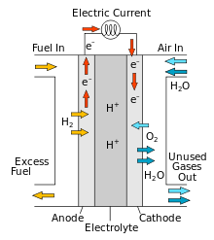
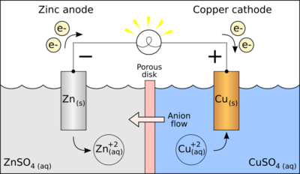
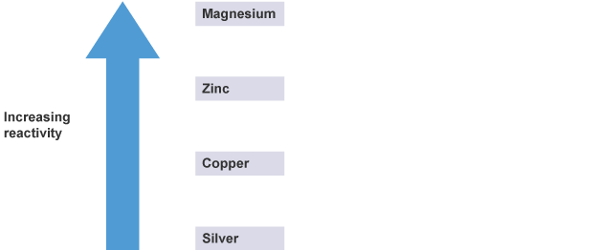
Chemical Cells – Separate Chemistry Only
Chemical cells use chemical reactions to transfer energy by electricity. The voltage of a cell depends upon a number of factors, including what the electrodes are made from, and the substance used as the electrolyte.
A simple cell can be made by connecting two different metals in contact with an electrolyte. A number of cells can be connected in series to make a battery, which has a higher voltage than a single cell.
In non-rechargeable cells, eg alkaline cells, a voltage is produced until one of the reactants is used up. When this happens, we say the battery ‘goes flat’.
In rechargeable cells and batteries, like the one used to power your mobile phone, the chemical reactions can be reversed when an external circuit is supplied.
If we connect different combinations of these metals to make a cell, we find that the voltage changes.
Swapping the two electrodes means that the recorded voltage becomes negative. The biggest voltage occurs when the difference in the reactivity of the two metals is the largest. A cell made from magnesium and copper has a higher voltage than magnesium and zinc, for example.
Fuel Cells – Separate Chemistry Only
Fuel cells work in a different way than chemical cells. Fuel cells produce voltage continuously, as long as they are supplied with:
a constant supply of a suitable fuel
oxygen, eg from the air
The fuel is oxidised electrochemically, rather than being burned, so the reaction takes place at a lower temperature than if it was to be burned. Energy is released as electrical energy, not thermal energy (heat).
Hydrogen-oxygen fuel cells
Hydrogen-oxygen fuel cells are an alternative
to rechargeable cells and batteries.
In a hydrogen-oxygen fuel cell, hydrogen and
oxygen are used to produce a voltage.
Water is the only product.
The overall reaction in a hydrogen-oxygen fuel
cell is:
hydrogen + oxygen → water
2H₂(g) + O₂(g) → 2H₂O(l)
Electrode half equations - Higher
At the negative electrode:
2H₂ + 4OH⁻ → 4H₂O + 4e⁻
At the positive electrode:
O₂ + 2H₂O + 4e⁻ → 4OH⁻
When you add these two half equations together, you get the following overall equation:
2H₂ + 4OH⁻ + O₂ + 2H₂O + 4e⁻ → 4H₂O + 4e⁻ + 4OH⁻
The hydroxide ions, electrons and two H₂O molecules will now cancel because they are on both sides, leaving the overall equation:
2H₂ + O₂ → 2H₂O
Type of cell | Pros | Cons
Alkaline cell | Cheaper to manufacture | May end up in landfill sites once fully discharged; recyclable though it is expensive
Rechargeable cell | Can be recharged many times before being recycled, reducing the use of resources | Costs more to manufacture
Hydrogen fuel cell | Easy to maintain as there are no moving parts; small size; water is the only chemical product | Very expensive to manufacture; need a constant supply of hydrogen fuel, which is a flammable gas
Evaluating Cells – Separate Chemistry Only
Fuel cells have different strengths and weaknesses, depending on the intended use. For example, fuel cells are used in spacecraft and vehicles.
Fuel cells in spacecraft
Hydrogen-oxygen fuel cells are used in spacecraft. In addition to the strengths in the table above, the water they produce is useful as drinking water for astronauts.
Hydrogen-oxygen fuel cells must be supplied with hydrogen fuel and oxygen. This could be a problem once a spacecraft leaves the Earth. However, spacecraft in orbit, such as the International Space Station, have solar cells. These convert light into electricity, so the hydrogen and oxygen can be replaced by the electrolysis of water.
Solar cells only work when they are in the light, so the fuel cells allow electricity to be produced even when the spacecraft is in the dark.

