Slide 1
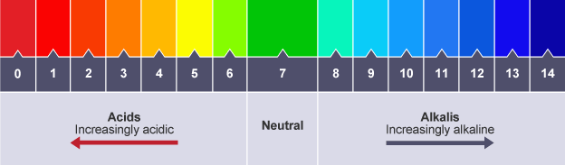
Chemical Changes – Combined Science
Extracting iron and copper
Unreactive metals such as gold are found in the Earth's crust as the uncombined elements. However, most metals are found combined with other elements to form compounds.
Most metals are extracted from ore found in the Earth's crust. An ore is a rock that contains enough of a metal or a metal compound to make extracting the metal worthwhile.
Extraction methods
The extraction method used depends upon the metal's position in the reactivity series. In principle, any metal could be extracted from its compounds using electrolysis. However, large amounts of electrical energy are needed to do this, so electrolysis is expensive.
If a metal is less reactive than carbon, it can be extracted from its compounds by heating with carbon. Copper is an example of this.
Copper oxide + carbon → copper + carbon dioxide
2CuO(s) + C(s) → 2Cu(l) + CO₂(g)
Copper oxide is reduced as carbon is oxidised, so this is an example of a redox reaction.
Metal | Reaction with cold water | Reaction with dilute acids | Reactivity | Extraction method
Potassium | Violent | Violent | Most reactive Least reactive | Electrolysis
Sodium
Lithium
Calcium | Fast | Rapid
Magnesium | Very slow
Aluminium | no reaction | Slow
(carbon)
Zinc | no reaction | Slow |  | Heating with carbon
Iron | Rusts slowly
(Hydrogen)
Copper | No reaction | No reaction |  | Heating with carbon
Gold |  |  |  | Found pure
A base is any substance that reacts with an acid to form a salt and water only. This means that metal oxides and metal hydroxides are bases.
Bases that are soluble in water are called alkalis and they dissolve in water to form alkaline solutions. For example:
copper oxide is a base, but it is not an alkali because it is insoluble in water
sodium hydroxide is a base, and it dissolves in water so it is also an alkali
The pH Scale and Neutralisation
Acids produce hydrogen ions (H+ ) in aqueous solutions. Aqueous solutions of alkalis contain hydroxide ions (OH– ). The pH scale, from 0 to 14, is a measure of the acidity or alkalinity of a solution, and can be measured using universal indicator or a pH probe. A solution with pH 7 is neutral. Aqueous solutions of acids have pH values of less than 7 and aqueous solutions of alkalis have pH values greater than 7. In neutralisation reactions between an acid and an alkali, hydrogen ions react with hydroxide ions to produce water. This reaction can be represented by the equation:
H⁺(aq) + OH⁻(aq) → H₂O(l)
Strong & Weak Acids – Higher Tier Only
A strong acid is completely ionised in aqueous solution. Examples of strong acids are hydrochloric, nitric and sulfuric acids. A weak acid is only partially ionised in aqueous solution. Examples of weak acids are ethanoic, citric and carbonic acids. For a given concentration of aqueous solutions, the stronger an acid, the lower the pH. As the pH decreases by one unit, the hydrogen ion concentration of the solution increases by a factor of 10.
The Reactivity Series
When metals react with other substances the metal atoms form positive ions.
The reactivity of a metal is related to its tendency to form positive ions.
Metals can be arranged in order of their reactivity in a reactivity series.
The metals potassium, sodium, lithium, calcium, magnesium, zinc, iron and copper can be put in order of their reactivity from their reactions with water and dilute acids.
The non-metals hydrogen and carbon are often included in the reactivity series.
A more reactive metal can displace a less reactive metal from a compound.

Slide 2
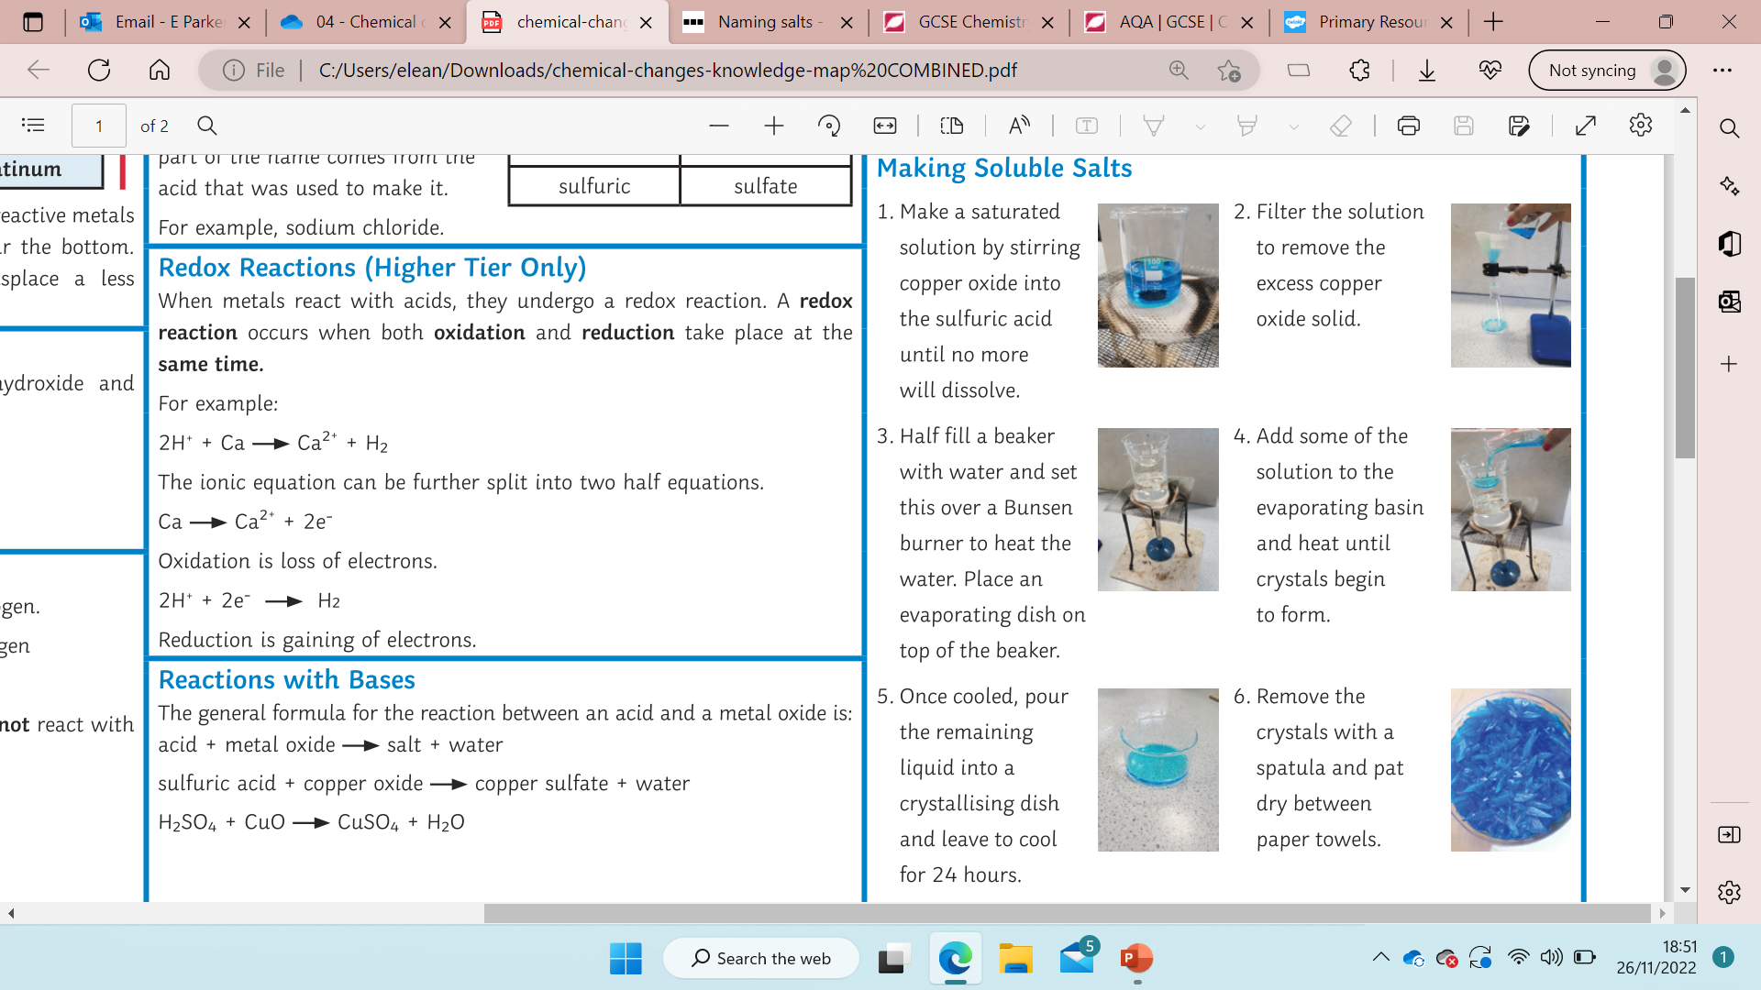
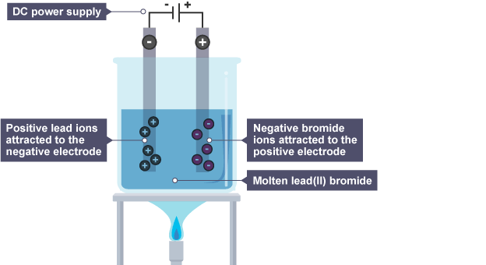
Chemical Changes – Combined Science
Naming Salts
Hydrochloric acid makes chloride salts. Sulphuric acid makes sulphate salts
Nitric acid makes nitrate salts
Reactions with Acid
The general formula for the reaction of an acid and metal is:
Acid + metal → salt + hydrogen
For example:
Hydrochloric acid + magnesium → magnesium chloride + hydrogen
2HCl(aq) + Mg(s) → MgCl₂(aq) + H₂(g)
Acid + metal oxide → salt + water
For example:
Sulfuric acid + copper oxide → copper sulfate + water
H₂SO₄(aq) + CuO(s) → CuSO₄(aq) + H₂O(l)
Alkalis are soluble bases. A salt and water are produced when acids react with alkalis. In general:
Acid + alkali → salt + water
For example:
Nitric acid + sodium hydroxide → sodium nitrate + water
HNO₃(aq) + NaOH(aq) → NaNO₃(aq) + H₂O(l)
The general formula for an acid reacting with a metal carbonate is:
Acid + metal carbonate → salt + carbon dioxide + water
For example:
Hydrochloric acid + calcium carbonate → calcium chloride + carbon dioxide + water
Required practical: making soluble salts
Make a saturated solution by stirring copper oxide into sulphuric acid until no more will dissolve.
Filter the solution to remove excess solid copper oxide.
Half fill a beaker with water and heat it over a Bunsen burner. Place an evaporating dish on top of the beaker.
Add some of the solution to the evaporating basin and heat until crystals begin to form.
Pour the remaining liquid into a crystallising dish and leave to cool for 24 hours.
Remove crystals with a spatula and pat dry between paper towels.
Metal Oxides
Metals can react with oxygen to make compounds called oxides.
The reactions are oxidation reactions because the metal gain oxygen.
Metal oxides are bases. This means they can neutralise an acid.
Non-metal oxides dissolve in water to make acidic solutions
If oxygen is lost from a compound, this is called reduction.
Redox Reactions – Higher tier only
Oxidation is the loss of electrons and reduction is the gain of electrons. Reduction and oxidation happen at the same time, so the reactions are called redox reactions.
The reactions of acids with metals are redox reactions. For example, the ionic equation for the reaction of magnesium with hydrochloric acid is:
2H⁺(aq) + Mg(s) → Mg²⁺(aq) + H₂(g)
This ionic equation can be split into two half equations:
Mg(s) → Mg²⁺(aq) + 2e⁻ (oxidation)
2H⁺(aq) + 2e⁻ → H₂(g) (reduction)
Notice that:
magnesium atoms lose electrons - they are oxidised
hydrogen ions gain electrons - they are reduced
Electrolysis of Molten Compounds
When a simple ionic compound (eg lead bromide) is electrolysed in the molten state using inert electrodes, the metal (lead) is produced at the cathode and the non-metal (bromine) is produced at the anode.
Electrolysis
When an ionic compound is melted or dissolved in water, the ions are free to move about within the liquid or solution. These liquids and solutions are able to conduct electricity and are called electrolytes. Passing an electric current through electrolytes causes the ions to move to the electrodes. Positively charged ions move to the negative electrode (the cathode), and negatively charged ions move to the positive electrode (the anode). Ions are discharged at the electrodes producing elements. This process is called electrolysis.
Using Electrolysis to Extract Metals
Metals can be extracted from molten compounds using electrolysis. Electrolysis is used if the metal is too reactive to be extracted by reduction with carbon or if the metal reacts with carbon. Large amounts of energy are used in the extraction process to melt the compounds and to produce the electrical current. Aluminium is manufactured by the electrolysis of a molten mixture of aluminium oxide and cryolite using carbon as the positive electrode (anode).

Slide 3
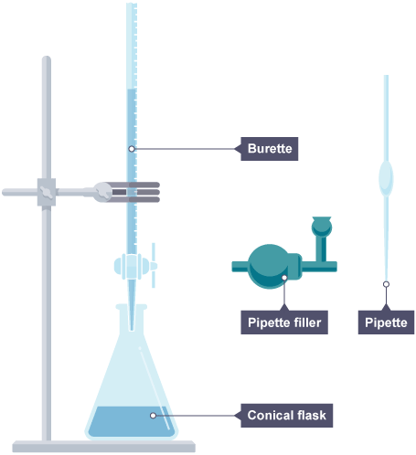
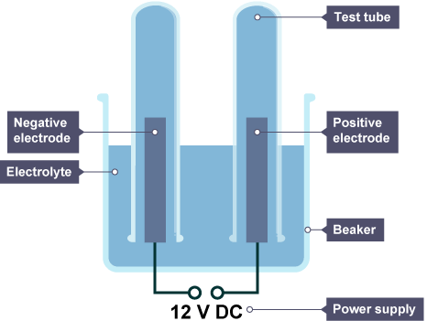
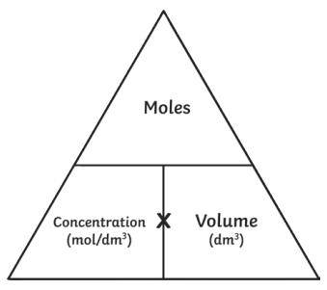
Chemical Changes – Combined Science
Required practical: Electrolysis of Aqueous Solutions
This required practical involves developing a hypothesis.
An investigation starts with a scientific question, for example:
What are the products of electrolysis of aqueous solutions?
Is there a pattern in the products of electrolysis of aqueous solutions?
The first step in answering a scientific question is to develop a hypothesis. A hypothesis is an idea to be tested, which is backed up by scientific knowledge. Suitable hypotheses are:
a non-metal will be produced at the positive electrode because non-metal ions are negative
solutions that include ions of metals that are low in the reactivity series produce the metal at the negative electrode (not hydrogen) because ions of unreactive metals have a greater tendency to gain electrons
The hypothesis can then be used to make predictions, such as 'In the hydrolysis of copper chloride, the product at the positive electrode will be chlorine.'
The set up below is suitable. The positive electrode is connected to the positive terminal of a dc power pack. The negative electrode is connected to the negative terminal of the power pack.
Test solutions
It is best to test at least five solutions. Suitable solutions include copper sulphate, copper chloride, sodium chloride, sodium nitrate, sodium bromide. There are many more.
Identifying the products
Any gases produced can be collected in the test tubes. They need to be stoppered and tested later. Gas tests include:
hydrogen - lighted splint goes out with a squeaky pop
oxygen - a glowing splint relights
chlorine - damp blue litmus paper turns red and is then bleached white
The electrodes need to be examined carefully each time, to see if a metal has been deposited on them.
Electrolysis of Aqueous Solutions
The ions discharged when an aqueous solution is electrolysed using inert electrodes depend on the relative reactivity of the elements involved. At the negative electrode (cathode), hydrogen is produced if the metal is more reactive than hydrogen. At the positive electrode (anode), oxygen is produced unless the solution contains halide ions when the halogen is produced. This happens because in the aqueous solution water molecules break down producing hydrogen ions and hydroxide ions that are discharged.
Required Practical Titration – Chemistry Only
Use the pipette and pipette filler to add 25 cm³ of alkali to a clean conical flask.
Add a few drops of indicator and put the conical flask on a white tile.
Fill the burette with acid and note the starting volume.
Slowly add the acid from the burette to the alkali in the conical flask, swirling to mix.
Stop adding the acid when the end-point is reached (the appropriate colour change in the indicator happens). Note the final volume reading.
The difference between the reading at the start and the final reading gives the volume of acid (or alkali) added. This volume is called the titre.
You can calculate the amount of a substance in moles in a solution if you know the volume and concentration. You can also work out the concentration of an acid reacting with an alkali, or vice versa.
Concentration in mol/dm³ = amount in mol ÷ volume in dm³
Worked example:
In a titration, 20cm3 of 1.0mol/dm3 sulphuric acid reacted with 25cm3 of sodium hydroxide. What was the concentration of sodium hydroxide?
Write out a balanced symbol equation for the reaction:
2NaOH + H₂SO₄ → Na₂SO₄ + 2H₂O
Draw a table as shown and fill in the information given in the question (shown in red)
Work out number of moles of acid,
(shown in blue). The equation tells
us there are twice as many
 | Acid (H₂SO₄) | Alkali (NaOH)
Moles | 0.02 | 0.04
Concentration mol/dm³ | 1.0 | 1.6
Volume dm³ | 0.02 | 0.025
Moles of alkali (0.04). Finally we can work out the concentration (moles/volume = 1.6mol/dam3)

