Slide 1
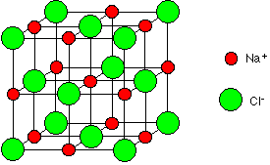
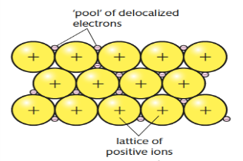
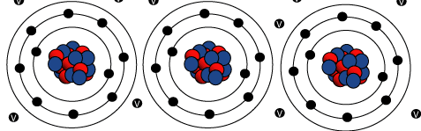
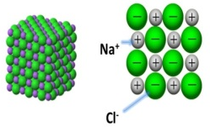
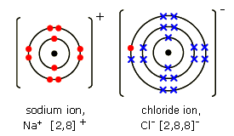
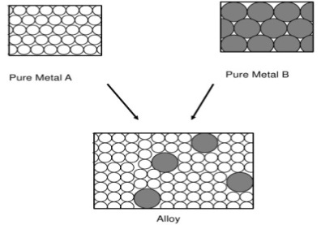
Bonding and Structure 1
PROPERTIES OF IONIC COMPOUNDS
Regular Structures (giant ionic lattices) in which there are strong electrostatic forces of attraction in all directions between oppositely charged ions
High melting and boiling points because of the large amounts of energy needed to break the many strong bonds
When melted or dissolved in water, ionic compounds conduct electricity because the ions are free to move and so charge can flow.
IONS
Ions are charged particles – they can be single atoms (eg Cl⁻) or group of atoms (eg NO₃⁻)
When atoms lose or gain electrons to form ions, all they are trying to do is get a full outer shell like a Nobel gas.
Atoms with full outer shells are very stable
The number of electrons lost or gained is the same as the charge on the ion. Eg if 2 electrons are lost the charge is 2+ (Mg²⁺)
METALLIC BONDING
Metals consist of giant structures of atoms arranged in a regular pattern
The electrons in the outer shell of metal atoms are delocalised and are free to move through the whole structure.
The sharing of delocalised electrons gives rise to strong metallic bonds.
IONIC COMPOUNDS
An ionic compound is a giant structure of ions
Ionic compounds are held together by strong electrostatic forces of attraction between oppositely charged ions
These forces act in all directions in the lattice – and this is known as ionic bonding
IONIC BONDING
PROPERTIES OF METALLIC BONDING
When a metal atom reacts with a non-metal atom, electrons in the outer shell of the metal atom are transferred.
Metal atoms lose electrons to become positively charged ions.
Non-metals atoms gain electrons to become negatively charged ions.
Metals have giant structures of atoms with strong metallic bonding
High melting and boiling points
Metals are good conductors of electricity because the delocalised electrons in the metal are free to move and can carry electrical charge
Metals are good thermal conductors because the energy is transferred by the delocalised electrons
The ions produced by metals in Groups 1 and 2 and by non-metals in Groups 6 and 7 have the electronic structure of a noble gas (Group 0)
Pure Metals – atoms are arranged in layers, which allow metals to be bent and shaped. They are too soft for many uses
Alloys – metals mixed to make the structure less regular and therefore stronger
The electron transfer during the formation of an ionic compound can be represented by a dot and cross diagram.

Slide 2
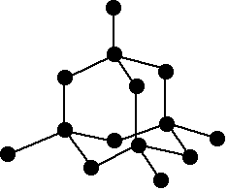
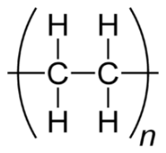
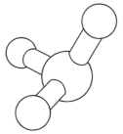
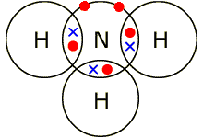
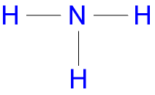
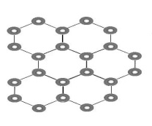

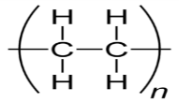
Bonding and Structure 2
GIANT COVALENT STRUCTURES
Giant covalent structures are solids with very high melting points
All the atoms in the structure are linked to other atoms by strong covalent bonds.
These bonds must be overcome to melt or boil
Diamond, Graphite and Silicon Dioxide are examples
COVALENT BONDING
When atoms share pairs of electrons, they form covalent bonds
These bonds between the atoms are strong (INTRAMOLECULAR)
Covalently bonded substances may consist of small molecules (liquids eg Water and gases eg Oxygen)
Some covalently bonded substances have very large molecules, such as polymers
Some covalently bonded substances have giant covalent structures, such as diamond and graphite.
DIAMOND
Each carbon atom forms four covalent bonds with other carbon atoms
Diamond is very hard
Very high melting points
Does not conduct electricity
GRAPHITE
Each carbon atom forms three covalent bonds with three other carbon atoms
Forms layers with hexagonal rings which have no covalent bonds between the layers so they can slide over each other
One electron from each carbon atom is delocalised and is free to move and carry charge so graphite can conduct electricity
PROPERTIES OF SMALL COVALENT MOLECULES
Usually gases or liquids with relatively low melting and boiling points
These substances have weak forces between the molecules (INTERMOLECULAR forces). It is these forces which are overcome (not the covalent bonds( when the substance melts or boils
The intermolecular forces increase with the size of the molecules, so larger molecules have higher melting points
They do not conduct electricity because the molecules do not have an overall charge
GRAPHENE & FULLERENES
Graphene is a single layer of graphite and has properties which make it useful in electronics and composites (materials)
Fullerenes are molecules of carbon atoms with hollow shapes. The structure is based on hexagonal rings of carbon atoms but they may also contain rings with 5 or 7 carbon atoms
The first fullerene to be discovered was Buckminsterfullerene (C₆₀) which has a spherical shape
Carbon Nanotubes are cylindrical fullerenes with very high length to diameter ratios. Their properties make them useful for nanotechnology, electronics and materials
PROPERTIES OF POLYMERS
Polymers have very large molecules
The atoms are linked to other atoms by strong covalent bonds
The intermolecular forces between the polymer molecules are relatively strong and so they are solid at room temperature

Slide 3
Bonding and Structure 3
TRIPLE ONLY
SIZES OF PARTICLES AND THEIR PROPERTIES
Nanoscience refers to structures 1-100nm in size (few hundred atoms)
Nanoparticles are smaller than fine particles (100-2500nm), coarse particles are 1 x 10⁻⁵ to 2.5 x 10⁻⁶m in size (dust)
As the size of cube decreases by a factor of 10 the surface area to volume ratio increases by a factor of 10
Nanoparticles may have different properties to the bulk atom because of their high surface area to volume ratio
It also means less nanoparticles are needed to be effective than materials with normal particle size.
USES OF NANOPARTICLES
Advantages:
Medicine (Cancer drug transporters in the body), electronics, cosmetics, deodorants (silver nanoparticles have antibacterial properties) , sun creams and catalysts
Disadvantages:
The way they affect the body is not fully understood (must be tested thoroughly), long term impacts on health are unknown, products should be clearly labelled so people are aware of nanoparticles

