Slide 1
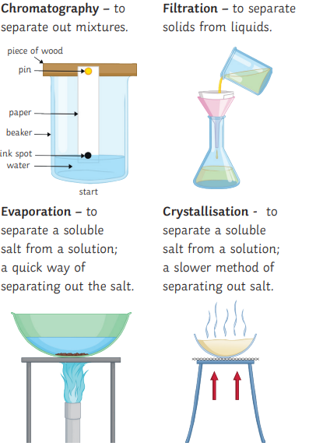
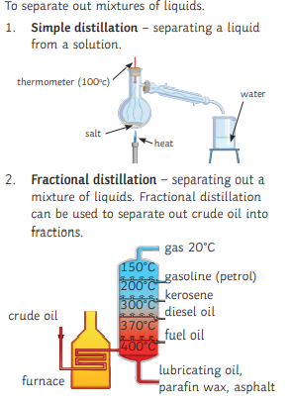
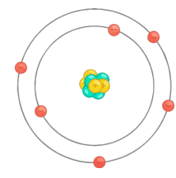
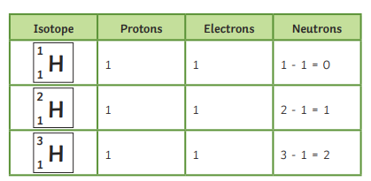
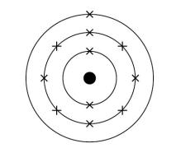
Atoms, elements & compounds
Elements are made of atoms with the same atomic number. Atoms can be represented as symbols. N = nitrogen F = flourine Zn = zinc Ca = calcium
Isotopes – an isotope is an element with the same number of protons and a different number of neutrons. They have the same atomic number, but a different mass number.
Compounds – a compound is when two or more elements are chemically joined in fixed proportions. E.g. carbon dioxide and magnesium oxide. The atoms are held together by chemical bonds. Compounds can only be made or separated by chemical reactions.
Atomic Structure & the Periodic Table
2. Chemical equations
Chemical reactions can be represented by word equations e.g.
Magnesium + oxygen → magnesium oxide
On the left are the reactants, on the right are the products. Chemical reactions can also be represented by symbol equations e.g.
2Mg + O₂ → 2MgO
Equations need to be balanced, so there are the same number of atoms on each side. To do this, numbers are put in front of the compounds – you can’t change the small numbers to the right of the compound.
Development of the model of the atom (common content with Physics)
Note: you only need to know the names of Bohr and Chadwick (in bold).
Scientist | Discovery
1800’s and before | Atoms were thought to be tiny spheres that could not be divided.
JJ Thomson, 1897 | The discovery of the electron led to the plum pudding model of the atom. The plum pudding model suggested that the atom is a ball of positive charge with negative electrons embedded in it.
Ernest Rutherford, 1909 | The results from the alpha particle scattering experiment led to the conclusion that the mass of an atom was concentrated at the centre (nucleus) and that the nucleus was charged. This nuclear model replaced the plum pudding model.
Niels Bohr, 1911 | Niels Bohr adapted the nuclear model by suggesting that electrons orbit the nucleus at specific distances. The theoretical calculations of Bohr agreed with experimental observations.
Ernest Rutherford, 1920 | Later experiments led to the idea that the positive charge of any nucleus could be subdivided into a whole number of smaller particles. The name proton was given to these particles.
James Chadwick, 1940 | Provided the evidence to show the existence of neutrons within the nucleus. This was about 20 years after the nucleus became an accepted scientific idea.
3. Mixtures
Mixtures – in a mixture there are no chemical bonds, so the molecules are easier to separate. Examples of mixtures are air and sea water.
Mixtures can be separated by physical processes such as filtration, crystallisation, simple distillation, fractional distillation and chromatography. These physical processes do not involve chemical reactions and no new substances are made.
5. Electronic Structure
The electrons in an atom occupy the lowest available energy levels
(innermost available shells). The first energy level can take up to 2
electrons. The subsequent levels can take up to 8 electrons. This rule
is applied for the first 20 elements only. The electronic structure of an
atom can be represented by numbers or by a diagram. For example,
the electronic structure of sodium is 2,8,1 or:

Slide 2
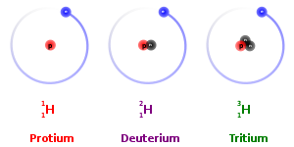
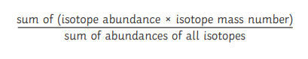
6. Relative Charges of Sub Atomic Particles
In an atom, the number of electrons is equal to the number of protons in the nucleus. Atoms have no overall electrical charge.
The number of protons, Ar, in an atom of an element is its atomic number. All atoms of a particular element have the same number of protons. Atoms of different elements have different numbers of protons.
Atoms are very small, having a radius of about 0.1 nm (1 x 10-10 m). The radius of a nucleus is less than 1/10 000 of that of the atom (about 1 x 10-14 m). Almost all of the mass of an atom is in the nucleus.
7. Mass number
The sum of the protons and neutrons in an atom is its mass number. Atoms can be represented as shown in this example:
Atoms of the same element have the same number of protons but a different numbers of neutrons; these atoms are called isotopes of that element. E.g.
The relative atomic mass of an element is an average value that takes account of the abundance of the isotopes of the element. To calculate relative atomic mass, use this formula:
Particle | Relative Mass | Relative Charge
Proton | 1 | +1
Neutron | 1 | 0
Electron | 0 | - 1
Mass number, Mr →
²³
Na
Atomic number, Ar →
¹¹
^{Sodium}
8. The Periodic Table
The elements in the periodic table are arranged in order
of atomic (proton) number and so that elements with
Similar properties are in columns, known as groups.
The table is called a periodic table because similar
properties occur at regular intervals. Elements in the
same group in the periodic table have the same number
of electrons in their outer shell (outer electrons) and this
gives them similar chemical properties. A horizontal row is called a period. Elements in the same period have the same number of electron shells.
10. Development of the Periodic Table
Before the discovery of protons, neutrons and electrons, scientists attempted to classify the elements by arranging them in order of their atomic weights. The early periodic tables were incomplete and some elements were placed in inappropriate groups if the strict order of atomic weights was followed. Mendeleev overcame some of the problems by leaving gaps for elements that he thought had not been discovered and in some places changed the order based on atomic weights. Elements with properties predicted by Mendeleev were discovered and filled the gaps. Knowledge of isotopes made it possible to explain why the order based on atomic weights was not always correct.
9. Metals & Non-metals
Elements that react to form positive ions are metals. Elements that do not form positive ions are non-metals. The majority of elements are metals. Metals are found to the left and towards the bottom of the periodic table. Non-metals are found towards the right and top of the periodic table.
13. Group 7
Group 7, the Halogens, are very reactive non-metals with 7 electrons on their outer shell. They are molecules made of pairs of atoms (they are diatomic). Reactivity decreases down the group and melting and boiling point increases down the group. They react strongly with group 1 metals. A more reactive halogen can displace a less reactive halogen from an aqueous solution of its salt.
11. Transition Metals – Separate Chemistry Only
The transition elements are metals with similar properties which are different from those of the elements in Group 1. Many transition elements have ions with different charges, form coloured compounds and are useful as catalysts. Example transition metals are Cr, Mn, Fe, Co, Ni, Cu. They tend to be harder, denser, stronger and have higher melting and boiling points than group 1 & 2 metals.
14. Group 0
The elements in Group 0 of the periodic table are called the noble gases. They are unreactive and do not easily form molecules because their atoms have stable arrangements of electrons. The noble gases have eight electrons in their outer shell, except for helium, which has only two electrons. The boiling points of the noble gases increase with increasing relative atomic mass (going down the group)
12. Group 1
The elements in Group 1 of the periodic table are known as the alkali metals and have characteristic properties because of the single electron in their outer shell.
They are very reactive with oxygen, water and group 7. Reactivity increases as you down the group and they have low melting and boiling points which decrease as you go down the group.

