Slide 1
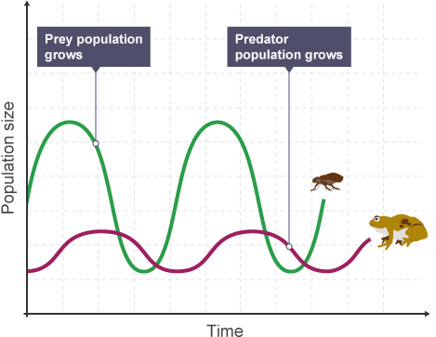
Producer | Producers are plants and algae, which photosynthesise to produce glucose.
Primary consumer | Primary consumers are herbivores, which eat producers.
Secondary consumer | Secondary consumers are carnivores, which eat primary consumers.
Tertiary consumer | Tertiary consumers are also carnivores. They eat secondary consumers.
Population | all the organisms of the same or closely-related species in an area.
Community | two or more populations of organisms.
Ecosystem | the interaction of a community of living organisms (biotic) with the non-living (abiotic) parts of their environment.
Interdependence | Within a community each species depends on other species for food, shelter, pollination, seed dispersal etc. If one species is removed it can affect the whole community.
Stable community | one where all the species and environmental factors are in balance so that population sizes remain fairly constant.
Adaptations | Features of an organism that enable them to survive in their habitat They may be structural (e.g. camouflage), behavioural (e.g. migration) or functional (e.g. low metabolism for hibernation).
Extremophile | Some organisms live in environments that are very extreme, such as at high temperature, pressure, or salt concentration. Bacteria living in deep sea vents are extremophiles.
Predator | Consumers that kill and eat other animals.
Prey | Animals that are eaten by other animals.
Carbon cycle | Returns carbon from organisms to the atmosphere as carbon dioxide to be used by plants in photosynthesis.
Water cycle | Provides fresh water for plants and animals on land before draining into the seas. Water is continuously evaporated and precipitated.
Biodiversity | The variety of all the different species of organisms on earth, or within an ecosystem.
Deforestation | Large-scale deforestation in tropical areas has occurred to provide land for cattle and rice fields and grow crops for biofuels.
Peat bog | An area of wet muddy ground that is too soft to support a heavy body. It is a good store of carbon.
Climate Change | Levels of carbon dioxide and methane in the atmosphere are increasing, and contribute to ‘global warming’ and climate change.
Fertilisers | Chemicals sprayed on crop plants to help their growth. These chemicals cause water pollution when they flow into rivers.
Ecology Knowledge Map
Biotic & Abiotic Factors
Abiotic (non-living) factors which can affect a community are:
• light intensity
• temperature
• moisture levels
• soil pH and mineral content
• wind intensity and direction
• carbon dioxide levels for plants
• oxygen levels for aquatic animals.
Biotic (living) factors which can affect a community are:
• availability of food
• new predators arriving
• new pathogens
• one species outcompeting another so the numbers are no longer sufficient to breed.
Competition
To survive and reproduce, organisms require a supply of materials from their surroundings and from the other living organisms there. Plants in a community or habitat often compete with each other for light and space, and for water and mineral ions from the soil. Animals often compete with each other for food, mates and territory.
Predator-Prey Cycles
The graph shows that there is almost always more prey than predators. It also shows the following patterns:
the number of predators increases because there is more prey
the number of prey reduces because there are more predators
the number of predators reduces because there is less prey
Food Chains
Food chains are diagrams that show the direction of energy transfer in an ecosystem. The producer always starts th food chain, and the arrows point in the direction of energy transfer (so point towards the predator)
A simple food chain is:
grass → rabbit → fox
If the foxes in the food chain above were killed, the population of rabbits would increase because they are no longer prey to the foxes. As a result the amount of grass would decrease because the increased population of rabbits would be eating it.

Slide 2
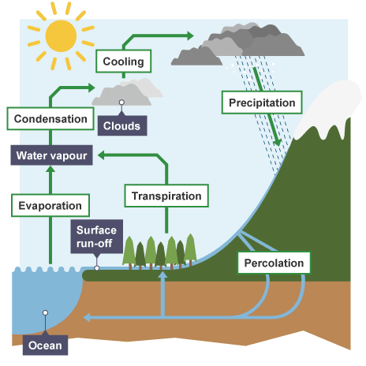
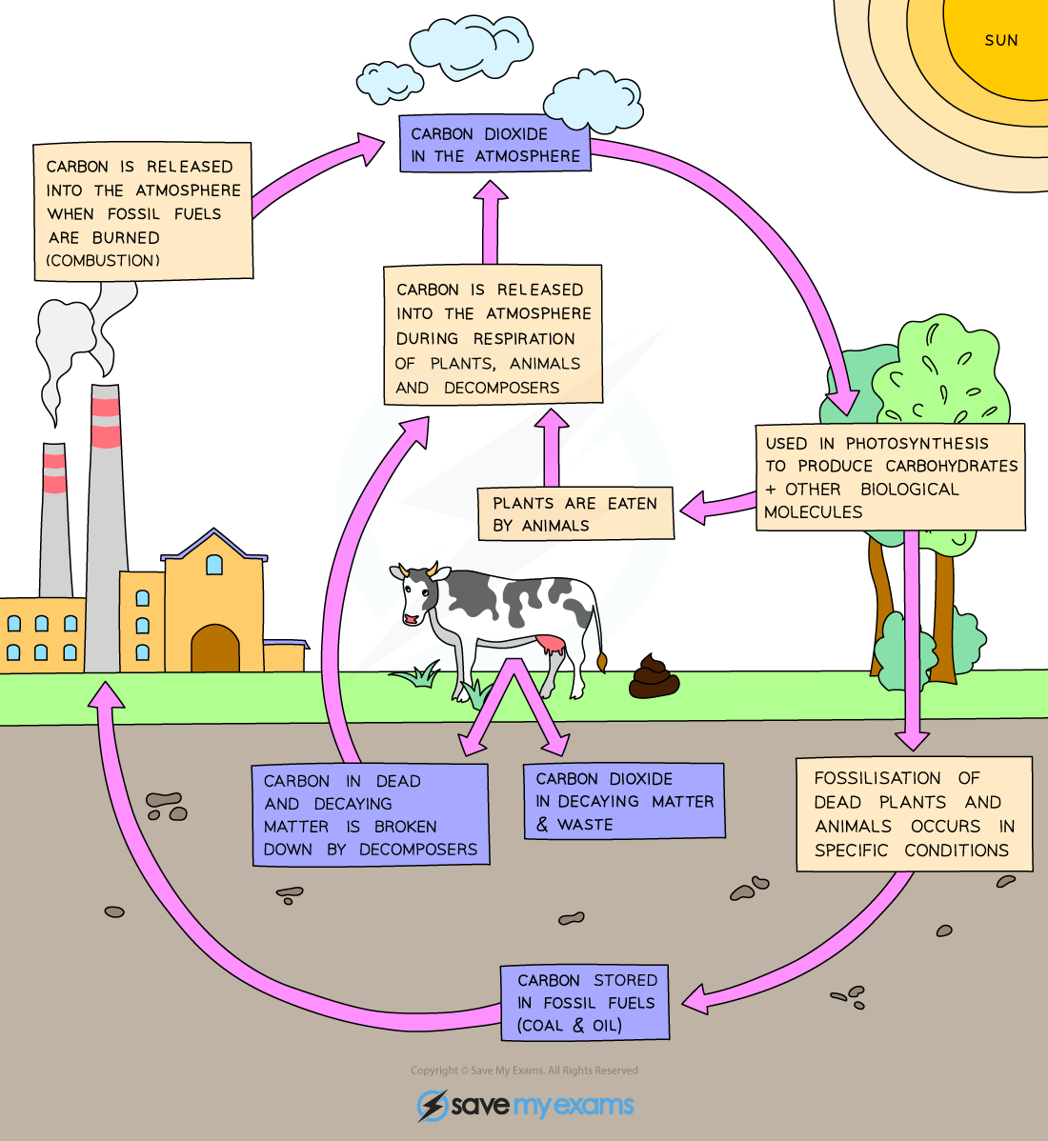
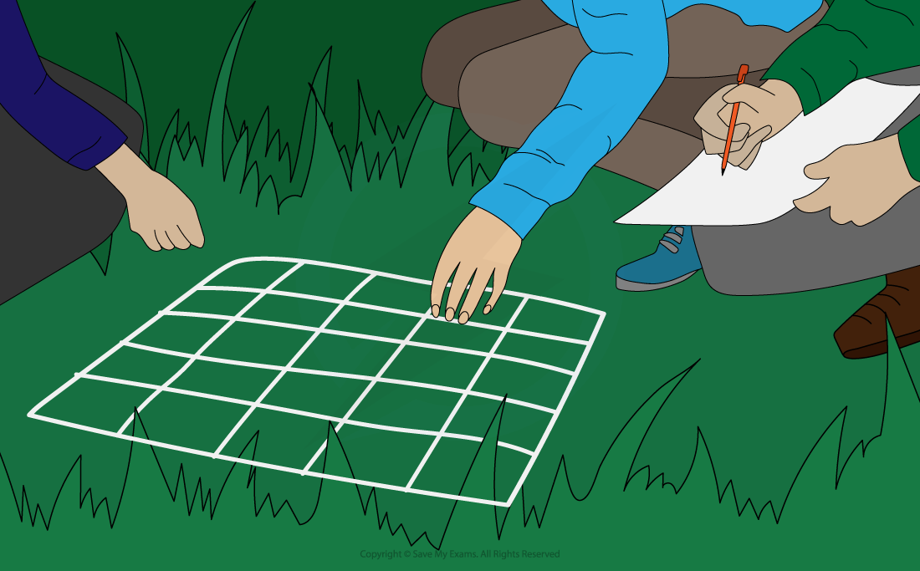
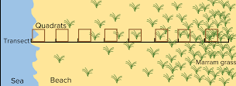
Required Practical: measure the population size of a common species in a habitat. Use sampling techniques to investigate the effect of a factor on the distribution of this species.
It is almost always impossible to count all of the organisms in a population. So we look at a small section of a population to draw conclusions about the rest. This process is called sampling
Quadrats are square frames of wire usually
0.25 m². These are placed on the ground to
look at the plants or slow-moving animals
within them.
A quadrat could be placed at regular distances, for example every five metres, along an imaginary line called a transect, which would run from one habitat to another. Systematic sampling would be used along the transect to link changes in species to abiotic factors, such as immersion by water, temperature fluctuations, light intensity, all of which are influenced by the tide.
Aim: To measure the species richness on the school field in areas in which the grass is regularly and irregularly cut.
Method:
choose a starting point on the school field in an area where the grass is often cut
use random numbers to generate a set of coordinates to place your first quadrat
count the number of different plant species within this quadrat
return to your starting position and repeat steps two and three a further 14 times using different random numbers
repeat steps one to four for a part of the school field which the grass is infrequently cut
compare your results by calculating a mean for each location
to estimate the total population of plants:
Process | What happens to water
Evaporation | Water turns from a liquid to a gas. Energy from the Sun can evaporate water.
Condensation | Water can cool and convert from gas to liquid, often forming clouds.
Transport | Water within clouds can be blown many miles by strong winds and so transported to other areas.
Precipitation | Precipitation occurs when rain, snow, hail and sleet fall from the sky.
Surface runoff | Some water can run along the surface of the ground.
Infiltration | Water is absorbed into the ground. This can then be stored within underground rocks called aquifers.
Transpiration | Plants allow some water to evaporate as water vapour from their leaves to mean that more is continually ‘pulled’ to their leaves from the soil.
Process | What happens to carbon
Combustion | CO₂ is released to the atmosphere when fuel is burned.
Respiration | All organisms release CO₂ as a waste product when energy is released.
Photosynthesis | Plants absorb CO₂ to convert it into glucose in photosynthesis.
Feeding | Carbon in the prey biomass is digested by the predator.
Excretion | Carbon is lost in urine and faeces.
Decomposition | Microbes release CO₂ during respiration when they feed on dead organic matter. They also return mineral ions to the soil.
Total area__ x number of plants counted
Area sampled

Slide 3
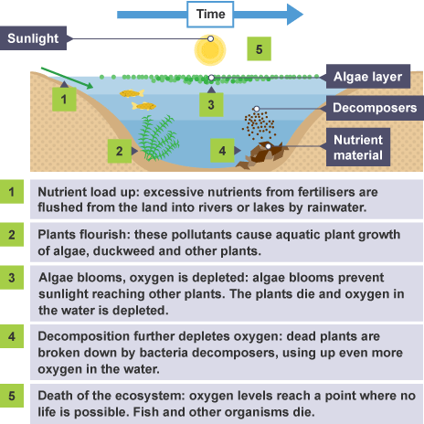
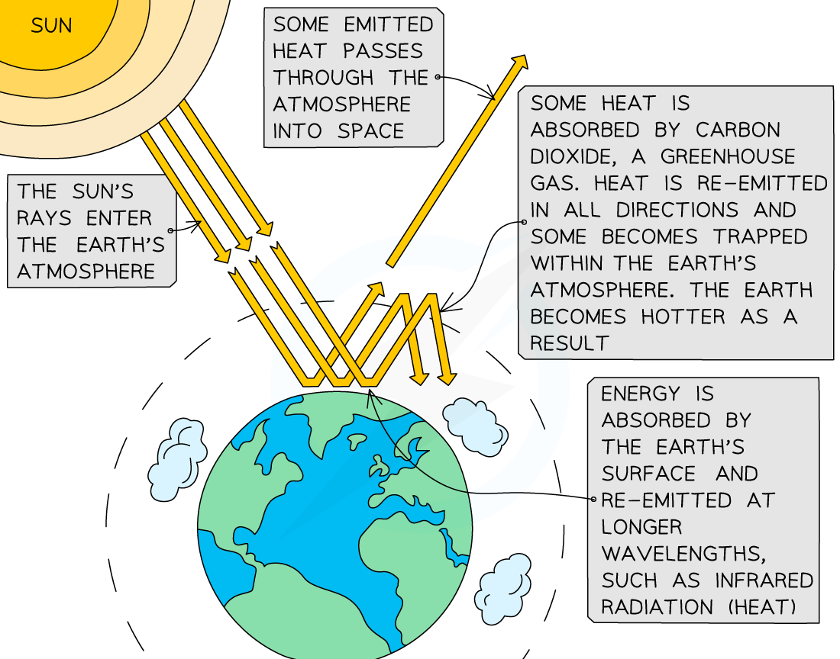
Biodiversity
A great biodiversity ensures the stability of ecosystems by reducing the dependence of one species on another for food, shelter and the maintenance of the physical environment. The future of the human species on Earth relies on us maintaining a good level of biodiversity. Many human activities are reducing biodiversity and only recently have measures been taken to try to stop this reduction
Scientists and concerned citizens have put in place programmes to reduce the negative effects of humans on ecosystems and biodiversity. These include:
• breeding programmes for endangered species
• protection and regeneration of rare habitats
• reintroduction of field margins and hedgerows in agricultural areas where farmers grow only one type of crop
• reduction of deforestation and carbon dioxide emissions by some governments • recycling resources rather than dumping waste in landfill.
Waste management
Rapid growth in the human population and an increase in the standard of living mean that increasingly more resources are used and more waste is produced. Unless waste and chemical materials are properly handled, more pollution will be caused.
Pollution kills plants and animals which can reduce biodiversity.
Water pollution
In some parts of the world, open sewers can lead into water courses, such as streams and rivers, which can cause serious illness in humans that may drink the contaminated water.
Some farmers use too many fertilisers, which can run off fields during heavy rain. This can pollute nearby streams and rivers leading to eutrophication (shown in diagram below). Some water pollution even comes from toxic chemicals released illegally by factories.
Land Pollution
Humans reduce the amount of land available for other animals and plants by building, quarrying, farming and dumping waste (landfills). The destruction of peat bogs, and other areas of peat to produce garden compost, reduces the area of this habitat and thus the variety of different plant, animal and microorganism species that live there (biodiversity). The decay or burning of the peat releases carbon dioxide into the atmosphere.
Air pollution
Combustion of fossil fuels and other fuels releases carbon dioxide. This contributes to the greenhouse effect and leads to global warming. It also releases sulphur dioxide and nitrogen oxides which can cause acid rain. Air pollution can also be caused by tiny particulates from smoke which can cause smog.

Slide 4
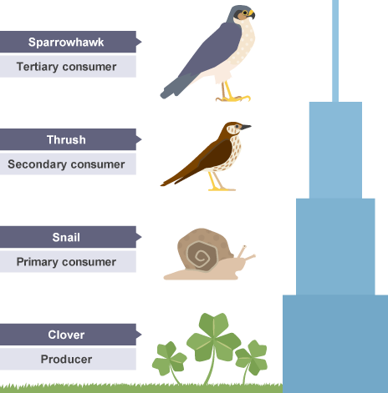
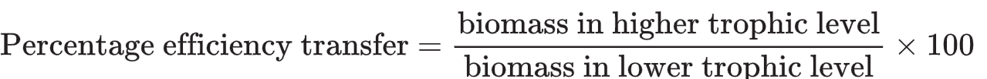
Separate Biology Only
Pyramids of Biomass
Pyramids of biomass must be drawn with the:
bars equally spaced around the midpoint
bars touching
bar for the producer at the bottom
length of each bar is proportional to the amount of biomass available at each trophic level
Producers are mostly plants and algae which transfer about 1% of the incident energy from light for photosynthesis.
Only about ten per cent of the biomass is transferred from each trophic level to the next. The remaining 90 per cent is used by the trophic level to complete life processes. Biomass can be lost between stages because not all of the matter eaten by an organism is digested. Some of it is excreted as waste such as solid faeces, carbon dioxide and water in respiration and water and urea in urine.
Because only around 10% of the biomass at each trophic level is passed to the next, the total amount becomes very small after only a few levels. So food chains are rarely longer than six trophic levels.
The efficiency of biomass transfer is a measure of the proportion of biomass transferred from a lower trophic level to a higher one.
To complete this calculation, we divide the amount from the higher trophic level by the amount from the lower trophic level and multiply by one hundred. That is, we divide the smaller number by the bigger one (and multiply by one hundred).
Decomposer | Microbes such as bacteria and fungi break down dead plant and animal matter by secreting enzymes into the environment. Small soluble food molecules then diffuse into the microorganism.
Apex predator | Carnivores with no predators.
Trophic level | The stages in a food chain. Trophic levels can be represented by numbers, starting at level 1 with plants and algae.
Pyramids of biomass | Represent the relative amount of biomass in each level of a food chain. Trophic level 1 is at the bottom of the pyramid.
Biomass | Dry mass of living or recently dead tissues
Decomposition
Decomposition, or decay, is the breakdown of dead matter by decomposers. The rate at which this happens depends upon the number of decomposing microorganisms and the following:
Temperature: At colder temperatures decomposing organisms will be less active, thus the rate of decomposition remains low. This is why we keep food in a fridge. As the temperature increases, decomposers become more active and the rate increases. At extremely high temperatures decomposers will be killed and decomposition will stop.
Water: With little or no water there is less decomposition because decomposers cannot survive. As the volume of available water increases, the rate of decomposition also increases.
Oxygen: Oxygen is needed for many decomposers to respire, to enable them to grow and multiply. This is why we often seal food in bags or cling film before putting it in the fridge. As the volume of available oxygen increases, the rate of decomposition also increases. Some decomposers can survive without oxygen.
Gardeners and farmers try to provide optimum conditions for rapid decay of waste biological material. The compost produced is used as a natural fertiliser for growing garden plants or crops. Anaerobic decay produces methane gas. Biogas generators can be used to produce methane gas as a fuel.
Required practical activity 10: investigate the effect of temperature on the rate of decay of fresh milk by measuring pH change.
Method
Place 20 cm³ of fresh milk into three beakers
Decide the three temperatures you will investigate. Write these onto the sides of the beakers. They may be 5, 20 and 35°C.
Use universal indicator paper or solution to determine the pH of the milk in the three beakers
Cover each beaker in cling film and incubate at the appropriate temperature
Use universal indicator paper or solution to determine the pH of the milk in the three beakers after 24, 48 and 72 hours.

Slide 5
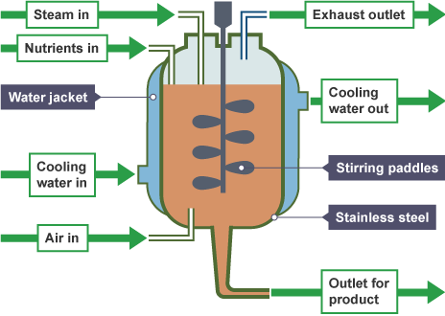
Role of biotechnology: Biotechnology is the alteration of living organisms to develop or make products that help us.
Genetic modification: A genetically modified bacterium produces human insulin. When harvested and purified this is used to treat people with diabetes. Golden rice is a variety of rice that has been genetically modified to contain beta-carotene which helps people who do not get enough vitamin A in their diet. Other crops have been genetically modified to be resistant to insects or to pesticides. This means that farmers can spray whole fields with pesticides and kill the pests, not the crops.
Modern biotechnology techniques enable large quantities of microorganisms to be cultured for food. The fungus Fusarium is useful for producing mycoprotein, a protein-rich food suitable for vegetarians. The fungus is grown in large containers called fermenters. The conditions inside are maintained to promote maximum growth:
The pH and temperature are maintained at the optimum
The temperature is controlled by a water jacket that surrounds the whole fermenter
Sterile oxygen is added to make sure that aerobic respiration occurs
A food source like glucose syrup is added
The mixture inside is stirred to make sure all the oxygen and nutrients are equally distributed
The biomass is harvested and purified.
Separate Biology Only
Farming techniques
The efficiency of food production can be improved by restricting energy transfer from food animals to the environment. This can be done by limiting their movement and by controlling the temperature of their surroundings. Some animals are fed high protein foods to increase growth.
Distribution of species can be affected by:
• temperature: As you climb up a mountain the temperature reduces. This reduction, together with other abiotic and biotic factors, determines what species of plant are found at different elevations.
• availability of water: All life on Earth needs water. Too much and some species will drown or rot. Too little and all species die.
• composition of atmospheric gases: Gases dissolve in liquids, thus oxygen in the air dissolves in water. It is this dissolved oxygen, together with that produced by plants and algae, that support aquatic life. When levels of pollution increase the levels of dissolved oxygen reduce.
These changes may be seasonal, geographic or caused by human interaction.
Advantage | Disadvantage
Higher yields | Costly additives needed
More efficient use of food | Risk of antibiotic resistance
Quality control easier | Considered unethical by some people
Factors affecting food security
Food security is a measure of the availability of food required to support a population. It is a measure of how much food there is, if it is of suitable quality and whether people can access it.
Biological factors which are threatening food security include:
• the increasing birth rate has threatened food security in some countries
• changing diets in developed countries means scarce food resources are transported around the world
• new pests and pathogens that affect farming
• environmental changes that affect food production, such as widespread famine occurring in some countries if rains fail
• the cost of agricultural inputs
• conflicts that have arisen in some parts of the world which affect the availability of water or food.
Sustainable methods must be found to feed all people on Earth.
Sustainable fisheries
Fish stocks in the oceans are declining. It is important to maintain fish stocks at a level where breeding continues or certain species may disappear altogether in some areas.
Sustainable fisheries do not reduce the overall number of fish, because the number of fish that are caught and killed does not ever exceed the birth of new fish.
Many countries have introduced fishing quotas which limit the amount of fish that can be caught and killed from specific species. The size of the gaps in fishing nets has also been increased to ensure that juvenile fish can reach reproductive maturity and have offspring before being killed.

