Slide 1
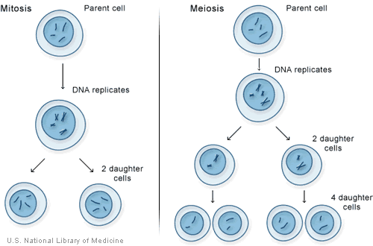
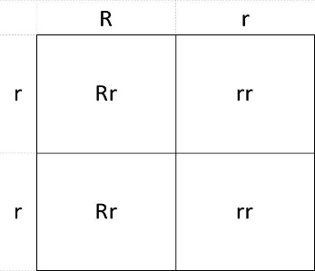
INHERITANCE (Combined)
Sexual and Asexual Reproduction
1. Mitosis leads to identical cells being formed
Asexual reproduction involves only one parent
There is no mixing of genetic information or fusion of gametes
Offspring are identical (clones)
2. Meiosis leads to non-identical cells being formed
Gametes (sperm and egg in animals and pollen and egg in flowering plants) are formed using meiosis in the reproductive organs
When a cell divides to form gametes:
Copies of the genetic information are made (mitosis with a slight mixing of DNA)
The cell divides twice to form four gametes, each with a single set of chromosomes
All gametes are genetically different from each other
Sexual reproduction involves the joining (fusion) of male and female gametes to form a cell with a complete set of genetic information
The new cell divides by mitosis. The number of cells increases. As the embryo develops cells differentiate and become specialised. Genetic information is mixed which leads to variety in offspring
DNA and the Genome
Genetic Inheritance
The genetic material in the nucleus of a cell is composed of a chemical called DNA.
DNA is a polymer make up of two strands forming a double helix.
The DNA is contained in structures called chromosomes
A gene is a small section of DNA on a chromosome. Each gene codes for a particular sequence of amino acids, to make a specific protein.
The genome of an organism is the entire genetic material of that organism.
The whole human genome has now been studied and this will help medicine in the future:
Search for genes linked to different types of disease
Understanding and treatment of inherited disorders
Use in tracing human migration patterns from the past
Some characteristics are controlled by a single gene, such as fur colour in mice and red-green colour blindness in humans.
Each gene may have different forms called alleles
The alleles present are called genotype and the characteristic that is expressed is called the phenotype
A dominant allele is always expressed even if only one copy of the allele is present. And is written using a capital letter
.
A recessive allele is only expressed if both alleles are present. And is written using a lower case letter
If the two alleles present are the same the organism is homozygous for that trait, but if the alleles are different they are heterozygous
Punnett squares are used to express the probable outcome of a genetic cross
Inherited Disorders
Polydactyl (extra digits) is caused by a dominant allele. If a parent has Polydactyl (Pp) there is a 50% chance of the offspring inheriting it
Cystic Fibrosis (disorder of the cell membrane where too much mucus is produced and the cilia can’t move it away from the airways) is caused by a recessive allele. Both parents must be carriers (Nn) in order for there to be a 25% chance of a child inheriting the disorder.
Sex Determination
One pair of the 23 pairs of chromosomes in human body cells carriers the genes that determine sex
Females the sex chromosomes are XX
Males the sex chromosomes are XY

Slide 2
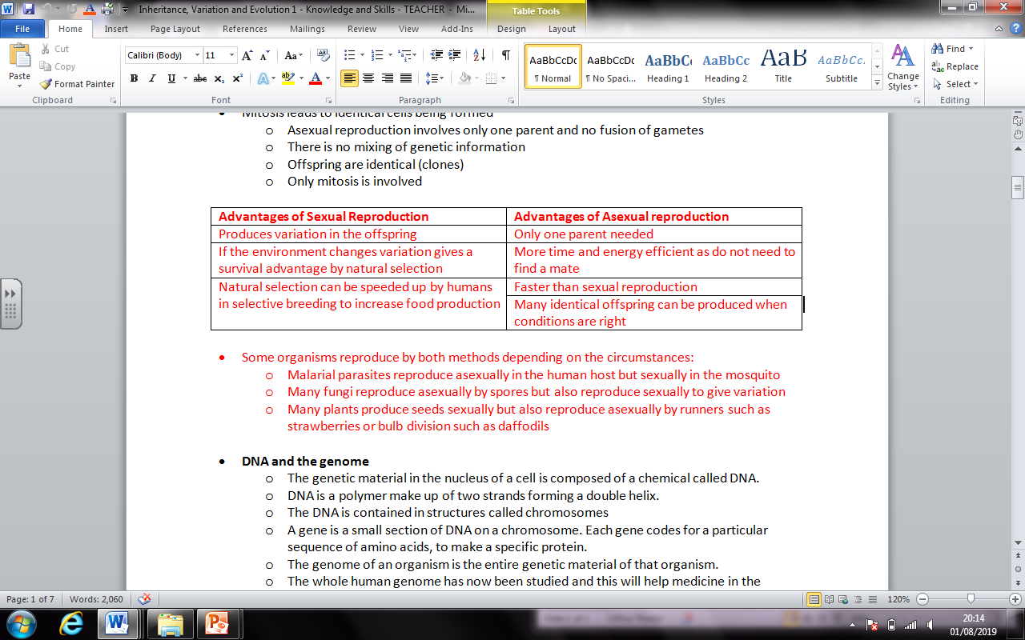
INHERITANCE (Biology)
Sexual and Asexual Reproduction
1. Mitosis leads to identical cells being formed
Asexual reproduction involves only one parent
There is no mixing of genetic information or fusion of gametes
Offspring are identical (clones)
2. Meiosis leads to non-identical cells being formed
Gametes (sperm and egg in animals and pollen and egg in flowering plants) are formed using meiosis in the reproductive organs
When a cell divides to form gametes:
Copies of the genetic information are made (mitosis with a slight mixing of DNA)
The cell divides twice to form four gametes, each with a single set of chromosomes
All gametes are genetically different from each other
Sexual reproduction involves the joining (fusion) of male and female gametes to form a cell with a complete set of genetic information
The new cell divides by mitosis. The number of cells increases. As the embryo develops cells differentiate and become specialised. Genetic information is mixed which leads to variety in offspring
Malarial parasites reproduce asexually in the human host but sexually in the mosquito
Many fungi reproduce asexually by spores but also reproduce sexually to give variation
Many plants produce seeds sexually but also reproduce asexually by runners such as strawberries or bulb division such as daffodils
Genetic Inheritance
Some characteristics are controlled by a single gene, such as fur colour in mice and red-green colour blindness in humans.
Each gene may have different forms called alleles
The alleles present are called genotype and the characteristic that is expressed is called the phenotype
Inherited Disorders
.
Polydactyl (extra digits) is caused by a dominant allele. If a parent has Polydactyl (Pp) there is a 50% chance of the offspring inheriting it
Cystic Fibrosis (disorder of the cell membrane where too much mucus is produced and the cilia can’t move it away from the airways) is caused by a recessive allele. Both parents must be carriers (Nn) in order for there to be a 25% chance of a child inheriting the disorder.
A dominant allele is always expressed even if only one copy of the allele is present. And is written using a capital letter
A recessive allele is only expressed if both alleles are present. And is written using a lower case letter
If the two alleles present are the same the organism is homozygous for that trait, but if the alleles are different they are heterozygous
Punnett squares are used to express the probable outcome of a genetic cross
Sex Determination
Ordinary human body cells contain 23 pairs of chromosomes
22 pairs control characteristics only, but one pair carriers the genes that determine sex
Females the sex chromosomes are XX
Males the sex chromosomes are XY

Slide 3
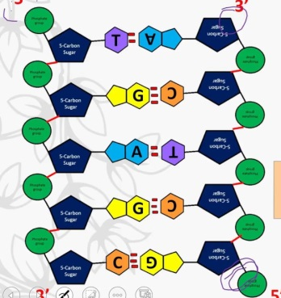
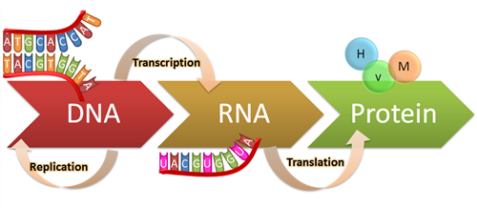
INHERITANCE (BIOLOGY)
DNA and the genome
The genetic material in the nucleus of a cell is composed of a chemical called DNA.
DNA is a polymer make up of two strands forming a double helix.
The DNA is contained in structures called chromosomes
A gene is a small section of DNA on a chromosome. Each gene codes for a particular sequence of amino acids, to make a specific protein.
The genome of an organism is the entire genetic material of that organism.
The whole human genome has now been studied and this will help medicine in the future:
Search for genes linked to different types of disease
Understanding and treatment of inherited disorders
Use in tracing human migration patterns from the past
DNA Structure
DNA is a polymer made from four different nucleotides.
Each nucleotide consists of a common sugar and phosphate group with one of four different bases attached to the sugar
DNA contains four bases, A, C, G and T
In the complementary strands a C is always linked to a G on the opposite strand and a T is always linked to an A.
A sequence of three bases is the code for a particular amino acid.
The order of bases controls the order of amino acids to produce a particular protein
A change in DNA will produce a different sequence of bases and this results in a change in the protein synthesised by a gene
.
Protein Synthesis
Mutations
Proteins are synthesised on ribosomes according to a template.
Carrier molecules bring specific amino acids to add to the growing protein chain in the correct order
When the protein chain is complete it folds up to form a unique shape.
This unique shape enables the proteins to do their job as enzymes, hormones or forming structures in the body such as collagen.
Mutations occur continuously. Most do not alter the protein or only alter it slightly so that its appearance or function is not changed
A few mutations code for an altered protein with a different shape. An enzyme may no longer fit the substrate biding site or a structural protein may lose its strength
Not all parts of DNA code for proteins. Non coding parts of DNA can switch genes on and off, so variations in these areas of DNA may affect how genes are expressed

Slide 4
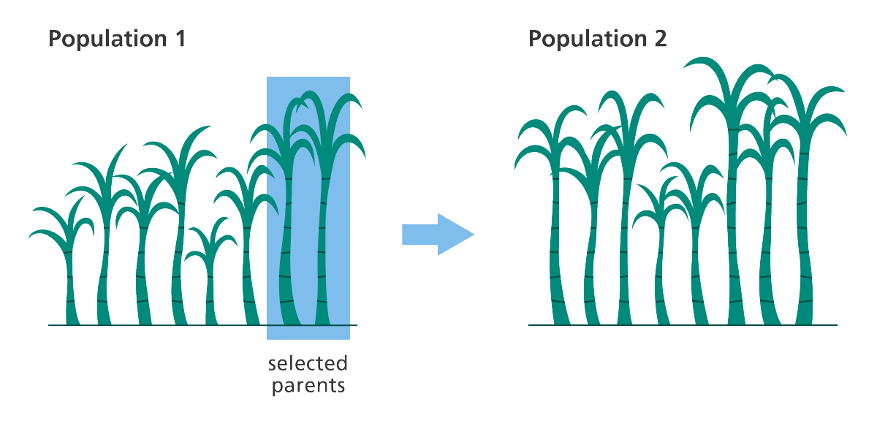
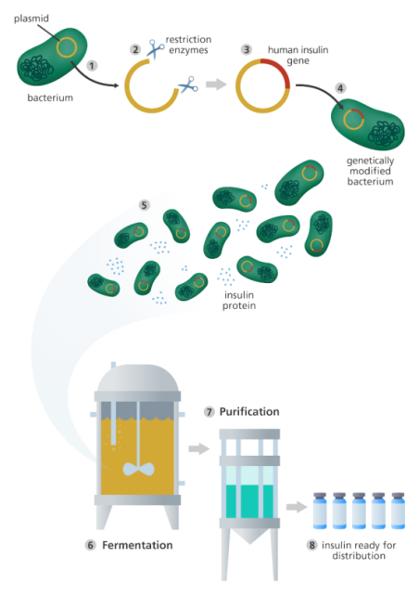
VARIATION
Evolution
Differences in the characteristics of individuals in a population is called variation and may be due to differences in:
The genes they have inherited (genetic causes)
The conditions in which they have developed (environmental causes)
A combination of both
There is usually extensive genetic variation within a population of a species
All variations arise from mutations and most have no effect on the phenotype only very few will determine the phenotype
This is a change in the inherited characteristics of a population over time through a process of natural selection which may result in the formation of a new species
The theory of evolution by natural selection states that all species of living things evolved from simple life forms that first developed more than three billion years ago
Natural Selection results in phenotypes (characteristics) that are best suited to their environment
If two populations of one species become so different in phenotype that they can no longer breed to produce fertile offspring they have formed two new species
Selective Breeding
Selective Breeding (artificial selection) is the process by which humans breed plants and animals for particular genetic characteristic.
Humans have been doing this for thousands of years since they first bred food crops from wild plants and domesticated animals
Parents with desired characteristics are chosen from a mixed population.
They breed together.
From the offspring those with the desired characteristics are bred together.
This continues over many generations until all the offspring show the desired characteristics
Diseases resistance in food crops
Animals which produce more meat or milk
Domestic dogs with a gentle nature
Large or unusual flowers
Selective Breeding can lead to “inbreeding” where some breeds are particularly prone to disease or inherited defects.
Genetic Engineering
.
Modifying the genome of an organism by introducing a gene from another organism to give a desired characteristic
Plant crops have been genetically engineered to be resistant to diseases or to produce bigger fruits
Bacterial cells have been genetically engineered to produce useful substances such as human insulin to treat diabetes
Genes from the chromosome of humans and other organisms can be ‘cut out’ and transferred to cells of other organisms
Enzymes are used to isolate the required gene; this gene is inserted into a vector, usually a bacterial plasmid or a virus
The vector is used to insert the gene into the required cells
Genes are transferred to the cells of animals, plants or microbes at an early stage in their development so that they develop with desired characteristics
Crops that have had their genes modified in this way are called genetically modified (GM) crops. GM crops include ones that are resistant to insect attack or to herbicides. GM crops generally show increased yields.
Concerns about GM crops include the effect on populations of wild flowers and insects. Some people feel the effects of eating GM crops on human health have not been fully explored
Modern medical research is exploring the possibility of genetic modification to overcome some inherited disorders

Slide 5
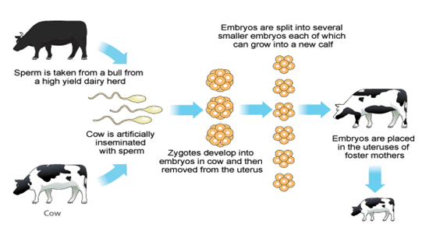
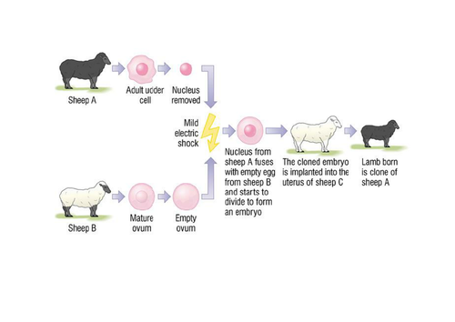
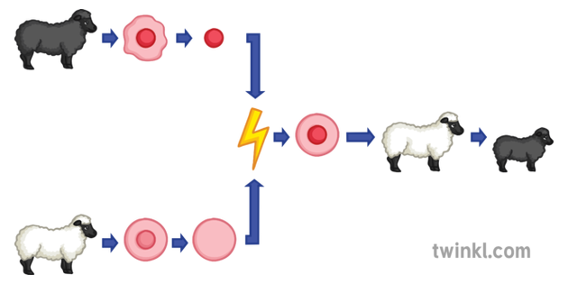
VARIATION (Biology)
Cloning
Tissue culture:
Using small groups of cells from part of a plant to grow identical new plants. This is important for preserving rare plant species or commercially in nurseries
Cuttings:
An older, but simple method used by gardeners to produce many identical new plants from a parent plant.
Adult cell cloning:
The nucleus is removed from an unfertilised egg cell
The nucleus from an adult body cell, such as skin cell, is inserted into the egg cell
An electric shock stimulates the egg cell to divide to form an embryo
These embryo cells contain the same genetic information as the adult skin cell
When the embryo has developed into a ball of cells, it is inserted into the womb of an adult female to continue its development.
Embryo transplants:
Splitting apart cells from a developing animal embryo before they become specialised, then transplanting the identical embryos into host mothers
.

Slide 6
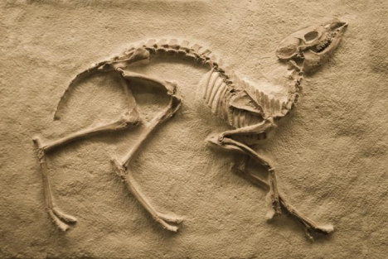
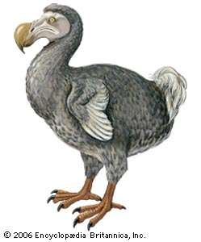
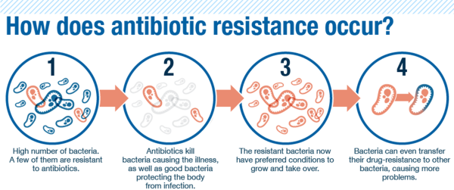
EVOLUTION
Evidence for Evolution
The theory for evolution by natural selection is now widely accepted
Evidence for Darwin’s theory is now available as it has been shown that characteristics are passed on to offspring in genes. There is further evidence in the fossil record and the knowledge of how resistance to antibiotics evolves in bacteria
Fossils
Fossils are the ‘remains’ of organisms from millions of years ago, which are found in rocks
Fossils may be formed:
From parts of organisms that have not decayed because one or more of the conditions needed for decay are absent
When parts of the organism are replaced by minerals as they decay
As preserved traces of organisms, such as footprints, burrows and rootlet traces
Many early forms of life were soft-bodied, which means that they have left few traces behind. What traces there were have neem mainly destroyed by geological activity. This is why scientists can’t be certain as to how life began on Earth
We can learn from fossils how much or how little different organisms have changed as life developed on Earth
Extinction
Resistant Bacteria
This occurs when there are no remaining individuals of a species still alive
Natural disaster
Disease
Habitat destroyed
Competition for food
New predator
Bacteria can evolve rapidly because they reproduce at a fast rate
Mutations of bacterial pathogens produce new strains. Some strains might be resistant to antibiotics, and so are not killed. They survive and reproduce, so the population of the resistant strain rises. The resistant strain will then spread because people are not immune to it and there is no effective treatment.
MRSA is resistant to antibiotics
To reduce the rate of antibiotic resistant strains:
Doctors should not incorrectly or over prescribe antibiotics
You should complete the course of antibiotics to ensure they are all killed
The agricultural use of antibiotics should be restricted
.
The development of new antibiotics is costly and slow. It is unlikely to keep up with the emergence of new resistant strains.

Slide 7
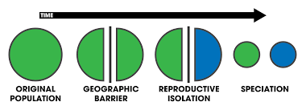
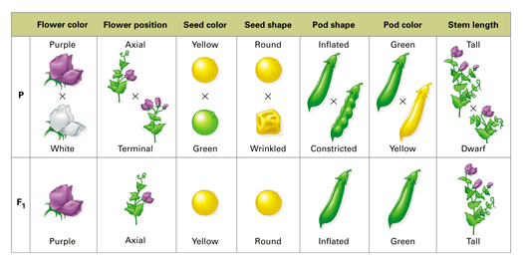
EVOLUTION (Biology)
The Theory of Evolution
Charles Darwin, as a result of observations on a round the world expedition, backed by years of experimentation and discussion and linked to developing knowledge of geology and fossils, proposed the theory of evolution by natural selection
Individual organisms within a particular species show a wide range of variation for a characteristic
Individuals with characteristics most suited to the environment are more likely to survive to breed successfully
The characteristics that have enabled these individuals to survive are then passed on the next generation
Darwin published his ideas in On the Origin of Species – the theory of evolution by natural selection was only gradually accepted because:
The theory challenged the idea that God made all the animals and plants that live on Earth
There was insufficient evidence at the time the theory was published to convince many scientists
The mechanism of inheritance and variation was not known until 50 years after the theory was published
Other theories – Jean-Baptiste Lamarck are based mainly on the idea that changes that occur in an organism during its lifetime can be inherited. We now know that in the vast majority of cases this type of inheritance cannot occur
Speciation
Alfred Russell Wallace independently proposed the theory of evolution by natural selection.
He published joint writings with Darwin which prompted Darwin to publish ‘On the Origin of Species’ the following year
Wallace worked worldwide gathering evidence for evolutionary theory. He is best known for his work on warning colourations in animals and his theory of speciation.
Wallace did much pioneering work on speciation but more evidence over time has led to our current understanding of the theory of speciation
The understanding of genetics
In the mid 19th century Gregor Mendel carried out breeding experiments on plants. One of his observations is determined by ‘units’ that are passed on to descendants unchanged
His work was not accepted until after his death because:
In the late 19th century behaviour of chromosomes during cell division was observed
In the early 20th century it was observed that chromosomes and Mendel’s ‘units’ behaved in similar ways. This led to the idea that the ‘units’ now called genes were located on chromosomes
In the mid 20th century the structure of DNA was determined and the mechanism of gene function worked out
This scientific work by many scientists led to the gene theory being developed

Slide 8
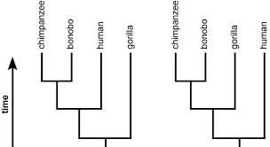
CLASSIFICATION
Classification of living organisms
Traditionally living things have been classified into groups depending on their structure and characteristics in a system developed by Carl Linnaeus
Linnaeus classified living things into kingdom, phylum, class, order, family, genus and species
Organisms are named by the binomial system of genus and species
As evidence of internal structures became more developed due to improvements in microscopes, and the understanding of biochemical processes progressed, new models of classification were proposed.
Due to evidence available from chemical analysis there is now a ‘three-domain system’ developed by Carl Woese:
Archaea (primitive bacteria usually in extreme environments)
Bacteria (true bacteria)
Eukaryota (which includes protists, fungi, plants and animals)
Evolutionary trees are a method used by Scientists to show how organisms are related.
.

