Slide 1
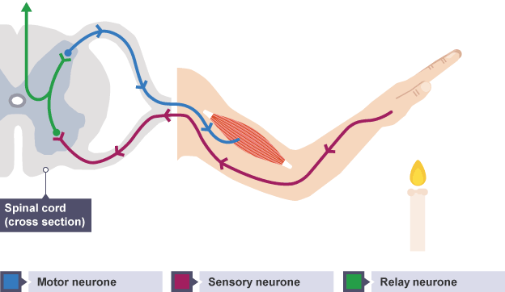
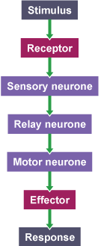
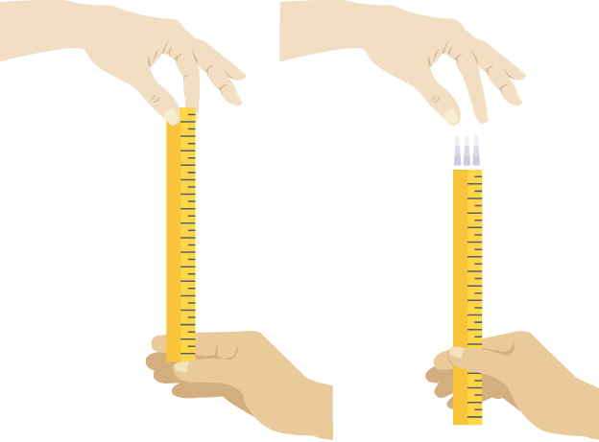
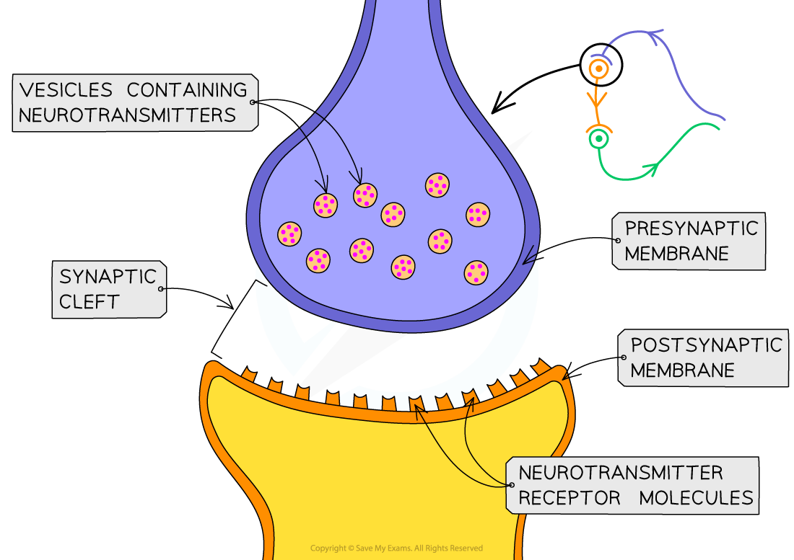
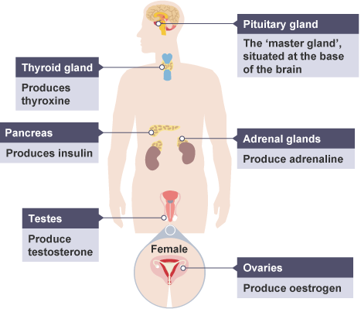
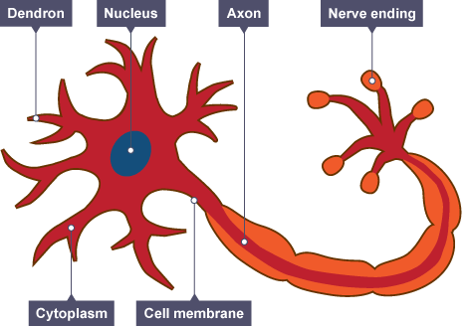
Biology Paper 2: Homeostasis & Response
Reflexes
A reflex action follows this general sequence and does not involve the conscious part of the brain, which makes it much quicker.
Required Practical
Reaction time is the time taken to respond to a stimulus. Reaction time can be affected by factors such as age, distractions or use of drugs (such as caffeine)
Method:
Work with a partner.
Person A holds out their hand with a gap between their thumb and first finger.
Person B holds the ruler with the zero at the top of person A's thumb
Person B drops the ruler without telling Person A and they must catch it.
The number level with the top of person A's thumb is recorded in a suitable table. Repeat this ten times.
Swap places, and record another ten attempts.
You can use a conversion table to help convert your ruler measurements into reaction time or just record the catch distance in cm.
Control variables:
The person catching the ruler using their dominant hand each time
Dropping the same ruler from the same height each time, with the ruler orientated in the same direction (0 cm facing down)
Homeostasis
Homeostasis maintains a constant internal environment in the body to provide the optimal conditions for enzyme action, as well as all cell functions.
In the human body, these include the control of:
blood glucose concentration
body temperature
water levels
These automatic control systems may involve nervous responses (nervous system) or chemical responses (endocrine system).
All control systems include:
cells called receptors, which detect stimuli (changes in the environment)
coordination centres (such as the brain, spinal cord and pancreas) that receive and process information from receptors
effectors, muscles or glands, which bring about responses which restore optimum levels.
Synapses
Where two neurones meet there is a small gap, a synapse.
An electrical impulse travels along the first axon.
2. This triggers the nerve-ending of a neurone to release chemical messengers called neurotransmitters.
3. These chemicals diffuse across the synapse and bind with receptor molecules on the membrane of the second neurone.
4. The receptor molecules on the second neurone bind only to the specific neurotransmitters released from the first neurone. This stimulates the second neurone to transmit the electrical impulse.
The Human Nervous System
The nervous system enables humans to react to their surroundings and to coordinate their behaviour.
Information from receptors passes along cells (neurones) as electrical impulses to the central nervous system (CNS). The CNS is the brain and spinal cord. The CNS coordinates the response of effectors which may be muscles contracting or glands secreting hormones.
Stimulus → receptor → coordinator → effector → response
Neurones look like this:
Hormones: The endocrine system secretes hormones into the bloodstream from glands throughout the body. Hormones produce an effect on specific target organs in the body. The pituitary gland is a ‘master gland’ which secretes several hormones into the blood in response to body conditions. These hormones in turn act on other glands to stimulate other hormones to be released to bring about effects are slower but act for longer.

Slide 2
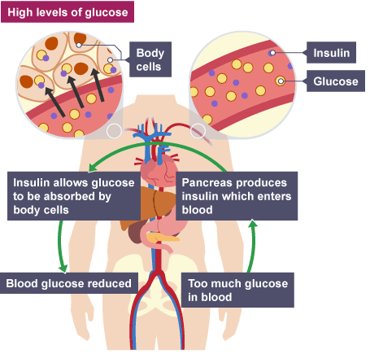
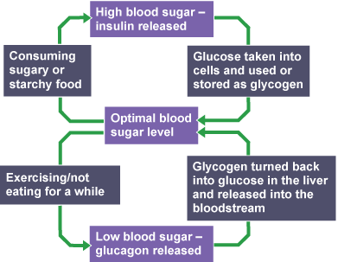
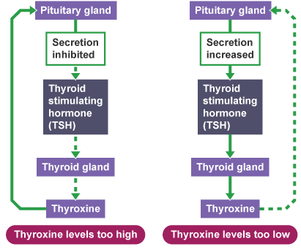
Control of Blood Glucose Concentration
Blood glucose concentration is monitored and controlled by the pancreas. If the blood glucose concentration is too high, the pancreas produces the hormone insulin that causes glucose to move from the blood into the cells. In liver and muscle cells excess glucose is converted to glycogen for storage
Hormones in Human Reproduction
Changes occur at puberty because of hormones:
testosterone - produced by the testes - controls the development of male secondary sexual characteristics
oestrogen - produced by the ovaries - controls the development of female secondary sexual characteristics
Secondary sexual characteristics appear during puberty and were not present at birth
Contraception
Fertility can be controlled by a variety of hormonal and non-hormonal methods of contraception. These include:
• oral contraceptives that contain hormones to inhibit FSH production so that no eggs mature
• injection, implant or skin patch of slow release progesterone to inhibit the maturation and release of eggs for a number of months or years
• barrier methods such as condoms and diaphragms which prevent the sperm reaching an egg
• intrauterine devices which prevent the implantation of an embryo or release a hormone
• spermicidal agents which kill or disable sperm
• abstaining from intercourse when an egg may be in the oviduct
• surgical methods of male and female sterilisation
Hormones in the Menstrual cycle
The menstrual cycle is a recurring process which takes around 28 days. During the process, the lining of the uterus is prepared for pregnancy. If implantation of the fertilised egg into the uterus lining does not happen, the lining is then shed. This is known as menstruation.
Hormone | Produced | Role
FSH (follicle stimulating hormone) | Pituitary gland | Causes an egg to mature in an ovary. Stimulates the ovaries to release oestrogen
Oestrogen | Ovaries | Stops FSH being produced (so that only one egg matures in a cycle). Repairs, thickens and maintains the uterus lining. Stimulates the pituitary gland to release LH.
LH (luteinising hormone) | Pituitary gland | Triggers ovulation (the release of a mature egg)
Progesterone | Ovaries | Maintains the lining of the uterus during the middle part of the menstrual cycle and during pregnancy.
Hormones to Treat Infertility: Higher tier only
Hormones can be used in modern reproductive technologies to treat infertility. This includes giving FSH and LH in a ‘fertility drug’ to a woman. She may then become pregnant in the normal way.
In Vitro Fertilisation (IVF) treatment.
• IVF involves giving a mother FSH and LH to stimulate the maturation of several eggs.
• The eggs are collected from the mother and fertilised by sperm from the father in the laboratory.
• The fertilised eggs develop into embryos.
• At the stage when they are tiny balls of cells, one or two embryos are inserted into the mother’s uterus (womb)
Low Blood Glucose: Higher tier only
If the blood glucose concentration is too low, the pancreas produces the hormone glucagon that causes glycogen to be converted into glucose and released into the blood.
Diabetes
Type 1 diabetes is a disorder in which the pancreas fails to produce sufficient insulin. It is characterised by uncontrolled high blood glucose levels and is normally treated with insulin injections. In Type 2 diabetes the body cells no longer respond to insulin produced by the pancreas. A carbohydrate controlled diet and an exercise regime are common treatments. Obesity is a risk factor for Type 2 diabetes
Negative Feedback: Higher tier only
A negative feedback control system responds when conditions change from the ideal and returns conditions to this point. An example is thyroxine. Thyroxine from the thyroid gland stimulates the basal metabolic rate. It plays an important role in growth and development. High thyroxine levels in the bloodstream prevent the release of TSH from the pituitary gland, so normal blood levels are restored. Low thyroxine levels in the bloodstream stimulate the pituitary gland to release TSH so the thyroid releases more thyroxine. So, blood levels return to normal.
Adrenaline is made by the adrenal glands in times of fear or stress. It increases heart rate and boosts the oxygen and glucose to the brain and muscles, preparing the body for ‘flight or fight’.

Slide 3
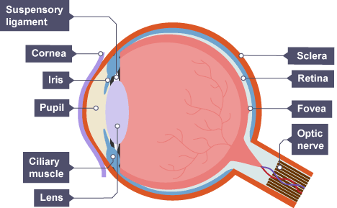
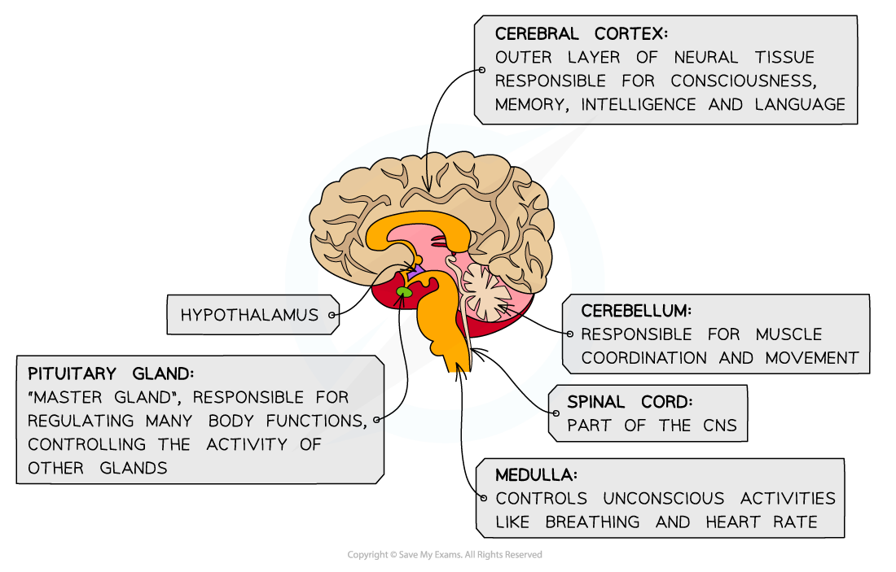
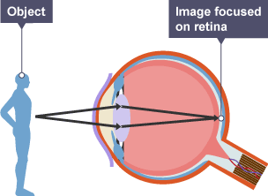
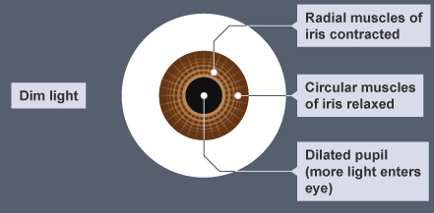
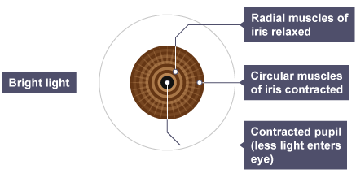
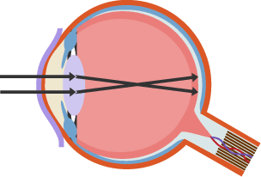
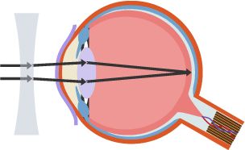
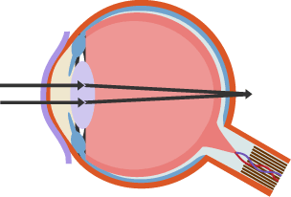
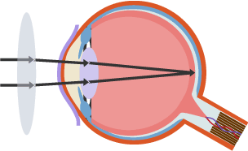
The Brain: Separate Biology Only
The brain controls complex behaviour. It is made of billions of interconnected neurones and has different regions that carry out different functions.
There are four main areas in the brain:
The cerebrum (the outer layer is called the cerebral cortex), which is split into two hemispheres and is highly folded. It controls intelligence, personality, conscious thought and high-level functions, such as language and verbal memory.
The cerebellum, which controls balance, co-ordination of movement and muscular activity.
The medulla, which controls unconscious activities such as heart rate and breathing rate,
The hypothalamus, which is the regulating centre for temperature and water balance within the body.
Modern science has allowed scientists to discover how different parts of the brain function. Neuroscientists have been able to map various regions of the brain to particular functions by studying patients with brain damage, electrically stimulating different parts of the brain and using MRI scanning techniques.
The complexity and delicacy of the brain makes investigating and treating brain disorders very difficult.
The Eye: Separate Biology Only
Accommodation is the process of changing the shape of the lens to focus on near or distant objects.
Two common defects of the eyes are myopia (short sightedness) and hyperopia (long sightedness) in which rays of light do not focus on the retina.
• Generally these defects are treated with spectacle lenses which refract the light rays so that they do focus on the retina.
• New technologies now include hard and soft contact lenses, laser surgery to change the shape of the cornea and a replacement lens in the eye.
Structure | Function
Cornea | Refracts light - bends it as it enters the eye
Iris | Controls how much light enters the pupil
Lens | Further refracts light to focus it onto the retina
Retina | Contains the light receptors
Optic nerve | Carries impulses between the eye and the brain
Sclera | Tough white outer layer of the eye. It helps protect the eye from injury
Position of object | Ciliary muscles | Suspensory ligaments | Muscle tension | Lens shape | Refraction
Near | Contract | Slacken/loosen | Low | Thicker | Light is refracted strongly
Distant | Relax | Stretched/tighten | High | Thin | Light is only refracted slightly
The pupil reflex The amount of light entering the eye is controlled by a reflex action. The size of the pupil changes in response to bright or dim light. This is controlled by the muscles of the iris.
Myopia
Myopia
corrected
Hyperopia
Hyperopia
corrected

Slide 4
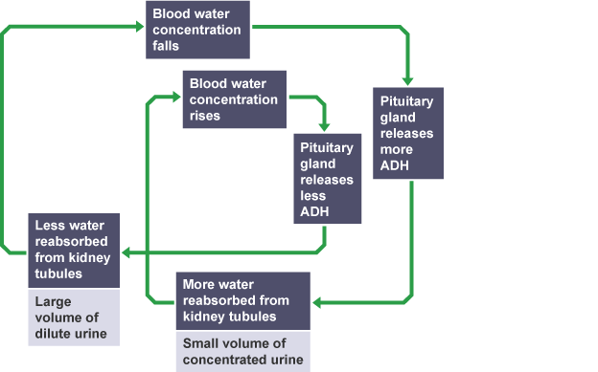
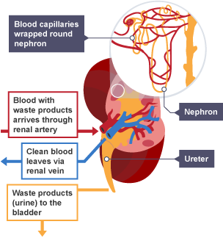
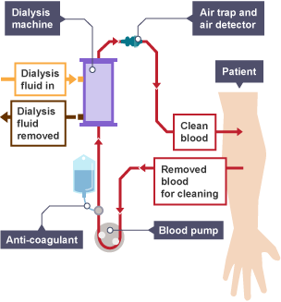
Dialysis:
Unfiltered blood that is high in urea is taken from a blood vessel in the arm, mixed with blood thinners or an anti-coagulant to prevent clotting, and pumped into the dialysis machine. Inside the machine the blood and dialysis fluid are separated by a partially permeable membrane the blood flows in the opposite direction to dialysis fluid, allowing exchange to occur between the two where a concentration gradient exists.
Dialysis fluid contains:
a glucose concentration similar to a normal level in the blood. This prevents the net movement of glucose across the membrane as no concentration gradient exists.
a concentration of ions similar to that found in normal blood plasma. This means movement of ions across the membrane only occurs where there is an imbalance. If the patient's blood is too low in ions, they will diffuse from the dialysis fluid into the blood, restoring the ideal level in the blood. If the patient's blood is too high in ions, the excess ions will diffuse from the blood to the dialysis fluid.
no urea. This meanes there is a large concentration gradient - meaning that urea moves across the partially permeable membrane, from the blood to the dialysis fluid, by diffusion. This is very important as it is essential that urea is removed from the patients' blood.
Separate Biology Only
Kidney Function:
Stage 1 - Filtration
Blood is transported to the kidney through the renal artery. Blood passes through the nephron inside the kidneys, there are many capillaries inside the kidney, and the blood is under high pressure at the start of the nephron, which aids the ultrafiltration of the blood. Small molecules are filtered out and pass into the nephron tubule. These small molecules include ureas, water, ions, and glucose. However, large molecules, such as blood proteins, are too big to fit through the capillary wall and remain in the blood.
Stage 2 - Selective reabsorption
Having filtered out small essential molecules from the blood - the kidneys must reabsorb the molecules which are needed, while allowing those molecules which are not needed to pass out in the urine. Therefore, the kidneys selectively reabsorb only those molecules which the body needs back in the bloodstream. The reabsorbed molecules include:
all of the glucose which was originally filtered out
as much water as the body needs to maintain a constant water level in the blood plasma
as many ions as the body needs to maintain a constant balance of mineral ions in the blood plasma
Stage 3 - The formation of urine
The molecules which are not selectively reabsorbed (the urea, excess water and ions) continue along the nephron tubule as urine. This eventually passes down to the bladder.
The affect of ADH: Different amounts of ADH are released into the bloodstream according to the concentration of water in the blood plasma. ADH is released by the pituitary
gland when the blood is too
concentrated and it
causes the kidney tubules
to become more permeable.
This allows more water to be
reabsorbed back into the blood
during selective reabsorption.
If a person has consumed a large
volume of water and has not lost
much as sweat, too much water
might be detected in the blood
plasma. If this occurs, less ADH
will be released, which results
in less water being reabsorbed
and a dilute and larger volume
of urine will be produced.
Maintaining water and nitrogen balance in the body: Water leaves the body via the lungs during exhalation.
Water, ions and urea are lost from the skin in sweat.
There is no control over water, ion or urea loss by the lungs or skin.
Excess water, ions and urea are removed via the kidneys in the urine.
If body cells lose or gain too much water by osmosis they do not function efficiently
The digestion of proteins from the diet results in excess amino acids which need to be excreted safely. In the liver these amino acids are deaminated to form ammonia. Ammonia is toxic and so it is immediately converted to urea for safe excretion.
 | Advantages | Disadvantages
Transplant | Patients can lead a more normal life without having to watch what they eat and drink Cheaper for the NHS overall. | Must take immune-suppressant drugs which increase the risk of infection Shortage of organ donors Kidney only lasts 8-9 years on average Any operation carries risks
Dialysis | Available to all kidney patients (no shortage) No need for immune-suppressant drugs | Patient must limit their salt and protein intake between dialysis sessions Expensive for the NHS The patient must be connected to this machinery 2-3 times a week for periods (on average) of between 4-6 hours at a time. Impacts on the patient's lifestyle Dialysis will only work for a limited amount of time before a transplant is needed, and sadly many patients will die before a suitable one is found.

Slide 5
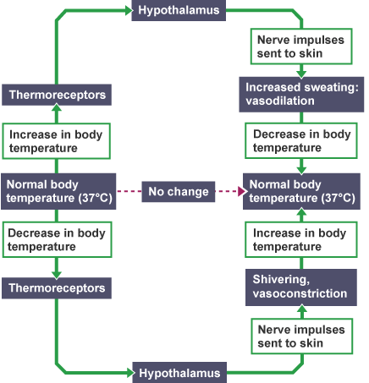
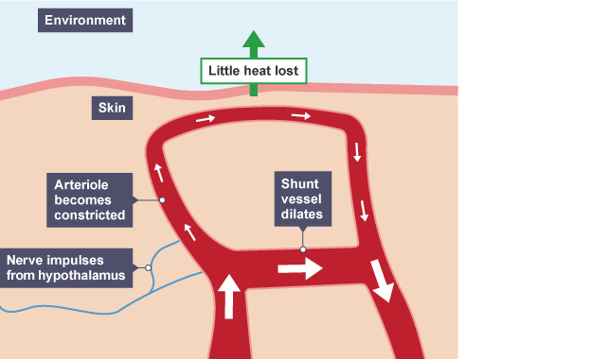
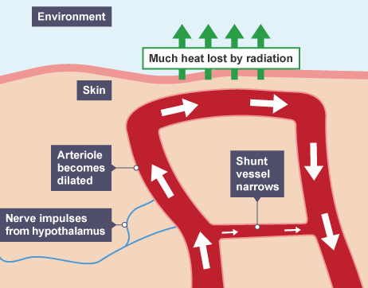
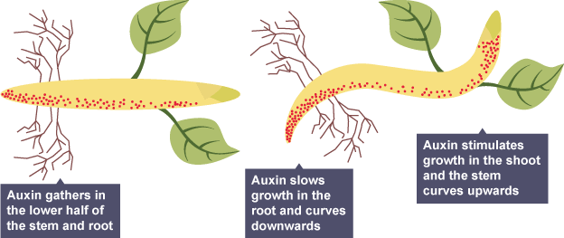
Control of body temperature:
Body temperature is monitored and controlled by the thermoregulatory centre in the brain. The thermoregulatory centre contains receptors sensitive to the temperature of the blood. The skin contains temperature receptors and sends nervous impulses to the thermoregulatory centre. If the body temperature is too high, blood vessels dilate (vasodilation) and sweat is produced from the sweat glands. Both these mechanisms cause a transfer of energy from the skin to the environment. If the body temperature is too low, blood vessels constrict (vasoconstriction), sweating stops and skeletal muscles contract (shiver).
Ethene controls cell division and ripening of fruits.
Fruit is often picked unripe and then ripened during transport and storage by adding ethene and then taken to the shops. Gibberellins, which are a group of plant hormones responsible for growth and development, are important for initiating seed germination. Low concentrations can be used to increase the speed of germination, and they stimulate cell elongation and cause plants to grow taller.
Separate Biology Only
Plant Hormones
Plants produce hormones to coordinate and control growth and responses to light (phototropism) and gravity (gravitropism or geotropism). Unequal distributions of auxin hormone cause unequal growth rates in plant roots and shoots.
There are two main types of tropisms:
positive tropisms – the plant grows towards the stimulus. E.g. In the plant stem, the response to light.
negative tropisms – the plant grows away from the stimulus. E.g. In the plant root, responses to light means the root grows away from the light
Auxins
Auxins are a family of plant hormones. They are mostly made in the tips of the growing stems and roots, which are known as apical meristems, and can diffuse to other parts of the stems or roots.
Auxins control the growth of plants by promoting cell division and causing elongation in plant cells (the cells get longer).
Stems and roots respond differently to high concentrations of auxins:
In a stem, the shaded side contains more auxin and grows longer, which causes the stem to grow towards the light. It is vital to note that the plant does NOT bend towards the light.
In a root, the shaded side contains more auxin and grows less - causing the root to bend away from the light.
Geotropism
when the stem grows against the force of gravity, this is known as a negative geotropism
when a root grows in the direction of the force of gravity, this is known as a positive geotropism
Just like phototropism, geotropism is also caused by an unequal distribution of auxin.
In a root placed horizontally, the bottom side contains more auxin and grows less - causing the root to grow in the direction of the force of gravity.
The opposite happens in a stem. When a stem placed horizontally, the bottom side contains more auxin and grows more - causing the stem to grow upwards against the force of gravity.
Required Practical: Investigate the effect of light or gravity on the growth of newly germinated seedlings
Mustard or cress seeds are a good choice for this investigation because they grow fast and their roots and stems are clearly visible.
Variables
Independent variable: Intensity, direction or colour of light. dark conditions.
Dependent variable: the mean height of seedlings.
Control variables: the number of seeds on each dish, how much they are spread out, the volume of water the seedlings are given, the temperature they are kept at.
Method
Put cotton wool into three petri dishes, and add the same volume of water to each dish.
Add ten seeds to each dish and place them in a warm place where they won’t be disturbed.
Allow the seeds to germinate, and add more water if the cotton wool dries out.
Once the seeds have germinated, ensure the petri dishes each contain the same number of seeds, and remove any extra seeds if necessary.
One petri dish will sit in full light on a windowsill, the second will be in a dark cupboard, and the final dish will be placed in partial light.
Every day for one week, measure the height of each seedling and record the results in a table. You must record the height of the individual seedlings on each day.
Calculate the mean of the seedlings each day, and compare the mean heights in the three different locations.

