Slide 1
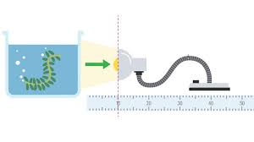
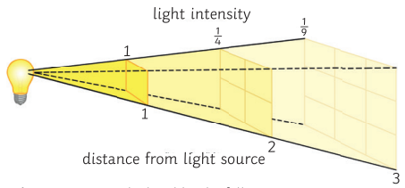
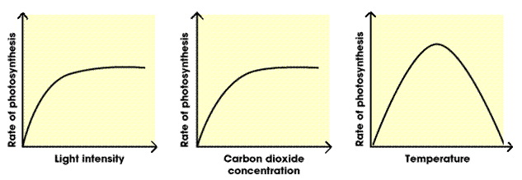
Bioenergetics
The Rate of Photosynthesis Required Practical
The rate of photosynthesis can be measured by monitoring the rate that oxygen is produced by plants. To do this we can count bubbles produced by water plants or measure the volume of oxygen produced
Method:
Set up a boiling tube containing 45 cm³ of sodium hydrogencarbonate solution (1%). Allow the tube to stand for a few minutes and shake to disperse any air bubbles that might form.
Cut a piece of the pondweed, Cabomba. The pondweed should be 8 cm long.
Use forcepts to place the pondweed in the boiling tube carefully. Make sure that you don't damage the pondweed, or cause the liquid to overflow.
Position the boiling tube so that the pondweed is 10 cm away from the light source. Allow the boiling tube to stand for five minutes. Count the number of bubbles emerging from the cut end of the stems in one minute. Repeat the count five times and record your results.
Calculate the average number of bubbles produced per minute. Repeat the experiment at different distances away from the light source.
Independent variable – distance from the light source/light intensity.
Dependent variable – the number of bubbles produced per minute.
Control variables – concentration of sodium hydrogencarbonate solution, temperature, using the same piece of Cabomba pondweed each time.
Photosynthesis
Photosynthesis is a chemical reaction which takes place in plants. It converts carbon dioxide and water into glucose and oxygen. It uses light energy to power the reaction which is absorbed by green chlorophyll. Because it absorbs energy, it is an endothermic reaction.
The whole reaction occurs inside chloroplasts in plant cells.
Photosynthesis can be represented by the following word and balanced symbol equations
Light
carbon dioxide + water ➔ glucose + oxygen
6CO₂ + 6H₂O ➔ C₆H₁₂O₆ + 6O₂
The inverse square law – Higher tier only
The inverse square law is used to describe light intensity at different distances from the source. It states that: the intensity of the light is inversely proportional to the square of the distance from the source.
Light intensity is proportional to 1/distance²
E.g. if the light source is 0.25m away, the light intensity will be 1/distance²
So 1/0.0625 = 16 arbitrary units
Limiting Factors
The rate of photosynthesis is affected by temperature, light intensity, carbon dioxide concentration and the amount of chlorophyll. These are referred to as limiting factors as if one is in short supply, it will limit the rate of reaction.
Increasing the light intensity or carbon dioxide concentration increases the rate of photosynthesis but does not do so indefinitely. The rate of photosynthesis will stop increasing as another limiting factor is in short supply.
Increasing the temperature increases the rate of photosynthesis until an optimum temperature is reached. Before the optimum temperature is reached the rate of photosynthesis is slowed by the particles involved in the chemical reaction, moving slowly. Above the optimum temperature the rate of photosynthesis decreases due to the denaturing of enzymes that act as catalyst for the reaction

Slide 2
Aerobic Respiration
Cellular respiration is a chemical reaction that takes place in the mitochondria of cells of all living organisms in order to release energy from glucose.
The energy released is used for movement, warmth and building larger molecules for growth and repair.
Respiration releases energy so it is exothermic.
Respiration can be either aerobic (using oxygen) or anaerobic (without oxygen)
Aerobic respiration can be represented by the following word and balanced symbol equations
glucose + oxygen ➔ carbon dioxide + water (+ energy)
C₆H₁₂O₆ + 6O₂ ➔ 6CO₂ + 6H₂O
Bioenergetics
Response to Exercise
When we exercise there is an increased demand for energy. To release this energy there is an increase rate of cellular respiration
The increased rate of cellular respiration requires an increase in oxygen and glucose to be delivered to cells.
To increase the oxygen in the body available for cellular respiration the body increases heart rate (to increase blood flow in order to transport oxygen and glucose), breathing rate and breath volume (to increase the intake of oxygen)
If insufficient oxygen is supplied anaerobic respiration will take place
Incomplete oxidation of glucose causes a build-up of lactic acid and creates an oxygen debt
Anaerobic Respiration
Anaerobic respiration in animal cells can be represented by the following word equation
glucose ➔ lactic acid (+ energy)
Anaerobic respiration is far less efficient than aerobic respiration, because of the incomplete oxidation of glucose, and so releases much less energy
Anaerobic respiration in plant and yeast cells can be represented by the following word equation
glucose ➔ ethanol + carbon dioxide (+ energy)
The products of anaerobic respiration in plant and yeast cells can be used for baking (carbon dioxide cause bread dough to rise) and producing alcohol (used in alcoholic drinks and biofuels)
Anaerobic respiration occurs in the cytoplasm of cells, rather than in mitochondria.
Metabolism
Metabolism is the sum of all the chemical reactions in a cell or in the body
The energy transferred by cellular respiration in cells is to make new molecules
Important factors contributing to an organism’s metabolism include reactions
such as –
Starch, glycogen and cellulose produced by converting glucose
Lipid molecules produced from fatty acids and glycerol
Proteins synthesised from glucose and nitrate ions
Respiration
The breakdown of proteins to form urea
Uses of Glucose in Plants
The glucose produced by photosynthesis can be used for
Respiration (a chemical reaction that releases the energy stored in glucose)
Converted to insoluble starch for storage
To produce fats and oils for energy storage (especially in seeds)
To produce cellulose that strengthens cell walls
To combine with nitrate ions (NO⁻₃) that are absorbed from the soil to produce amino acids for protein synthesis
Oxygen Debt
When a period of exercise is over, lactic acid must be removed. The body's tolerance of lactic acid is limited.
Lactic acid is taken to the liver by the blood, and either:
oxidised to carbon dioxide and water, or
converted to glucose, then glycogen - glycogen levels in the liver and muscles can then be restored
These processes require oxygen. This is why, when the period of activity is over, a person’s breathing rate and heart rate do not return to normal straightaway.
The amount of oxygen required to remove the lactic acid, and replace the body's reserves of oxygen, is called the oxygen debt.
Greenhouse Economics – Higher tier only
A greenhouse creates the most suitable conditions for growing plants.
Artificial lighting can provide light in darker winter days
A paraffin heater provides extra warmth and carbon dioxide is given off in combustion.
These additions can be expensive, but the cost is often outweighed by the additional yield of the crop.

