Slide 1
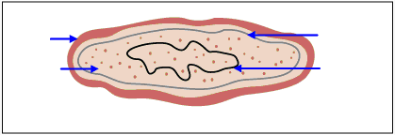
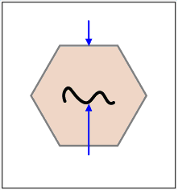
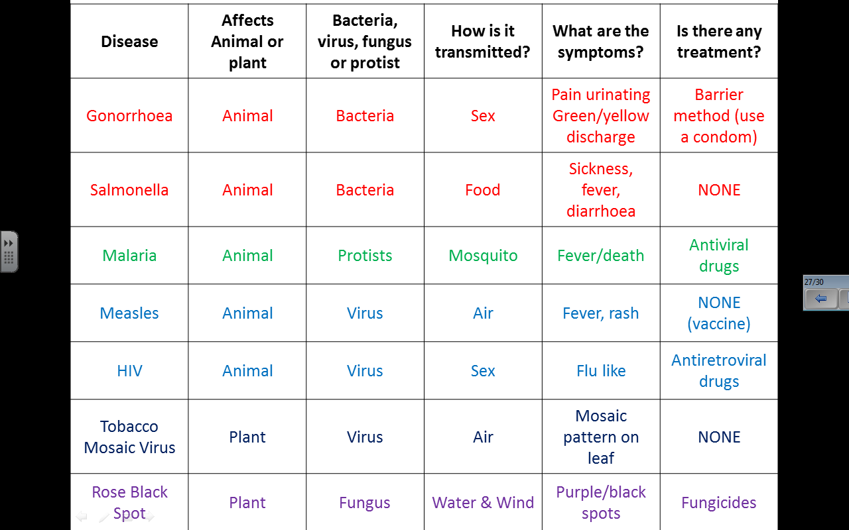
Cell wall
INFECTION & RESPONSE
Types of Disease
Cell membrane
Cytoplasm
Circle of DNA
Bacteria
1. Communicable (infectious) diseases
Protein Coat
Virus
Pathogens are microorganisms which cause diseases in plants and animals
Pathogens can be viruses, bacteria, fungi or protists
Diseases that can be passed on are called Communicable (infectious)
Diseases can be spread by direct contact (touch), water (drinking water) or air (carried on droplets when we cough or sneeze
BACTERIA – reproduce rapidly inside the body and produce toxins (poisons) that damage tissues and make us feel ill
VIRUSES – live and reproduce inside our cells causing cell damage. The cell bursting is what makes us feel ill.
PROTISTS – some are parasites and live in or on other organisms and can cause them damage. They are often transferred to the organism by a vector which doesn’t get the disease (for example a mosquito is the vector for malaria)
FUNGI – single celled organisms.
Strand of DNA
Viral diseases
TOBACCO MOSAIC VIRUS (TMV)
Affects growth as there is a lack of chlorophyll for photosynthesis to occur.
HIV
The virus attacks the body’s immune cells. Late stage HIV (AIDS) occurs when the body’s immune system becomes so damaged it can no longer deal with other infections.
MEASLES
Affects children mainly
Protist diseases
Fungal diseases
MALARIA
Protist lives in the mosquito. The mosquito is known as a vector. Spread is controlled by preventing the mosquitos from breeding and using mosquito nets to avoid being bitten.
ROSE BLACK SPOT
Causes purple/black spots on the leaves which often turn yellow and drop off. There is a lack of chlorophyll in these leaves so photosynthesis is reduced which affects growth.
Bacterial diseases
SALMONELLA
Food poisoning. In the UK, poultry are vaccinated against Salmonella.
GONORRHOEA
Bacteria developed resistance to penicillin so it became ineffective.

Slide 2
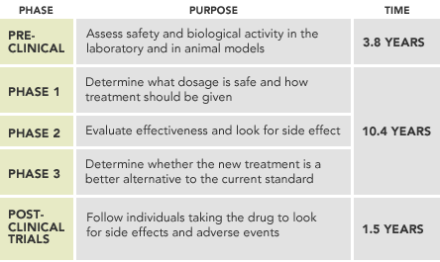
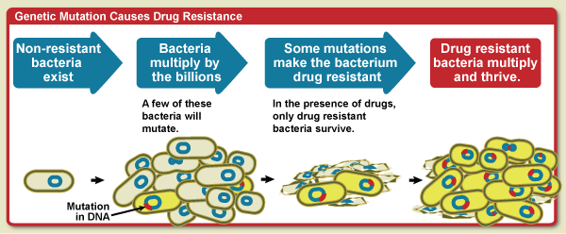
INFECTION & RESPONSE Fighting Disease
1. Human Defence Systems
4. Drug Development
The human body has many defence systems against pathogens; skin (barrier to pathogens entering), nose (hairs and mucus to trap pathogens), trachea and bronchi (cilia hairs and mucus to trap pathogens) stomach (hydrochloric acid to kill pathogens)
If a pathogen enters the blood stream then the immune system has white blood cells to destroy the pathogen in three ways:
1. Phagocytosis – the white blood cell ingests the pathogen and then enzymes destroy the pathogen
2. Antibody production – pathogens have specific antigens on their surface. White blood cells produce specific antibodies which lock onto the antigen. These are then ingested and destroyed by other white blood cells. If a person is infected with the pathogen again then the body will release the right antibodies very quickly.
3. Antitoxins – white blood cells release antitoxins which neutralise the toxins produced by the invading bacteria
Aspirin (painkiller or lower fever) found in willow
Digitalis (treat heart conditions) found in foxgloves
Alexander Fleming discovered Penicillin from the fungus Penicillium which kills bacteria
Today drugs are made on a large scale in the pharmaceutical industry. It often still starts with a chemical extracted from a plant.
Drugs must be tested and trialled before being used to check that they are safe and effective. They are tested for Toxicity, Efficacy and Dose
Preclinical - Test efficacy (does the drug work and produce the effect you’re looking for), to find out its toxicity (how harmful it is) and to find the best dosage (concentration that should be given and how often to take it)
Clinical trials are then tested on human volunteers. First healthy volunteers are used to make sure it doesn’t have any harmful side effects. Very low doses are given and then increased. If the drug is safe it is then tested on patients and the optimum dose is found (most effective and few side effects).
2. Vaccinations
This is a method for reducing the spread of disease.
A small amount of dead/inactive pathogen is injected into the body. This causes the white blood cells to produce antibodies. If the same pathogen enters the body then the white blood cells will respond quickly by releasing the right antibodies to prevent infection.
PROS: Help control lots of communicable diseases and prevents epidemics (big outbreak)
CONS: Sometimes they don’t work or you can have a bad reaction to a vaccine.
3. Antibiotics & Painkillers
Antibiotics (penicillin) help cure bacterial diseases by killing infective bacteria inside the body.
Antibiotics are specific for different bacteria.
Antibiotics have greatly reduced deaths from bacterial diseases.
Bacteria can mutate (their DNA changes). The resistant strain could cause a serious illness that can’t be treated by antibiotics (MRSA).
Patients are randomly put into two groups, one is given the drug and the others are given a placebo (a substance that does not contain the active drug).
In double blind trials the patient doesn’t know whether they’re getting the drug or placebo and neither does the doctor to avoid bias.
The results of a drugs trial isn’t published until it’s been peer reviewed to prevent false claims.
To slow down resistance doctors shouldn’t over prescribe antibiotics and you must always finish the whole course of antibiotics.
Antibiotics cannot kill viral pathogens
Painkillers are used to treat the symptoms of a disease but do not kill pathogens
It is difficult to develop drugs to kill viruses without damaging the body’s tissues

Slide 3
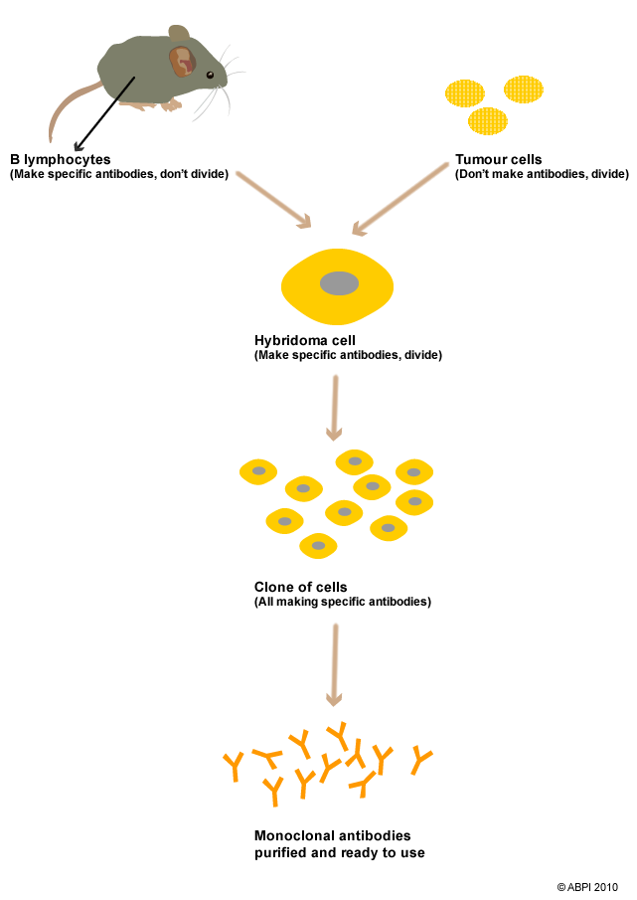
INFECTION & RESPONSE
TRIPLE SCIENCE CONTENT
1. MONOCLONAL ANTIBODIES
Producing Monoclonal Antibiotics.
Antibodies are produced by B-lymphocytes (a type of white blood cell). Monoclonal Antibodies are produced from a single white blood cell that has been cloned. They are identical and will target one specific protein antigen and so can target a specific cell or chemical in the body. Tumour cells divide rapidly and therefore a mouse B-lymphocyte is fused with a tumour cell to create a cell called a hybridoma which produces monoclonal antibodies. The hybridoma can be cloned and then the antibodies produced can be collected a purified.
Uses of Monoclonal Antibodies
Pregnancy tests – the hormone HCG in found in the urine of pregnant women. Pregnancy tests contain monoclonal antibodies that detect this hormone. When you wee on the stick the HCG sticks to the antibodies on the blue beads. The urine moves up the stick carrying the hormone and the beads. The beads and hormones bind to the antibodies that are stuck on the positive window. The blue beads get stuck on the strip turning it blue.
Treat Diseases – for cancer the monoclonal antibody can be bound to a radioactive substance, a toxic drug or a chemical which stops cells growing and dividing. It delivers the substance to the cancer cells without harming other cells in the body.
Used in labs and research to find specific substances by binding them with a fluorescent dye.
In labs to measure the levels of hormones and other chemicals in blood, or to detect pathogens.
Monoclonal antibodies create more side effects than expected. They are not as widely used as everyone hoped when they were first developed.
2. PLANT DISEASES
3. PLANT DEFENCES
Plants need mineral ions from the soil.
1. Nitrates – needed to make proteins for growth. Deficiency causes stunted growth
2. Magnesium ions – needed to make chlorophyll which is needed for photosynthesis. Deficiency causes chlorosis and yellow leaves.
Plants can get diseases (TMV and Rose black spot) by microbes and insects
Common signs a plant has a disease are: stunted growth, spots on leaves, patches of decay, abnormal growth, malformed stems or leaves, discolouration, presence of pests
Identifying which disease a plant has can be done by:
Reference to a gardening manual or website
Taking infected plant to a lab to identify the pathogen
Using testing kits that identify the pathogen using Monoclonal Antibodies
Physical defences – waxy cuticle (barrier), cell wall made of cellulose, layers of dead cells around their stems for protection (eg bark)
Chemical defences – produce chemicals and poisons
Mechanical defences – thorns, hairs, droop or curl, mimic other organisms to prevent being eaten

