Slide 1
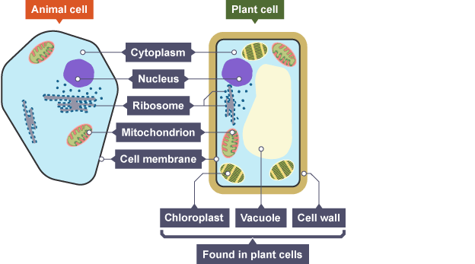
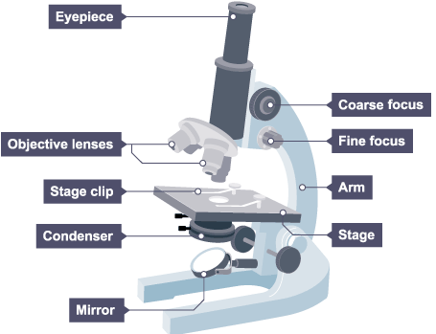
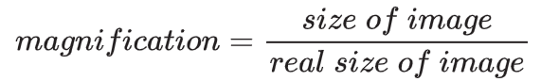
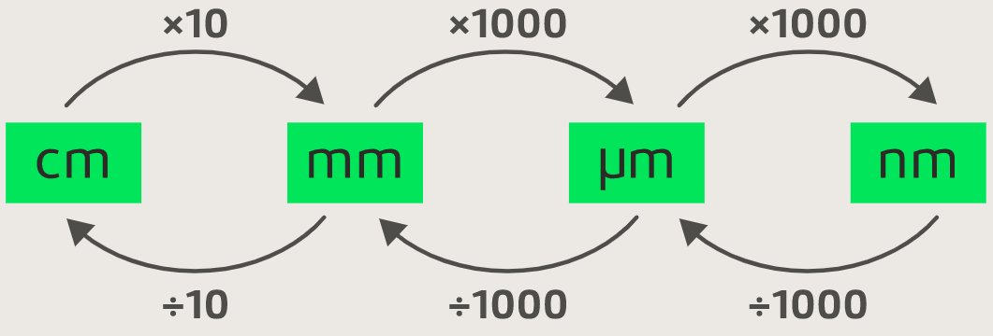
Eukaryotic & Prokaryotic Cells
A defining feature of eukaryotic cells is that their genetic material (DNA) is enclosed within a nucleus. Eukaryotic cells vary in size, usually between 10 and 100 µm and they have subcellular structures, each carrying out a particular function called organelles. Animal, plant and fungi are eukaryotic.
Bacterial cells are a type of prokaryotic cell. A defining feature of prokaryotic cells is that their genetic material is not enclosed within a nucleus, it is found as a single loop of DNA within the cytoplasm
Additional smaller, circular pieces of DNA called plasmids may also be present. The cell membranes of all prokaryotic cells are surrounded by a cell wall. Prokaryotic cells are much smaller in comparison to eukaryotic cells, with many measuring ~ 1 µm in size.
Cell Biology
Organelle | Function
Cytoplasm | A jelly-like material that contains dissolved nutrients and salts and structures called organelles. It is where many of the chemical reactions happen.
Nucleus | Contains genetic material, including DNA, which controls the cell’s activities.
Cell membrane | Its structure is permeable to some substances but not to others. It therefore controls the movement of substances in and out of the cell.
Mitochondria | Organelles that contain the enzymes for respiration, and where most energy is released in respiration.
Ribosomes | Tiny structures where protein synthesis occurs.
Chloroplast | Organelles that contains the green pigment, chlorophyll, which absorbs light energy for photosynthesis. Contains the enzymes needed for photosynthesis.
Cell wall | Made from cellulose fibres and strengthens the cell and supports the plant.
Permanent vacuole | Filled with cell sap to help keep the cell turgid.
Required Practical: use a light microscope to observe, draw and label a selection of plant and animal cells. A magnification scale must be included.
Microscopes use lenses to magnify the image of a biological specimen so that it appears larger.
Magnification of the microscope = magnification of eyepiece × magnification of objective. So, if the magnification of an eyepiece is ×10 and the objective is ×4, the magnification of the microscope is 40.
The formula to calculate magnification of an image is:
It’s important to work in the same units when calculating
magnification. Sizes of most cells are given in micrometres, μm.
For example: In a book, a photo of the cell measured 100 mm.
The real size of the cell shown is 0.05 mm. To calculate the
magnification: 100/0.05 = 2000
Method
Put the slide on the microscope stage and select the lowest power objective lens (this is usually ×4 objective lens). The end of the objective lens needs to almost touch the slide.
Turn the coarse adjustment knob to move the lens towards the slide. Look from the side (not through the eyepiece) when you are adjusting the lens.
Look through the eyepiece. Slowly turn the coarse adjustment knob in the direction to increase the distance between the objective lens and the slide. Do this until the cells come into focus.
When you have found some cells, switch to a higher power lens (×100 or ×400 magnification).
You will have to use the fine adjustment knob to bring the cells back into focus.
Make a clear, labelled drawing of some of the cells. Make sure that you draw and label any component parts of the cell. Use a pencil to draw the cells. Write the magnification underneath your drawing.

Slide 2
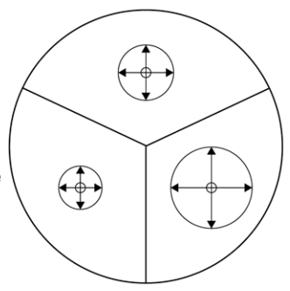
Cell specialisation
Cells may be have a specialised structure to carry out a particular function.
Development of Microscopes
Throughout their development, the magnification of light microscopes has increased, but very high magnifications are not possible. The maximum magnification with a light microscope is around ×1500.
The ability to see greater detail in an image depends on the resolution or resolving power. This is the ability to see two points as two points, rather than merged into one. The resolution of a light microscope is around 0.2 μm, or 200 nm. This means that it cannot distinguish two points closer than 200 nm.
Electron microscopes use a beam of electrons instead of light rays. They have a maximum magnification of around ×1 000 000, but images can be enlarged beyond that photographically. The limit of resolution of the electron microscope is now less than 1 nm.
Specialised Cell | Function | Adaptation
Sperm | To get the male DNA to the female DNA. | Streamlined head, long tail, lots of mitochondria to provide energy.
Neuron | To send electrical impulses around the body | Long to cover more distance. Has branched connections to connect in a network.
Muscle | To contract quickly | Long and contain lots of mitochondria for energy.
Root Hair | To absorb water from the soil. | A large surface area to absorb more water.
Phloem | Transports substances around the plant. | Pores to allow cell sap to flow. Cells are long and joined end to end.
Xylem | Transports water through the plant. | Hollow in the centre. Tubes are joined end-to-end
Cell differentiation
As an organism develops, cells differentiate to form different types of cells. Most types of animal cell differentiate at an early stage. Many types of plant cells retain the ability to differentiate throughout life. In mature animals, cell division is mainly restricted to repair and replacement. As a cell differentiates it acquires different sub-cellular structures to enable it to carry out a certain function. It has become a specialised cell.
Culturing microorganisms (biology only)
Bacteria multiply by simple cell division (binary fission) as often as once every 20 minutes if they have enough nutrients and a suitable temperature. Bacteria can be grown in a nutrient broth solution or as colonies on an agar gel plate. Uncontaminated cultures of microorganisms are required for investigating the action of disinfectants and antibiotics.
Required practical activity: investigate the effect of antiseptics or antibiotics on bacterial growth using agar plates
and measuring zones of inhibition
Method
Make sure your hands and work space are thoroughly clean before and after the experiment.
Use a permanent marker to mark the bottom of the nutrient agar plate (not the lid) as shown in the diagram below. Make sure that the lid
stays in place to avoid contamination.
Divide the plate into three equal sections and number them 1, 2 and 3 around the edge. Add your initials, the date and the name of the bacteria.
Put a different antiseptic onto each of three filter paper discs, being careful to shake off excess liquid to avoid splashing.
Carefully lift the lid of the agar plate at an angle away from your face. Do not open it fully.
Use the forceps to carefully put each disc onto each section. Make a note of which antiseptic is in each section.
Secure the lid of the agar plate in place using two small pieces of clear tape. Do not seal the lid all the way around as this creates anaerobic conditions. Anaerobic conditions will prevent the bacteria from growing and can encourage some other very nasty bacteria to grow.
Incubate the plate at 25 °C for 48 hours and store upside down to prevent water condensing on the agar and disturbing the bacteria growth.
Measure the diameter of the clear zone around each disc. Measure again at 90° to your first measurement, then calculate the mean diameter.
Two measurements of each clear zone

Slide 3
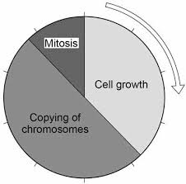
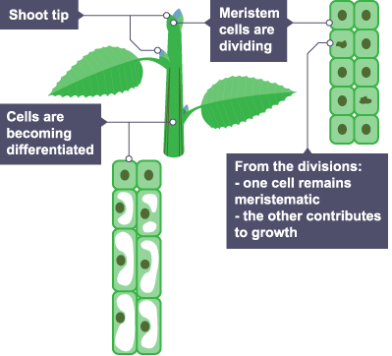
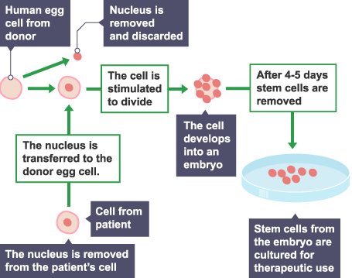
Cell Division
The nucleus of a cell contains chromosomes made of DNA molecules. Each chromosome carries a large number of genes. In body cells the chromosomes are normally found in pairs. Cells divide in a series of stages called the cell cycle.
Cell division by mitosis is important in the growth and development of multicellular organisms.
Stem Cells
A stem cell is an undifferentiated cell of an organism which is capable of giving rise to many more cells of the same type, and from which certain other cells can arise from differentiation.
An embryo develops from a fertilised egg. Cells at the early stages in the development of the embryo are stem cells. If cells are removed from the embryo – called embryonic stem cells - they will differentiate into any cell type.
Some stem cells remain in the bodies of adults – adult stem cells. Adult stem cells are found in limited numbers at certain locations in the body.
Adult stem cells can differentiate into related cell types only, for example, bone marrow cells can differentiate into blood cells and cells of the immune system but not other cell types.
During the cell cycle the genetic material is doubled and then divided into two identical cells. There are three stages to the cell cycle:
Cell growth: Before a cell can divide it needs to grow and increase the number of sub-cellular structures such as ribosomes and mitochondria.
Copying of chromosomes: The DNA replicates to form two copies of each chromosome.
Mitosis: one set of chromosomes is pulled to each end of the cell and the nucleus divides. Finally the cytoplasm and cell membranes divide to form two identical cells.
Stem Cells in Plants
Cell division in plants occurs in regions called meristems.
Cells of the meristem can differentiate to produce all types of plant cells at any time during the life of the plant.
The main meristems are close to the tip of the shoot, and the tip of the root.
Stem Cell Treatments
Treatment with stem cells may be able to help conditions such as diabetes and paralysis.
In therapeutic cloning an embryo is produced with the same genes as the patient. Stem cells from the embryo are not rejected by the patient’s body so they may be used for medical treatment. The use of stem cells has potential risks such as transfer of viral infection, and some people have ethical or religious objections.
Stem cells from meristems in plants can be used to produce clones of plants quickly and economically.
• Rare species can be cloned to protect from extinction.
• Crop plants with special features such as disease resistance can be cloned to produce large numbers of identical plants for farmers
Stem Cell Ethical issues
A source of embryonic stem cells is unused embryos produced by in vitro fertilisation (IVF)
For therapeutic cloning is it right to create embryos for therapy, and destroy them in the process?
At what stage of its development should an embryo be regarded as, and treated as a person?
Stem Cell Social issues
Educating the public about what stem cells can, and can't do, is important.
Whether the benefits of stem cell use outweigh the objections.

Slide 4
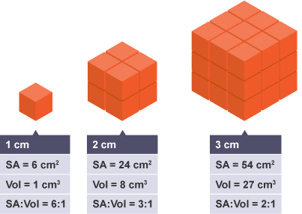
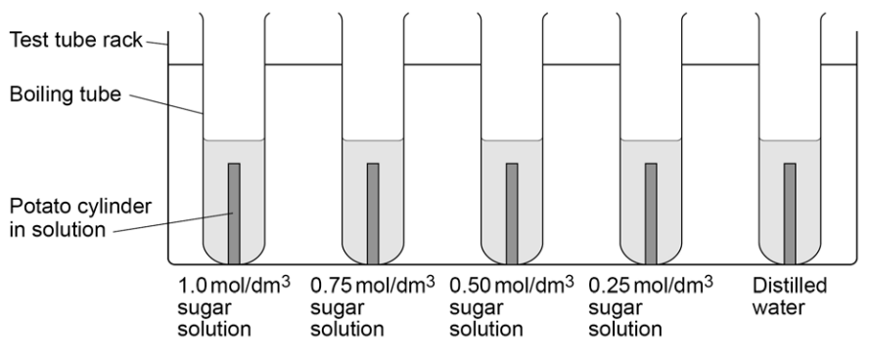
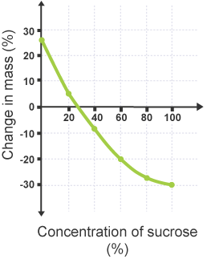
Diffusion
Substances may move into and out of cells across the cell membranes via diffusion. Diffusion is the spreading out of the particles of any substance in solution, or particles of a gas, resulting in a net movement from an area of higher concentration to an area of lower concentration. Some of the substances transported in and out of cells by diffusion are oxygen and carbon dioxide in gas exchange, and of the waste product urea from cells into the blood plasma for excretion in the kidney.
Factors which affect the rate of diffusion are:
• the difference in concentrations (concentration gradient)
• the temperature
• the surface area of the membrane.
A single-celled organism has a relatively large surface area to volume ratio. This allows sufficient transport of molecules into and out of the cell to meet the needs of the organism.
In multicellular organisms, surfaces and organ systems are specialised for exchanging materials. This is to allow sufficient molecules to be transported into and out of cells for the organism’s needs. For example, the small intestine and lungs in mammals, gills in fish, and the roots and leaves in plants, are adapted for exchanging materials
The effectiveness of an exchange surface is increased by:
• having a large surface area
• a membrane that is thin, to provide a short diffusion path
• (in animals) having an efficient blood supply
• (in animals, for gaseous exchange) being ventilated.
Osmosis
Water may move across cell membranes via osmosis. Osmosis is the diffusion of water from a dilute solution to a concentrated solution through a partially permeable membrane.
Required Practical: Investigate the effect of a range of concentrations of salt or sugar solutions on the mass of plant tissue.
Method
Use a cork borer to cut five potato cylinders of the same diameter. Use the knife to trim off any potato skin on each potato cylinder. Then trim each potato cylinder so that they are all the same length.
Accurately measure the mass and length of each potato cylinder. Record your measurements in a table
Measure 10 cm³ of each concentration of sugar or salt solution and put into boiling tubes. Label each boiling tube clearly.
Add one potato cylinder to each boiling tube and leave 24hrs
Remove the potato cylinders from the boiling tubes and carefully blot them dry with the paper towels.
Measure the new mass and length of each potato cylinder again. Record your measurements for each concentration in your table.
Calculate the percentage change in mass and length of each potato cylinder and record your results in your table.
Where the plotted line crosses the horizontal axis at 0 per cent change in mass, the sucrose concentration is equal to the concentration of dissolved substances in the potato cells.
This can be identified on the graph as the point which shows no change in mass, and therefore represents no net movement of water by osmosis.
Active Transport
Active transport moves substances from a more dilute solution to a more concentrated solution (against a concentration gradient). This requires energy from respiration. Active transport allows mineral ions to be absorbed into plant root hairs from very dilute solutions in the soil. Plants require ions for healthy growth. It also allows sugar molecules to be absorbed from lower concentrations in the gut into the blood which has a higher sugar concentration. Sugar molecules are used for cell respiration.

