Slide 1
GRADE 7+ IN RS
2025-2026

Slide 2
Your chances of grades 7+ in any subject will dramatically increase if you revise at home as well as work in school. There will be weekly RS revision sessions at school but they won’t be enough on their own. Basically, if you want grades 7+ you will need to revise at home as well as working in lessons.
You have already been shown the most effective revision strategies/methods eg flashcards etc
In the RS exams themselves, basically three things are going to increase your chances of grades 7+:
Depth of knowledge – all areas/topics
Correct structure of different types of answers (2/5/8/15 mark questions use different structures)
Timings – basically, it’s one mark per minute (for those who do not get extra time etc) so an 8 mark question, for example, is 8 minutes or slightly less. If you do it in 1 minute, you have not written enough and if you do it in 15 minutes, you have lost time for the other questions which could cost you a lot of marks.
To work on all three of these at once: Try writing practice answers, at home/LRC etc in timed conditions and you can give them to me for marking/feedback. Practice questions etc are available on the RS padlet site (see following slides).

Slide 3


LINK IS ALSO IN THE WEEKLY YEAR 11 NEWSLETTER SENT HOME!
CLICK PICS FOR LINKS
This is the official revision guide you can purchase
This is the textbook we use

Slide 4

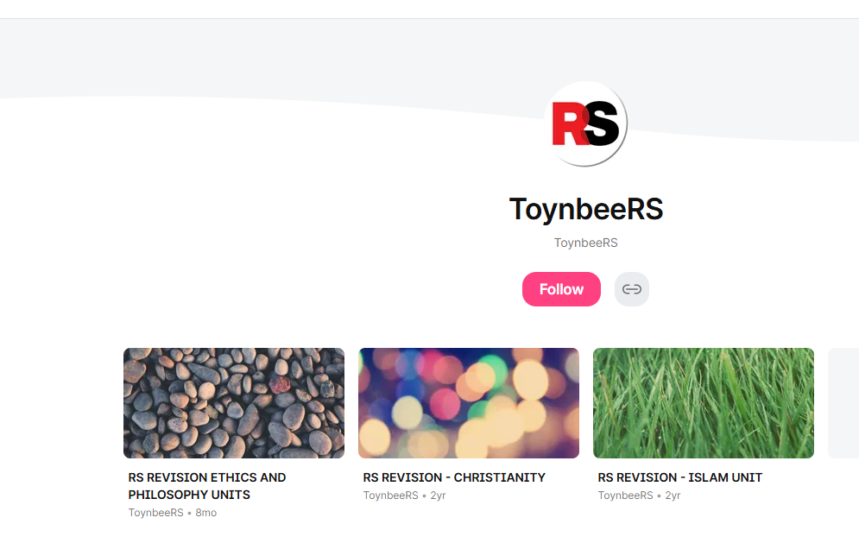
LINK IS ALSO IN THE WEEKLY YEAR 11 NEWSLETTER SENT HOME!
https://padlet.com/ToynbeeRS

Slide 5
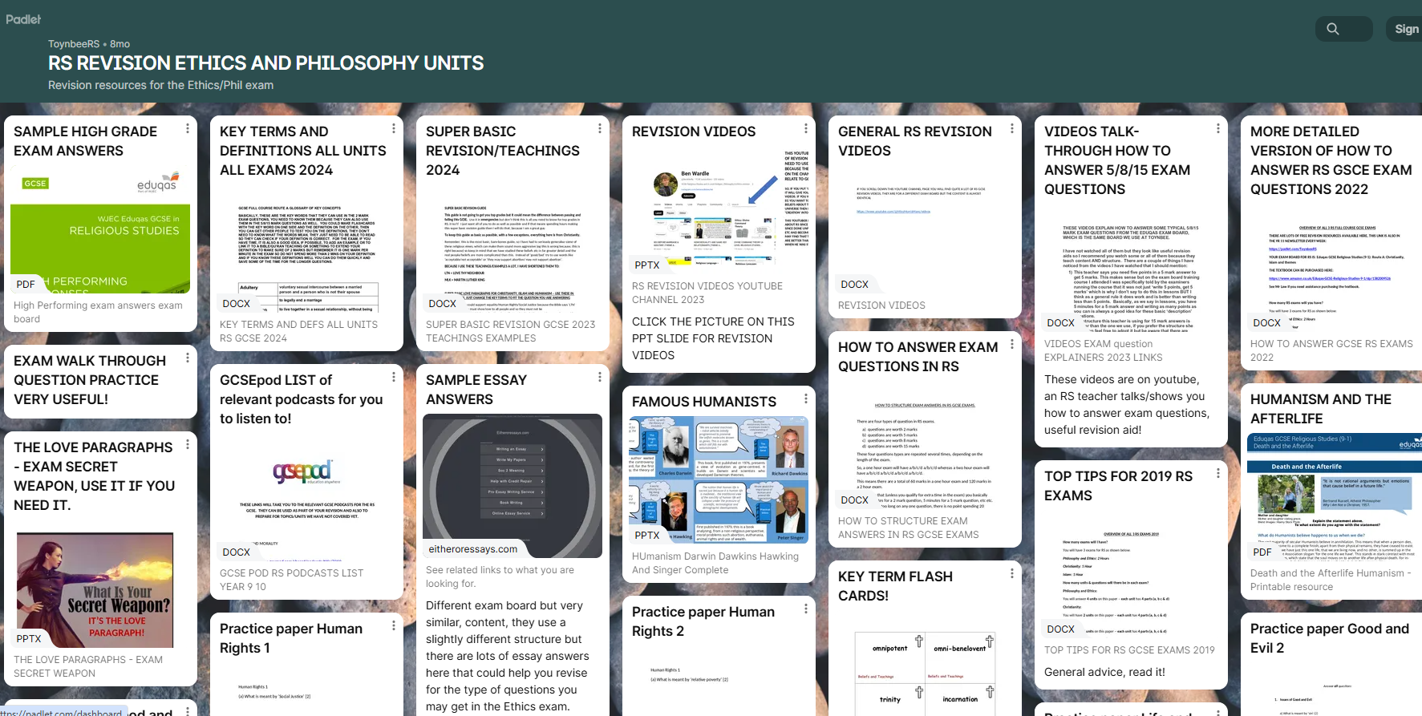
LINK IS IN THE WEEKLY YEAR 11 NEWSLETTER SENT HOME!

Slide 6
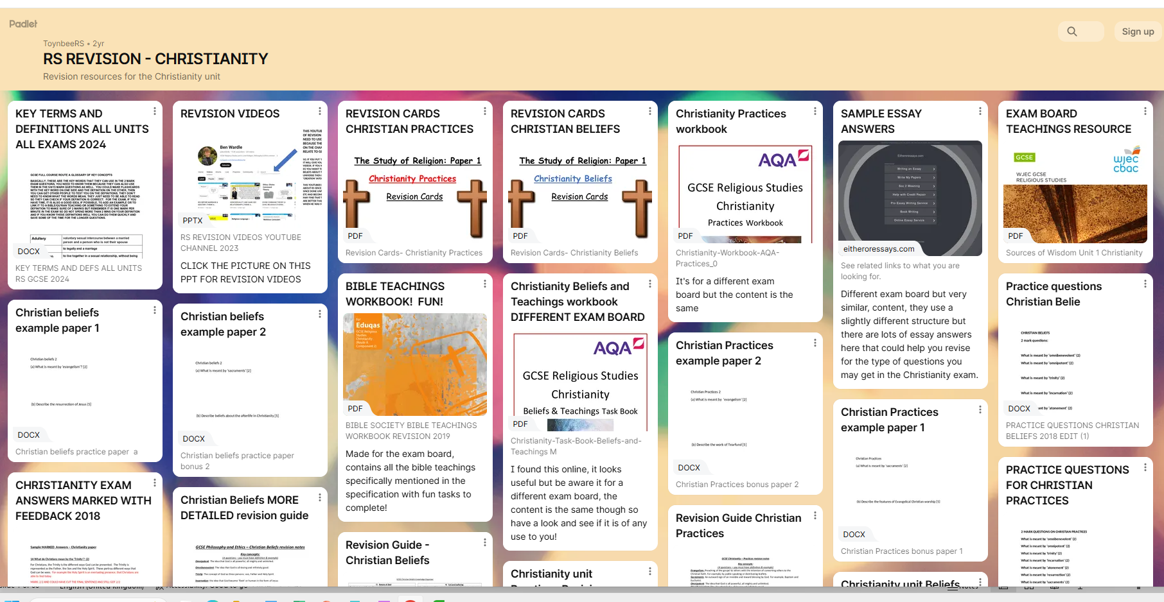
LINK IS IN THE WEEKLY YEAR 11 NEWSLETTER SENT HOME!

Slide 7
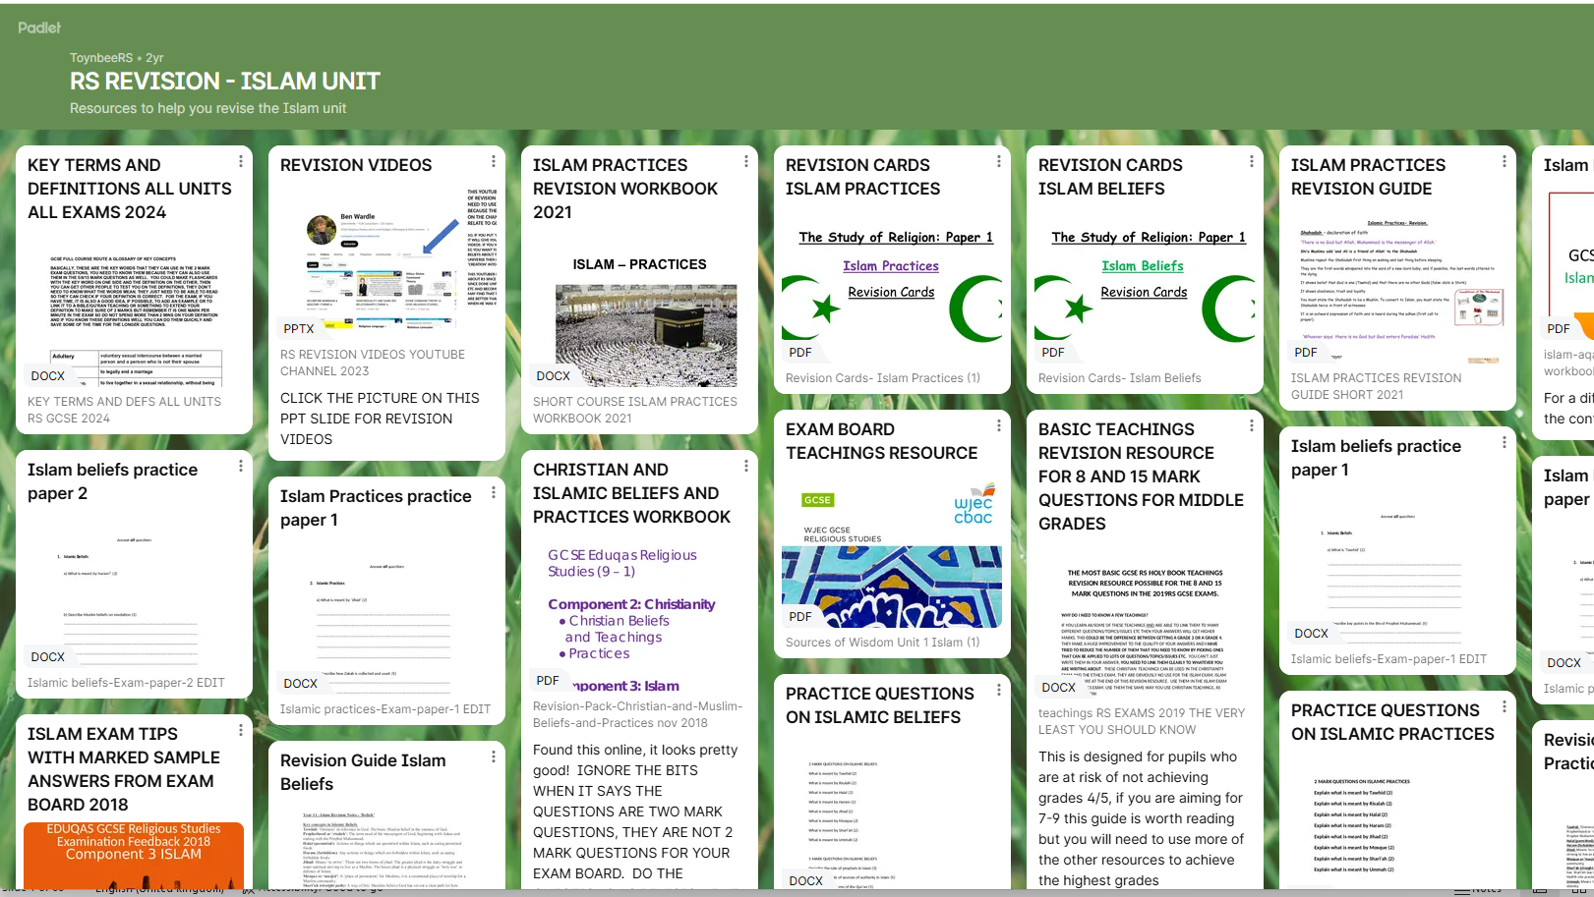
LINK IS IN THE WEEKLY YEAR 11 NEWSLETTER SENT HOME!

Slide 8
Structure of different types of answers (2/5/8/15 mark questions use different structures)
2 marks – ‘What is the meaning of (this word)’ - it will be one of the listed key terms. Write a sentence or two to define the meaning of the word. Add an example if you can, to be sure of 2 out of 2 marks
5 marks – Describe questions – DO NOT USE THE WORD ‘BECAUSE’ because they do not want you to explain in these answers, just describe.
The problem is that sometimes they will phrase the question as ‘Describe the importance of X’ which is difficult to answer without using ‘because’ or similar word. In this case, cross out your ‘because’. Eg, ‘Describe the importance of the Bible to Christians’. The obvious answer is ‘The Bible is important to Christians because it is their holy book’ but that includes the word ‘because’! So, cut the ‘because’ and replace with a comma = ‘The Bible is important to Christians, because it is their holy book’ this is now just description!
I know it’s annoying, it’s not my fault, it’s the exam board. I have asked them directly about this but have never been given a satisfactory answer about why they do this. It is what it is, folks.

Slide 9
Structure of different types of answers (2/5/8/15 mark questions use different structures)
8 marks – These are ‘Explain’ questions which will need words like ‘Because’. We use the basic PEE structure that we have used since the start of the course.
‘Explain Christian views on the use of Wealth’ (8)
POINT: Some Christians believe that their wealth should be used to help others
EVIDENCE: This is because of teachings in the Bible, such as The Parable of the Rich Man and Lazarus
EXAMPLE: This can influence them to donate to or even work for charities that help others, for example, Christian Aid.
YOU CAN ALSO LINK BACK TO QUESTION AT THE END, PARTICULARLY IF FOR SOME REASON YOU DID NOT INCLUDE THE WORDING OF THE QUESTION IN YOUR OPENING SENTENCE: This shows that some Christians believe that their wealth should be used to help others.
THIS PARAGRAPH IS CORRECT AND WILL SCORE MARKS. BUT IT IS NOT THE SORT OF PARAGRAPH THAT 7+ CANDIDATES SHOULD BE SATISIFIED WITH. NEXT SLIDE, HOW TO IMPROVE IT!

Slide 10
‘Explain Christian views on the use of Wealth’ (8)
POINT: Some Christians believe that their wealth should be used to help others.
EVIDENCE: This is because of teachings in the Bible, such as The Parable of the Rich Man and Lazarus
EXAMPLE: This can influence them to donate to or even work for charities that help others, for example, Christian Aid.
Notice the use of the wording of the question in the opening line, this shows focus and relevance to the examiner and helps you to keep focus in your answer
Correct but short, lacks detail. Examiner wants to give you marks but needs more relevant detail to do that. Basically, you need to add a sentence of explanation for what this teaching is about and why it relates to the subject of ‘wealth’. Also, why are you only using one teaching? This one is wealth-specific which is great but all the usual ‘Love teachings’ also apply here, so add more, eg ‘Love thy neighbour’ to increase depth of knowledge and marks.
Same again! Correct but short, lacks detail. Examiner wants to give you marks but needs more relevant detail to do that. Basically, how does Christian Aid actually help people using the donations it receives? Can you add another example as well? What about Tearfund? What about the Trussell Trust? Eastleigh Food Bank?

Slide 11
‘Explain religious views on the use of Wealth’ (8)
POINT: Some Christians believe that their wealth should be used to help others.
EVIDENCE: This is because of teachings in the Bible, such as The Parable of the Rich Man and Lazarus
EXAMPLE: This can influence them to donate to or even work for charities that help others, for example, Christian Aid.
Notice the use of the wording of the question in the opening line, this shows focus and relevance to the examiner and helps you to keep focus in your answer
8 MARK ANSWERS -- EXAM PAPER HAS ONE SIDE OF A4 FOR THESE. THAT’S PARTLY IN CASE YOU HAVE BIG HANDWRITING BUT IT ALSO MEANS YOU NEED TO WRITE AS MUCH AS YOU CAN IN ABOUT 7-8 MINUTES MAXIMUM.
THIS COULD BE SEVERAL SHORT PEE PARAGRAPHS OR 1 / 2 BIG ONES!
REMEMBER, ON THE ETHICS PAPER THEY WILL NOT SPECIFY THE RELIGION OR RELIGIOUS TRADITION. SO YOU CAN USE CHRISTIANITY, ISLAM, CATHOLICS, PROTESTANTS, SUNNI, SHIA. IF YOU KNOW ANOTHER RELIGION, EG HINDUISM, YOU CAN ADD THAT TOO!
Correct but short, lacks detail. Examiner wants to give you marks but needs more relevant detail to do that. Basically, you need to add a sentence of explanation for what this teaching is about and why it relates to the subject of ‘wealth’. Also, why are you only using one teaching? This one is wealth-specific which is great but all the usual ‘Love teachings’ also apply here, so add more, eg ‘Love thy neighbour’ to increase depth of knowledge and marks.
Same again! Correct but short, lacks detail. Examiner wants to give you marks but needs more relevant detail to do that. Basically, how does Christian Aid actually help people using the donations it receives? Can you add another example as well? What about Tearfund? What about the Trussell Trust? Eastleigh Food Bank?

Slide 12
IF YOU ARE STRUGGLING TO ADD DETAIL…CALM DOWN, BREAK YOUR ANSWER DOWN AND EXTEND EACH POINT.
Some Christians, for example, Catholics and Protestants..(ADDED DETAIL AND SHOWN GREATER DEPTH OF KNOWLEDGE) etc etc!
‘Explain Christian views on the use of Wealth’ (8)
POINT: Some Christians believe that their wealth should be used to help others.
EVIDENCE: This is because of teachings in the Bible, such as The Parable of the Rich Man and Lazarus
EXAMPLE: This can influence them to donate to or even work for charities that help others, for example, Christian Aid.
What is the Bible? Why is it important to Christians? Link to God, why is God important to Christians? Why are they doing what God tells them to? Parables are stories told by Jesus, so mention Jesus, why is Jesus important to Christians? Add a brief (one or two sentences, don’t overdo the description as it is an 8 mark ‘explain’ answer) summary of the story/meaning of the parable..(ADDED DETAIL AND SHOWN GREATER DEPTH OF KNOWLEDGE) etc etc!
Learn some specific things that the charity/example does and add it to answers..(ADDED DETAIL AND SHOWN GREATER DEPTH OF KNOWLEDGE) etc etc!

Slide 13
TIPS FOR 8 MARK QUESTIONS!
‘EXPLAIN X FROM ONE/TWO DIFFERENT RELIGIONS OR RELIGIOUS TRADITIONS’ (8)
IN THIS CONTEXT, ‘TRADITIONS’ DOES NOT MEAN ‘TRADITIONALLY CHRISTIANS EAT TURKEY AT CHRISTMAS’.
BASICALLY, THESE QUESTIONS ARE ASKING YOU TO WRITE ABOUT ONE/TWO RELIGIONS (EG CHRISTIANITY AND ISLAM) OR ONE/TWO GROUPS/DENOMINATIONS WITHIN A RELIGION (EG CATHOLICS/PROTESTANTS OR SUNNI/SHIA’
SO, IN THE CASE OF TWO RELIGIONS/TRADITIONS, YOUR PARAGRAPHS START SOMETHING LIKE THIS…
MANY CHRISTIANS….
MANY MUSLIMS
OR
MANY CATHOLICS
MANY PROTESTANTS
ETC

Slide 14
TIPS FOR 8 MARK QUESTIONS!
‘EXPLAIN X FROM ONE/TWO DIFFERENT RELIGIONS OR RELIGIOUS TRADITIONS’ (8)
IN THIS CONTEXT, ‘TRADITIONS’ DOES NOT MEAN ‘TRADITIONALLY CHRISTIANS EAT TURKEY AT CHRISTMAS’.
BASICALLY, THESE QUESTIONS ARE ASKING YOU TO WRITE ABOUT ONE/TWO RELIGIONS (EG CHRISTIANITY AND ISLAM) OR ONE/TWO GROUPS/DENOMINATIONS WITHIN A RELIGION (EG CATHOLICS/PROTESTANTS OR SUNNI/SHIA’
SO, IN THE CASE OF TWO RELIGIONS/TRADITIONS, YOUR PARAGRAPHS START SOMETHING LIKE THIS…
MANY CHRISTIANS….
MANY MUSLIMS
OR
MANY CATHOLICS
MANY PROTESTANTS
ETC
IMPORTANT: IF YOU CAN ONLY WRITE ABOUT ONE RELIGION AND IT IS ASKING FOR TWO, EG YOU ONLY KNOW TWO CHRISTIAN VIEWS ON ABORTION, AND YOU CAN’T REMEMBER SPECIFIC CATHOLIC/PROTESTANT VIEWS, YOU CAN DO ONE PARAGRAPH USING ‘MANY CONSERVATIVE CHRISTIANS…’ AND ONE PARAGRAPH USING ‘MANY LIBERAL CHRISTIANS’. THIS WILL BE ACCEPTED AS TWO SPECIFIC TYPES OF CHRISTIAN BY THE EXAMINER.
BASICALLY, ‘CONSERVATIVE CHRISTIANS’ TEND TO BE STRICTER, MORE TRADITIONAL, RULE-BASED, SO THEY ARE USUALLY ANTI-ABORTION, ANTI-EUTHANASIA, PRO DEATH PENALTY ETC
‘LIBERAL CHRISTIANS’ TEND TO BE MORE ACCEPTING, MORE OPEN TO NEW IDEAS AND CHANGES IN SOCIETY ETC SO THEY ARE MORE LIKELY TO BE PRO-CHOICE, PRO EUTHANASIA AND ANTI DEATH PENALTY.

Slide 15
Notice the use of the wording of the question in the opening line, this shows focus and relevance to the examiner and helps you to keep focus in your answer
‘Explain Christian views on the use of Wealth’ (8)
POINT: Some Christians believe that their wealth should be used to help others.
EVIDENCE: This is because of teachings in the Bible, such as The Parable of the Rich Man and Lazarus
EXAMPLE: This can influence them to donate to or even work for charities that help others, for example, Christian Aid.
Correct but short, lacks detail. Examiner wants to give you marks but needs more relevant detail to do that. Basically, you need to add a sentence of explanation for what this teaching is about and why it relates to the subject of ‘wealth’. Also, why are you only using one teaching? This one is wealth-specific which is great but all the usual ‘Love teachings’ also apply here, so add more, eg ‘Love thy neighbour’ to increase depth of knowledge and marks.
Same again! Correct but short, lacks detail. Examiner wants to give you marks but needs more relevant detail to do that. Basically, how does Christian Aid actually help people using the donations it receives? Can you add another example as well? What about Tearfund? What about the Trussell Trust? Eastleigh Food Bank?
THIS 8 MARK PARAGRAPH STRUCTURE IS ALSO USED IN 15 MARK ANSWERS –
WE JUST ADD EVALUATION.
SEE NEXT SLIDE…

Slide 16
Structure of different types of answers (2/5/8/15 mark questions use different structures)
THIS 8 MARK PARAGRAPH STRUCTURE IS ALSO USED IN 15 MARK ANSWERS –
WE JUST ADD EVALUATION.
‘Rich people should help the poor’ Discuss. (15)
POINT: Some Christians believe that their wealth should be used to help others, such as poor people.
EVIDENCE: This is because of teachings in the Bible, such as The Parable of the Rich Man and Lazarus
EXAMPLE: This can influence them to donate to or even work for charities that help poor people, for example, Christian Aid.
THEN YOUR SECOND PARAGRAPH HAS TO START WITH AN EVALUATIVE CONNECTIVE! IN THIS CASE, ‘ALSO’ WOULD WORK…
POINT: ALSO Some Muslims believe that their wealth should be used to help others, such as poor people.
EVIDENCE: This is because of Islamic teachings such as The Pillar of Zakat, donating 2.5% of their wealth to charity every year
EXAMPLE: This can influence them to donate to or even work for charities that help poor people, for example, Islamic Relief.
THIS IS THE MINIMUM YOU NEED TO DO FOR A 15 MARK ANSWER! IF YOU DO NOT PUT THE EVALUATIVE CONNECTIVE ON THE SECOND PARAGRAPH, YOU WILL SCORE MUCH LOWER MARKS THAN SOMEONE WHO PUTS THE CONNECTIVE IN. SO DO IT!

Slide 17
Structure of different types of answers (2/5/8/15 mark questions use different structures)
THIS 8 MARK PARAGRAPH STRUCTURE IS ALSO USED IN 15 MARK ANSWERS – WE JUST ADD EVALUATION.
7+:
Both paragraphs need bulking out with greater explanation of teachings and examples
Both paragraphs need bulking out with evaluation. Basically, the benefits for the ‘Individual and Society’ – this is usually something like:
Individual: How does ‘helping the poor’ benefit the individual person donating? Reward in Heaven, obeying God, helping others right now in the real world.
Benefit the individual person receiving the donation? Reduces their suffering etc.
Benefit society? Reduces overall poverty/suffering etc.
What you write in your evaluation is dependent on what you write in your answer, I can’t just give you a list of ‘Evaluation’ points to make.
‘Rich people should help the poor’ Discuss. (15)
POINT: Some Christians believe that their wealth should be used to help others, such as poor people.
EVIDENCE: This is because of teachings in the Bible, such as The Parable of the Rich Man and Lazarus
EXAMPLE: This can influence them to donate to or even work for charities that help poor people, for example, Christian Aid.
THEN YOUR SECOND PARAGRAPH HAS TO START WITH AN EVALUATIVE CONNECTIVE! IN THIS CASE, ‘ALSO’ WOULD WORK…
POINT: ALSO Some Muslims believe that their wealth should be used to help others, such as poor people.
EVIDENCE: This is because of Islamic teachings such as The Pillar of Zakat, donating 2.5% of their wealth to charity every year
EXAMPLE: This can influence them to donate to or even work for charities that help poor people, for example, Islamic Relief.
Sentence starters for evaluation:
Basic: ‘This is a good thing because…(eg Christian Aid can use this money to save people’s lives)
Advanced: ‘This is a strong argument that rich people should help the poor because…(eg by donating their Zakat money, the individual Muslim is fulfilling their duty to Allah and could be rewarded in the afterlife and society benefits from the increase in charitable donations and the help this provides to poorer communities’

Slide 18
REMEMBER: 15 mark questions are ‘Discuss’ questions.
You need at least two views but you can have as many views as you want, you just can’t have only one because that would not be a ‘discussion’
Does not have to be ‘agree/disagree’, can be ‘agree/agree’, ‘disagree/disagree’ etc etc.
Some candidates take 30 seconds at the start to write a little note on the exam paper as a guide for their answer. Eg ‘Christians – parable Rich Man Lazarus – Christian Aid + Islam – Zakat – Islamic Relief. This can help focus your thoughts and remind you what you are going to write.
DO NOT SPEND ALL THE 15 MINS WRITING ONE VIEW/PARAGRAPH, IT IS ALMOST POINTLESS! YOU WILL GET HIGHER MARKS WITH TWO WEAK VIEWS/PARAGRAPHS THAN ONE STRONG VIEW/PARAGRAPH BECAUSE OF THE RULE ABOUT ‘DISCUSS’ IN YOUR ANSWER.
DO NOT BOTHER EVALUATING IN 5 OR 8 MARK ANSWERS, IT IS NOT GOING TO SCORE MARKS!

Slide 19
Exam skills:
You can do the questions in any order. Read the questions carefully, doing the 8/15 mark questions first is not a bad idea, particularly if you struggle with keeping to the time limit.
Examiners cannot penalise you for repeating teachings/examples etc in different questions. This is why we focus on a relatively small number of teachings that can be applied to a variety of issues/topics eg Love thy Neighbour. This is also why we have pre-prepared paragraphs that can be memorised and used in answers repeatedly to speed up your answers and score higher marks…

Slide 20
The love paragraph!
Pre-prepared paragraphs that can be memorised and used in answers repeatedly to speed up your answers and score higher marks…
SPECIALIST LANGUAGE AND SOURCES OF AUTHORITY
Basic 8 mark answer paragraph structure
Use also in 15 mark answers BUT YOU MUST ADD EVALUATION, even if just an evaluative connective at start of paragraph, eg ‘However’.
TEACHINGS
MLK/CHRISTIAN AID/TEARFUND
THIS IS A STRONG ARGUMENT BECAUSE..
INFLUENCE OF THESE ON BELIEVERS
D (15 mark) QUESTIONS ONLY – MORAL EVALUATION
15 mark answers only

Slide 21
THE LOVE PARAGRAPH FOR CHRISTIANITY!
SOME CHRISTIANS WOULD AGREE/DISAGREE WITH (TOPIC OF THE QUESTION eg ABORTION) BECAUSE THE BIBLE SAYS ‘LOVE THY NEIGHBOUR’, WHICH MEANS THAT THEY MUST SHOW UNCONDITIONAL (AGAPE) LOVE TO ALL PEOPLE, THIS IS THE MESSAGE OF THE PARABLE OF THE GOOD SAMARITAN. JESUS ALSO TOLD HIS FOLLOWERS TO ‘LOVE ONE ANOTHER’ AND ‘BLESSED ARE THE PEACEMAKERS’ THIS MEANS THAT THEY SHOULD BASE THEIR MORAL ACTIONS ON THE BASIS OF THE MOST LOVING ACTION, SO THEY WILL ALLOW (ABORTION ETC). THEY ALSO DO THIS BECAUSE THEY BELIEVE THEY WILL BE JUDGED BY GOD AT THE END OF THEIR LIVES AND REWARDED WITH HEAVEN OR PUNISHED WITH HELL BASED ON THE THEIR ACTIONS IN LIFE, THIS IS BECAUSE OF TEACHINGS SUCH AS ‘THE PARABLE OF THE SHEEP AND GOATS’ WHICH CLEARLY EXPLAIN THE CONSEQUENCES OF CARING FOR OTHER PEOPLE. THIS WILL INFLUENCE TO…MLK, CHRISTIAN AID, TEARFUND (EXPLAIN WHAT THEY DO)
THIS IS A STRONG ARGUMENT BECAUSE… (WHAT ARE THE GOOD/BAD THINGS FOR A PERSON OR SOCIETY IN GENERAL IF THIS IS DONE/NOT DONE) IT HELPS POOR PEOPLE, OR IT GIVES WOMEN CONTROL OVER THEIR BODIES (ABORTION) OR IT ENDS SOMEONE’S SUFFERING (ASSISTED SUICIDE) etc etc
AND/OR
THIS IS A WEAK ARGUMENT BECAUSE (BAD THINGS, EG GOD HAS A PLAN FOR EVERYONE EVEN BEFORE THEY ARE BORN – abortion) ETC ETC.
7+
EXTEND THIS PARAGRAPH WITH MORE TEACHINGS/ MORE EXPLANATION OF EXAMPLES, MORE EVALUATION ETC.

Slide 22
LOVE PARAGRAPH FOR ISLAMIC VIEWS
SOME MUSLIMS WILL AGREE/DISAGREE BECAUSE THERE ARE MANY ISLAMIC TEACHINGS EMPHASISING THE IMPORTANCE OF (LOVE/PEACE/EQUALITY/HUMANS RIGHTS ETC), SUCH AS THE PILLAR OF ZAKAT, WHICH MEANS THAT MUSLIMS SHOULD GIVE 2.5% OF THEIR WEALTH TO CHARITY EVERY YEAR. ALSO, PROPHET MUHAMMAD SAID ‘WE ARE ALL EQUAL LIKE THE TEETH OF A COMB’. THIS IS BECAUSE MUSLIMS WANT TO HELP THOSE LESS FORTUNATE/PROMOTE EQUALITY…HUMAN RIGHTS…SOCIAL JUSTICE etc. ANOTHER TEACHING ON EQUALITY COULD BE SAWM, FASTING DURING RAMADAN, THIS ALLOWS MUSLIMS TO EXPERIENCE HUNGER, AND SO EMPATHISE WITH THE POOR THIS MAKES THEM MORE LIKELY TO HELP THE POOR
THIS COULD INFLUENCE THEM TO SUPPORT CHARITIES SUCH AS ISLAMIC RELIEF/MUSLIM AID (ADD SOME DETAIL ABOUT WHAT THESE CHARITIES DO)
A GOOD THING ABOUT THIS IS..(OR ‘THIS IS A STRONG ARGUMENT BECAUSE…)
BAD THINGS..(OR ‘THIS IS A WEAK ARGUMENT BECAUSE…)
7+
EXTEND THIS PARAGRAPH WITH MORE TEACHINGS/ MORE EXPLANATION OF EXAMPLES, MORE EVALUATION ETC.

Slide 23
HUMANIST LOVE PARAGRAPH
HUMANISTS SUCH AS STEPHEN FRY AND RICHARD DAWKINS WILL AGREE/DISAGREE BECAUSE ACTIVELY DOING GOOD IN THE WORLD IS OF CENTRAL IMPORTANCE TO HUMANISM, NOT BECAUSE THEY FOLLOW A HOLY BOOK OR EXPECT TO BE REWARDED/PUNISHED IN THE AFTERLIFE BUT BECAUSE THEY BELIEVE WE ONLY HAVE ‘ONE LIFE AND ONE WORLD’ AND WE HAVE TO MAKE THIS LIFE AND THIS WORLD AS GOOD FOR ALL OF US AS WE CAN DURING THIS ONE LIFETIME. SO, THEY WILL TRY TO TAKE THE MOST LOVING /KIND ACTION IN ANY CIRCUMSTANCE, EG IF IT IS LOVING TO HELP THE POOR /ALLOW ABORTION/ALLOW ASSISTED SUICIDE ETC ETC ETC THEN THEY WILL SUPPORT THIS/AGREE/DISAGREE WITH IT.
GOOD THINGS/BAD THINGS ABOUT THIS…ETC ETC
7+
EXTEND THIS PARAGRAPH WITH MORE TEACHINGS/ MORE EXPLANATION OF EXAMPLES, MORE EVALUATION ETC.

Slide 24
IMPORTANT TIPS!
THE EXAMINERS ARE REALLY IMPRESSED BY:
‘DIVERSITY OF VIEWS WITHIN A RELIGION’ WHICH IS WHY IT IS REALLY USEFUL IF YOU CAN WRITE ABOUT DIFFERENT CHRISTIAN BELIEFS IN THE SAME ANSWER (EG CATHOLIC/PROTESTANT, SUNNI/SHIA, CONSERVATIVE/LIBERAL)
‘GOLDEN NUGGETS’ – THIS NAUSEATINGLY CRINGE TERM IS USED BY THE EXAM BOARD TO SIGNIFY POINTS MADE IN ANSWERS THAT SURPRISE THEM, SO BASICALLY IT’S STUFF THAT IS NOT IN THE TEXTBOOK. THIS IS WHY WE COVER STUFF IN LESSONS THAT IS NOT IN THE TEXTBOOK, EG THE MURDER OF STEPHEN LAWRENCE. BUT THERE IS NO REASON WHY YOU CAN’T ADD YOUR OWN ‘GOLDEN NUGGETS’ WHEN YOU GET THE CHANCE. ANYTHING RELEVANT TO THE TOPIC OF YOUR ANSWER CAN GAIN MARKS. SO, IF YOU ARE WRITING ABOUT SOMETHING AND YOU THINK ‘HANG ON, THAT LINKS TO SOMETHING I SAW ON THE NEWS, OR A DOCUMENTARY, OR A BOOK, OR SOMETHING I SAW ON TIK TOK OR WHATEVER, AS LONG AS IT IS FACTUALLY CORRECT AND RELEVANT TO YOUR ANSWER, IT MAKES YOUR ANSWER STAND OUT AS BEING WRITTEN BY SOMEONE WHO ACTUALLY PAYS ATTENTION TO THE WORLD AROUND THEM, IS ACTUALLY DOING MORE THAN JUST REGURGITATING KNOWLEDGE FROM LESSONS ETC AND SO IT IMPRESSED THE EXAMINER AND COULD ADD SOME MARKS.

Slide 25
FOR ETHICS EXAM: CREATE YOUR OWN, DETAILED VERSIONS OF THE THREE ‘LOVE PARAGRAPHS’ FOR USE IN EMERGENCIES IN THE ETHICS EXAM.
WHEN/IF YOU USE THEM, MAKE SURE YOU LINK THEM CLEARLY AND SPECIFICALLY TO THE TOPIC OF THE QUESTION.
(DO NOT JUST WRITE ‘BECAUSE LOVE THY NEIGHBOUR’, EXPLAIN THE TEACHING, EXPLAIN WHY CHRISTIANS ARE FOLLOWING IT, THEN EXPLAIN HOW IT LINKS DIRECTLY TO THE TOPIC OF THE QUESTION, EG DONATING TO CHARITY.)
KNOW THE BIG AND FAMOUS EXAMPLES OF PEOPLE AND ORGANISATIONS WE COVER IN LESSONS, APPLY THEM AS OFTEN AS POSSIBLE AND LINK THEM CLEARLY AND SPECIFICALLY TO THE TOPIC OF THE QUESTION.
USE THE CORRECT STRUCTURE IN EACH QUESTION
WATCH YOUR TIMINGS IN EXAMS
WORK HARD IN LESSONS
REVISE AT HOME
WRITE PRACTICE ANSWERS AT HOME, GIVE THEM TO ME FOR MARKING AND FEEDBACK
DO NOT IGNORE THE LESS EXCITING PARTS OF THE COURSE. YOU MAY PREFER LEARNING ABOUT WAR THAN PEACE BUT THEY LIKE TO ASK EXAM QUESTIONS ON THE LESS INTERESTING PARTS OF THE COURSE.

Slide 26
ANY QUESTIONS?

Slide 27
HAVE A LOOK AT WHAT THERE IS ON PADLET TODAY! GET REVISING !

