Slide 1
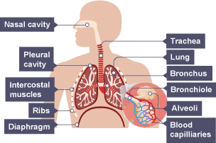
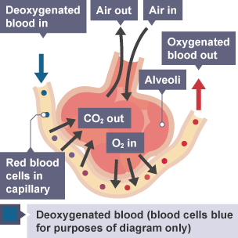
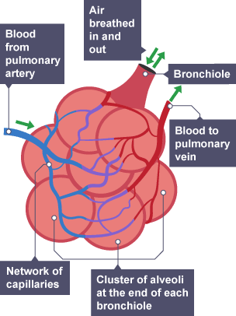
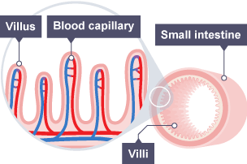
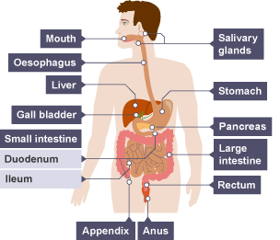
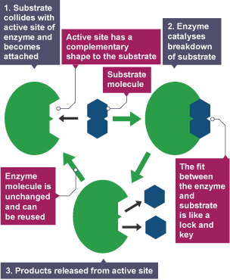
Levels of organisation
In order of increasing complexity, multicellular organisms are made of:
cells → tissues → organs → organ systems
Organisation
In multicellular organisms, surfaces are specialised for exchanging materials.
The effectiveness of exchange surfaces in plants and animals is increased by having:
A large surface area
A short distance required for diffusion
An efficient blood supply to transport molecules to and from the exchange surface increases effective exchange.
The human respiratory system is adapted to allow air to pass in and out of the body, and for efficient gas exchange to happen. The exchange of gases occurs between the alveoli and blood in the capillaries that supply the lungs
The surface of the small intestine wall is folded, and has projections called villi. Villi is the plural of villus.
The epithelial cells that cover each villus themselves have projections called micro villi.
The digestive system
Organ | Function
Mouth | The salivary glands produce amylase to begin the digestion of starch.
Stomach | Produces protease to digest protein. Also produces hydrochloric acid to kill pathogens and create the optimum pH for protease. Muscle tissue that contracts to churn food
Pancreas | Produces lipase, amylase & protease
Small intestine | Produces lipase, amylase & protease; absorption of single sugars, amino acids and fatty acids and glycerol. The inside of the small intestine is covered in small structures called villi that increase its surface area and contain blood vessels.
Liver | Produces bile. Bile is an alkaline emulsifier. The alkaline pH of bile provides the optimum conditions for lipase to digest lipids. Bile also emulsifies lipids allowing smaller droplets which increases the surface area of the lipids increasing the rate of digestion.
Gall bladder | Stores bile
Large intestine | Absorption of water; egestion of undigested food
Enzymes
Enzymes are biological catalysts that control the rate of biological process. Enzymes are made of protein so they are affected by temperature and pH. The optimum is 37 °C. If temperature increases, or pH changes then their shape will change. If the shape of the active site changes the enzyme can no longer attach to and digest food molecules. When the active site changes shape the enzyme is denatured.

Slide 2
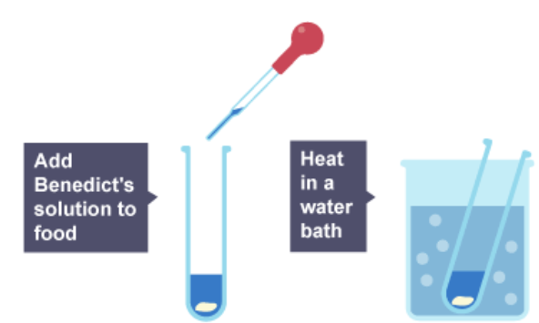
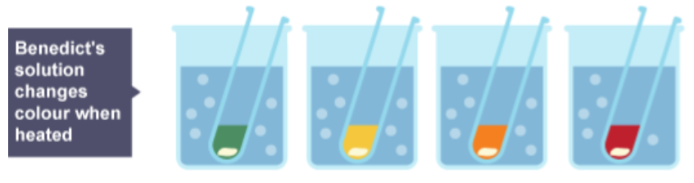
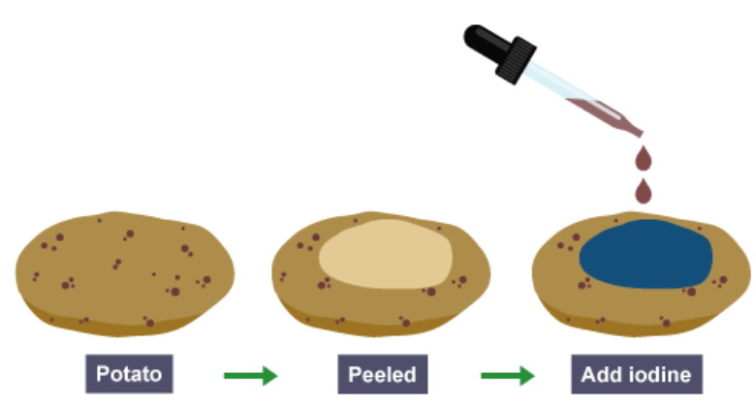
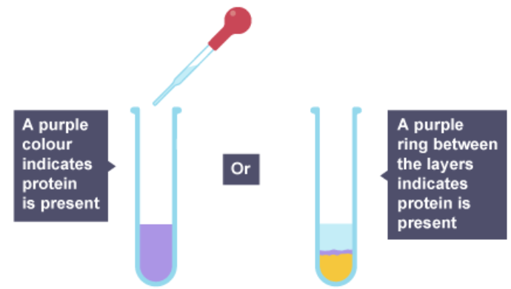
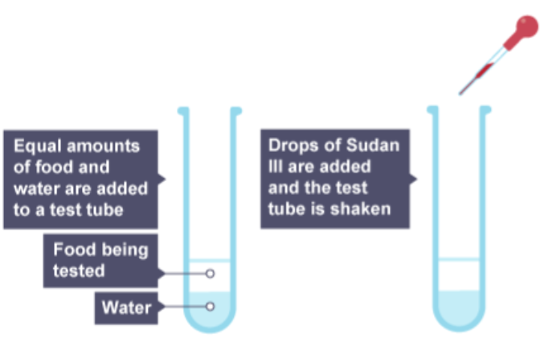
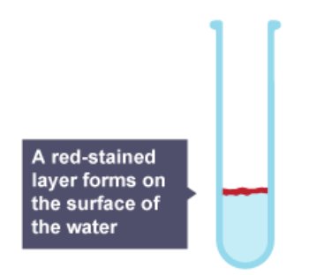
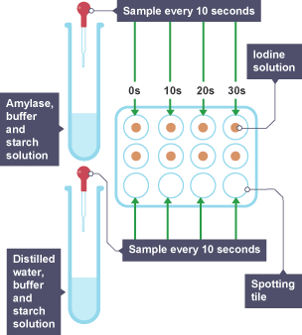
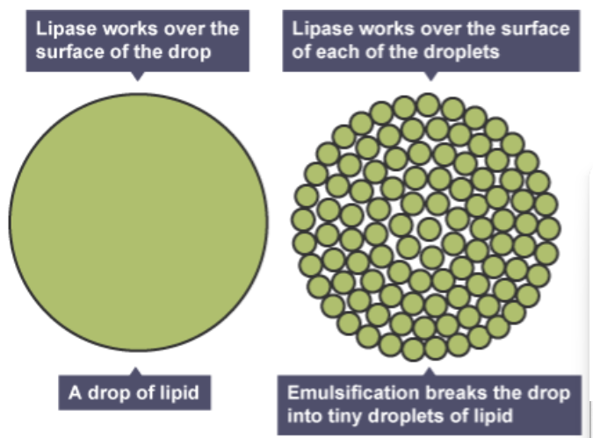
Nutrient | Major function | Major sources
Carbohydrates | Source of energy, glucose is the main respiratory substrate | Starch - potatoes, rice and bread, cereals and pasta; sugars - fruit, fizzy drinks, chocolate and sweets
Proteins | Growth and repair | Meat, eggs, cheese, beans, nuts and seeds
Lipids | Energy, make up part of cell membranes so essential for normal growth | Butter, meat, plant oils, oily fish, nuts and seeds
Required practical activity - food tests
Use qualitative reagents to test for a range of carbohydrates, lipids and proteins
Test for sugars
Benedict's test is used to
detect sugars
Result
Enzyme | Organ | Substrate | Product
Protease | Stomach, pancreas, small intestine | Protein | Amino acids
Amylase | Salivary glands, pancreas, small intestine | Starch | Glucose
Lipase | pancreas, small intestine | Lipids | Fatty acids & glycerol
Test for starch
Add iodine solution to the food being tested
Required practical activity - investigate the effect of pH on the rate of reaction of amylase enzyme
Test for proteins
The biuret test is used to detect proteins.
Place single drops of iodine solution in rows on the tile
Label a test tube with the pH to be tested
Use the syringe to place 2cm³ of amylase in the test tube
Add 1cm³ of pH buffer solution to the test tube using a syringe
Use another test tube to add 2cm³ of starch solution to the amylase and buffer solution, start the stopwatch whilst mixing using a pipette
After 10 seconds, use a pipette to place one drop of the mixture on the first drop of iodine, which should turn blue-black
Repeat every 10 seconds until iodine solution remains orange-brown
Repeat experiment at different pH values – the less time the iodine solution takes to remain orange-brown, the quicker all the starch has been digested and so the better the enzyme works at that pH
Test for fats
The Sudan III test
The Sudan III test is one test used to test for lipids
Result
The liver does not secrete an enzyme, but it makes bile, which is then stored in the gall bladder. Bile is a chemical that emulsifies fats. This means it breaks fat into smaller droplets,
which increases its surface area over which lipase can digest it. Bile is alkaline, so it neutralises the acidic solution coming from the stomach so the enzymes in the small intestine are not denatured.

Slide 3
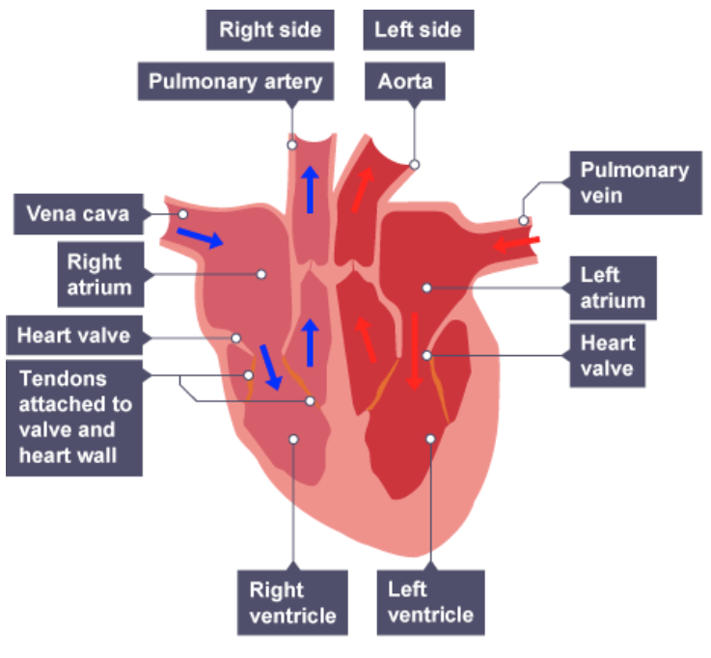
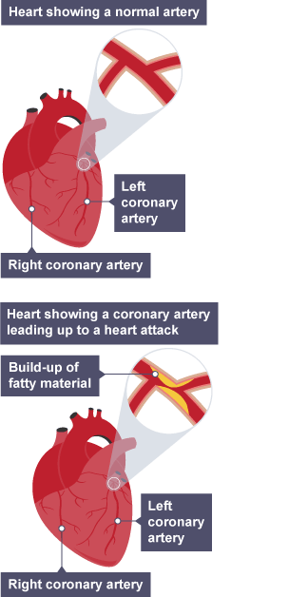
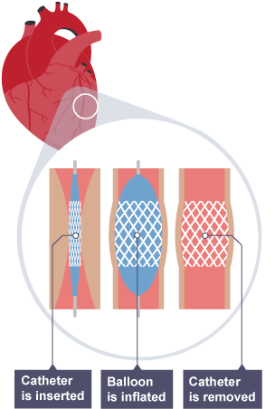
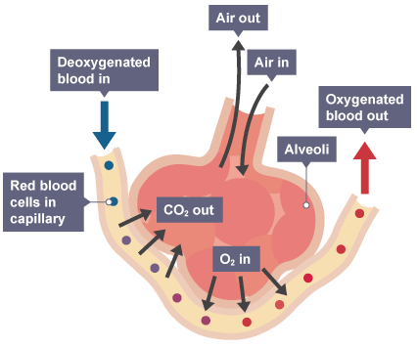
Component | Function(s)
Plasma | Transporting carbon dioxide, digested food molecules, urea and hormones; distributing heat
Red blood cells | Transporting oxygen
White blood cells | Ingesting pathogens and producing antibodies
Platelets | Involved in blood clotting
The heart is an organ that pumps blood around the body in a double circulatory system. This means blood passes through the heart twice in one circulation. The left side of the heart pumps blood to the body, while the right side pumps blood to the lungs.
Deoxygenated blood enters the heart through the vena cava and proceeds into the right atrium, through a valve (that prevents backflow) into the right ventricle. Blood is then pumped to the lungs, where it is oxygenated, through the pulmonary artery.
Blood is oxygenated in the lungs before it returns to the heart through the pulmonary vein. The blood travels through the left atrium and into the left ventricle. It is then pumped out through the aorta to the rest of the body.
The natural resting heart rate is controlled by a group of cells located in the right atrium that act as a pacemaker. Artificial pacemakers can be used if this is not working properly.
 | Artery | Vein | Capillary
Function | Carry blood away from the heart (usually oxygenated blood, except for the pulmonary artery) | Carry blood towards the heart (usually deoxygenated blood, except for the pulmonary vein) | Allows diffusion of gases and nutrients from blood into the body cells
Wall | Thick, muscular | Thinner | Very thin, one cell thick
Lumen | Small | Large | Very small, only allows blood to pass through one cell at a time
Other features | Thick muscular walls to withstand blood flowing at high pressure as it leaves the heart; the largest artery is the aorta | Contain valves to prevent back flow of blood | Walls are made of semi-permeable membrane to allow transport of gases and nutrients into and out of the blood
The coronary arteries supply oxygen to the heart muscle. They may become blocked by a build-up of fatty material, caused by cholesterol.
Statins are drugs that help to lower cholesterol in the blood. They do this by lowering its production in the liver.
Coronary arteries that are blocked or have become narrow can be stretched open and a stent inserted to restore and maintain blood flow.
A heart transplant is required in the case of heart failure.
Artificial hearts are plastic devices used occasionally to keep patients alive whilst waiting for a heart transplant.
The lungs are part of the respiratory system. Air travels to the lungs via the trachea. The trachea splits into two bronchi (singular - bronchus) which carry the air to each of the lungs. When the bronchi reach the lungs, they split into many smaller tubes called bronchioles. These bronchioles spread though out the lungs with each ending in a small air sac called an alveolus (plural - alveoli).

Slide 4
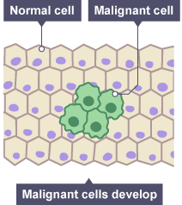
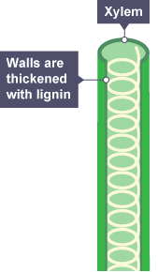
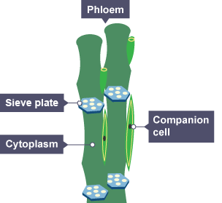
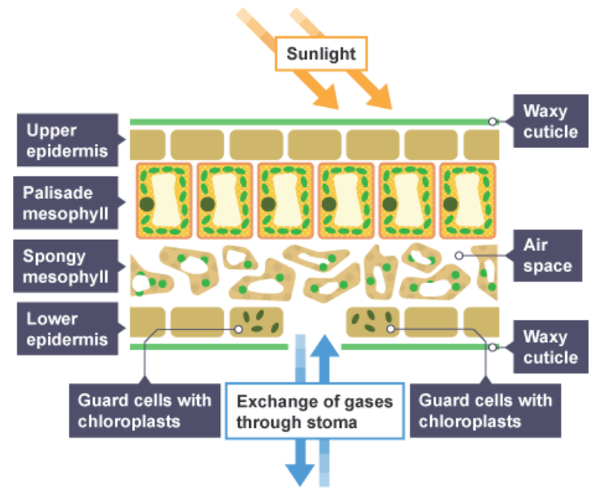
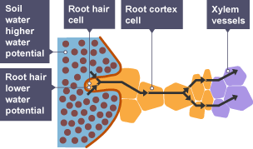
Diseases, both communicable and non-communicable, are major causes of ill health. Other factors including diet, stress and life situations may have a profound effect on both physical and mental health.
Defects in the immune system mean that an individual is more likely to suffer from infectious diseases.
Viruses living in cells can be the trigger for cancers.
Immune reactions initially caused by a pathogen can trigger allergies such as skin rashes and asthma.
Severe physical ill health can lead to depression and other mental illness.
Risk factors are linked to an increased rate of a disease.
A causal mechanism has been proven for some risk factors, but not in others.
The effects of diet, smoking and exercise on cardiovascular disease.
Obesity as a risk factor for Type 2 diabetes.
The effect of alcohol on the liver and brain function.
The effect of smoking on lung disease and lung cancer.
The effects of smoking and alcohol on unborn babies.
Carcinogens, including ionising radiation, as risk factors in cancer.
Cells grow then divide by mitosis only when we need new ones. When a cell grows and divide uncontrollably it forms a group of cells called a tumour. Tumours can be benign or malignant (cancerous)
Type of tumour | Characteristics
Benign | Grows slowly; usually grow within a membrane, so can easily be removed; does not invade other parts of the body
Malignant | Grows quickly; invades neighbouring tissues and can spread to other parts of the body in the bloodstream; as the tumour grows, cancer cells detach and can form secondary tumours in other parts of the body - this is called metastasis.
The xylem transports water and minerals from the roots up the plant stem and into the leaves.
Xylem cells are dead and have no end walls so they form a continuous, hollow tube.
The cells are strengthened by a chemical called lignin. Lignin gives strength and support to the plant. We call lignified cells wood. Transport in the xylem is a physical process. It does not require energy.
The phloem moves food substances produced by photosynthesis to where they are needed. Transport in the phloem is therefore both up and down the stem and is called translocation.
Phloem consists of living cells and have adaptations:
- Sieve tubes - specialised for transport and have no nuclei. Each sieve tube has a perforated end, so its cytoplasm connects one cell to the next.
- Companion cells – phloem transport requires energy. One or more companion cells attached to each sieve tube provide this energy.
The palisade mesophyll layer of the leaf is adapted to absorb light efficiently. The cells:
are packed with many chloroplasts
are column-shaped and arranged closely together
towards the upper surface of the leaf
Spongy mesophyll tissue is packed loosely for efficient gas exchange as gasses can diffuse easily around them. To enter the leaf, gases diffuse through small pores called stomata. As the stomata open, water vapour is lost by the process of evaporation. The guard cells can close the stomata to help control water loss.
Water is drawn from the xylem to replace that which has been lost from the leaves. Water enters the xylem through the roots by osmosis. This process of water moving from roots to be lost from the leaves is called transpiration.
Factor | Explanation
Temperature | An increase in temperature increases evaporation, so the rate of diffusion of water out the leaf increases
Humidity | A decrease in humidity reduces the concentration of water molecules outside the leaf, so the rate of diffusion of water out the leaf increases
Air movement | An increase in air movement removes water vapour from outside the leaf, so the rate of diffusion of water out the leaf increases
Light intensity | An increase in light intensity generally increases the number of open stomata, so the rate of diffusion of water out the leaf increases

