Slide 1
Key word match up -
Republicans
Hire Purchase
Laissez Faire
Natural Resources
World War One
Electrification
Tariffs
When the government approach is to not get involved.
Resources that occur naturally e.g. wood, coal.
Gave the USA an economic advantage as they produced resources for countries affected by war.
Taxes placed on goods from abroad.
Goods including cars purchased on credit.
Nearly 2/3 of all homes had electricity which led to increased demand for electrical goods.
The political party in power in

Slide 2
Grade 7+ in History
There is no ‘magic’ skill to get a grade 7, it is about consistency – doing well on all questions on all topics.
The most important thing you can do is to revise thoroughly throughout Year 11.
You also need to know how to answer the different question types – today we are going to focus on question 5.

Slide 3
Question 5: To what extent do you agree with this interpretation? (16 marks + 3 SPAG marks)
Paragraph 1 – what do you agree with in the interpretation. Include at least 2 quotes from it and at least 2 facts to support it.
Paragraph 2 – why does the author have this view? Include the authorship, title etc. State that it should be viewed as part of the wider historical debate and different historians would have different views.
Paragraph 3 – explain what the other interpretations could be (e.g. what else could be a reason) – make sure you use evidence from your own knowledge to support this.
Conclusion: To what extent do you agree.
This question is the same on both the Conflict and Upheaval paper and the USA paper.

Slide 4
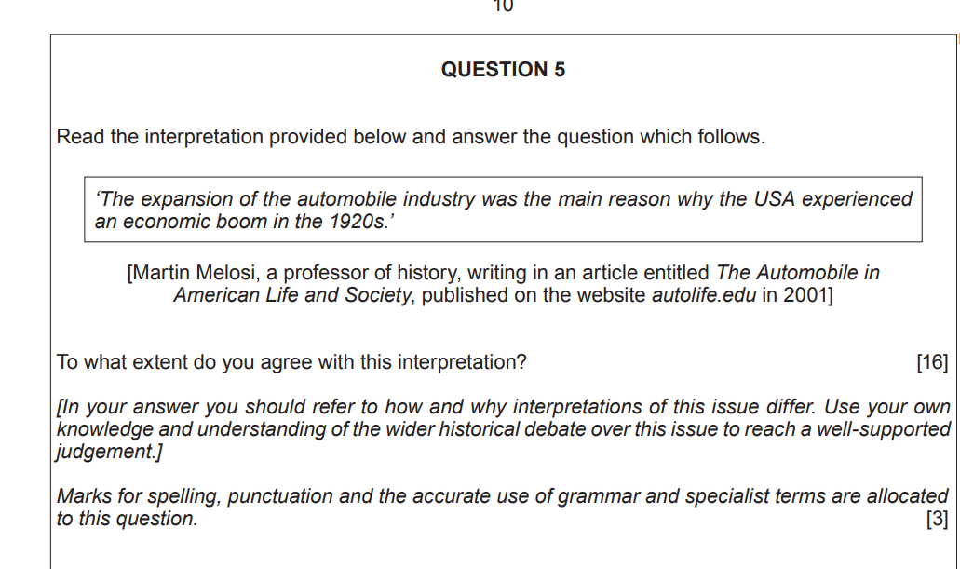

Slide 5
Paragraph 1: The interpretation includes…..
Automobile Industry:
Henry Ford
Assembly Line
Model T
By 1929 Americans owned 23 million cars.
Led to developments in other industries e.g. motels, highway building, restaurants.
The number of drive-in gas stations in the U.S. exploded between 1921 and 1929, from 12,000 to 143,000.
By the mid-1920s, 1-in-8 American workers was somehow involved in the “production, sales, service, and fueling of automobiles.”

Slide 6
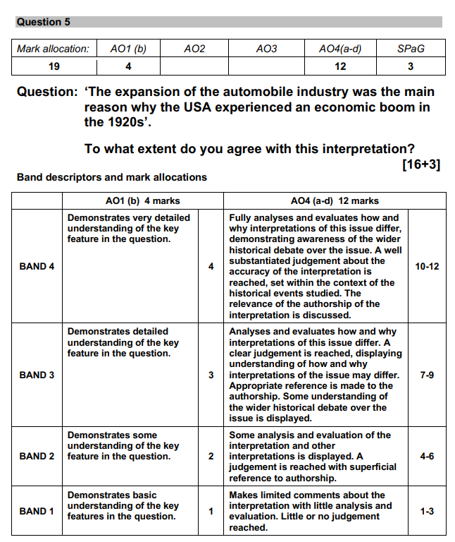

Slide 7
Paragraph 2:
Must be viewed as part of the wider historical debate.
Well researched as the author is a professor of history.
Narrow focus.
Article is called The Automobile in American Life and Society which explains the narrow focus. Would also be written for a particular audience.
Other historians would focus on a wider range of factors e.g political historian on Republicans’ policies.
Conclusion:

Slide 8
Paragraph 3:
Other causes of the economic boom not mentioned:
Policies of the Republican Presidents – tariffs (Fordney McCumber Act) encouraged Americans to buy American goods so this aided the American economy.
Laissez Faire approach meant taxes were low so people had more disposable income.
Abundance of natural resources made it easy for America to produce goods which could be sold to the rest of the world, making more money.
Credit/Hire Purchase.

Slide 9
How can you prepare at home:
Revise regularly – use the knowledge organisers provided and on Toynbee’s website. There are also useful videos on YouTube.
You will be set weekly revision quizzes on Satchel One – complete these.
Practise exam questions – these are on the Eduqas website or ask your teacher.
If you want something quicker than practise exam questions practise annotating interpretations with who wrote it; why; and what a different historian would say.

