Slide 1
Tutor

Slide 2
Tutor
Attendance
Attendance and punctuality are essential in ensuring that you child reaches their potential at Toynbee. Every child is expected to have at least 95% attendance
What to do if your child will not be in school:
Email: attendance@toynbee.hants.sch.uk stating your child’s name, tutor group and reason for absence
Please email everyday if you are unsure when your child will be returning to school
If your child has a scheduled medical appointment coming up, please let school know in the same way

Slide 3
TUTOR TIME
Learning starts at 8.40am!
DAY | ACTIVITY
Day 1 | ASSEMBLY
Day 2 | READING & LITERACY
Day 3 | HOUSE
Day 4 | PERSONAL DEVELOPMENT & WELLBEING
Day 5 | 1:1 INDEPENDENT STUDY
WELLBEING THEMES:
CONNECT
GIVE TO OTHERS
KEEP LEARNING
TAKE NOTICE
BE ACTIVE
Notes:
Every morning at Toynbee begins with Tutor Time. This is a really crucial part of the daily timetable. Tutor time starts the learning for the day. It is a structured session with 5 different activities over the week.
A focused assembly on various themes, Reading and Literacy session to develop skills, A House activity each week where the tutor group work together on different competitions to win points, a Personal Development and Wellbeing session linked to the 5 different wellbeing themes and a 1:1 session with your tutor to find out how you are getting on and talk about how you are settling in. The rest of the tutor group will be working independently – for example quiet reading.

Slide 4
Notes:
We want to encourage our pupils to develop their whole character. Enabling them to become well rounded individuals that will leave school equipped with skills to be successful in life.
The 5 core values of Personal Development at Toynbee are: Participation, Respect, Opportunity, Unique and Determination and we recognise and celebrate when pupils display these values through PROUD POINTS. Getting involved in activities beyond the classroom and through HOUSE activities are a great way to get HOUSE points

Slide 5
Celebrating Success at Toynbee School
At Toynbee we celebrate the positive achievements of our pupils whether that be in their academic success, their extracurricular talents or their personal development of character. There are milestone badges for our APs and PPs!
ACHIEVEMENT POINTS:
Awarded for academic success and improved progress in lessons.
PROUD POINTS:
Awarded for celebrating Personal Development.
The 5 Core Values are: Participating, Respect, Opportunity, Unique and Determination
MODEL PUPIL AWARD
SUBJECT STARS
ATTENDANCE AWARDS
HEADTEACHER AWARD
Successes are celebrated publicly:
Assemblies
Celebration Breakfasts/Afternoon Teas
Awards Evenings
Celebration Trips

Slide 6
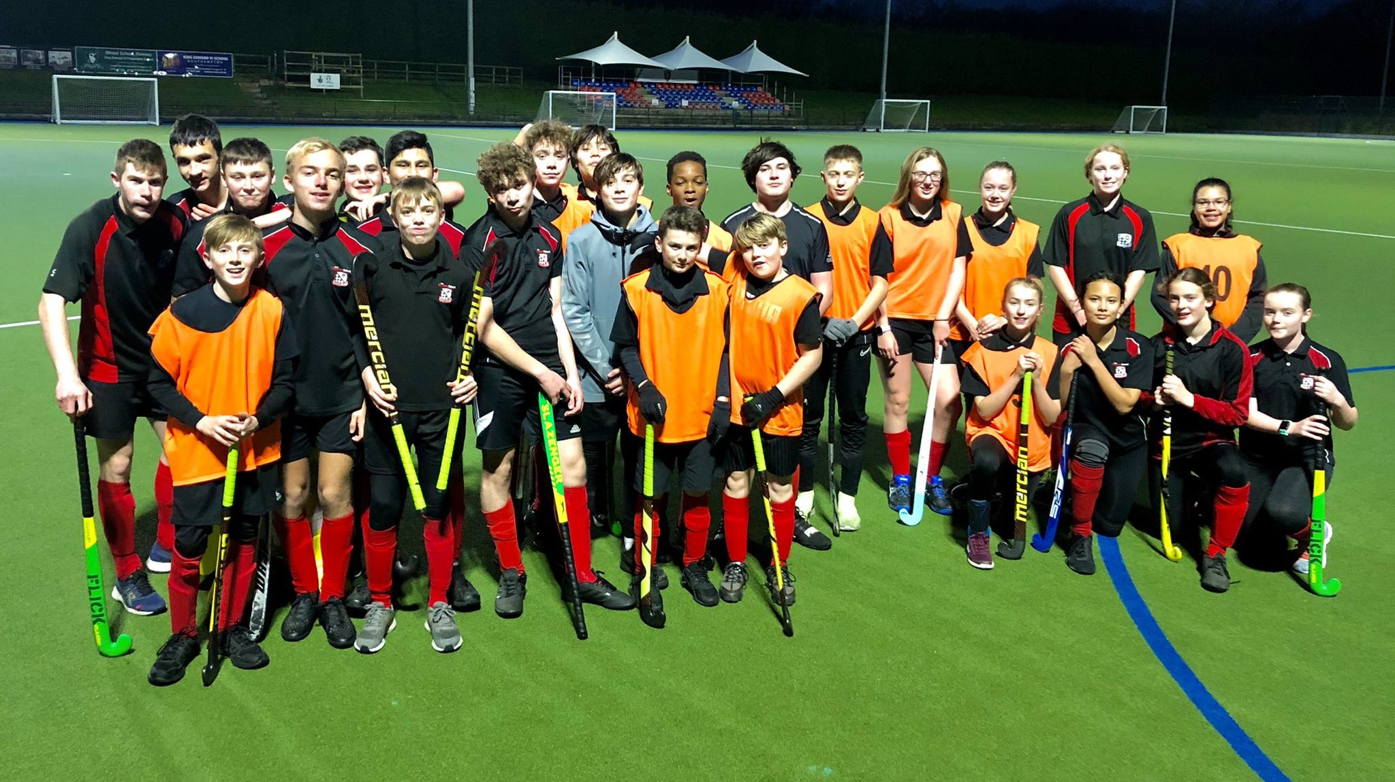
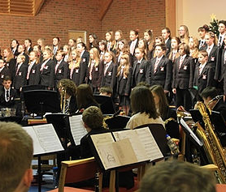
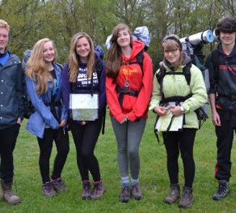
Enrichment at Toynbee
At Toynbee we offer a fully engaging and inclusive program of enrichment designed to complement the curriculum
Enrichment clubs are an integral part of Toynbee life.
Students involved in school life beyond lesson time often perform better academically.
Clubs are before, during or after school.
Aim to support work covered in curriculum time or can be completely non curriculum based.
Clubs are free (unless led by an external expert)
Clubs are open to all (unless aimed at a specific group)

Slide 8
Tutor
Year 7 Homework
We are aware that the transition from primary to secondary can be challenging, and one of the main areas is in managing homework
To ensure our Year 7 Pupils make an extremely positive start at Toynbee we will be phasing in homework:
Phase 1: From 25th September – English, Maths and Science only
Phase 2: From 16th October – All subjects (this is the week before half term)

Slide 9
Communicating with school
Communication
Pastoral Query
Curriculum Query
Tutor
Class Teacher
Guidance Manager
Head of Department
Progress Director
Progress Director
Senior Leadership Team
Senior Leadership Team
b.sherrell@toynbee.hants.sch.uk e.butler@toynbee.hants.sch.uk

Slide 10
Tutor
Thank you for listening
The Senior Leadership Team, Miss Butler, Miss Sherrell, Mrs Hill, Mrs Howbrook, Mrs Woodall and Mrs Morris will be available for questions outside the canteen
This presentation will be added to the website for you to refer to throughout the year

