Slide 1

Toynbee School
Year 7 Induction Evening
Mr Longden - Headteacher
Mr Lawrence - Deputy Headteacher
Miss Butler - Lower School Progress Director
Miss Sherrell- Year 7 Guidance Manager

Slide 2
Mr Longden
Headteacher
Headteacher

Slide 3
Senior Prefects
Life at Toynbee
Year 10 Pupils

Slide 4
Mr Lawrence
Deputy Headteacher
Deputy Headteacher

Slide 5
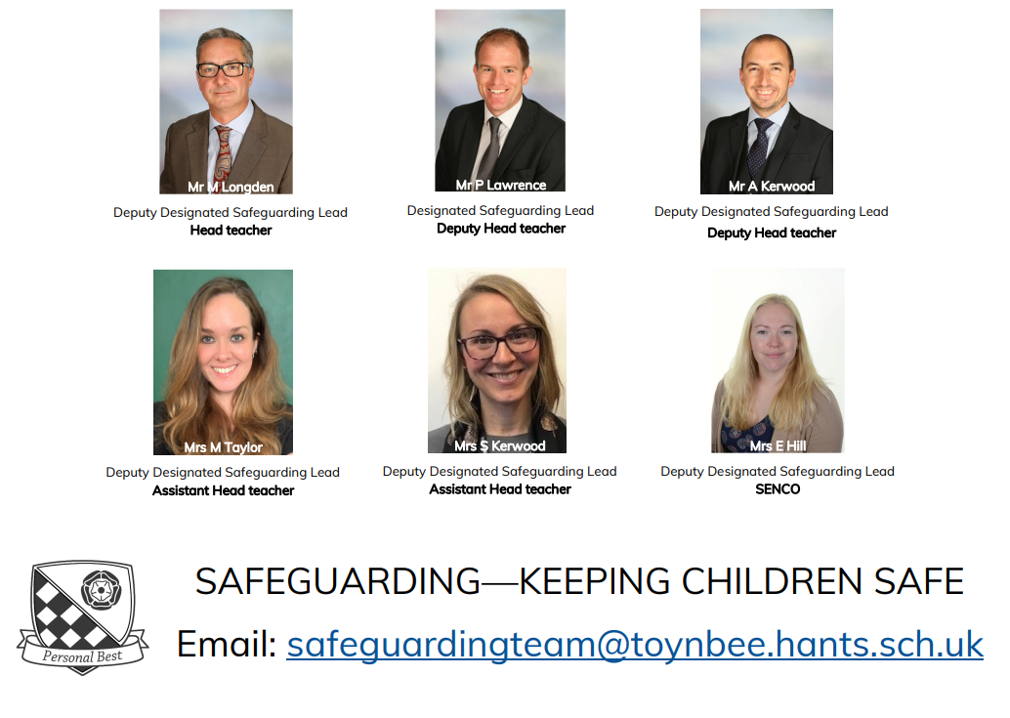
Deputy Headteacher

Slide 6

Deputy Headteacher
VISION:
Toynbee’s culture of Respect is built on shared beliefs, values and strong relationships between all stakeholders.
We strive to have consistent routines and if these are broken there are clear and consistent consequences linked to our values.
This allows all our pupils to be successful, develop their character and achieve their personal best.

Slide 7
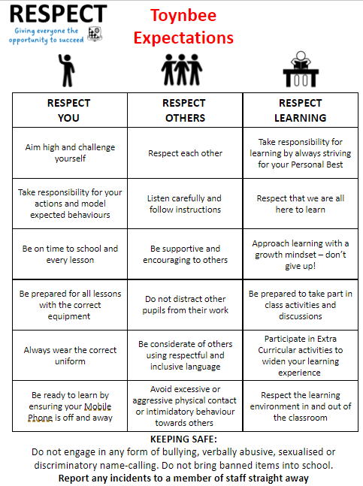
Deputy Headteacher

Slide 8




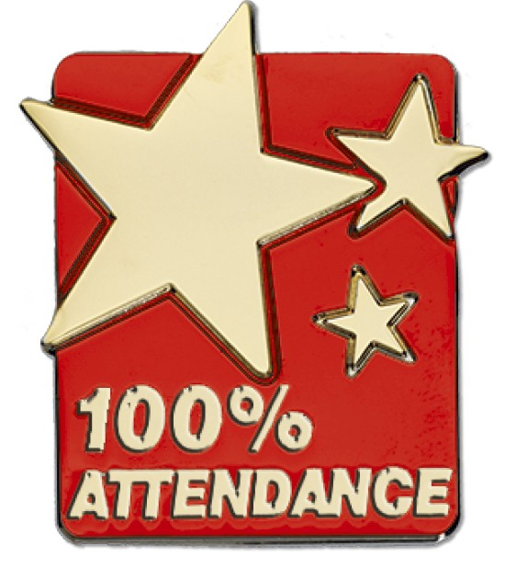


Celebrating Success at Toynbee School
At Toynbee we celebrate the positive achievements of our pupils whether that be in their academic success, their extracurricular talents or their personal development of character. There are milestone badges for our APs and PPs!
ACHIEVEMENT POINTS:
Awarded for academic success and improved progress in lessons.
PROUD POINTS:
Awarded for celebrating Personal Development.
The 5 Core Values are: Participating, Respect, Opportunity, Unique and Determination
MODEL PUPIL AWARD
SUBJECT STARS
ATTENDANCE AWARDS
HEADTEACHER AWARD
Successes are celebrated publicly:
Assemblies
Celebration Breakfasts/Afternoon Teas
Awards Evenings
Celebration Trips

Slide 9
Miss Butler
Progress Director
Progress Director

Slide 10
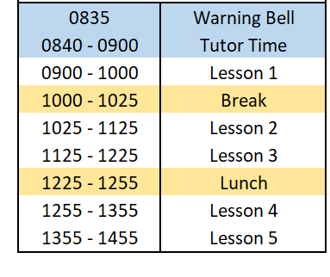
Progress Director
The School Day

Slide 11
Progress Director
Year 7 Curriculum
Subject | Lessons | Subject | Lessons
English | 7 | Art | 2
Maths | 7 | Music | 2
Science | 7 | Drama | 2
Languages | 4 | Technology | 2
History | 4 | RS | 2
Geography | 4 | Computing | 2
PE | 4 | PSHCE | 1
Two Week Timetable
Pupils are taught in mixed ability classes, primarily in their Tutor Groups

Slide 12
Year 7 Tutor Team:
Progress Director
Miss Beech-Guarido 7BC
Mr Cox 7CX
Miss Connolly 7CO
Mr Howe 7HO
Miss Thompson 7TS
Mrs Hill SENCO
Mrs Howbrook Learning Support
Mrs Morris Admissions
Mrs Woodall Pupil Welfare Officer

Slide 13
Progress Director
Year 6 Induction Day 26th June
Arrival: 8.35am in the Sports Hall to meet their Tutor
Pupils should: Wear their Junior School uniform
Bring a bag, pencil case, water bottle and a break time snack
Pupils will: Have a Year Group Assembly
Spend some time getting to know their Tutor and Tutor Group
Attend a series of ‘Taster’ lessons with their peers
Take part in a team building competition
Lunch All pupils will be provided with a packed lunch
If you have any dietary requirements, please let Miss Sherrell know.
End of the day Pupils will be dismissed at 2.45pm

Slide 14
Progress DIrector
First day of Year 7 – Monday 4th September
Arrival: 8.35am in the Sports Hall to meet their Tutor
Pupils should: Wear their Toynbee School uniform
Bring a bag, pencil case, PE kit, water bottle and snack
Pupils will: Have a Year Group Assembly
Receive their timetable and planner
Complete the ‘Toynbee Year 7 Induction’ Programme
Lunch All pupils will be provided with a packed lunch for their first day only. If you have any dietary requirements, please let Miss Sherrell know
End of the day Pupils will be dismissed at 2.55pm
Year 7 Pupils should report to their Tutor Room on Tuesday 5th September at 8.35am

Slide 15
Progress Director
Key Year 7 Events
Year 7 Curriculum Evening
Meet your Tutor Evening
House Weeks and competitions
Year 7 Parents Evening
Awards Events
Sports Day
End of Year Celebration Trip

Slide 16




Satchel One
Homework, Timetable, Achievement Points https://www.satchelone.com/login
Progress Director
Office 365
Email, Word, Excel, Powerpoint
https://www.office.com/
Schoolgateway
Attendance, absence
https://login.schoolgateway.com/0/auth/register
Scopay
Finance, Payments
https://www.scopay.com/login.html

Slide 17
Miss Sherrell
Year 7 Guidance Manager
Guidance Manager

Slide 18

Guidance Manager

Slide 19
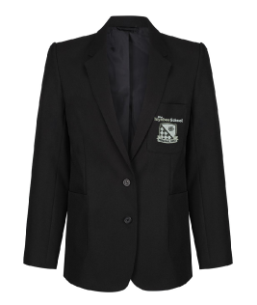
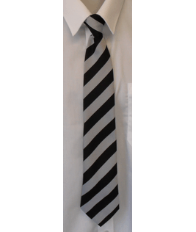
Guidance Manager
Toynbee Uniform
Black blazer with school logo or badge
White shirt
Grey and black clip-on tie
Black trousers or Toynbee skirt
Tights if required (black or natural)
Black school shoes – no canvas shoes, pumps or trainers
No fake nails or nail varnish
Only natural hair colours
No haircuts shorter than grade 2
No jewellery including bracelets, rings or necklaces.
Only one stud per ear lobe

Slide 20
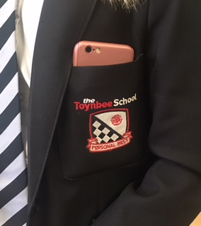
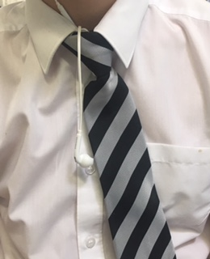
Guidance Manager
In September 2018 the new Mobile Phone policy was introduced at Toynbee
Phones are to be switched off and in school bags as soon as pupils enter the school site
We have procedures in place should a pupil be seen using their mobile phone whilst in school
Mobile Phones

Slide 21
Communicating with school
Guidance Manager
Pastoral Query
Curriculum Query
Tutor
Class Teacher
Guidance Manager
Head of Department
Progress Director
Progress Director
Senior Leadership Team
Senior Leadership Team
b.sherrell@toynbee.hants.sch.uk e.butler@toynbee.hants.sch.uk

