Slide 1
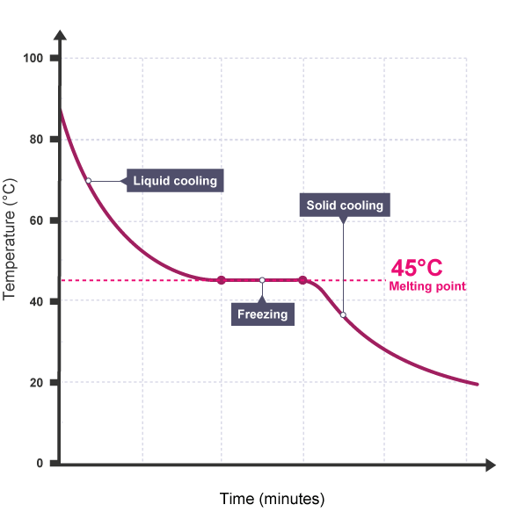
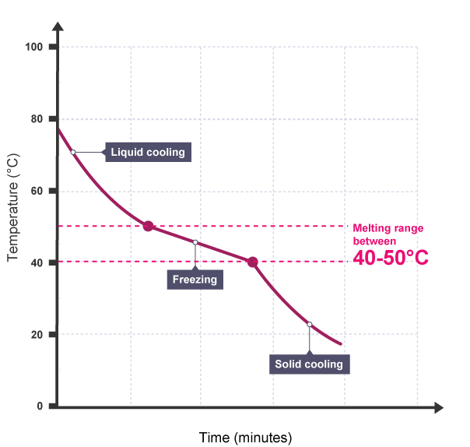
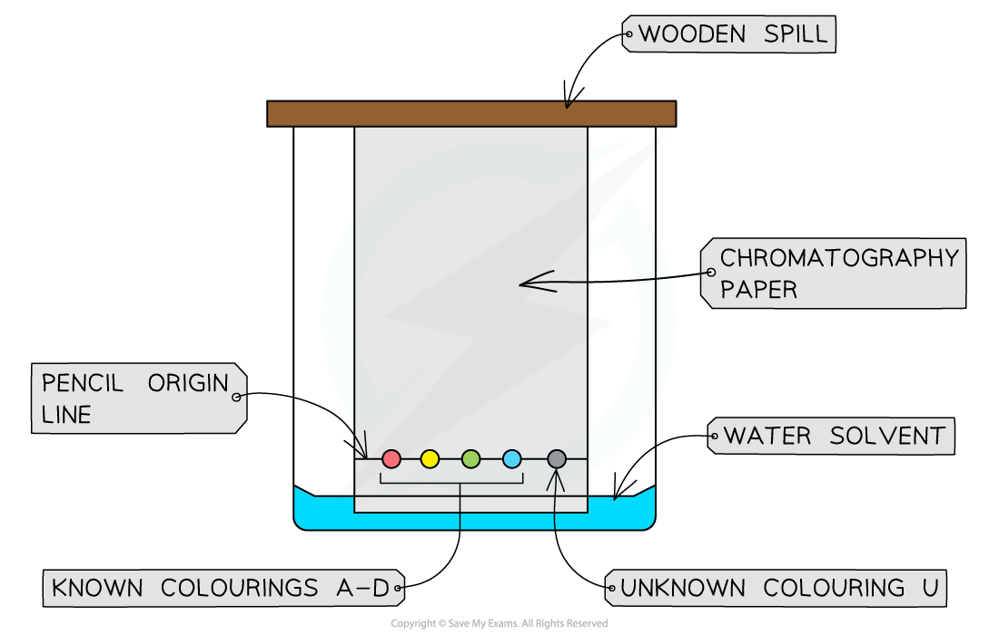
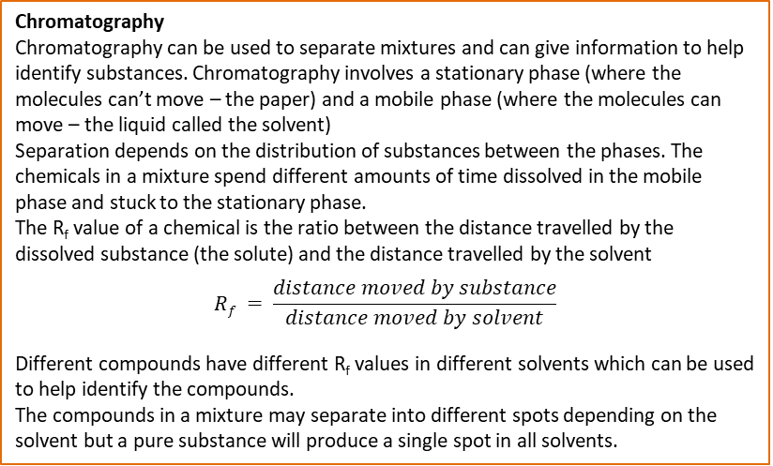
Chemical Analysis
Formulations
A formulation is a mixture that has been designed as a useful product.
Many products are complex mixtures in which each chemical has a particular purpose. Formulations are made by mixing the components in carefully measured quantities to make sure the product has the required properties, e.g.
Fuels Cleaning agents Paints Medicines Alloys Fertilisers Foods
Pure Substances
In chemistry a pure substance is a single element or compound, not mixed with any other substance.
Pure elements and compounds melt and boil at specific temperatures.
Melting point and boiling point data can be used to distinguish pure substances from mixtures.
In advertising a pure substance can mean a substance that has had nothing added to it (in its natural state).
Chromatography
Chromatography can be used to separate mixtures and can give information to help identify substances. Chromatography involves a stationary phase (where the molecules can’t move – the paper) and a mobile phase (where the molecules can move – the liquid called the solvent)
Separation depends on the distribution of substances between the phases. The chemicals in a mixture spend different amounts of time dissolved in the mobile phase and stuck to the stationary phase.
The R_{f} value of a chemical is the ratio between the distance travelled by the dissolved substance (the solute) and the distance travelled by the solvent
$$Rf = \frac{distance moved by substance}{distance moved by solvent}$$
Different compounds have different R_{f} values in different solvents which can be used to help identify the compounds.
The compounds in a mixture may separate into different spots depending on the solvent but a pure substance will produce a single spot in all solvents.
Pure substances have a fixed melting point.
Impure substances melt over arrange of temperatures
Testing for Gases
Test | Observation | Inference
Glowing splint held in a test tube | Splint relights | Oxygen is present
Lighted splint held in a test tube | Pop sound heard | Hydrogen is present
Gas bubbled through limewater | Limewater turns milky or cloudy white | Carbon dioxide is present
Damp litmus paper held in a test tube | Paper turns white | Chlorine is present
Required Practical Method:
draw a pencil line across the chromatography
paper, 1 - 2 cm from the bottom
use a pipette or capillary tube to add
small spots of each ink to the line on the
paper
place the paper into a container
with a suitable solvent in the
bottom
allow the solvent to move through the
paper, but remove the
chromatogram before it reaches the top
allow the chromatogram to dry, then measure the distance travelled by each spot and by the solvent

Slide 2
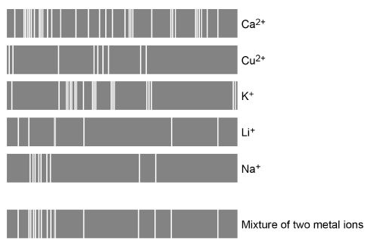
Chemical Analysis: Separate Chemistry Only
Metal Hydroxides
Sodium hydroxide can be used to identify some metal ions (cations). They form metal hydroxide precipitates.
Flame tests
Flame tests can be used to identify some metal ions (cations)
If a sample contains a mixture of ions, then some flame colours can be masked.
Metal Ion | Colour of Precipitate | Ionic equation for precipitate
Calcium Ca²⁺ | White | Ca²⁺ _{(aq)} + 2OH⁻ _{(aq)} → Ca(OH)_{2 (s)}
Copper (II) Cu²⁺ | Blue | Cu²⁺ _{(aq)} + 2OH⁻ _{(aq)} → Cu(OH)_{2 (s)}
Iron (II) Fe²⁺ | Green | Fe²⁺ _{(aq)} + 2OH⁻ _{(aq)} → Fe(OH)_{2 (s)}
Iron (III) Fe³⁺ | Brown | Fe³⁺ _{(aq)} + 3OH⁻ _{(aq)} → Fe(OH)_{3 (s)}
Aluminium Al³⁺ | White but then re dissolves to form a colourless solution | Al³⁺ _{(aq)} + 3OH⁻ _{(aq)} → Al(OH)_{3 (s)}
Magnesium Mg²⁺ | White | Mg²⁺ _{(aq)} + 2OH⁻ _{(aq)} → Mg(OH)_{2 (s)}
Metal Ion | Flame Colour
Lithium | Crimson
Sodium | Yellow
Potassium | Lilac
Calcium | Orange-red
Copper | Green
Carbonates
Carbonates react with dilute acids to form carbon dioxide gas.
Carbon dioxide can then be tested for using limewater.
Na₂CO₃ _{(aq)} + 2HCl _{(aq)} → CO₂ _{(g)} + 2NaCl _{(aq)} + H₂O _{(l)}
Instrumental analysis
Advantages over chemical testing: They produce fast, sensitive and accurate means of analysing chemicals and are particularly useful when the amount of chemical being analysed is small.
Halides
Adding halides to silver nitrate solution (with nitric acid). produce precipitates of silver halides.
Flame emission spectroscopy
Used to analyse metal ions in solution.
The sample is put into a flame and the
light given out is passed through a
spectroscope.
The output is a line spectrum that can be
Analysed to identify the metal ions in the
solution and measure their concentrations.
The line spectrum is unique for every ion
– so you compare the pattern you get with
Known samples to identify the correct ion.
Halide | Colour of Precipitate in acidified silver nitrate | Ionic equation for precipitate
Chloride Cl⁻ | White | Ag⁺ _{(aq)} + Cl⁻ _{(aq)} → AgCl _{(s)}
Bromide Br⁻ | Cream | Ag⁺ _{(aq)} + Br⁻ _{(aq)} → AgBr _{(s)}
Iodide I⁻ | Yellow | Ag⁺ _{(aq)} + I⁻ _{(aq)} → AgI _{(s)}
Required practical:
Carry out one or more tests on each salt. You may need to dissolve a sample of salt in a little distilled water if you are given solids, rather than solutions.
Record your observations carefully. Repeat any tests that do not get clear results.
Carry out flame tests.
Carry out hydroxide precipitate tests
Test for carbonate ions, sulphate ions, halide ions
Sulphates
Sulphate ions in solution produce a white precipitate with barium chloride solution (in the presence of dilute HCl).
The precipitate is barium sulphate.
Ba²⁺ _{(aq)} + SO₄²⁻ _{(aq)} → BaSO₄ _{(s)}

