Slide 1
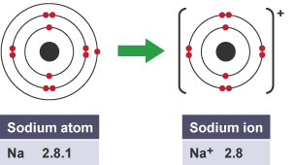
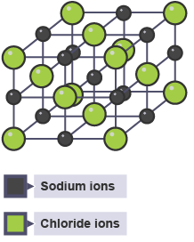
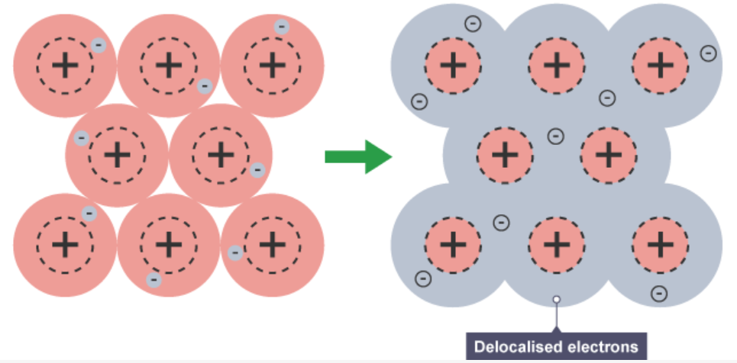
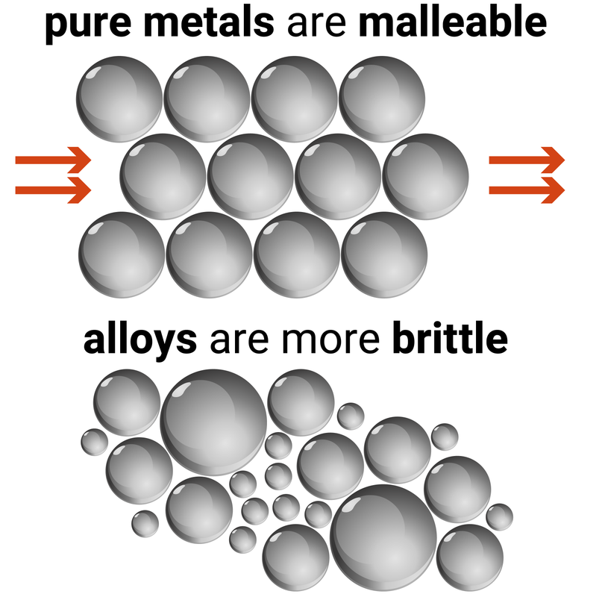
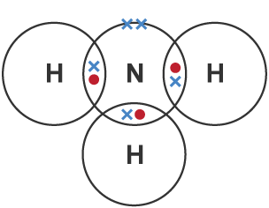
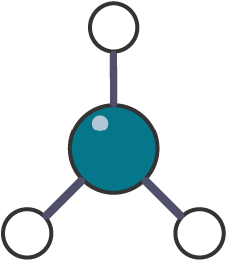

Ions
Ions are charged particles – they can be single atoms
(e.g. Cl⁻) or group of atoms (e.g. NO₃⁻).
When atoms lose or gain electrons to form ions, all
they are trying to do is get a full outer shell like a Nobel
gas.
Atoms with full outer shells are very stable.
The number of electrons lost or gained is the same
as the charge on the ion, e.g. if 2 electrons are lost the
charge is 2+ (Mg²⁺).
Properties of Ionic Compounds
High melting and
boiling points because of
the large amount of energy
needed to break the many
strong bonds.
When melted or
Dissolved in water (aqueous),
ionic compounds conduct
electricity because the ions
are free to move and so
charge can flow.
Ionic Bonding
When a metal atom reacts with a non-metal atom, electrons in the outer shell of the metal atom are transferred to the non-metal.
Metal atoms become positively charged ions.
Non-metals atoms become negatively charged ions.
An ionic compound is a giant structure of ions.
Ionic compounds are held together by strong electrostatic forces of attraction between oppositely charged ions acting in all directions in the lattice – and this is known as ionic bonding.
Metallic Bonding
Metals consist of giant structures of atoms arranged
in a regular pattern.
The electrons in the outer shell of metal atoms are
delocalised and are free to move through the whole
structure.
The sharing of delocalised electrons gives rise to
strong metallic bonds.
Pure Metals – as all atoms are the same size the atoms are arranged in layers, which allow metals to be bent and shaped. They are too soft for many uses
Alloys – a mixture of metals atoms means the layers are distorted and can’t slide. So the metal is less malleable and therefore stronger
Properties of Metallic Bonding
Metals have a giant structure of atoms with strong metallic bonding.
High melting and boiling points.
Metals are good conductors of electricity because the delocalised electrons in the metal are free to move and can carry electrical charge.
Metals are good thermal conductors because the energy is transferred by the delocalised electrons.
Covalent Bonding
When non-metal atoms share pairs of electrons, they form covalent bonds
These bonds between the atoms are strong (intramolecular)
Molecules can be drawn in few different ways:
Properties of Small Covalent Molecules
They are usually gases or liquids with relatively low melting and boiling points.
These substances have weak forces between the molecules (intermolecular forces). It is these forces which are overcome (not the covalent bonds) when the substance melts or boils.
The intermolecular forces increase with the size of the molecules, so larger molecules have higher melting points.
They do not conduct electricity because the molecules do not have an overall charge.
Dot & cross diagram
Structural formula
3D model

Slide 2
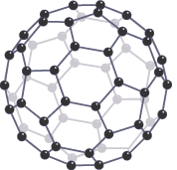
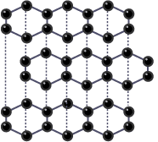
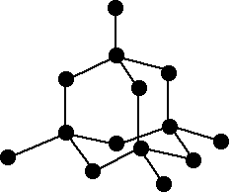

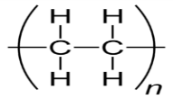
Giant Covalent Structures
Giant covalent structures are solids with very high melting points
All the atoms in the structure are linked to other atoms by strong covalent bonds which must be overcome for the substance to melt or boil.
Diamond, graphite and silicon dioxide are examples.
Graphene is a single layer of graphite and has properties which make it useful in electronics and composites.
Fullerenes are molecules of carbon atoms with hollow shapes. The
structure is based on
hexagonal rings of carbon
atoms, but they may also
contain rings with 5 or 7
carbon atoms.
The first fullerene to be discovered was Buckminsterfullerene (C₆₀) which has a spherical shape.
Carbon Nanotubes are cylindrical fullerenes with very high length to diameter ratios. Their properties make them useful for nanotechnology, electronics and materials.
Graphite
Each carbon atom forms three
covalent bonds with three other
carbon atoms.
Forms layers with hexagonal
rings which have no covalent bonds
between the layers so they can slide
over each other.
One electron from each carbon atom is delocalised and is free to move and carry charge so graphite can conduct electricity.
Diamond
Each carbon atom forms four covalent bonds with other carbon atoms.
Diamond is very hard.
Very high melting point.
Does not conduct electricity
as there are no delocalised electrons.
Polymers
Polymers have very large molecules.
The atoms are linked to other atoms by strong covalent bonds.
The intermolecular forces between the polymer molecules are relatively strong and so they are solid at room temperature.
Rather than draw out the whole chain, polymers can be shown with their monomer in brackets as shown to the right:
Chemistry GCSE only
Nanoscience
Nanoscience is the study of structures that are between 1 and 100 nanometres (nm) in size. Most nanoparticles are made up of a few hundred atoms.
Nanoparticles are smaller than fine particles (100-2500nm), coarse particles are 1 x 10⁻⁵ to 2.5 x 10⁻⁶m in size (dust). 1 nm is 0.000000001 m or 1 x 10⁻⁹ m.
As the size of cube decreases by a factor of 10 the surface area to volume ratio increases by a factor of 10.
Nanoparticles may have different properties to the bulk atom because of their high surface area to volume ratio.
It also means less nanoparticles are needed to be effective than materials with normal particle size.
Particle | Diameter
Atoms and small molecules | 0.1 nm
Nanoparticles | 1 to 100 nm
Fine particles (also called particulate matter - PM_{2.5}) | 100 to 2,500 nm
Coarse particles (PM₁₀, or dust) | 2500 to 10,000 nm
Thickness of paper | 100,000 nm
Advantages of nanoparticles:
Medicine (cancer drug transporters in the body), electronics, cosmetics, deodorants (silver nanoparticles have antibacterial properties), sun creams and catalysts.
Disadvantages of nanoparticles:
The way they affect the body is not fully understood (must be tested thoroughly), long term impacts on health are unknown, products should be clearly labelled so people are aware of nanoparticles.

