Slide 1

Aiming for grade 7+ in Science: advice for clever people

Slide 2
Grade | Score
99 | 71%
88 | 63%
77 | 54%
66 | 44%
1. No need for perfection; we’ve got low grade boundaries

Slide 3

Research has shown 55% of pupils believe reading and highlighting notes is effective revision.
Pupils who had just read their revision did 33% worse in tests than the group that did retrieval practice.
2016(Smith et al)
2. Don’t just read and highlight
Notes:
Reading a whole chapter of a textbook is quite a lot of work, so surely it’s beneficial? But how much do you actually remember the next day, next week, next month? A studyin2006 (RoedigerandKarpicke) compared the learning of three groups who used a combination of re-reading and retrieval practice to prepare for a test. When asked, those who just relied onre-reading believed it was an effective strategy for learning and felt really confident about the final test. The results said the opposite though- those who used retrieval practice did at least 30% better in the final test. Another study in 2016(Smith et al) took similar groups and subjected half of them to stressful environments before testing how much they could remember. Students who had just re-read their notes performed 32% worse in stressful situations, whereas students who had used retrieval practice were not negatively affected by increased stress.

Slide 4
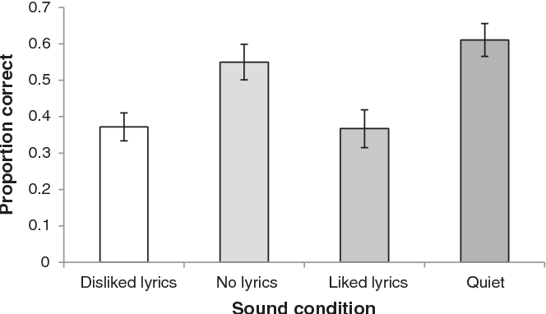
47% of students believe music helps them concentrate
2014 study(Perham and Currie)
3. If you must listen to music, make it without words.
Notes:
Music can be beneficial for certain tasks-it can improve our mood, boost our motivation and increase creativity. But is it helpful when revising? According to research, 47% of students believe music helps them concentrate and 29% claim it keeps them calm. What does the research say? A 2014 study (Perham and Currie) compared four study groups: one group working in silence; another revising to songs they liked; a third group revising to songs they didn’t like; the final group listening to music without lyrics. Those revising in silence performed significantly better than those listening to songs with lyrics, and it made no difference if they liked the songs! Despite what many students think, listening to your favourite songs is not the best way to revise; music takes up processing space in the brain, leaving less space to process revision materials. Lots of testing–also known as retrieval practice–done in silence, is the best strategy when revising

Slide 5
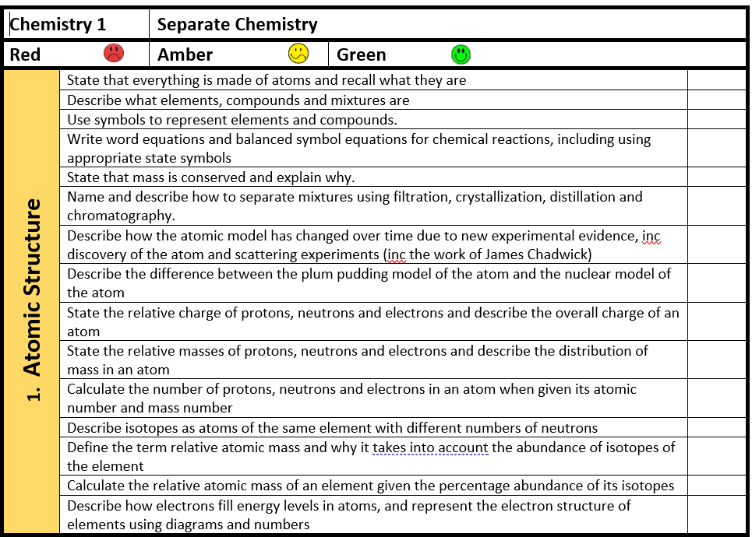
Biology: 7 topics & 7 required practicals
Chemistry: 10 topics & 6 required practicals
Physics: 7 topics & 8 required practicals
4. Divide and conquer; use a checklist

Slide 6
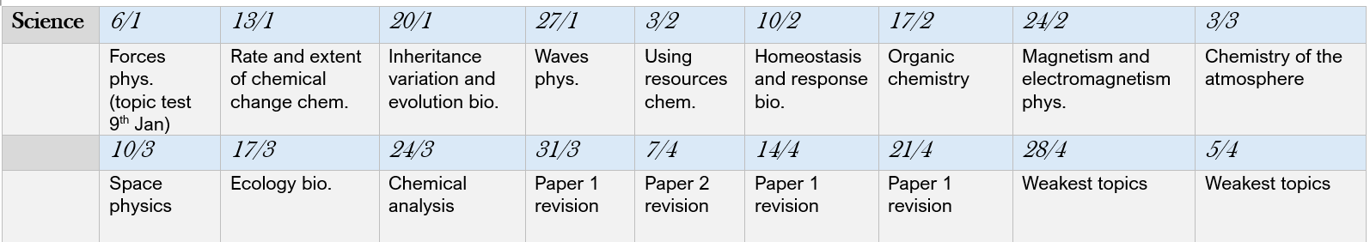
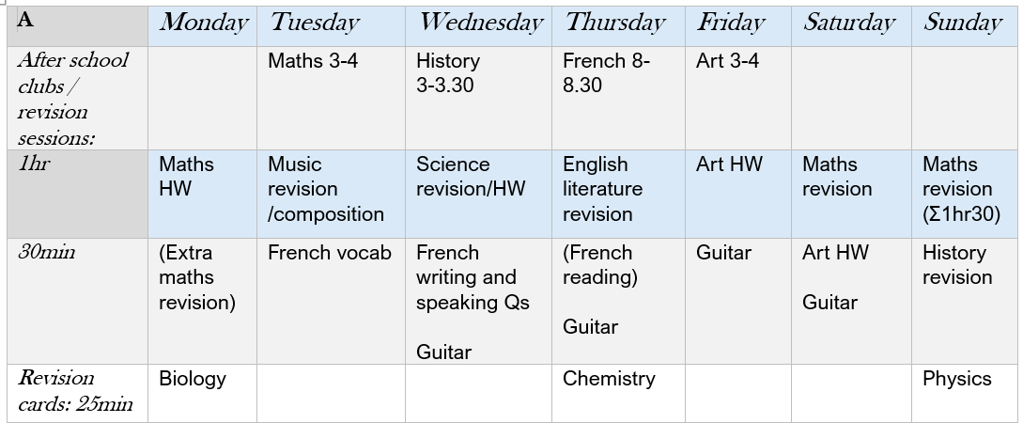
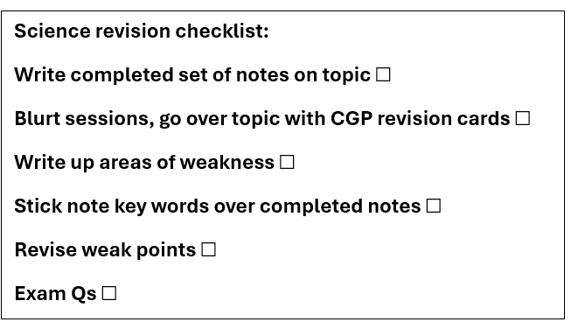
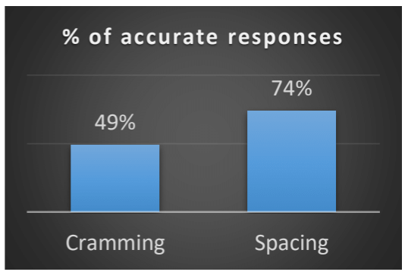
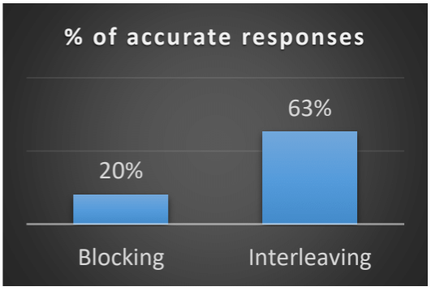
An hour of Physics each day for 5 days is much more effective than 5 hours in one day.
Interleaving
(mix up the subjects)
30 minutes of Shakespeare,
30 minutes of algebra,
30 minutes of Poetry,
30 minutes of Ratio
rather than an hour of
English & an hour of Maths
5. Have a plan: start early, space it out and mix it up.
2007 (Rohrer and Taylor)

Slide 7
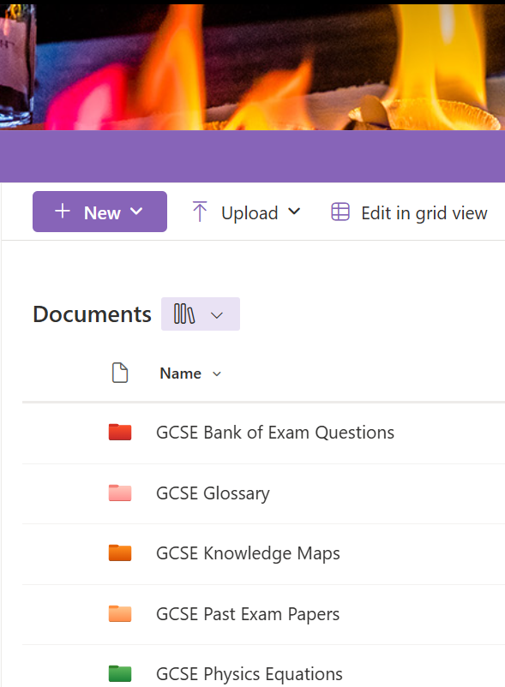
The mark schemes are essential.
Work out why you got questions wrong: a mistake? A lack of understanding? You forgot?
Ask us for help. The highest achieving pupils ask us the most questions!
6. Past exam papers: once you’ve revised the knowledge.

Slide 8
Key words are essential! Show off how many you know.
e.g. if you mention energy, use the words respiration, mitochondria, contract (muscles)
7. Biology: get your words right

Slide 9
Chemistry papers are the most predictable of the three sciences.
You must be able to do the maths skills e.g. Calculate Mr, moles, concentrations
Explain properties; why can graphite conduct? Why is diamond hard? Why do group 1 get more reactive?
8. Chemistry: top tips

Slide 10
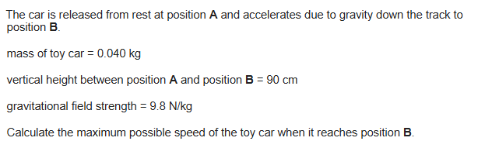
GPE = mgh
Velocity = √energy/o.5 x mass
(5)
In 5 or 6 mark questions, you’ll have to use 2 formulas.
What units have you got → first formula
What units do you need → second formula
9. Physics: top tips

Slide 11
For all 21 practicals, you must know:
The method
The variables
The hazards
The possible errors (systematic or random)
How to interpret results
10. Required practicals: top tips

