Slide 1
Achieving a
Grade7+
AQA English Language

Slide 2
📝 GCSE English Language Paper 1 Breakdown
📖 Section A – Reading (1 Extract)
🔢 Multiple Choice Questions → Test your understanding of key ideas and details
🧠 Analyse Language → Zoom in on words, imagery, tone & techniques
🏗️ Analyse Structure → Track shifts, openings, endings, paragraphing
🎯 Evaluate → Make a judgment: how effective is the writer’s craft?
💡 Top Tip: Use short quotes and link your analysis to the question focus.
✍️ Section B – Writing (Q5)
🖋️ Narrative or Descriptive Writing → Choose one: tell a story or paint a vivid scene
🎨 Use sensory detail, figurative language & varied sentence structure
🧱 Plan your structure: beginning, development, climax, resolution
🔍 Focus on clarity, originality, and technical accuracy
💡 Top Tip: Show, don’t tell. Make the reader feel immersed.

Slide 3
📘 GCSE English Language Paper 2 Breakdown
Section A – Reading (2 Extracts)
✅ True or False 🔍 Identify 4 accurate statements from Source A
🔗 Summarise Similarities or Differences 📄 Compare Source A & B on a specific topic
🧠 Tip: Use comparative connectives like “Similarly”, “In contrast”
🖊️ Analyse Language 💬 Zoom in on words, imagery, tone & techniques
🧠 Tip: Explain effect on the reader, not just name the device
🔁 Compare Writers’ Perspectives 🧭 Explore attitudes, methods, and viewpoints
🧠 Tip: Use evidence + inference + comparison
✍️ Section B – Writing (Q5) 📢 Transactional (Non-Fiction) Writing
📝 Write to argue, persuade, inform, or explain
🎯 Purpose | 👥 Audience | 📐 Form (e.g. article, letter, speech)
💡 Top Tips:
Plan before you write🧱Use rhetorical devices🎯Vary sentence structure ✂️Proofread for SPaG ✅

Slide 4
Why Reading Widely Matters at GCSE
🔍 What Does “Reading Widely” Mean?
Exploring different genres: fiction, non-fiction, poetry, drama
Choosing texts that challenge your thinking
Reading for fun, not just for school
🎯 Why It’s Important
Boosts GCSE performance: A reading age of 15+ is needed to access most exam papers
Improves vocabulary & comprehension across all subjects—even maths and science
Develops empathy & critical thinking by exposing you to diverse perspectives
💡 Top Tips to Read More
Try audiobooks or graphic novels
Set a daily reading goal (even 10 minutes counts!)
Explore the library

Slide 5
✍️ Writing Regularly: Your Secret Weapon for Grade 7+
🌟 Why It Matters
Builds confidence and fluency in expressing ideas
Sharpens your voice, tone, and style—key for top marks in Paper 1 & 2
Encourages risk-taking with language: metaphors, structure, narrative twists
🧠 What Top Students Do
Write beyond the classroom: blogs, short stories, opinion pieces
Experiment with different topics
💡 Try This
Write under timed conditions aiming for focused writing of 1 to 2 sides of A4 paper.

Slide 6
The writing section of both papers is worth 50% of your overall GCSE mark.
These two writing questions are worth 40 marks each.
Here is your opportunity to have a big impact.

Slide 7
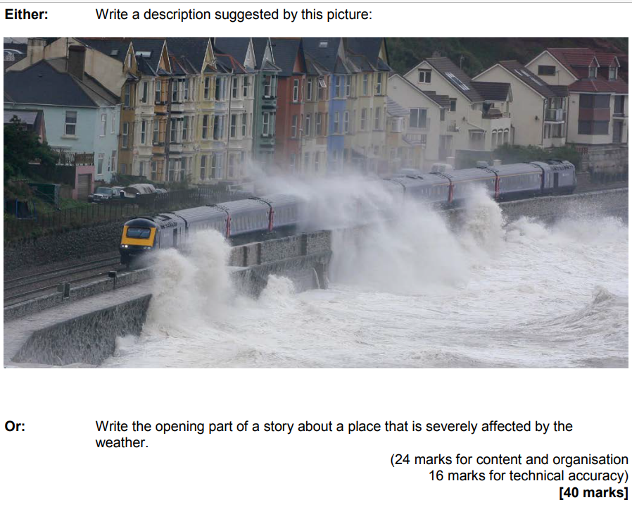
Paper 1 Section B Question 5 Writing
Example
Worth 50% of the overall GCSE Grade.
40 mark question
45 minute writing task.

Slide 8
Top Tips for writing in Paper 1
🎬 Start in Media Res - Begin at a pivotal moment — drop the reader straight into the action or emotion.
Example: “The ice cracked beneath her boots as the lake swallowed the silence.”
👤 Create an Authentic Character
Use specific, meaningful details — not just what they look like, but how they move, think, and react. Avoid clichés like “he was tall, dark and mysterious.”
Instead: “His coat hung like a burden, stitched with years of wear and quiet defiance.”
🚫 Avoid Clichés No “it was a dark and stormy night.” Be fresh, original, and precise. Think like a writer, not a copycat.
👁️ Show, Don’t Tell Let the reader infer emotions and atmosphere through actions, imagery, and setting.
Telling: “She was scared.” Showing: “Her fingers trembled as she reached for the latch, breath snagging in her throat.”
🧠 Use Section A Techniques
Apply what you’ve learned from the reading section: Zoom in on detail Vary sentence structure Use figurative language Create tension or mood
🔇 Minimise Dialogue - Use it sparingly and purposefully. Let description do the heavy lifting.
⏳ Timing: End Strong : Plan your ending. A powerful final image or twist leaves a lasting impression.
Example: “The photograph fluttered to the floor, its edges curling like secrets.”
✅ Technical Accuracy (16 Marks)Spelling, punctuation, grammar
Paragraphing Sentence variety Consistent tense and tone
🚀 Be Ambitious & Original -Take risks. Be bold with your imagery, structure, and ideas.
Don’t just describe a storm — describe how it feels to be inside one.
🧱 Plan & Craft - Spend 5–10 minutes planning:What’s the central moment? What’s the emotional journey? How will it end?

Slide 9
What does the mark scheme say?
- Sustained conscious crafting
The standard is maintained.
Every word and sentence is carefully considered and chosen with care.
The writing carefully builds to a planned conclusion.
The writing is complete and checked.
One and a half to two sides of writing can achieve this.

Slide 10
Example 1:
What does full marks (40 / 40) look like?
The bus careered through the Soho area of London, its chunky tyres straining under the weight of the passengers’ high expectations. A fear clung onto nightclub goers, the glinting yellow bars, swinging like undeveloped chimps attempting to pull off a slow dance. Clunk. We stopped. A man emerged from the underground station, dripping with sweat and pulled along by the armada of people dispensing from the contemporary cavern. Spotted. He sprinted along the gum-cladded paving slabs, his Samsonite suitcase dancing in the ruts.
Notes:
Every word and sentence is carefully considered and maintained to a high standard.
1 ½ to 2 sides is adequate.

Slide 11
Example 2
What does full marks (40/40) look like?
The bus rocketed through the labyrinth of city roads, the wheels screaming as the driver alternated rapidly between braking and accelerating. The engine groaned audibly, with a degree of reluctance to continue; the groans radiated throughout the cold, metal cage of the bus, making the windows flux inwards and outwards, over and over, to the point where they seemed as if they were about to break. A fly, gently hovering above the abyss-like asphalt, attracted to some unworldly stench, met the windshield, and was obliterated.

Slide 12
Paper 2 Section B Question 5 Writing
Example
TASK
‘Choosing a future career should be based on helping others and making a positive contribution to society, not achieving status or making lots of money.’
Write an article for your school or college magazine in which you argue your point of view on this statement.
Worth 50% of the overall GCSE Grade.
40 mark question
45 minute writing task.

Slide 13
📢 GCSE English Language Paper 2 – Q5 Writing Guide
🧭 Know Your Purpose, Audience & Form
The question will tell you:
Purpose: Argue, persuade, explain, inform
Audience: Teen magazine, newspaper readers, local MP, etc.
Form: Article 📰, letter ✉️, speech 🎤, essay 📄
🧠 Tip: Tailor your tone and structure to match the form. A letter needs a greeting and sign-off; an article might need a headline.
💬 Respond to the Statement
You’ll be given a provocative or controversial statement. Your job: express your viewpoint clearly and convincingly.
Example: “Homework has no value. Students should be relaxing in their free time.”
🎯 Tip: You don’t have to agree — just argue your case with clarity and evidence.
🧠 AO5 – Content & Organisation (24 marks)
Structure your ideas logically 🧱
Use paragraphs, connectives, and rhetorical devices
Vary tone and style to suit your audience
Include anecdotes, facts, opinions, and examples
✨ Be engaging, persuasive, and well-organised.
✅ AO6 – Technical Accuracy (16 marks)
Use a range of vocabulary
Vary sentence structures
Check spelling, punctuation, grammar
Proofread carefully 🕵️‍♀️
🧠 Tip: Leave 5 minutes at the end to edit and polish.
🔥 Top Tips for Grade 7+
📌 Plan before you write — jot down key points and structure
🎨 Use rhetorical questions, emotive language, and repetition for impact
🚫 Avoid clichés and vague generalisations
🧠 Be original, confident, and clear in your viewpoint
🕒 Time your response — aim for 5–6 paragraphs in 45 minutes

Slide 14
Example 1 – What does full marks for Paper 2 Section B look like? (40 marks)
TASK
‘Choosing a future career should be based on helping others and making a positive contribution to society, not achieving status or making lots of money.’
Write an article for your school or college magazine in which you argue your point of view on this statement.

Slide 15
To be Self-Sacrificial is to suffer
Once, when I was younger, I had gotten myself into an insignificant accident, somehow still managing to end up at the nearest A&E. Although the accident itself is of little importance to me now, the memory of that day will forever be etched into my brain. I can still vividly recall that scene at the A&E; all those people, sitting lined up against the wall in rows, impatiently waiting their turn as the hours passed. I can still recall their faces, morphed into desperation and suffering, clutching their injured body part tightly to them or clasping their hands together to distract from their pain. I saw all the doctors frantically running up and down, barely able to catch their breaths as they tried to treat as many patients as possible but finding themselves spread too thinly. Their faces looked worse than their patients – as if they were suffering some eternal pain that had no end in sight. That scene in the A&E is forever etched in my brain.
I've often debated on the issue at hand with others, always finding myself confronted with the same, unavoidable arguments: ‘the greater good is the most important’, ‘helping others brings people joy’, ‘it is our duty to help better society’. To me, all these arguments could not be more ridiculous. It's very easy to proclaim such things when you have parents to support you, a comfortable home to live in, a fancy car to drive in. It's very easy to say that we must work not for money but to help when you have money, but what about those who don’t?

Slide 16
To be Self-Sacrificial is to suffer
Once, when I was younger, I had gotten myself into an insignificant accident, somehow still managing to end up at the nearest A&E. Although the accident itself is of little importance to me now, the memory of that day will forever be etched into my brain. I can still vividly recall that scene at the A&E; all those people, sitting lined up against the wall in rows, impatiently waiting their turn as the hours passed. I can still recall their faces, morphed into desperation and suffering, clutching their injured body part tightly to them or clasping their hands together to distract from their pain. I saw all the doctors frantically running up and down, barely able to catch their breaths as they tried to treat as many patients as possible but finding themselves spread too thinly. Their faces looked worse than their patients – as if they were suffering some eternal pain that had no end in sight. That scene in the A&E is forever etched in my brain.
I've often debated on the issue at hand with others, always finding myself confronted with the same, unavoidable arguments: ‘the greater good is the most important’, ‘helping others brings people joy’, ‘it is our duty to help better society’. To me, all these arguments could not be more ridiculous. It's very easy to proclaim such things when you have parents to support you, a comfortable home to live in, a fancy car to drive in. It's very easy to say that we must work not for money but to help when you have money, but what about those who don’t?

