Slide 1
Achieving a 7+ in Maths

Slide 2
Achieving a 7+ in Maths
Achieving a 7+ in Maths is a tremendous achievement, one that only about 16% of the UK population will gain
Achieving a 7+ in maths will open doors to opportunities throughout your future life
In Toynbee, this percentage has been roughly 20% in the past few years and this year, we are confident that we can increase this proportion considerably
Everyone in this room has the potential to achieve this
……if they really want it……
Be prepared to put in the effort, to put in the work…

Slide 3
Steps to success – a 4-fold plan of action
In lesson
  Arrive on time
      ‘Do Now’ task = key knowledge points secured
  Follow methods shown
      Workings count – we show the best workings to get the most marks
  Listen
      Actively LISTEN and follow explanations, don’t just let words wash over you
  Use initiative
      Don’t wait to be told, take extra notes, ask questions. Only YOU know what YOU understand, ask if you don’t!
  Make the most of the time
      You have 8 hours a week where you MUST study maths. Use this time productively, and you will remember skills for longer, so this will make your revision easier

Slide 4
Steps to success – a 4-fold plan of action
At Home
  Sparx
      Secures current learning but also contributes towards ‘Retention of Knowledge over time’ = revision.
      100% each week is a MINIMUM (boost topics / independent learning for extra)
  Ongoing revision NOW
      GCSE maths – accumulated knowledge and a HUGE number of topics….

Slide 5
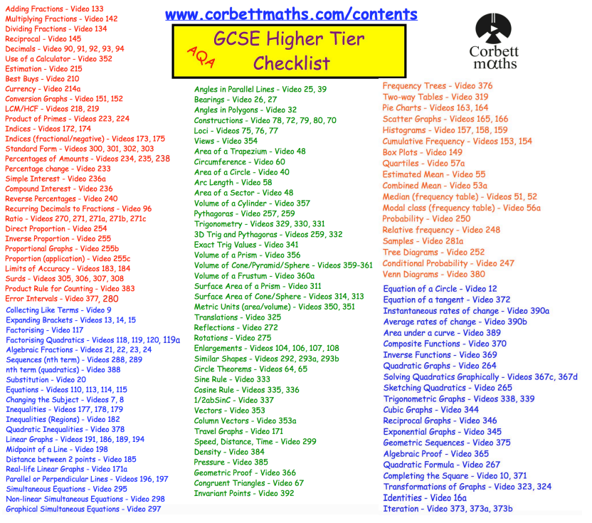

Slide 6
Steps to success – a 4-fold plan of action
At Home
  Sparx
      Secures current learning but also contributes towards ‘Retention of Knowledge over time’ = revision.
      100% each week is a MINIMUM (boost topics / independent learning for extra)
  Ongoing revision NOW
      GCSE maths – accumulated knowledge and a HUGE number of topics….
      Identify your topics to revise and start addressing issues now
      Revision in maths = PRACTICE
      Up to Christmas, revision = securing key skills
      Use Topic Tests and feedback sheets from Year 10 Mixed Topic Assessments
      Use the Corbett sheet to highlight your areas of focus and keep track of revision
      Use Corbettmaths online textbook to give practice on knowledge points
      Short, frequent sessions most effective
  Corbettmaths – Videos, worksheets, 5-a-day and much more

Slide 7
Steps to success – a 4-fold plan of action
GCSE paper practice
  Practice Paper Programme
      After Christmas, weekly homework = past paper
      Revision = application of skills
      Attack with intent = use revision tools to help answer questions for the first few weeks
      Create a chat group with friends to tackle questions together
      Try to improve your mark each week, persistence and resilience
  Assessments / Mocks
      Apply a ‘Can Do’ attitude – it’s supposed to be challenging
      Look for the maths you CAN DO within the question, what maths is the question requiring you to use?
      Consider timing – 1 mark = 1 minute
      CHECK YOUR WORKINGS AND ANSWERS

Slide 8
Steps to success – a 4-fold plan of action
In school support
  Your Teacher
      They want your best outcome for you too – use them!
      Speak to after class / before school / after school / whenever but COMMUNICATE!
      Follow advice given. It’s coming from years of experience….
  Revision / intervention sessions
      Take advantage of everything that is offered
      Use this time productively – you don’t get marks at GCSE for attendance of sessions

Slide 9
And finally…..
You now have approximately 24 weeks of learning left. Consider your own Year 10 Summer assessment.
Consider now what 24 extra marks could do to your grade in that assessment….
Now consider what 48 extra marks could do to your grade…..
EVERYONE in here can secure at least one extra mark a week by following the 4 step plan to success
…ONE MORE MARK CAN MAKE ALL THE DIFFERENCE….

